Slide 1
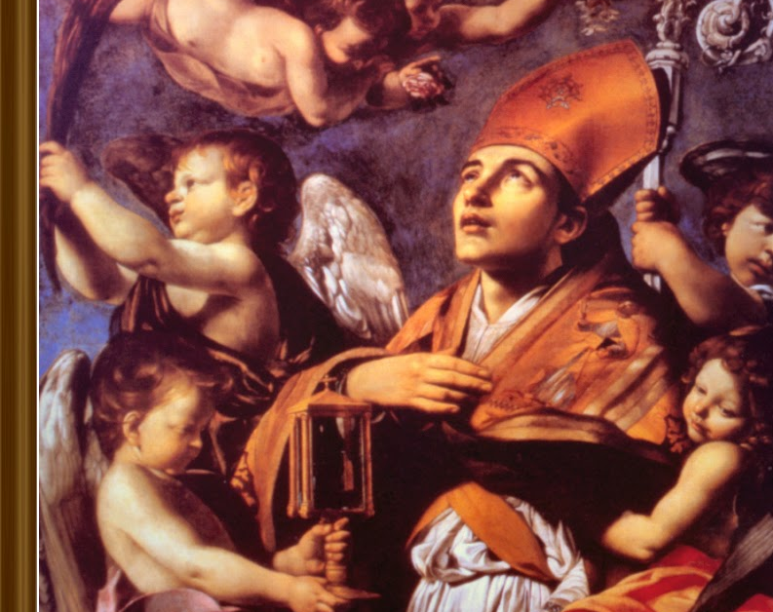
St. Raymond of Peñafort
Ninth Grade
Class 2
September 15, 2024

Slide 2
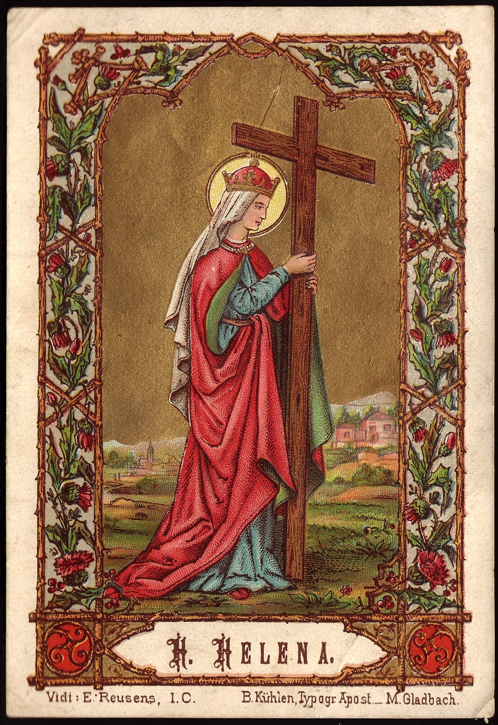
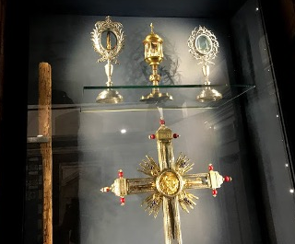
EXALTATION OF THE HOLY CROSS
”Behold the Wood of the Cross”
Wood from the Cross of Jesus at Basilica Di Santa Croce in Rome.
Brought to Rome by St. Helena – Emperor Constantine’s mother in the third century.

Slide 3
“Exaltation of the Holy Cross stems from the truth that ‘apart from the cross, there is no other ladder by which we may get to heaven’ (Saint Rose of Lima)…Exalting the holy cross each year encourages us in the midst of our own sufferings…”
(Taken from Magnificat)

Slide 4
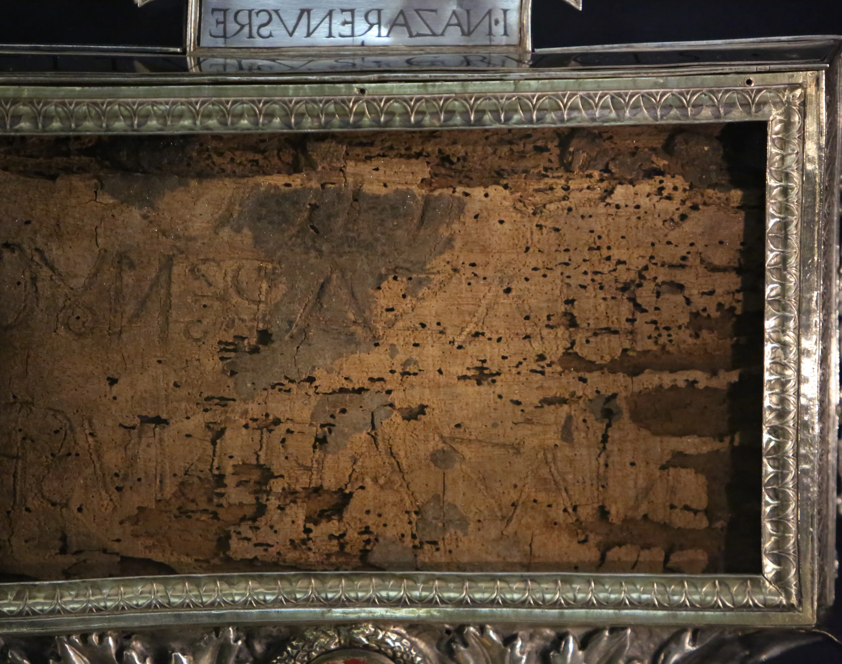
Inscription above the Cross
Returned to Rome from the Holy Land in the 3rd century by St. Helena, the mother of Emperor Constantine.
“Jesus of Nazareth King of the Jews”

Slide 5
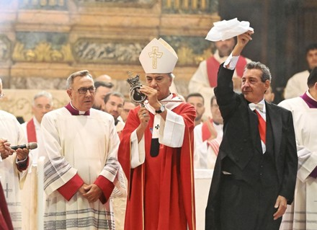
St. Januarius, Feast on September 19th
Relatively obscure saint as a .4th century bishop of Naples, Italy. He was martyred during the persecution of Diocletian.
A woman preserved some of his blood which then dried.
Three times a year the dried blood liquifies:
  his feast day on September 19th,
  the Saturday before the first Sunday in May, and
  December 16, as devotees thank him for his intercession to lessen the effects of the 1631 Mount Vesuvius volcano).
This has studied for centuries without a natural cause for this to happen.
Clearly a miracle – showing the presence of God in the world even today.
His blood liquified on his May 4, 2024, at Naples’ Cathedral of the Assumption of Mary during the celebratory Mass honoring the transfer of his remains to Naples as the city’s patron saint.
Notes:
https://www.churchpop.com/st-januarius-blood-liquifies-on-his-feast-day-in-italy-watch-miraculous-the-video/
The first occasion is the day commemorating the transfer of his remains to Naples, the Saturday before the first Sunday in May; and the second is his liturgical feast day, Sept. 19.
The third occasion is Dec. 16, when devotees thank him for his intercession to lessen the effects of the eruption of the Mount Vesuvius volcano, which occurred in 1631.
St. Januarius' Blood Liquifies on His Feast Day in Italy - Watch the Miraculous Video! (churchpop.com)
https://www.youtube.com/watch?v=g9x6-n3s_Pg

Slide 6
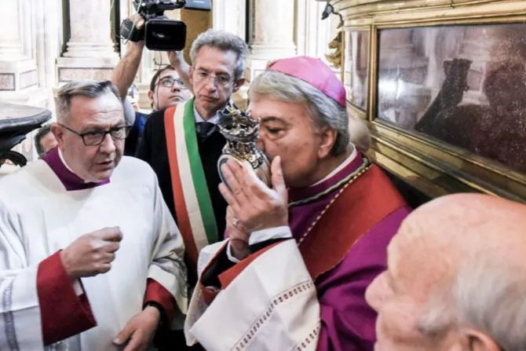
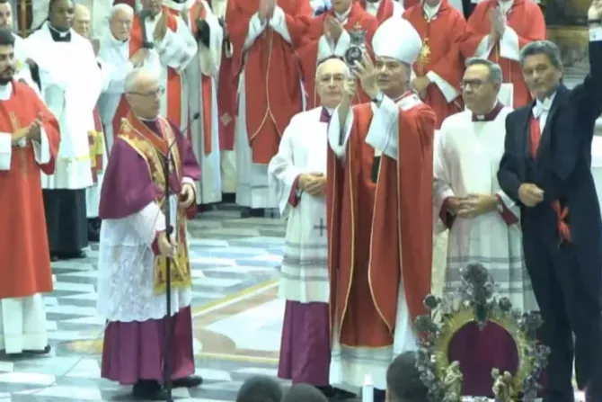
St. Januarius
March 4, 2024
September 19, 2023
Notes:
https://www.churchpop.com/st-januarius-blood-liquifies-on-his-feast-day-in-italy-watch-miraculous-the-video/
St. Januarius' Blood Liquifies on His Feast Day in Italy - Watch the Miraculous Video! (churchpop.com)
https://www.youtube.com/watch?v=g9x6-n3s_Pg

Slide 7

Proving God’s Existence based on Science
Notes:
https://www.crediblecatholic.com/12ppt/7E-P2-A/
Start with #9 to #25.

Slide 8
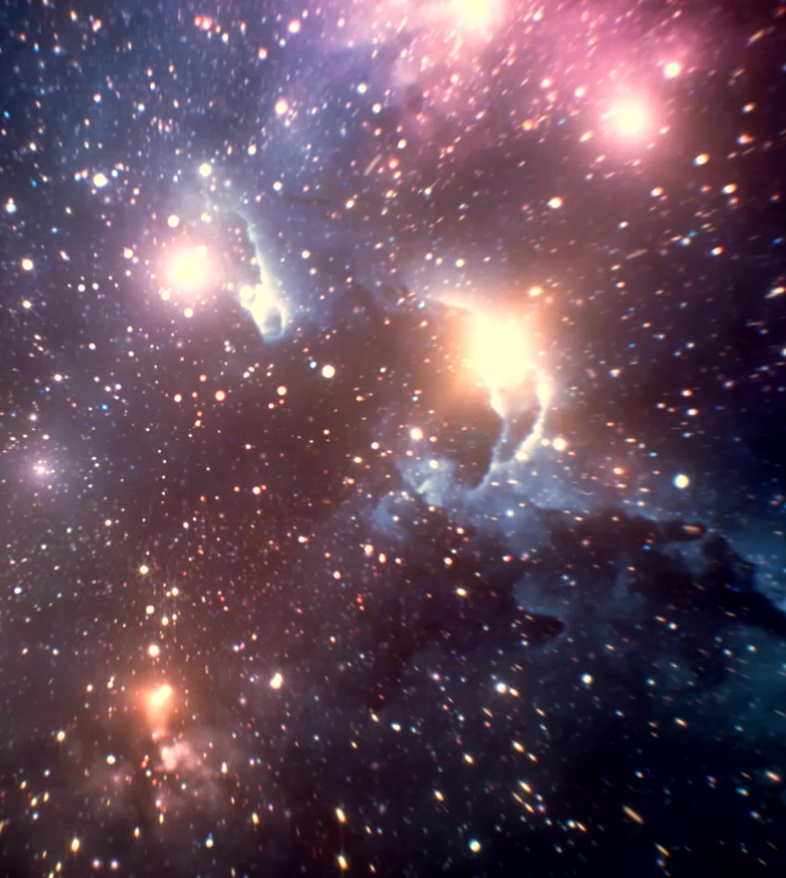
Review of the Last Class
What are the key take-aways from the long video about the origin of the universe?
What is the Doppler effect?
Why is the Doppler effect important?
What is the significance of an expanding universe regarding Creation?
Why is the speed of light important?
Is it worth betting against God?

Slide 9


Slide 10
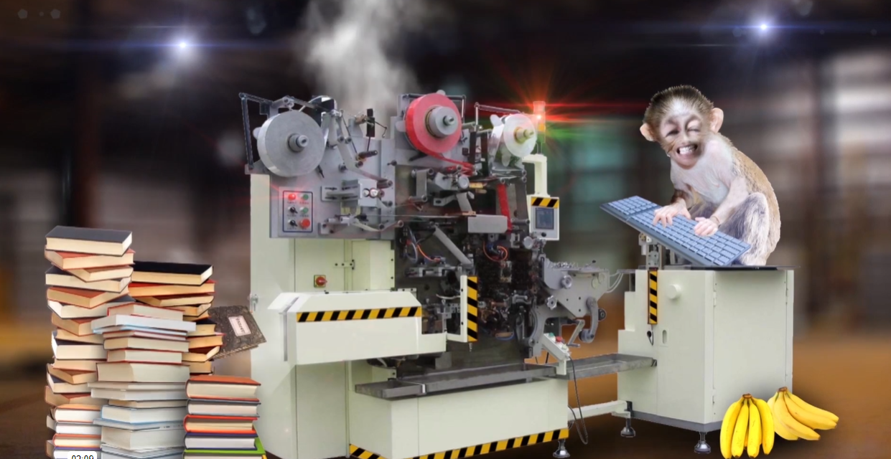

Slide 11

Wonders of Nature: Water
Notes:
Last year, a space craft from India landed on the south pole of the moon…the pole that is always away from the sun. What was it seeking? Water. Why water, because if there is water, then there is a chance that life can be sustained.

Slide 12

Wonders of Nature: Water
Notes:
Earlier this week, a space craft from India landed on the south pole of the moon…the pole that is always away from the sun. What was it seeking? Water. Why water, because if there is water, then there is a chance that life can be sustained.

Slide 13
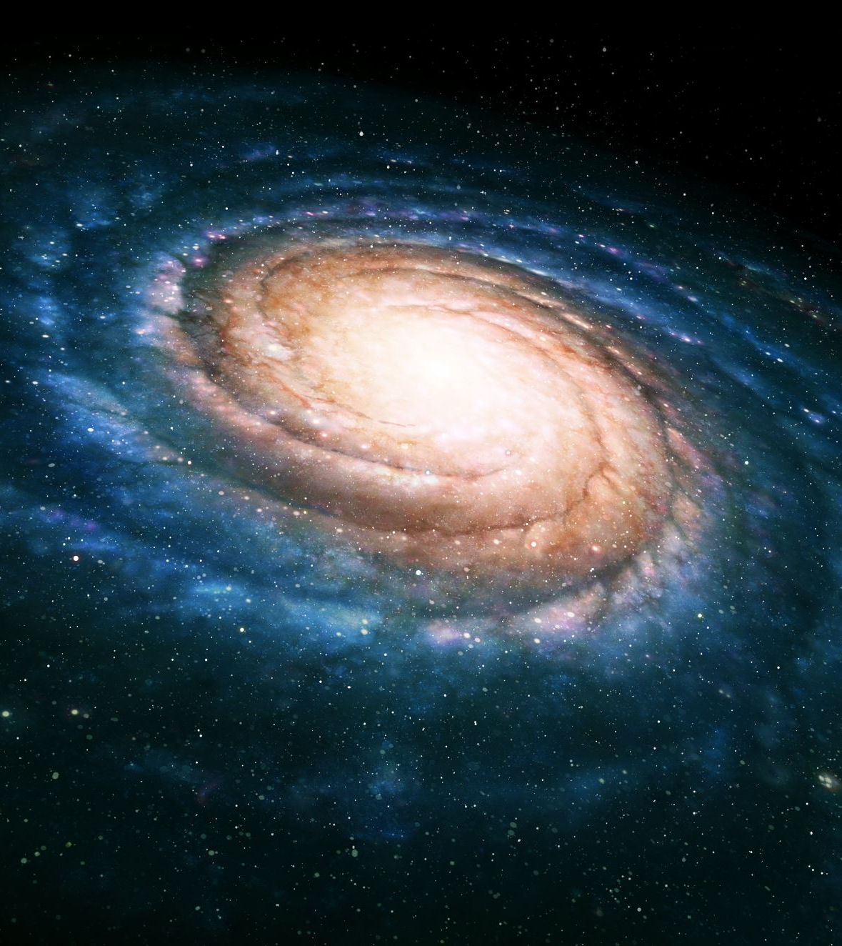
The Cosmological Argument
Whatever begins to exist has a cause. (TRUE)
The universe began to exist. (TRUE)
Therefore, the universe has a cause. That Cause had to exist outside of time and space and had to be Super Intelligent. (THEREFORE TRUE)
WHERE WAS GOD WHEN THE UNIVERSE CAME INTO EXISTENCE?
This is similar to St. Thomas Aquinas’ “The argument from causes.”

Slide 14
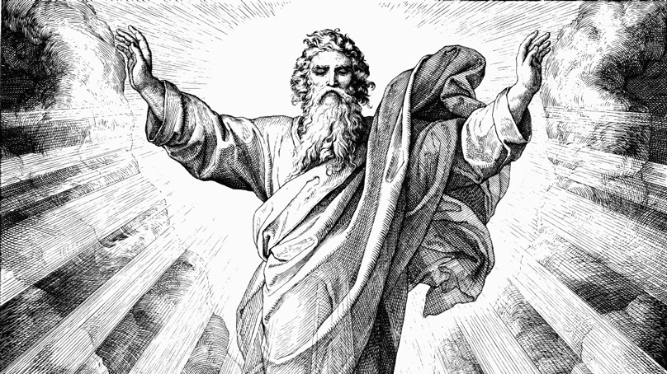
Who is God? Who made me?
  What do you think?
    Human beings have developed over millions of years from less advanced forms of life, but God guided this process?
    Human beings have developed over millions of years from less advanced forms of life, but God had no part in this process?
    Human beings were created by God pretty much in their present form at one time within the last 10,000 years or so?

Slide 15

Myth 1: Science and faith are incompatible, and since science is true, it has replaced religion. NO: Science and faith are compatible because both have origins with God.
Myth 2: Human beings are like every other animal—merely a complex of atoms and molecules. We have no soul, no eternal destiny, and no transcendent nature. When we die, we die.
Myth 3: There is no evidence for Jesus as a historical figure, and therefore his resurrection or divinity. If Jesus did exist, he was just an interesting prophet, but not a Savior or the Son of God.
Myth 4: There is no explanation for why an all-loving God would allow suffering. Therefore, suffering is fundamentally negative, and a loving God probably does not exist.

Slide 16
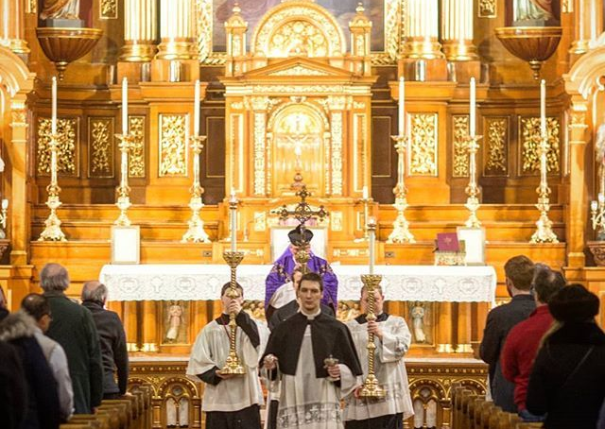
Where Does Our Faith Come From?
Sacred Scripture: The Bible: “Inspired word of God.”
Sacred Tradition: Teaching handed down to us. Written or oral, entrusted by Christ to the Apostles and their successors, which has been transmitted to us through Apostolic Succession
“Truth cannot contradict truth.” (from Pope St. JPII’s address to the Pontifical Academy of Science)
What if there is a contradiction?

Slide 17

What is “Sola Scriptura?”
Faith without works. (James 2:14-18)

Slide 18
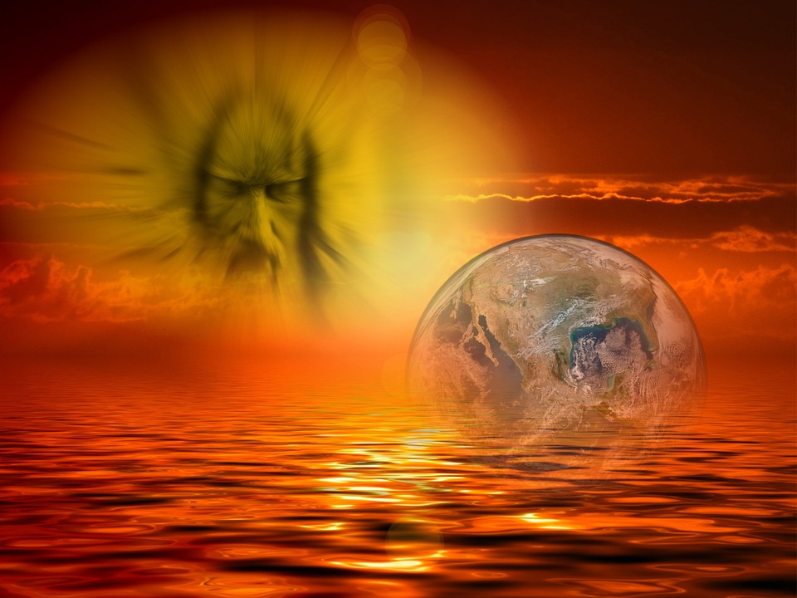

Creation and Evolution
Creation:
  God being infinitely perfect; created the universe from nothing. He could not make a mistake.
  Everything was in place the instant after the Big Bang (just needed time and space).
  Nothing happened haphazardly (Anthropic Coincidence).
Evolution:
  Charles Darwin, On the Origin of Species
    All living species in the world descended from a small number of common ancestors (plants, animals, etc.)
  Charles Darwin, The Descent of Man
    Proposes that man came into being the same way
  Natural selection, unlike animal or plant breeding; the best survive naturally

Slide 19
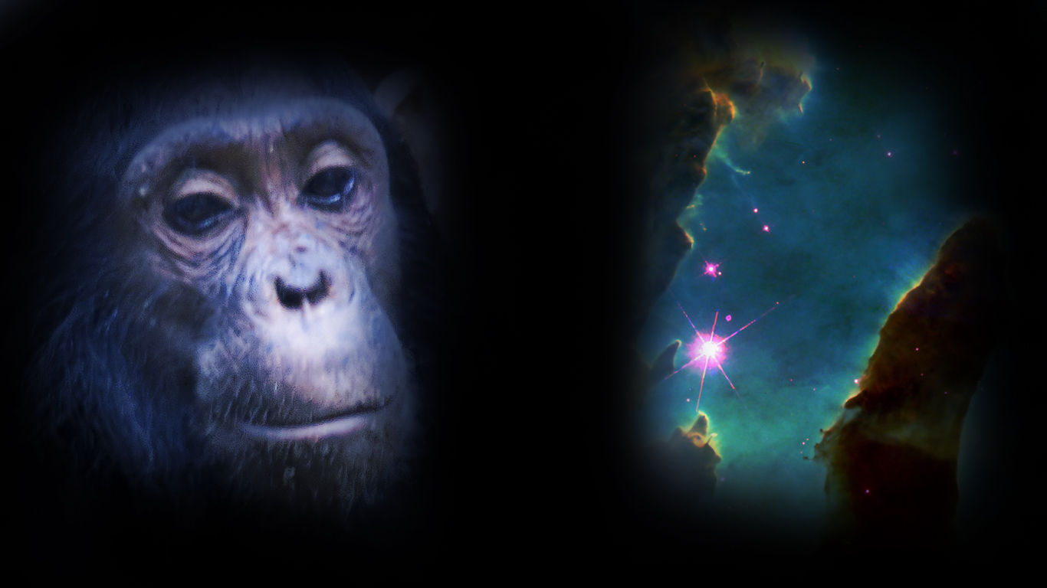
Are Evolution and Creation in Conflict?

Slide 20
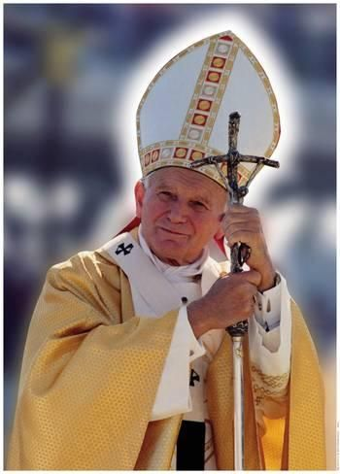
Pope John Paul II’s address to the Pontifical Academy of Science 10/22/1996
“Truth cannot contradict truth”
“There was no opposition between evolution and the doctrine of the faith about man…on condition that one did not lose sight of several indisputable points.”
  “…if the human body takes its origin from pre-existent living matter the spiritual soul is immediately created by God.”
“…theories of evolution which…consider the mind as emerging from the forces of living matter…are incompatible with the truth about man."
Notes:
Thus, God perfected the universe with the Big Bang allowing everything evolve from that first instant…except Man. “…if the human body takes its origin from pre-existent living matter the spiritual soul is immediately created by God.”

