Slide 1
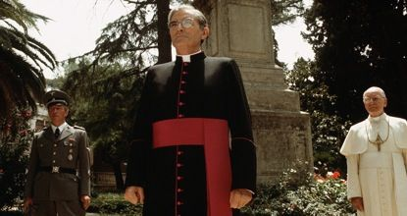
Socialism, Communism, Nazism and the Catholic Church
Notes:
From: ”The Scarlet and the Black” with Nazi SS Colonel Herbert Kappler, Msgr. Hugh O’Flaherty, and Pope Pius XII

Slide 2
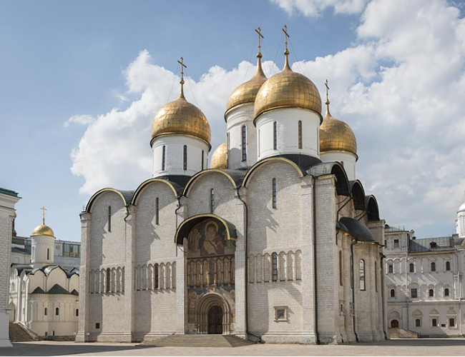
Notes:
Assumption Cathedral – Moscow - Kremlin

Slide 3
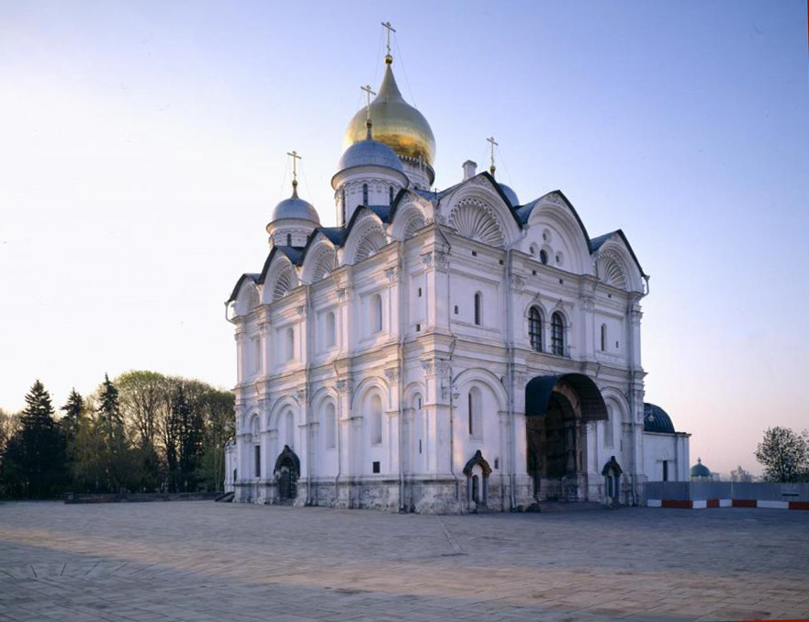
Notes:
Archangel Cathedral – Moscow, Kremlin

Slide 4
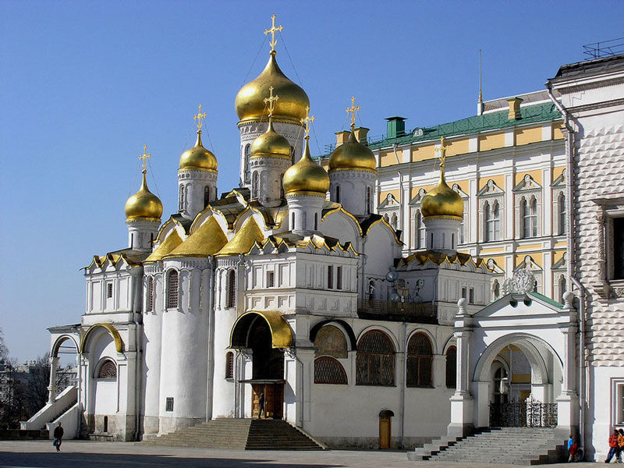
Notes:
Annunciation Cathedral – Moscow - Kremlin

Slide 5
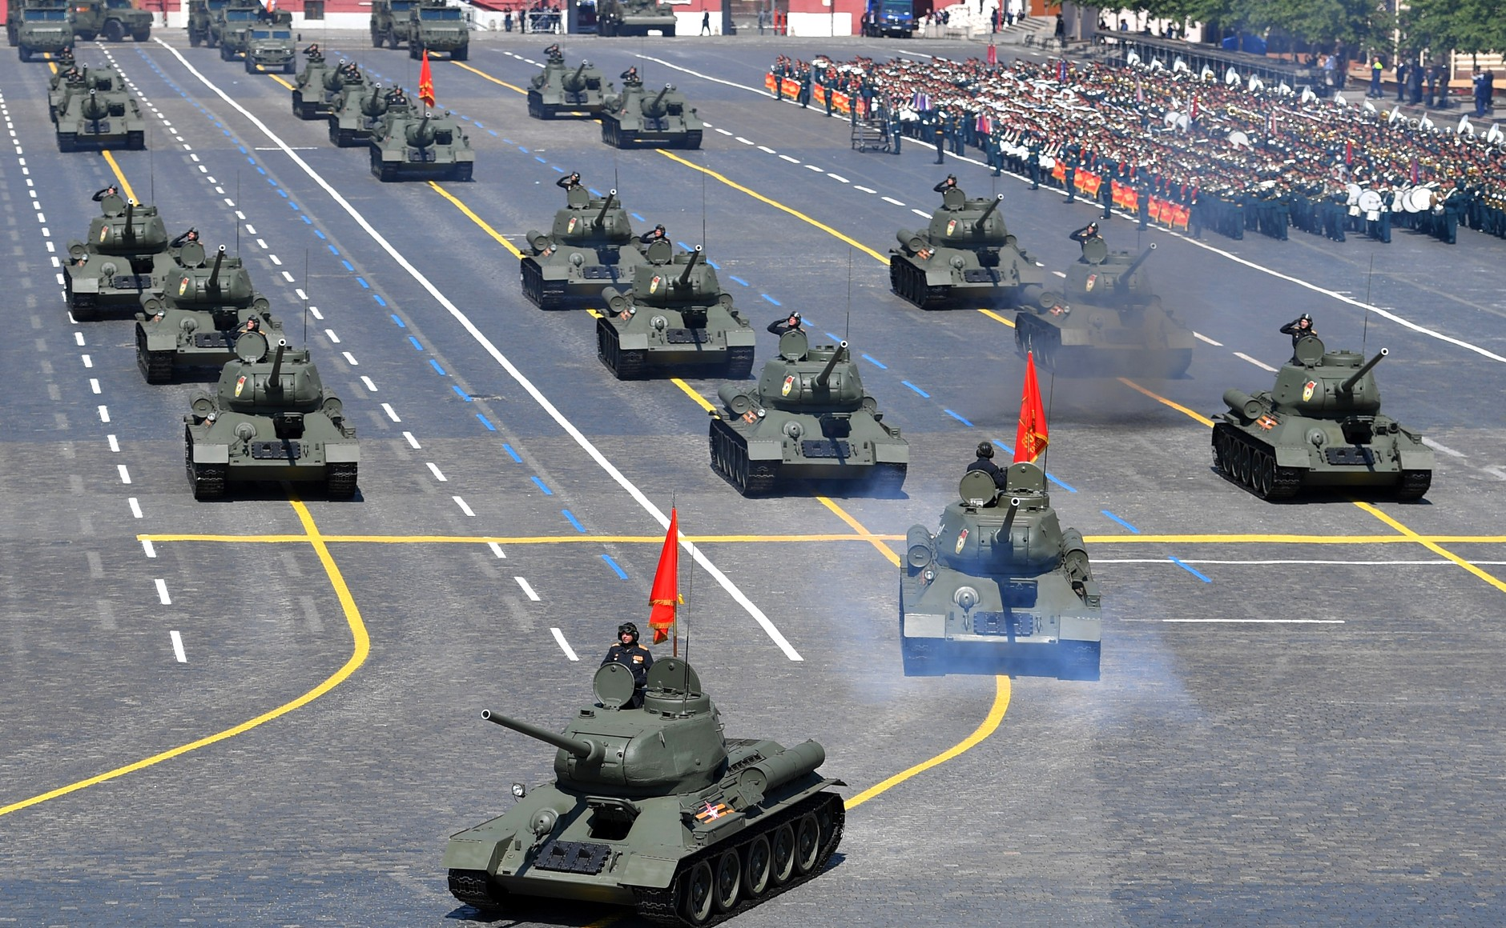
Notes:
May Day Parade – Red Square - Moscow

Slide 6
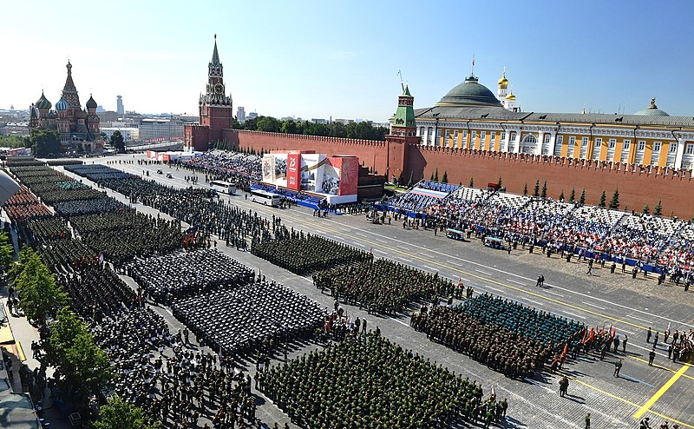

Slide 7
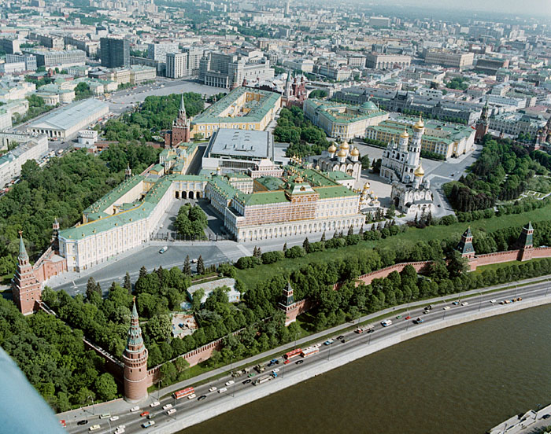

Slide 8
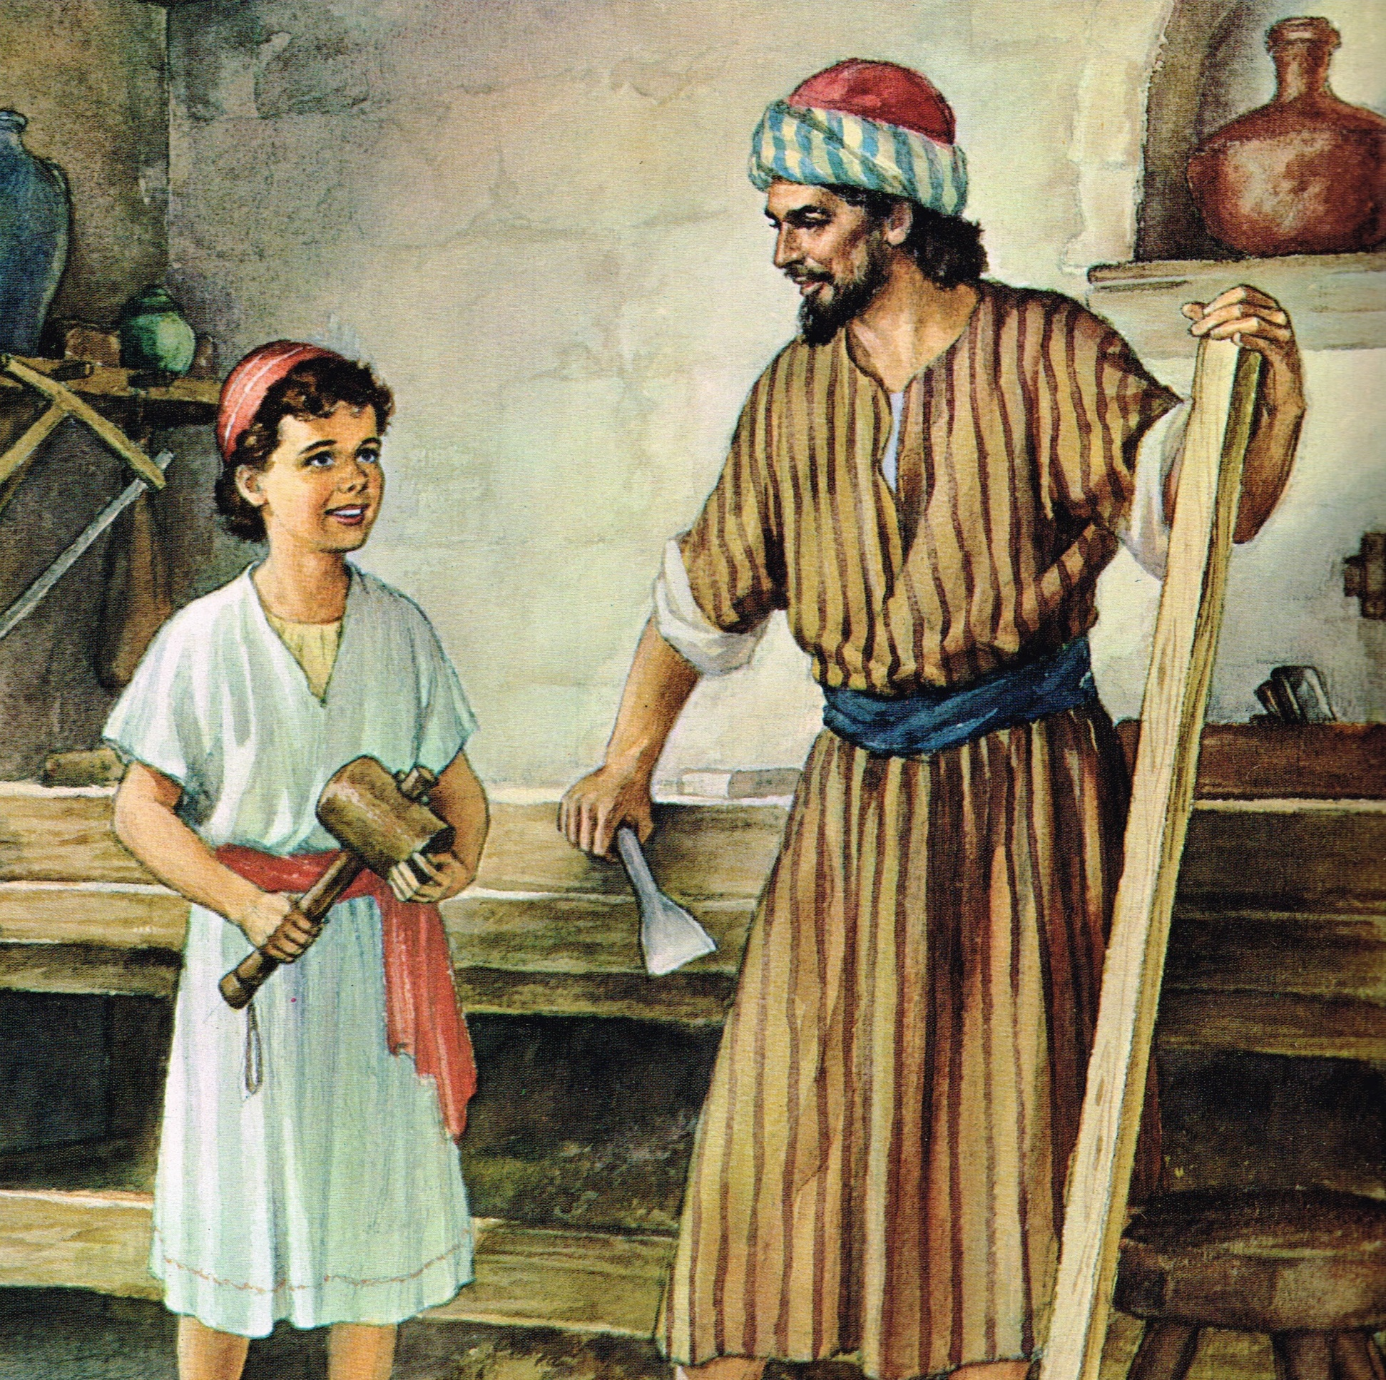
May 1, 2024 Memorial of St. Joseph the Worker
Instituted by Pope Pius XII in 1956

Slide 9
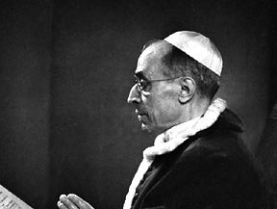
Pope Pius XII (1939-1958)

Slide 10
Class #27, May 4, 2024
Socialism, Communism, Nazism and the Catholic Church
Notes:
From: ”The Scarlet and the Black” with Nazi SS Colonel Herbert Kappler, Msgr. Hugh O’Flaherty, and Pope Pius XII

Slide 11
Major Principles of Catholic Social Teaching
The intrinsic transcendent dignity (worth) of every human being,
The principle of the common good,
The universal destination of goods,
The principle of subsidiarity (matters ought to be handled by the smallest, lowest or least centralized competent authority),
Participation in democracy, and
The principle of solidarity.

Slide 12
Principle of the Common Good
“The principle of the common good, to which every aspect of social life must be related if it is to attain its fullest meaning, stems from the dignity, unity and equality of all people.”
“The sum total of social conditions which allow people, either as groups or as individuals to reach their fulfilment more fully and more easily.”
Examples:
  Sound judicial system
  Organization of states’ powers
  Provision of essential services to all
  Personal and group actions

Slide 13
Universal Destination of Goods
This expression refers to the fact that God wills that His creation of the earth (and its fruits) sustain all people.
All people have the right to share the earth’s goods in order to meet their needs (and their families’ needs) (right to private property).
These include sustenance, shelter, safety.
Also include personal fulfillment such as work, community, education, and culture.
Notes:
Collectivism is a social organization in which the individual is seen as being subordinate to a social collectivity¹. It is a political or economic theory advocating collective control especially over production and distribution². Collectivism is a worldview where people tend to see themselves as part of a larger group rather than focus on their individuality. As a result, they value behavior that emphasizes unity³. Collectivism is a kind of ethics based on people being a group, and its opposite is individualism which is based on people being individuals⁴.

Slide 14
Participation in Democracy
Democracy requires:
Solidarity – (Universal Destination of Goods)
The intrinsic transcendent dignity of every human person.
Democracy breaks down when:
Individuals do not participate in the democratic process (e.g., voting)
Individuals allow people of influence to receive unfair and unearned privileges.
Government centralizes decision-making and the production of goods
Subsidiarity – (Common Good)

Slide 15
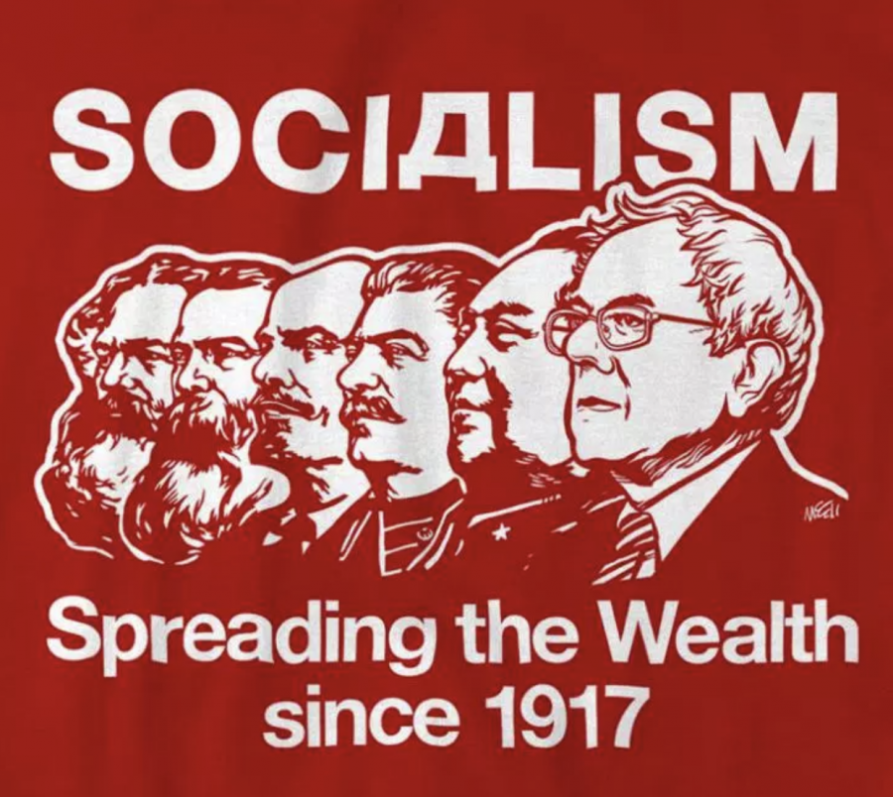
What is Socialism?
State controls the marketplace by setting prices, providing services, redistributing wealth.
Private enterprises are permitted, but they are heavily regulated by price and production controls.
Examples:Elements of ObamaCare nationalized healthcare. Government requirements that work only performed by businesses where the workers are unionized.
  Government takes over the power grids, the internet, etc.
  In schools? (Teachers’ unions)
  What else?

Slide 16
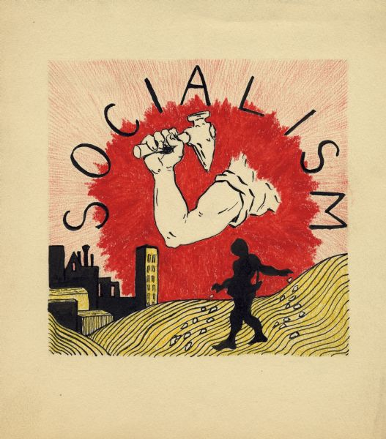
What is Socialism?
Pope Leo XIII in (Rerum Novarum 15) said that socialism is contrary to the natural right to own property and that “the main tenet of socialism, [the] community of goods, must be utterly rejected.”
May 2019 poll – (Can a Catholic be a Socialist? – pg. 91)
  1/3 of Americans associated socialism with equality, the government providing people with health care, housing and jobs, and ending poverty.
  1/5 didn’t know what socialism was.
  1/5 could not name the primary tenet of socialism: government ownership of the economy and the abolishment of private property.

Slide 17
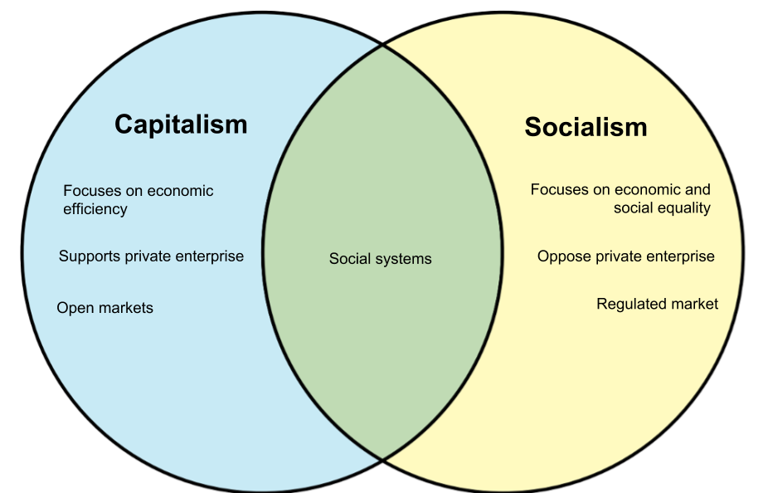
Diversity, Equity, and Inclusion – That is socialism when it becomes the focus of economic or social equality.
Notes:
Diversity, Equity, and Inclusion – That is socialism when it becomes the focus of economic or social equality. What about quotas?

Slide 18
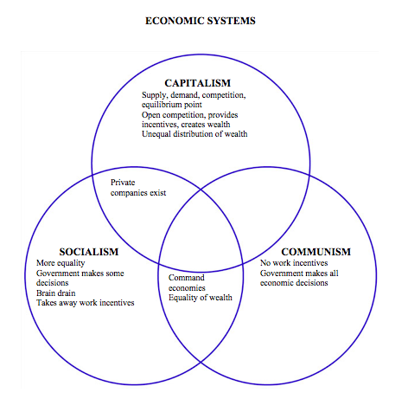

Slide 19
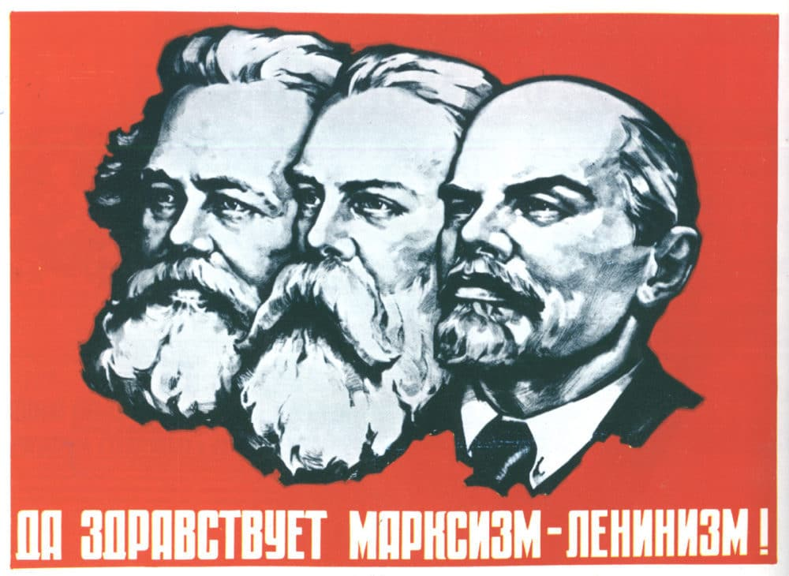
Communism/Marxism
Fundamental foundation based on a non-acceptance of God in the world nor of the afterlife.
Reduces man to an instrument of the state.
Based on the writings of Karl Marx and Friedrich Engels.
State/”community” ownership of all property and wealth distributed among the citizens.
No work incentives; government makes all economic decisions.
Notes:
I will be using the terms Marxism and communism interchangeably. [Picture: Marx, Engels, Lenin)

Slide 21
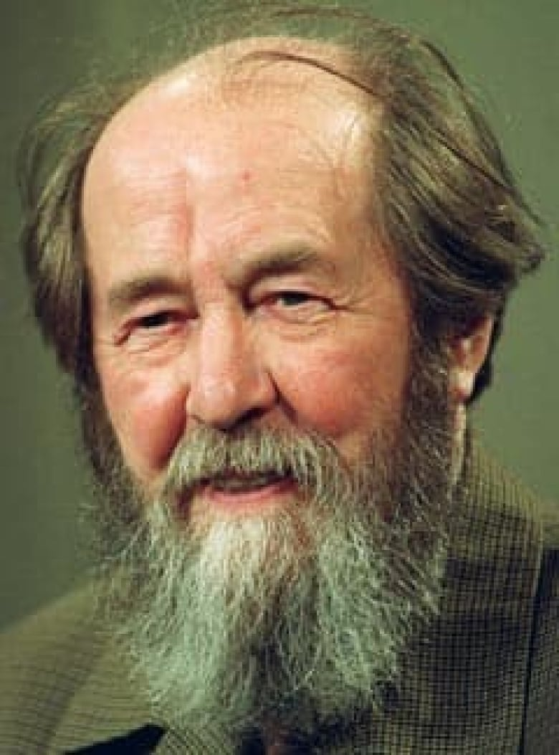
Marxism According to Solzhenitsyn
How could it happen? There are 8 levels of control:
Healthcare – Control healthcare and you control the people.
Poverty – Increase the poverty level as high as possible, poor people are easier to control and will not fight back if you are providing everything to them.
Debt – Increase the debt to an unsustainable level. Then you will be able to increase taxes, and that will produce more poverty.
Gun Control – Remove the ability to defend themselves from the government. That way you are able to create a police state.

Slide 22
Marxism According to Solzhenitsyn
5. Welfare – Take control of every aspect (food, housing, income) of their lives because that will make them fully dependent on the government.
6. Education – Take control of what people read and listen to and take control of what children learn in school.
7. Religion – Remove the belief in God from the government and schools because the people need to believe ONLY that the government knows what is best for the people.
8. Class Warfare – Divide the people into the wealthy and the poor. Eliminate the middle class. This will cause more discontent and it will be easier to tax the wealthy with the support of the poor.

Slide 23
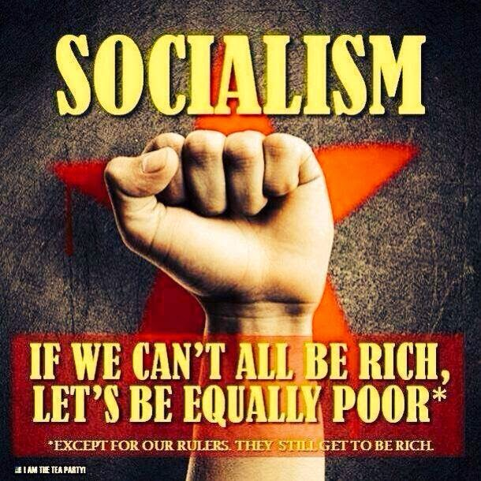
Steps toward a Marxist society
  Worker creates more value than he is paid for, and this surplus value goes to the employer, who exploits the worker to that extent.
  The employer puts this surplus value back into his business, and this constitutes capital. The lower the wages, the more capital for the capitalist.
  A basic premise of Marxism is that the rich get richer and the poor get poorer.
  Capitalism then collapses; the masses revolt and seize the means of production and establish a dictatorship of the proletariat.
  Within this dictatorship, Communist utopia will exist because class struggles will cease because all classes of society will have disappeared.
See Pope Pius XI, Divini Redemptoris, 1937.

Slide 24
Communism
Social doctrine which affirms the community of goods and denies the right to ownership of private property.
The philosophy is dialectical materialism
  claims that matter and not spirit, and least of all the infinite Spirit who is God, is the primary reality in the universe;
  claims that material forces in conflict (dialectic) explain all the progress in the world.
Economics is the sole basis of human civilization, making all ethical, religious, philosophical, artistic, social, and political ideas the result of economic conditions.
The Communist strategy is a shifting expediency that defies analysis but has two constants that never really change:
  Massive indoctrination of the people, and
  Ruthless suppression of any ideas or institutions that threaten totalitarian control by the Party.

Slide 25
Steps to Communism
Abolition of property and land and application of all rents of land to public purposes.
A heavy progressive or graduated income tax.
Abolition of all right of inheritance.
Confiscation of the property of all emigrants and rebels.
Centralization of credit in the hands of the State by means of a national bank with State capital and an exclusive monopoly.
Centralization of the means of communication and transportation in the hands of the State.

Slide 26
Steps to Communism
Equal liability of all to labor. Establishment of industrial armies, especially for agriculture.
Combination of agriculture with manufacturing industries; gradual abolition of the distinction between town and country by a more equitable distribution of the population over the country.
Free education for all children in public schools.

Slide 27
Socialism, Communism, Nazism and the Catholic Church
“The Scarlet and the Black”
Notes:
From: ”The Scarlet and the Black” with Nazi SS Colonel Herbert Kappler, Msgr. Hugh O’Flaherty, and Pope Pius XII
https://www.youtube.com/watch?v=1pitdqUuK2I (from 1:34:14 to 1:35:40)

