Slide 1
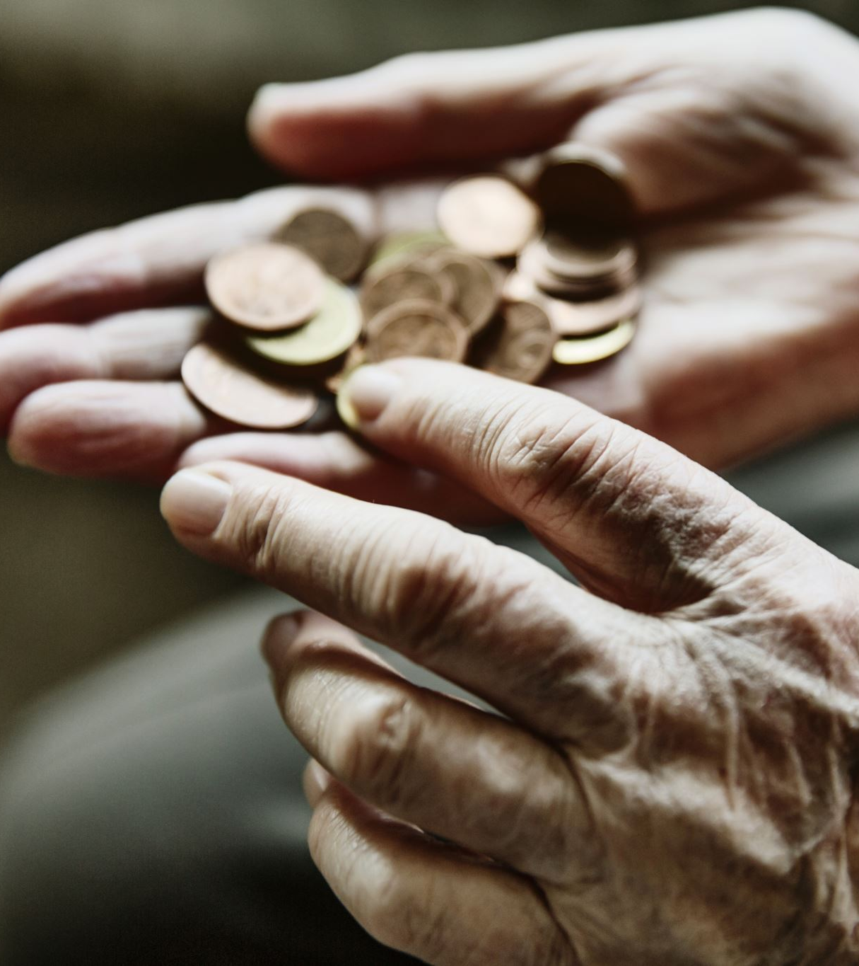
Seventh and Tenth Commandments
Class #25
April 21, 2024
How the Proper Understanding of the 7th and 10th Commandments Avoid Socialism, Communism, Marxism, etc.

Slide 2
Seventh/Tenth Commandments
Forbids
Unjustly taking/keeping of our neighbor’s goods,
Wronging him in any way w/r to his goods.
Commands charity in the:
Care of earthly goods,
Fruits of men’s labor.
Requires respect for:
The universal destination of goods,
Respect for the right to private property. (CCC 2401)

Slide 3
The Universal Destination of Goods
Principle that the goods of the earth are meant to be used to supply the needs of all human persons…
…especially those basic material needs of life, nourishment, and shelter.

Slide 4

Behaviors and Actions Contrary to Human Dignity
Theft, deliberate retention of goods borrowed, or objects lost or business fraud (cf. Dt. 25:13-16)
Unjust wages (cf. Dt. 24:14-15)
Increasing prices by trading on the ignorance or hardship of another (cf. Am 8:4-6)

Slide 5
Behaviors and Actions Contrary to Human Dignity
Misappropriation and private use of corporate property of an enterprise
Work badly done
Tax fraud
Forgery of checks and invoices
Excessive expenses
Waste

Slide 6

Behaviors and Actions Contrary to Human Dignity
Actions or enterprises which
  Lead to enslavement of human beings
  Disregard the personal dignity of human beings
  Buy or sell human beings like merchandise
Reducing persons to a source of profit (Veritatis Splendor, 100)

Slide 7

Covet/Greed/Avarice/Envy
Covetousness - excessive desire for goods of others
Greed - “desire to amass earthly possessions without limit” (CCC 2536)
Avarice – “passion for riches and their attendant power” (CCC 2536)
Envy – “sadness at the sight of another’s goods and the immoderate desire to acquire them for oneself, even unjustly. When it wishes grave harm to a neighbor it is a mortal sin.” (CCC 2539)

Slide 8
Major Principles of Catholic Social Teaching
The intrinsic transcendent dignity (worth) of every human being,
The principle of the common good,
The universal destination of goods,
The principle of subsidiarity (matters ought to be handled by the smallest, lowest or least centralized competent authority),
Participation in democracy, and
The principle of solidarity.

Slide 9
Principle of the Common Good
“The principle of the common good, to which every aspect of social life must be related if it is to attain its fullest meaning, stems from the dignity, unity and equality of all people.”
“The sum total of social conditions which allow people, either as groups or as individuals to reach their fulfilment more fully and more easily.”
Examples:
  Sound judicial system
  Organization of states’ powers
  Provision of essential services to all
  Personal and group actions

Slide 10
Universal Destination of Goods
This expression refers to the fact that God wills that His creation of the earth (and its fruits) sustain all people.
All people have the right to share the earth’s goods in order to meet their needs (and their families’ needs) (right to private property).
These include sustenance, shelter, safety.
Also include personal fulfillment such as work, community, education, and culture.
Notes:
Collectivism is a social organization in which the individual is seen as being subordinate to a social collectivity¹. It is a political or economic theory advocating collective control especially over production and distribution². Collectivism is a worldview where people tend to see themselves as part of a larger group rather than focus on their individuality. As a result, they value behavior that emphasizes unity³. Collectivism is a kind of ethics based on people being a group, and its opposite is individualism which is based on people being individuals⁴.

Slide 11

Principle of Subsidiarity
No higher (larger) social unit should determine and absorb any lower (smaller) social unit.
The preference for action within society should always be given to the lowest (smallest) social unit that can accomplish it.
Why does the Church care?
  Interested in the autonomy of individuals as essential to their intrinsic dignity as being made in God’s image.
  Church is interested in the family as a “little Church” and the basic unit of society.
  Church is interested in protecting community autonomy – they are better suited to solving local problems.

Slide 12

Principle of Solidarity
Like subsidiarity
Most fundamental social principle affecting every citizen’s participation in social and civil structures as well as those social and civil structures themselves.
“A concern and determination to orient social and civil structures toward justice and the common good – to find ways to change unjust social structures that are contrary to the common good.”

Slide 13
Participation in Democracy
Democracy requires:
Solidarity
The intrinsic transcendent dignity of every human person.
Democracy breaks down when:
Individuals do not participate in the democratic process (e.g., voting)
Individuals allow people of influence to receive unfair and unearned privileges.
Government centralizes decision-making and the production of goods
Subsidiarity

Slide 14
Doctrine or Prudential Judgment?
The intrinsic transcendent dignity (worth) of every human being.
The principle of the common good,
The universal destination of goods,
The principle of subsidiarity),
Participation in democracy, and
The principle of solidarity.

Slide 15

Equity, Diversity, and Inclusion
Are these
fundamental rights?
Notes:
https://www.youtube.com/watch?v=hqY0O0xNZJA
Start at 0:40
End at 12:36
For the parents note: https://www.youtube.com/watch?v=2_zLFQwlPNQ – “I don’t understand the Catholic faith.” “They don’t answer my questions!”
Not dumbing down the faith.

Slide 16
Bishop Barron on Source of our Human Rights
https://twitter.com/BishopBarron/status/1761125620388356603

Slide 17
Definitions
Democracy – a form of civil government which is only for the people, of the people, and by the people. Government heads are elected either directly or indirectly by the people.
  Representative Government – a democracy whereby the leaders are elected by the representatives of the people who themselves are directly elected by the people. Example: the electoral college in the U.S. or the Prime Minister of England.
Totalitarianism – a form of government in which a single party controls all aspects of the government and suppresses any opposition.
  Fascism – a form of totalitarianism headed by a dictator in which the government controls business and labor and opposition is not permitted.
  Nazism – a form of totalitarianism headed by a dictator based on intense nationalism. (Hitler was determined to purify the German race.)

Slide 18
Definitions
Socialism – A form of government in which the state controls the marketplace by setting prices, providing services, redistributing wealth; private enterprises are permitted, but they are heavily regulated by price and production controls.
Marxism/Communism – A form of government in which the state owns all property and denies the ownership of any private property. The three steps toward communism are first totalitarianism, then socialism, and then communism.
Notes:
Capitalism Vs Socialism | What is the difference between Capitalism and Socialism? - YouTube

Slide 19
Capitalism?
Capitalism allows for the free exchange of goods and services.
Dunkin Donuts values a donut at $1.00.
Capitalism can be summarized as “give me what I want and I’ll give you what you want.”
Profit is a sign that a business is meeting the peoples’ needs by providing them with something that they want at a price that is higher than the cost of producing it. It’s an indicator of a healthy business, which benefits the business and the people who are associated with it.
Profits show that people are being benefited. Workers are getting paid and the consumers get what they want.
Capitalism is a good thing when it is properly ordered toward the common good.
Notes:
When can capitalism NOT be ordered toward the common good – monopolies, goal is not profit 2019 Harvard Business Journal article showing that corporate boards are being pushed by activist board members toward environmental, social, and governmance (ESG) issues which has directly affected their long-term profitability. Two days ago the Secretary of the Navy, Carlos Del Toro, testified before congress that climate change was a top priority: ‘equally important’ to other goals. The Department of Defense Naming Commission recommended the removal of West Point’s Reconciliation Plaza, which was donated by the WP class of 1916 to mark the 100-year anniversary of the start of the Civil War and the reconciliation between North and South following the war.

Slide 20
What is Socialism?
State controls the marketplace by setting prices, providing services, redistributing wealth.
Private enterprises are permitted, but they are heavily regulated by price and production controls.
Examples:Elements ObamaCare nationalized healthcare.Government requirements that work only performed by businesses where the workers are unionized.
  Government takes over the power grids, the internet, etc.
  In schools?
  What else?

Slide 21
What is Socialism?
Pope Leo XIII in (Rerum Novarum 15) said that socialism is contrary to the natural right to own property and that “the main tenet of socialism, [the] community of goods, must be utterly rejected.”
May 2019 poll – (Can a Catholic be a Socialist? – pg. 91)
  1/3 of Americans associated socialism with equality, the government providing people with health care, housing and jobs, and ending poverty.
  1/5 didn’t know what socialism was.
  1/5 could not name the primary tenet of socialism: government ownership of the economy and the abolishment of private property.

Slide 22
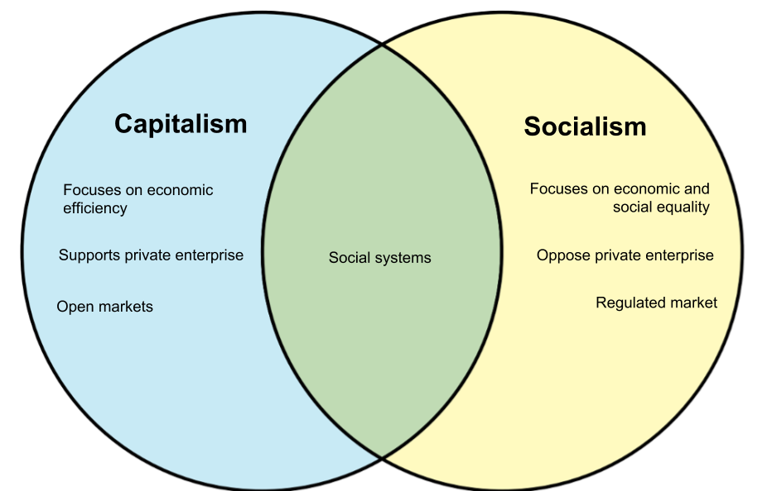

Slide 23
