Slide 1

Class #21
The Fourth & Fifth

Slide 2

Book of the Week
The Jeweler’s Shop

Slide 3

How Can We Test What We Believe?
“Young birds do not grow into fishes.”
. The new concept must “retain both the doctrine and the principle with which it started”
The power of assimilation.
There is a single unchanging deposit of faith. It is our understanding that grows and deepens, not the deposit of the faith itself.
It anticipates the future.
It “illustrates, not obscures, corroborates, not corrects, the body of thought from which it proceeds.”
The principle is not a fleeting trend of the times…a shooting star, vs. a planet or star.

Slide 4

Catholic Doctrine or Not?
The Nicene Creed as promulgated by the Council of Nicea in 325.

Slide 5
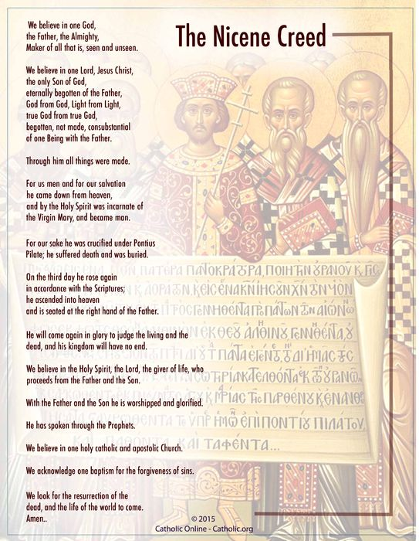
Nicene Creed (325 A.D.)
I believe in one God, the Father almighty, maker of heaven and earth, of all things visible and invisible.
I believe in one Lord Jesus Christ, the Only Begotten Son of God,
born of the Father before all ages. God from God, Light from Light,
true God from true God, begotten, not made, consubstantial with the Father; through him all things were made. For us men and for our salvation he came down from heaven, and by the Holy Spirit was incarnate of the Virgin Mary, and became man. For our sake he was crucified under Pontius Pilate,
he suffered death and was buried, and rose again on the third day
in accordance with the Scriptures.
He ascended into heaven and is seated at the right hand of the Father. He will come again in glory to judge the living and the dead
and his kingdom will have no end.
And in the Holy Spirit.
Notes:
Source Vatican Website https://www.PapalEncyclicals.net/councils/ecum01.htm

Slide 6
Catholic Doctrine or Not?
The Nicene Creed as promulgated by the Council of Nicea in 325.
The Nicene-Constantinople Creed as promulgated by the Council of Constantinople in 381.

Slide 7
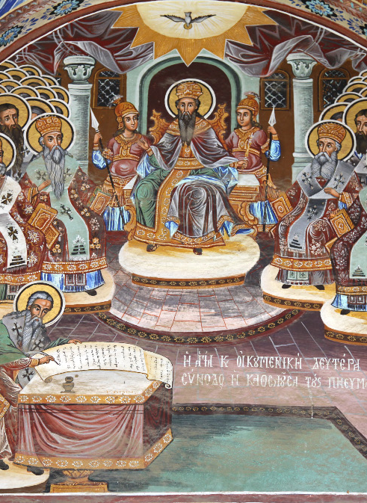
Constantinople Creed (381 A.D.)
I believe in one God, the Father almighty, maker of heaven and earth,
of all things visible and invisible.
I believe in one Lord Jesus Christ, the Only Begotten Son of God,
born of the Father before all ages. God from God, Light from Light,
true God from true God, begotten, not made, consubstantial with the Father; through him all things were made. For us men and for our salvation he came down from heaven, and by the Holy Spirit was incarnate of the Virgin Mary, and became man.
For our sake he was crucified under Pontius Pilate, he suffered death and was buried, and rose again on the third day in accordance with the Scriptures. He ascended into heaven and is seated at the right hand of the Father. He will come again in glory to judge the living and the dead and his kingdom will have no end.
I believe in the Holy Spirit, the Lord, the giver of life, who proceeds from the Father and the Son, who with the Father and the Son is adored and glorified, who has spoken through the prophets.
I believe in one, holy, catholic and apostolic Church. I confess one Baptism for the forgiveness of sins and I look forward to the resurrection of the dead and the life of the world to come.
Amen.
Notes:
https://www.PapalEncyclicals.net/councils/ecum02.htm

Slide 8
Catholic Doctrine or Not?
The Nicene Creed as promulgated by the Council of Nicea in 325.
The Nicene-Constantinople Creed as promulgated by the Council of Constantinople in 381.
Ordination of women to the priesthood.
Marriage of two individuals of the same sex.
The words of consecration at the Mass.
The Mass as a meal.

Slide 9
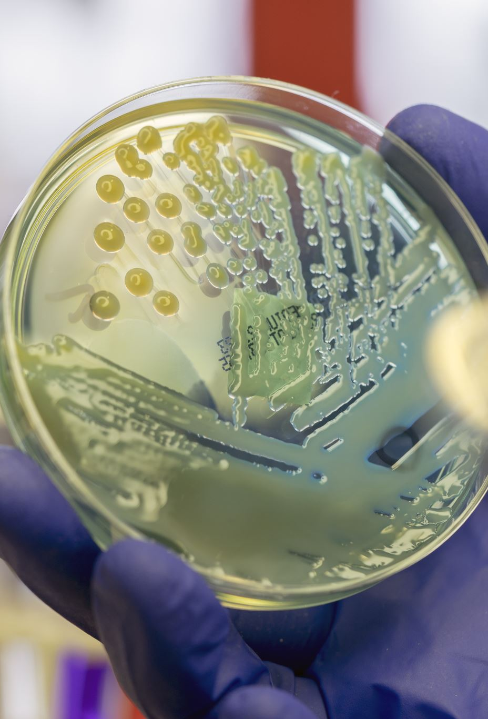
IVF and the
Consistent Ethic of Life
Background:
  What is in vitro fertilization? Woman’s egg fertilized outside of the body and then implanted back into the woman’s uterus.
    Multiple eggs fertilized and sometimes multiple zygotes (technical term for the embryo) implanted looking for the “strongest one” or the one most likely to survive.
    The other embryos are then removed from the uterus.
  Why is IFV immoral?
    The act itself is immoral because conception occurs not between the husband and wife (out of love), but in a laboratory.
    The embryos are either frozen or implanted or discarded.
  What happens to the frozen embryos?
  What is the Texas Supreme Court decision about?

Slide 10
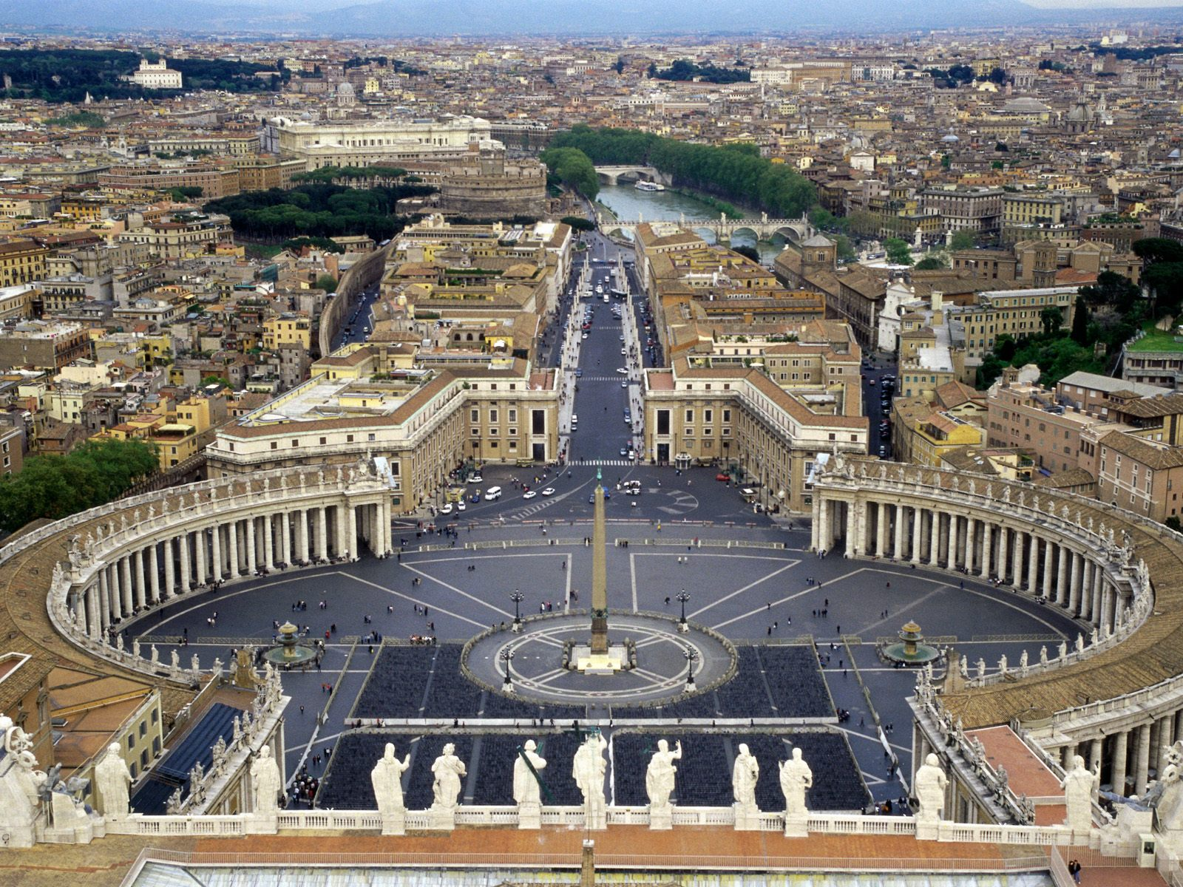
How Does the Catholic Church Resolve Bioethical Issues?
What is the process of resolving these issues?
  Takes time and doesn’t jump to “knee-jerk” conclusions.
    The Church may take months, years, or even decades to decide.
  Use the processes outlined previously.
  Work regardless of media attention.
  Identify important considerations and guiding principles.
  Stay ahead of the curve!
  Officially promulgated!
Example: Ethical and Religious Directives for Catholic Health Care Services

Slide 11
How Does the Catholic Church Resolve Bioethical Issues?
What are some bioethical issues?
  Aborting a child at any time prior to birth.
  The use of contraceptive pills and devices to prevent a pregnancy.
  Intentionally delivering a baby early when it appears that the baby will be deformed or may not survive after child birth.
  In vitro fertilization
  Human cloning
  Conscientious objection to a medical procedure (abortion, sex reassignment surgery, etc.)

Slide 12

Fifth Commandment:
Thou Shalt Not Kill
Respect for the Integrity of the Body
“The human body is a beautiful gift from God. Our responsibility as stewards of life includes:
cultivating good health,
avoiding physical injury to oneself or others, and
recognizing our own bodies as deserving respect and reverence.”
(Introduction to Catholicism, pp. 484-485)

Slide 13

Fifth Commandment: Thou Shalt Not Kill
Examination of Conscience
Did I easily become angry or lose my temper?
Did I purposefully or carelessly injure anyone?
Was I an occasion of sin for others by way of conversation, telling offensive jokes, dressing immodestly, sharing harmful books or magazines, etc.? Did I try to repair the scandal done?
How many persons did I lead to sin? What sin or sins were involved?

Slide 14

Fifth Commandment: Thou Shalt Not Kill
Examination of Conscience
Did I neglect my health?
Did I attempt to take my life?
Have I mutilated myself or another?
Did I get drunk or use prohibited drugs?
Did I eat or drink more than a sufficient amount, allowing myself to get carried away by and commit gluttony?
Did I participate in any form of malicious, physical violence?

Slide 15
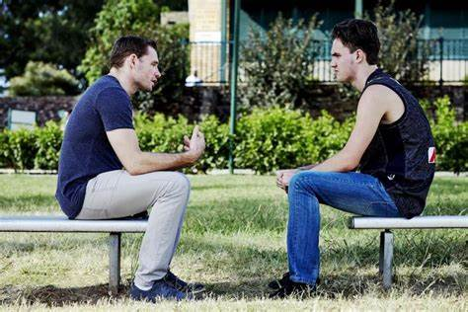
Fifth Commandment: Thou Shalt Not Kill
Examination of Conscience
Did I consent to, advise, or actively take part in an abortion?
Did I cause harm to anyone with my words or actions?
Did I desire revenge or harbor enmity, hatred, or ill-feelings against someone who offended me?
Did I ask pardon whenever I offended anyone?
Did I insult or offensively tease others?
Did I quarrel with one of my brothers or sisters?

