Slide 1
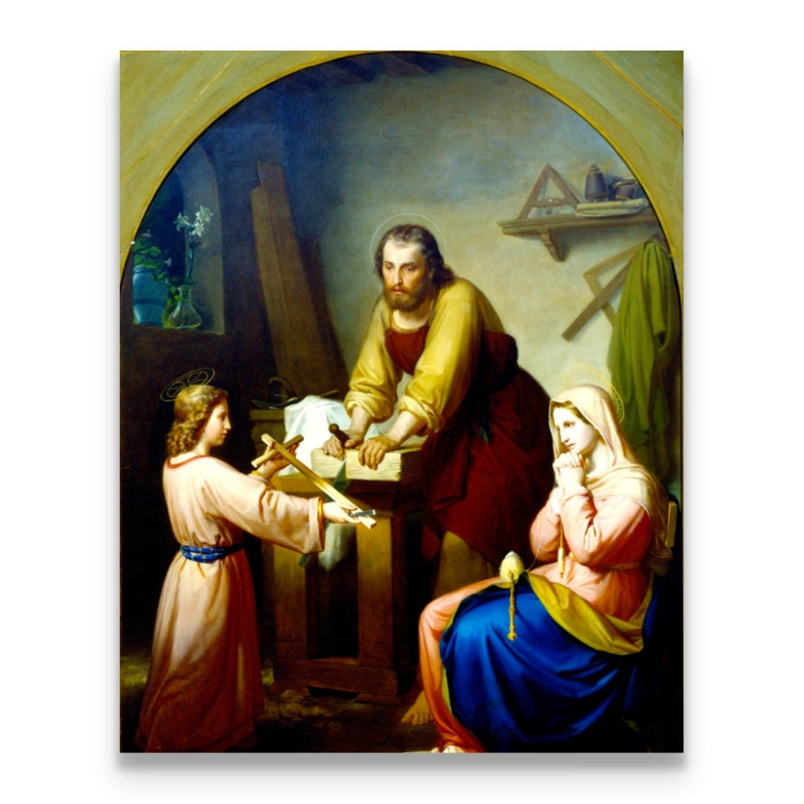
Ninth Grade CCD Class #19
February 25, 2024
Third, Fourth, & Fifth Commandments Establishment of the Church

Slide 2
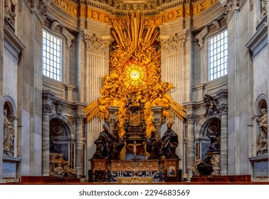
The Feast of the Chair of St. Peter
February 22
St. Peter’s Basilica
Vatican City

Slide 3
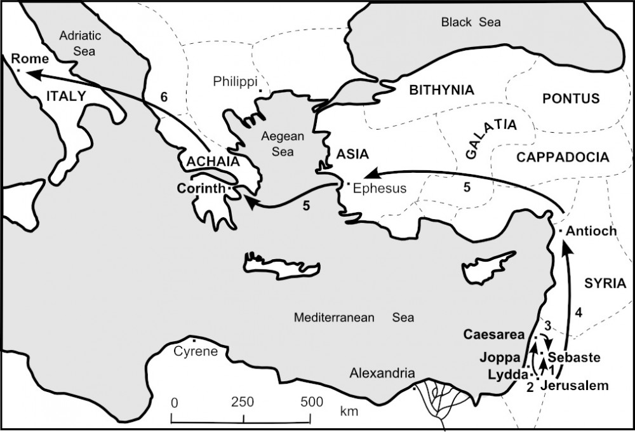
Travels of St. Peter
Notes:
Antioch was the “capital” of the ancient world; Rome was the ”capital” of the “modern” world.

Slide 4
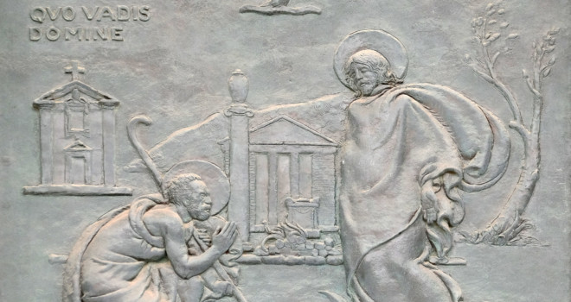
Quo Vadis Domine?
Notes:
“Where are you going, Lord?” ”I am going to Rome to be crucified again!”

Slide 5
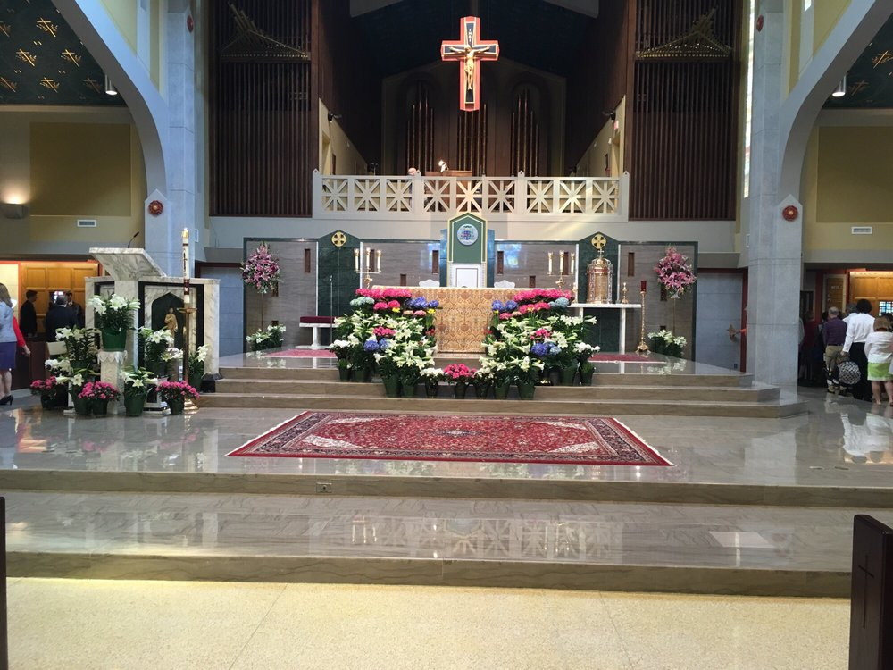
Cathedral of St. Thomas More, Arlington, VA

Slide 6
Third Commandment
Thou Shall Keep Holy the Sabbath!

Slide 7
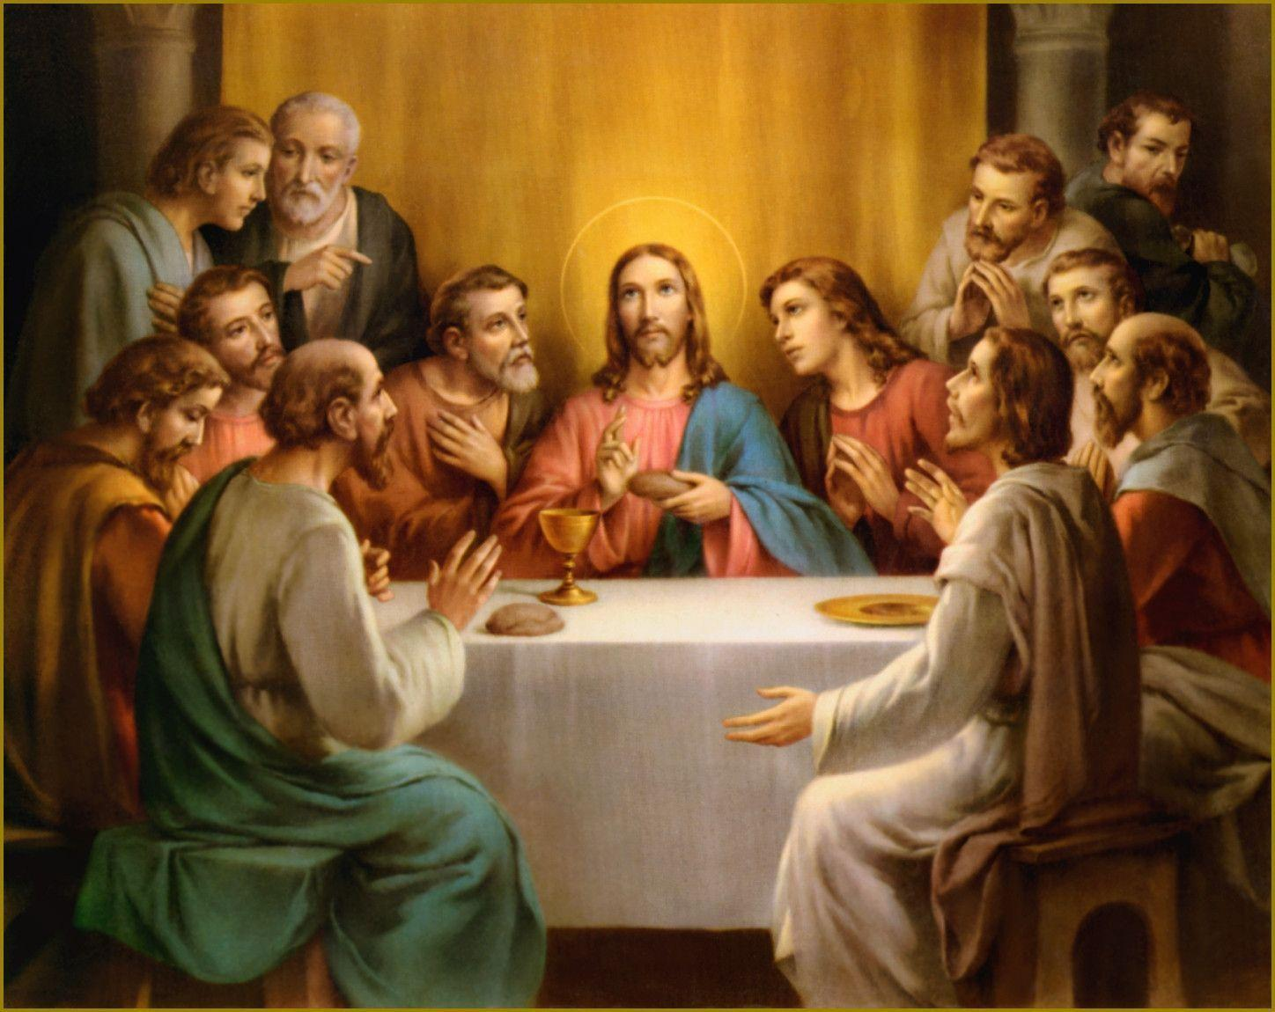
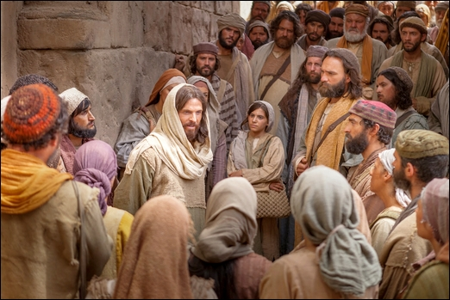
Establishment of the Eucharist
Last Supper
  Read John 6: 25-69
  “Do not labor for the food which perishes, but for the food which endures to eternal life, which the Son of man will give to you; for on him has God the Father set his seal.” (27)
  “This is the work of God, that you believed in him who he has sent.” (29)

Slide 8
Establishment of the Eucharist
  “I am the bread of life; he who comes to me shall not hunger….” (35)
  “And the Jews then murmured at him….” (41)

Slide 9
Establishment of the Eucharist
  “I am the bread of life….” (48)
  “…the bread that I give for the life of the world is my flesh.” (51)
  “And then the Jews disputed among themselves….” (52)

Slide 10
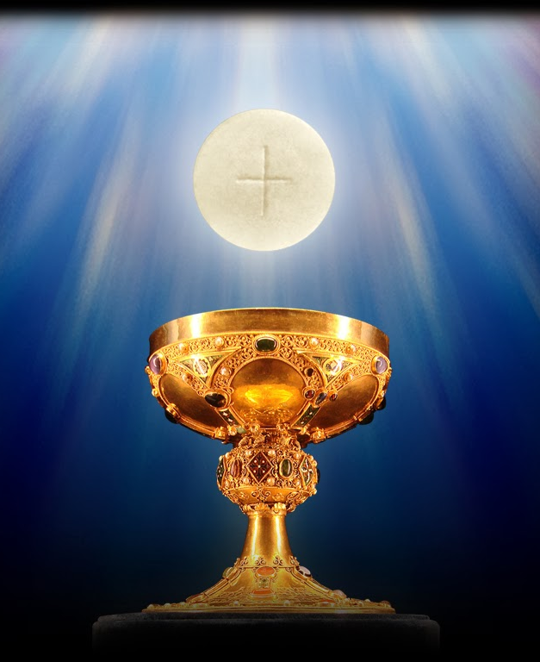
Establishment of the Eucharist
“For my flesh is real food indeed and my blood real drink indeed. He who eats my flesh and drinks my blood abides in me, and I in him.” (56)

Slide 11
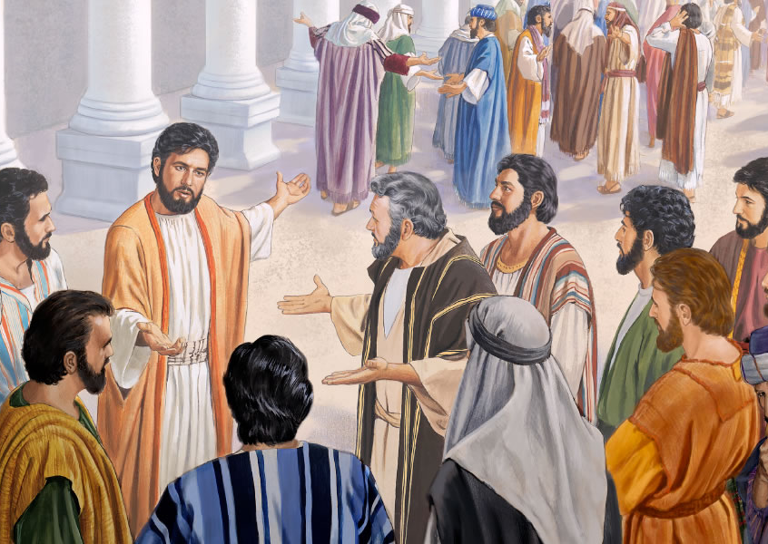
Establishment of the Eucharist
  “After this, many of his disciples drew back and no longer walked with him.” (66)

Slide 12

Is there a unified response by the Protestants to John 6?
They interpret it figuratively; rather than literally.
Most Protestant traditions call the ritual communion, rather than the Eucharist. There are major differences between the Protestant practice of communion and the Eucharist.
Most Protestant traditions about communion do not rely on the power of a priest to transform the bread into the body of Christ.
Luther believed that the Lord’s Supper and that the body of Christ was physically present in the communion offering because Christ said, “This is my body.”

Slide 13
What is the Fourth Commandment?
Honor Your Father and Mother!
Chosen (Finding of Jesus in the Temple; 0-2:06)
The Chosen Episode 5 - Bing video
https://www.bing.com/videos/search?q=the+chosen+episode+5+youtube&docid=608047072037504964&mid=4A1D51F797356009BCE24A1D51F797356009BCE2&view=detail&FORM=VIRE
Chosen (Wedding Feast at Cana; 38:25-39:35)
The first miracle of Jesus • The Chosen | Jesus turns water to wine | Download “The Chosen” app now - YouTube

Slide 14
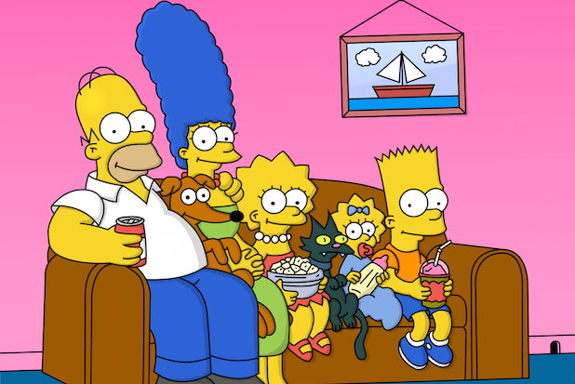
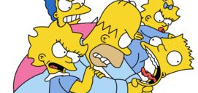
FAMILY:
“Building the smallest democracy at the heart of society”
Notes:
Gerri, can you bring your banner and tell stories about your trip to China.

Slide 15
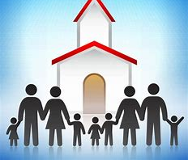
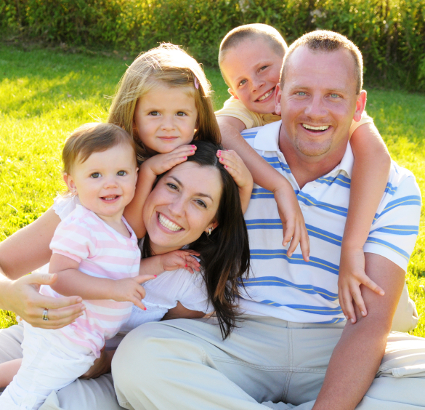
FAMILY
A
Little
Church

Slide 16

What Is the Expanded Meaning of the Fourth Commandment?
Direct Relationships:
  The Fourth Commandment requires us to honor and obey our parents and all legitimate authority (both civil and religious).
Reciprocal Relationships:
  The Fourth Commandment requires:
    Parents to protect their children
    Civil authorities and citizens to protect children

Slide 17

Who is Responsible for Your Education?
Who has Primary Responsibility?
State (Fairfax County)?
Church (Fr. De Celles)?
Parents?
Who plays a subordinate role in your education?
State (Fairfax County)?
Church (Fr. De Celles)?
Parents?

Slide 18
Hmmm…are parents perfect?
We owe our parents love and respect simply because:
  They are our parents; and
  They gave us life.
We honor our parents by:
  Always being courteous to them;
  Helping with family activities and household chores; and
  Striving to be good sons and daughters who make them proud.

Slide 19
Social Units in a Healthy Society
Basic unit of a healthy society is the family. (CCC 2207)
Families gather to form communities.
Communities gather to form states.
States gather to form nations.
“The well-being of the individual person and of both human and Christian society is closely bound up with the healthy state of conjugal and family life.” (GS 47 §1)

Slide 20
The Positive Aspects of the Family of Today
Role of the Christian Family in the Modern World (Familiaris Consortio)
There is more lively awareness of:
1. personal freedom and greater attention to the quality of interpersonal relationships in marriage,
2. the dignity of women,
3. responsible procreation, and
4. the education of children.

Slide 21
The Negative Aspects of the Family of Today
Role of the Christian Family in the Modern World (Familiaris Consortio)
There are signs of disturbing degradation of some fundamental values:
Serious misconceptions regarding the relationship of authority between parents and children;
The concrete difficulties that the family itself experiences in the transmission of values;
The growing number of divorces;
The mistaken theoretical and practical concept of the independence of the spouses in relation to each other;
scourge of abortion;
The ever more frequent recourse to sterilization; and
The appearance of a truly contraceptive mentality.

Slide 22

What Does This Have to Do With the Fourth Commandment?
“As long as a child lives at home with his parents, the child should obey his parents in all that they ask of him when it is for his good or that of the family. ‘Children, obey your parents in everything, for this pleases the Lord.’ (Col 3:20)
Children should also obey the reasonable directions of their teachers and all to whom their parents have entrusted them.
But if a child is convinced in conscience that it would be morally wrong to obey a particular order, he must not do so. (CCC 2217)
Notes:
There is also a responsibility for parents to guide their children toward the truth .

Slide 23
Fourth Commandment – Examination of Conscience
Did I disobey my parents?
Did I neglect to help my parents when my help was needed?
Did I treat my parents with little affection or respect?
Did I react proudly when I was corrected by my parents?
Did I have an excess desire for independence?
Did I do my chores?

Slide 24
Fourth Commandment and the Mathematics of the Family

Slide 25
The Fourth Commandment and the Extended Family
Family bonds extend beyond your parents.
The Catechism describes the extensive familial and social obligations of the Fourth Commandment. (CCC 2199)

Slide 26
The Fourth Commandment and the Extended Family
The Catechism (CCC 2199)
Honor, affection, and gratitude toward elders. It extends to:
  Pupils to teachers,
  Employees to employers,
  Subordinates to leaders,
  Citizens to their country, and
  Citizens to those who administrate or govern it.
The opposite is also true. The 4th Commandment includes and presupposes the duties of parents, instructors, teachers, leaders, magistrates, those who govern, all who exercise authority over others or over a community of persons.

Slide 27
Fourth Commandment Wrap Up
“Honor your father and your mother.” (Deut 5:16; Mk 7:10)
Family: “Marriage and family are ordered to the good of the spouses, to the procreation and the education of children.” (CCC 2249)
”Children owe their parents respect, gratitude, just obedience, and assistance.” (CCC 2251)
“Parents have the first responsibility for the education of their children in the faith, prayer, and all the virtues. They have the duty to provide as far as possible for the physical and spiritual needs of their children.” (CCC 2252)
“Parents should respect and encourage their children’s vocations.” (CCC 2253)

Slide 28
What Is the Expanded Meaning of the Fourth Commandment?
Direct Relationships:
  The Fourth Commandment requires us to honor and obey our parents and all legitimate authority.
Reciprocal Relationships:
  The Fourth Commandment requires:
    Parents to protect their children
    Civil authorities and citizens to protect children

Slide 29
Fourth Commandment Wrap Up
“Public authority is obligated to respect the fundamental rights of the human person and the conditions for the exercise of his freedom.”
(CCC 2254)
“It is the duty of citizens to work with civil authority for building up society in the spirit of truth, justice, solidarity, and freedom.”
(CCC 2255)
“Citizens are obligated in conscience not to follow the directives of civil authorities when they are contrary to the demands of the moral order. ‘We must obey God rather than man’ (Acts 5:29).” (CCC 2256)
Notes:
There is also a responsibility for parents to guide their children toward the truth .

