Slide 1
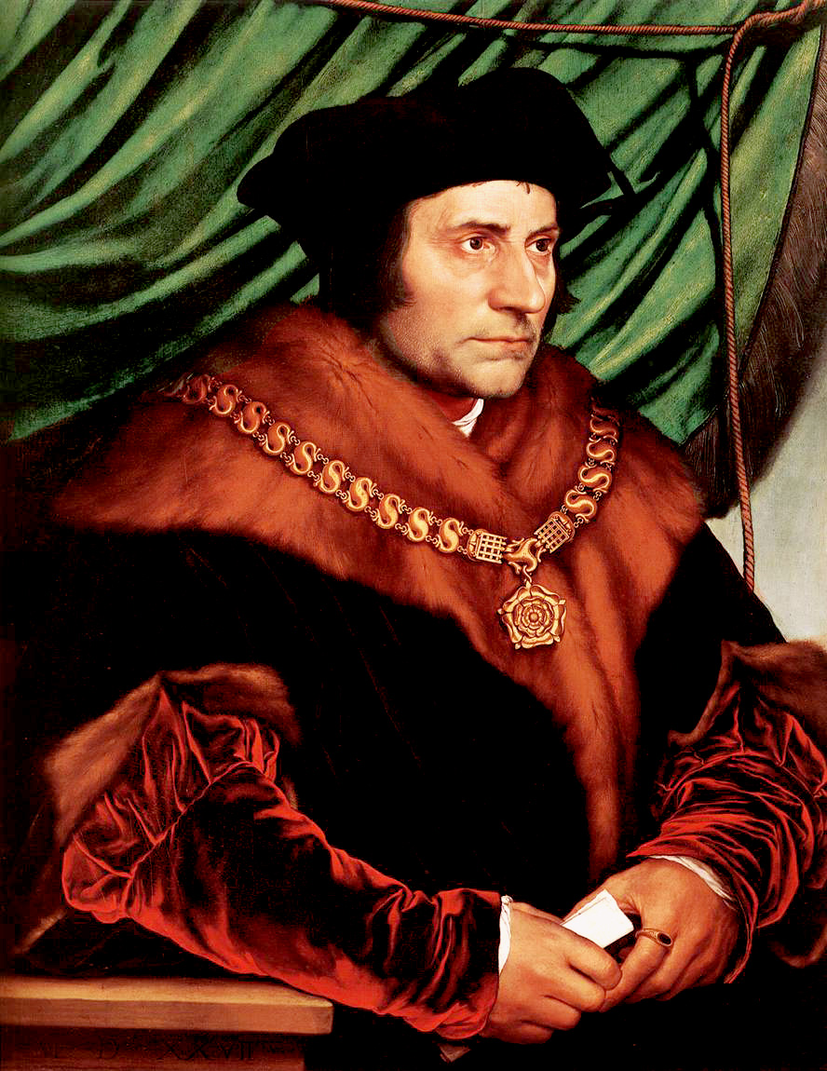
The dog in the photo was trained to identify life after earthquakes. His posture and the fact of staying fixed as seen in the image is the posture that tells the rescuer that there is life in that place. And look at nothing more and nothing less where and in front of who is placed: in front of Jesus as the Eucharistic bread in the tabernacle, the living God among us.
Ninth Grade
Religious Education
Classes 16/17
January 28/
February 4, 2024

Slide 2
10 Universal Principles
Principle of Beneficence (The Golden Rule)
Principle of Non-Contradiction
Principle of Complete Explanation
Principle of Objective Evidence
Principle of Non-Maleficence (The Silver Rule)

Slide 3
10 Universal Principles
6. Principle of Consistent Ends and Means
7. Principle of Full Human Potential
8. Principle of Natural Rights
9. Principle of the Hierarchy of Rights
10. Principle of Limits to Freedom

Slide 4
Aquinas’ Definition of “Law”
Law is nothing else than an ordinance of reason for the common good, promulgated by him who has the care of the community.¹
An ordinance – “an order or a command given by someone who is in a position of authority….It imposes an obligation and has binding force.”
Of reason – “must be reasonable; must be just.” It can’t contradict higher laws. It must be observable, enforceable, and useful for achieving the ends that are designated.
¹ St. Thomas Aquinas, Summa Theologiae, I-II,q.90, a.4.

Slide 5
Categories of Laws
Origin (who established the law)
Promulgation (how are they established)
Duration (how long do they last)

Slide 6
According to Origin
Eternal Law
Natural Moral Law
Divine Law
Natural Physical Law
According to Origin
Divine Positive Law
Civil Law (Laws of the States)
Human Law
Ecclesiastical Law (Laws of the Church)

Slide 7
According to Promulgation
Natural Physical Law (Laws of nature, i.e., gravity)
Natural (laws made known by the very nature of the creature it governs)
Natural Moral Law (natural law)
According to Promulgation
Divine Positive (i.e., 10 Commandments)
Positive (law which is “laid down”)
Human Law (i.e., Constitution)

Slide 8
According to Duration
According to Duration
Eternal Law – unchanging order of things as it exists in the mind of God.
Temporal Law - Laws with a duration.
Natural Law - applies to rational creatures
Laws of nature - applies to non-rational creatures.

Slide 9
What is the hierarchy of law?
Eternal Law (creation itself)
Divine Law (Divine Positive Law – 10 Commandments)
Natural Law (Natural Physical Law & Natural Moral Law)
Human Law (Civil and Ecclesiastical)

Slide 10
Exercises – What Kind of Law(s) are involved?
1. You are a high jump coach seeking to get your athletes to jump higher. What is your hindrance? What type of law is impeding your efforts?
2. You are driving back to college on the Sunday after Thanksgiving. You get an early start and don’t get to Mass before you leave. You arrive at 4:00 p.m. and there is a 5:00 p.m. Mass at school. Must you attend it? What type of law governs?
3. Your cat is chewing the leg of your parent’s wooden kitchen table. You shoo it away, but it returns and continues chewing. What law is involved here?
Notes:
Natural law; legal (civil law – although immoral); divine law; positive law
Gravity (natural physical law)
Mass – Divine Law

Slide 11
Exercises – What Kind of Law(s) are involved?
4. You are on a kayaking trip on the Shenandoah River. You see another kayaker in distress. What law influences you in helping him?
5. Your parents have an outdoor bird feeder a squirrel keeps climbing. You are tempted to take your high-powered bb gun and teach the squirrel a lesson. What law influences you to carry that out or not carry it out?
6. A woman argues that abortion is legal because “it’s my body and I can do with it what I want.” What laws are involved?
Notes:
Natural law; legal (civil law – although immoral); divine law; positive law
Gravity (natural physical law)
Mass – Divine Law

Slide 12
Evaluating Laws
DC law allows the DDOT to set speed limits on local roads. On May 29, 2020, the following public announcement was made: “As DC begins reopening today, Mayor Murial Bowser announced that the city will lower the default speed limit on local roads to 20 MPH, down from 25. The change will go into effect on Monday, June 1.”
a. What type of law?
b. Does it benefit the common good?
c. Does the one making the law have the authority to do so?
d. Does it impose an obligation?
e. Does it conflict with higher laws?
f. Was it promulgated? Was it made known to all impacted by it?
g. Is it reasonable? Is it just?
h. Is it mandatory?
Notes:
This is a good example to discuss a moral law. For some of these, there is no right or wrong answer. Here are mine.
Mandatory – Yes
Reasonable – Questionable in that what does lowering the speed limit have to do with opening up DC after being shut down for COVID. Was the mayor using COVID as a reason for lowering the speed limit?
Beneficial to the common good? Questionable – see above.
Promulgated? Note that this had two days to take effect. Was the city going to change all of the speed limit signs in those two days.
Authorative? Yes, mayor has authority to do it. But does having the authority give her the right to do it?
So, is it a legitimate law?

Slide 13
What is a “right”?
The word “right” has two meanings, both of which stem from the same basic idea referring to what ought to be the case:
a. Right as morally good – that which is in line with the moral norm.
How I ought to act: “I am right helping my sister or brother with his/her homework.”
b. Right as corresponding to duty – that which is just.
How others ought to act toward me: “I have the right to a good education.”
Because we have an obligation to obey the moral law, we must be guaranteed the means we need in order to do so.
Notes:
This entails us to have the power to do whatever is necessary to keep the moral law as well as the power to keep others from stopping or interfering with us. Rights give us power; they empower us to obey the moral law.

Slide 14


A Man for All Seasons
Notes:
https://video.search.yahoo.com/search/video?fr=mcafee&ei=UTF-8&p=A+MAN+FOR+ALL+SEASONS+MOVIE+1966&type=E210US91088G0#id=2&vid=e0c523150de04ba842eba521044ef4d8&action=click

