Slide 1
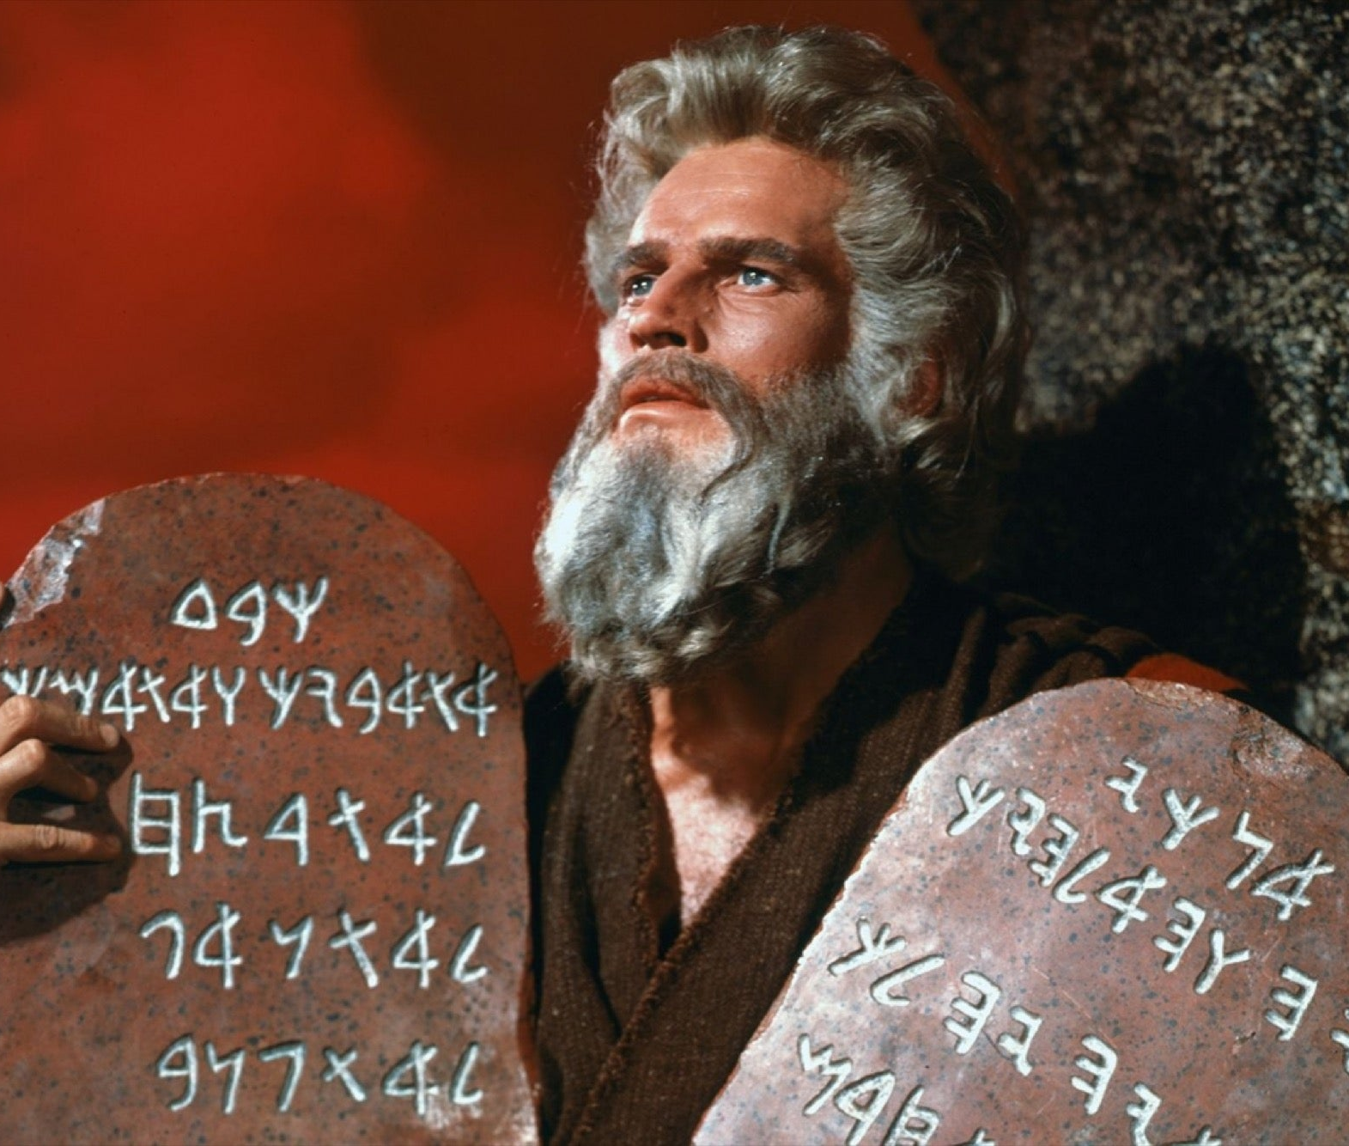
Ninth Grade Religious Education Class #18
Lent is upon us
10 Commandments & 8 Beatitudes
February 11, 2024

Slide 2
What is ‘conscience’?
Etymology: from Latin conscientia meaning “knowing within.”
Ethics definition: ”refers to a person’s act of knowing the moral quality of his free acts.”
  Answers the question, “Is this act good for me right now?”
  St. Thomas defines conscience as “the act of applying moral knowledge to a particular act.” (Summa Theologiae, 1, 79, 13.)

Slide 3
What is ‘conscience’? (cont.)
1. One must act according to his/her conscience.
2. Conscience can be erroneous.
3. Conscience must always be informed.
(Joan of Arc “If in the state of grace may God keep me there; if not in the state of grace may God put me there.”)
Notes:
1 Cor 4:4-5 “It is the Lord who judges me…I am not aware… = living according to conscience
But I am not acquitted – could be wrong

Slide 4
Correct and Erroneous Judgments
“Follow your conscience…once you have informed it.” (Quote by JPII)
We are always required to follow our conscience – whether it is correct or erroneous.
“Conscience…a window through which one can see outward to that common truth which founds and sustains us all.” (Joseph Cardinal Ratzinger, “Conscience & Truth.”)
Notes:
Erroneous Conscience – My parents told me that we don’t have to go to Mass on Sunday because it is the only Commandment that is not based on natural law. So we go to Mass when it is convenient.

Slide 5
Doubtful Conscience
If we are certain that our conscience is acting correctly, it is called a “certain conscience.”
If we are unsure, it is called a “doubtful conscience.”
Morally, a person cannot act on a doubtful conscience because it could lead to the risk of doing something evil.

Slide 6
Doubtful Conscience
Two cases:
A doubtful obligation is binding: Always follow a safer course – hunter goes out to hunt deer. He hears movement in the brush 200 yards away but cannot ascertain if it is a deer or another hunter.
What is the moral norm?
What is the particular act?
What is the moral judgment?
He is morally obligated to take the safer course of action.

Slide 7
Doubtful Conscience
2. A doubtful obligation is not binding: e.g., neighbor’s fruit falling in your yard.
What is the moral norm?
What is the particular act?
What is the moral judgment?

Slide 8
Doubtful Conscience
3. Your parent is driving 65 mph in a 55 mph zone on a new highway.
What is the moral norm?
What is the particular act?
What is the moral judgment?
In these cases, after trying to find out your obligation, if you are still in doubt, you are morally justified to act according to your personal preferences.
4. My mother asks if I want peanut butter sandwich on white bread or rye bread?

Slide 9
Christ Calls Matthew (Levi)
Matthew 9:9-13
“Those who are well have no need of a physician, but those who are sick.”
“Go and learn what this means, I desire mercy, and not sacrifice.”
“For I came not to call the righteous but sinners.”
Notes:
https://vimeo.com/412843483
Scene from The Chosen: dinner at Matthew’s house.
https://www.youtube.com/watch?v=5yO6oR3jNCA
Reading from the Bible this scripture passage: The Chosen: Calling of Matthew; Matthew’s dinner: Father De Celles’ homily from 2/25/2023

Slide 10
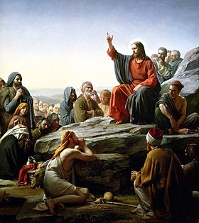
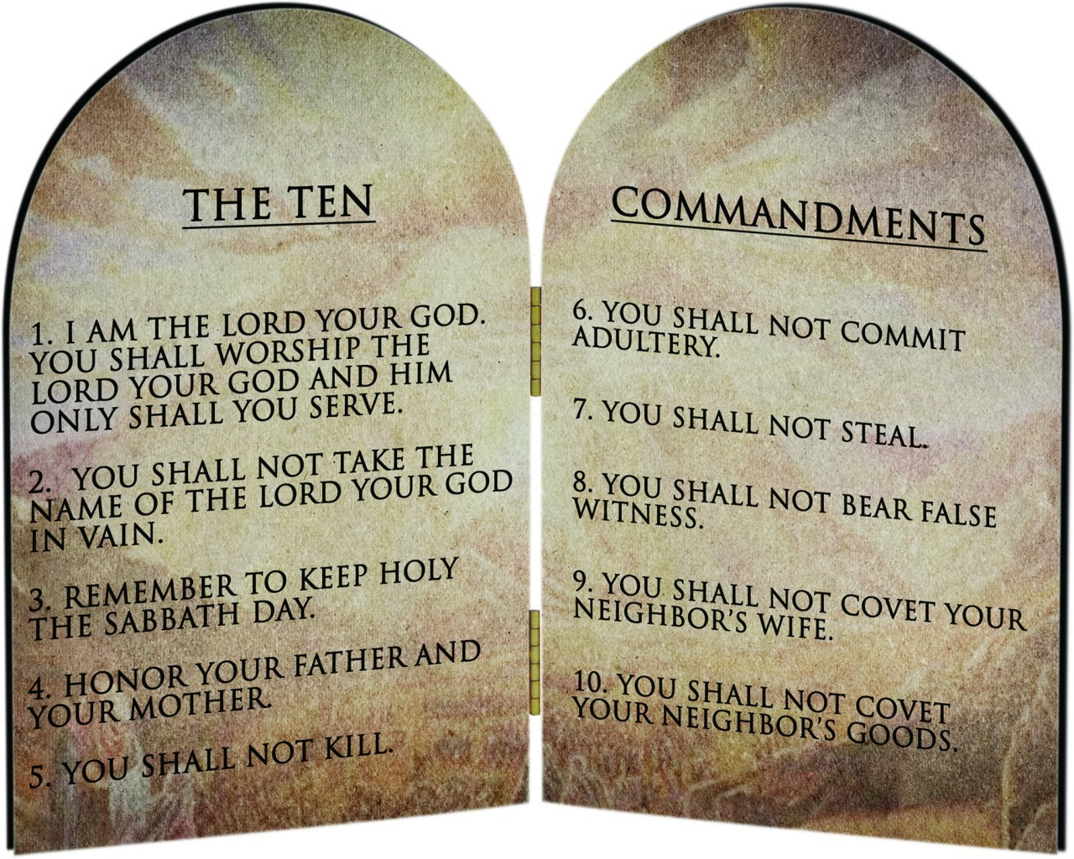
The Commandments and Beatitudes

Slide 11
The Old Law and The New Law Old Law
Mark 12:28-31
“Thou shall love the Lord your
God with all your heart, and
with all your soul, and with
all your mind, and with all your
strength….
Love your neighbor as yourself.”
Notes:
Read Mark 12:28-31
What is the Old Law? 10 Commandments
What is the New Law? Love God and Love Neighbor
Mark 12:28-31 -

Slide 12
New Law as a Fulfillment of the Old Law
Old Law
New Law
Do not worship false gods.
Do not kill.
Do not commit adultery.
Do not covet your neighbor’s goods.
Love and worship God as Blessed Trinity.
Love everyone as God loves you.
Live interior chastity in thought and desire.
Have an active love of neighbor in word and deed.

Slide 13
The Commandments and Beatitudes
Commandments:
Only 1 God
God’s Name
Sabbath
Father/Mother
Kill
Adultery
Steal
Lie
Covet people
Covet goods
Beatitudes:
Poor in Spirit
Mourn
Meek
Righteousness
Merciful
Pure of Heart
Peacemakers
Persecuted

Slide 14
The Commandments and
Beatitudes
Q: What kind of law are the 10 Commandments?
A: Divine positive law derived from natural law.
Q: Which of the commandments is not found in natural law?
A: Third Commandment - ”Remember the sabbath day, to keep it holy.” (Ex 20:8)
Q: If the Third Commandment is not found in natural law, why are we compelled to obey it?
A: It is a divine positive law which is also found in the Precepts of the Church.

Slide 15
First Commandment
“I am the Lord your God; you shall not have strange gods before me.”
Q: Each of the commandments contains positive commands and negative commands! What is the positive command in the First Commandment?
A: I am the Lord your God. You shall worship God alone!
Q: Is worshipping God alone an absolute requirement?
A: Yes!
Q: What about atheists?
A: They are still required to comply!

Slide 16
First Commandment
“I am the Lord your God; you shall not have strange gods before me.”
Q: Each of the commandments contains positive commands and negative commands! What are some of the negative commands?
A: You shall not worship strange gods before me.
Q: What are some ‘strange gods?”
A: Money, power…

Slide 17
First Commandment and the Theological Virtues
What are the theological virtues?
  Faith - belief
  Hope - trust
  Charity - love
Notes:
What are the theological virtues?

Slide 18
Sins against the First Commandment
Sins against Faith
Apostasy – rejection of the Christian faith by a baptized person.
Heresy – obstinate denial of one or more truths of divine revelation.
Indifferentism – theory that all religions are the same or are equally good and true.
Sins against Hope
Despair – doubt that God will save us.
Presumption – expecting God will save us without doing our part.
Sins against Charity
Hatred for God or for other people.

Slide 19
Sins against the First Commandment
Other Sins against the First Commandment
Sacrilege – Contemptuous treatment or abuse of any sacred person, place, or thing
Superstition – Giving a creature or object some power that belongs to God alone
Spiritualism – Belief that we can contact deceased relatives or others in the spiritual world
Obsession of (fascination with) the Devil

Slide 20
Second Commandment
”Thou shalt not take the name of the Lord thy God in vain.”
What is in a name?
In the Old Testament, the name of the Lord was never uttered.
Moses at the Burning Bush (Read Exodus 2: 13-14)
“I am who I am.” -- YHWH or Yahweh! So sacred to the Jewish faith it is never pronounced by orthodox Jews.
For Christians, the most beloved name is “Jesus Christ.”
”Jesus” means “Savior.”
“Christ” means “The anointed one.”
Our Lord was anointed as the Son of God, The Messiah.
(Phil 2:4-11)
Notes:
Read Exodus 2:13-14
Read Phil 2:4 -11

Slide 21
Sins against the Second Commandment
Blasphemy – Insulting or abusive language that expresses contempt for God either directly or indirectly through his saints, through those consecrated to his service, or through holy objects.
Cursing – Calling down evil on someone or something.
Profanity – Using the name of God or Jesus to express anger, fear, surprise, impatience, or without proper reverence.
Perjury – Making a false oath or lying under oath.

Slide 22
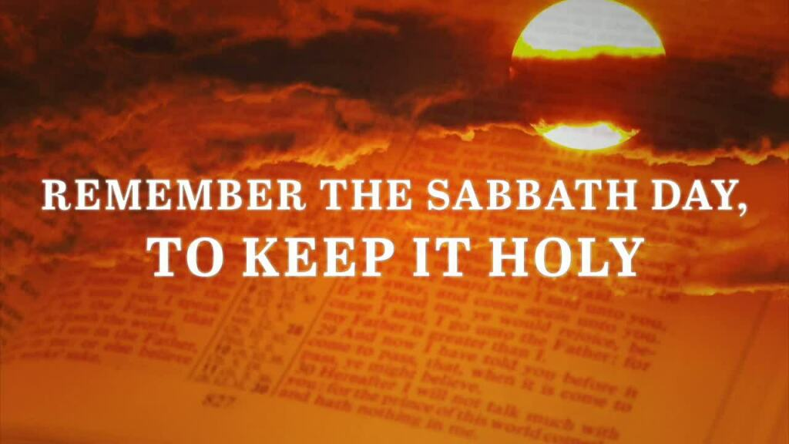
The Third Commandment
Keep Holy the Sabbath
Notes:
https://www.bing.com/videos/riverview/relatedvideo?q=tixtla+eucharistic+miracle+in+mexico+2006&mid=A68BFE69F4D6025E8564A68BFE69F4D6025E8564&FORM=VIRE
Eucharistic Miracle at Tixtla, Mexico 2006.

Slide 23
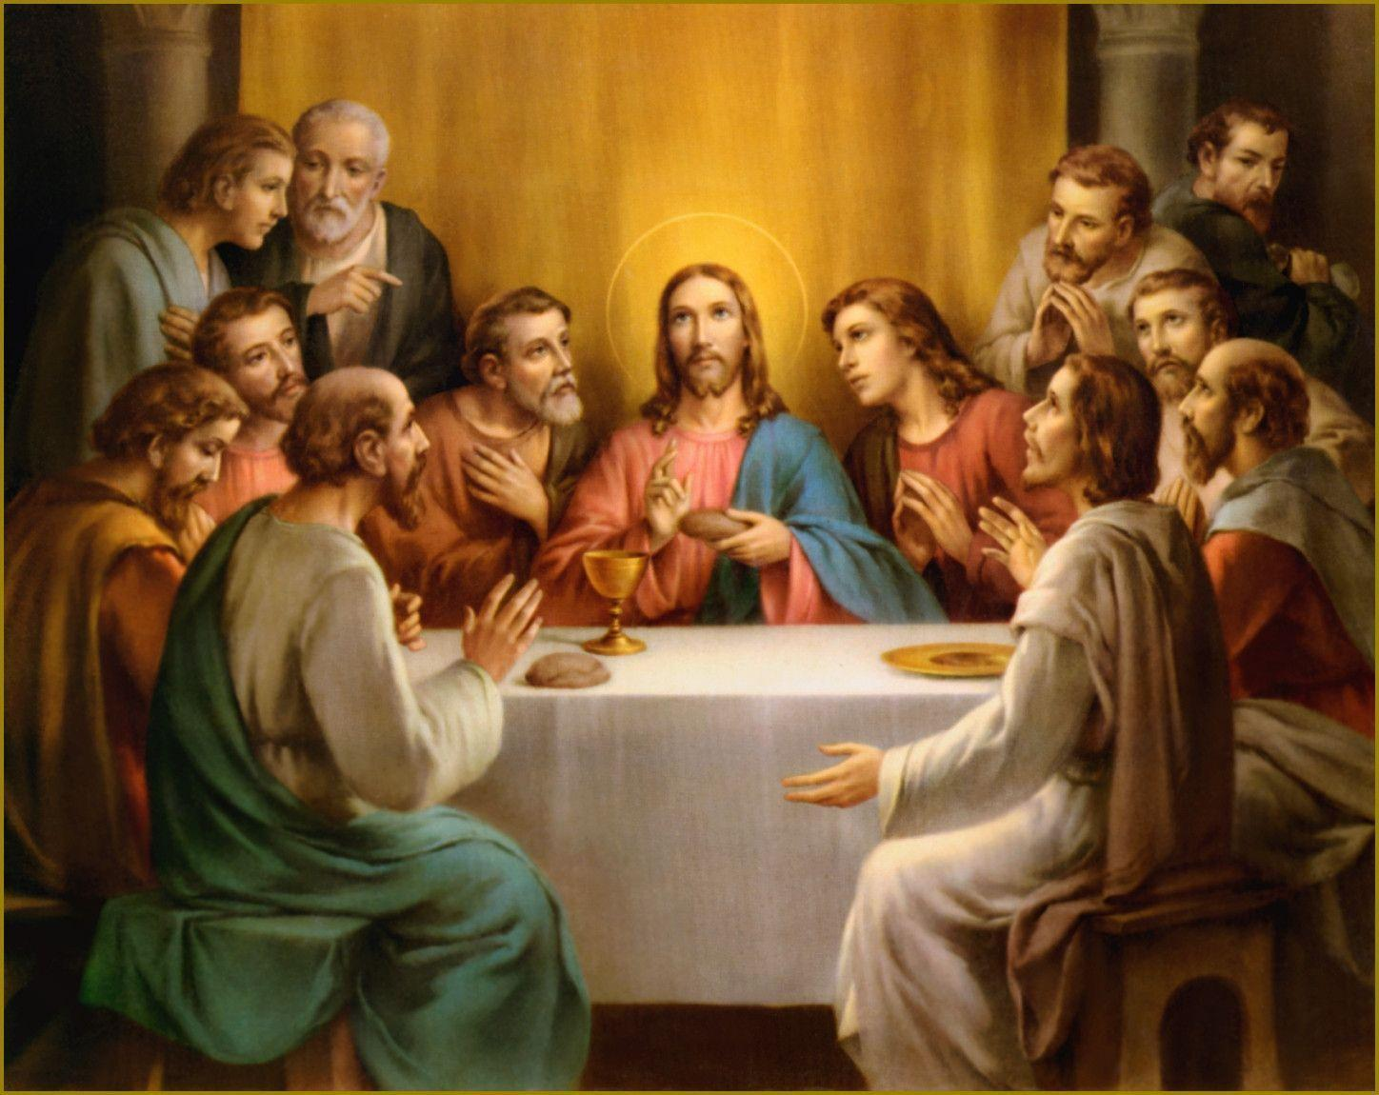
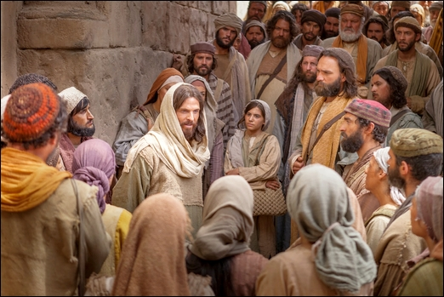
Establishment of the Eucharist
Last Supper
  Read John 6: 25-69
  “Do not labor for the food which perishes, but for the food which endures to eternal life, which the Son of man will give to you; for on him has God the Father set his seal.” (27)
  “This is the work of God, that you believed in him who he has sent.” (29)

Slide 24
Establishment of the Eucharist
  “I am the bread of life; he who comes to me shall not hunger….” (35)
  “And the Jews then murmured at him….” (41)

