Slide 1
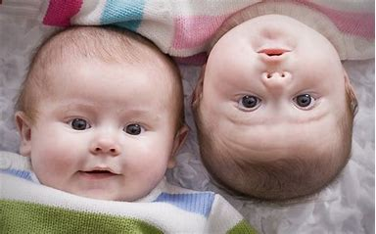
9th Grade Religious Education Class #14
January 7, 2024

Slide 2
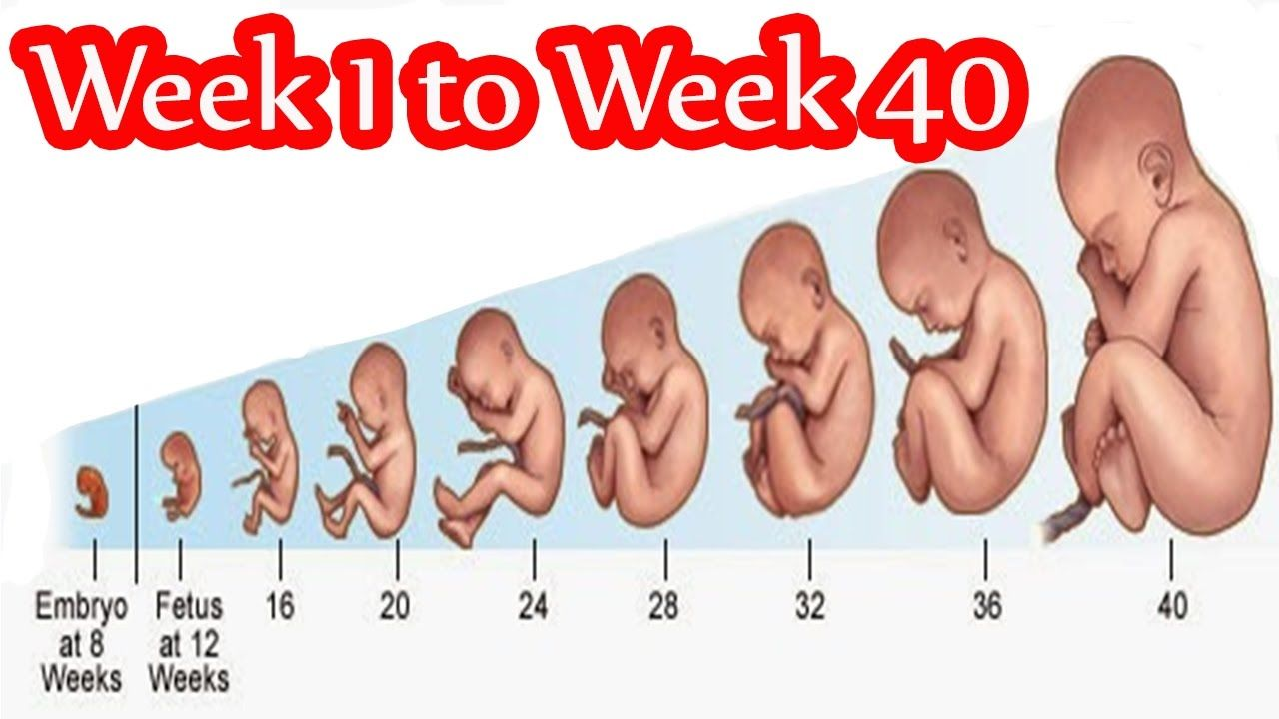
Is that a Baby?
Notes:
[Watch video from beginning to 9:50 mark: “Is that a baby?”] January 27, 2021
https://www.youtube.com/watch?v=5kdp2w6FrsY
(from beginning to about 8:24, after “we as a society…”)

Slide 3
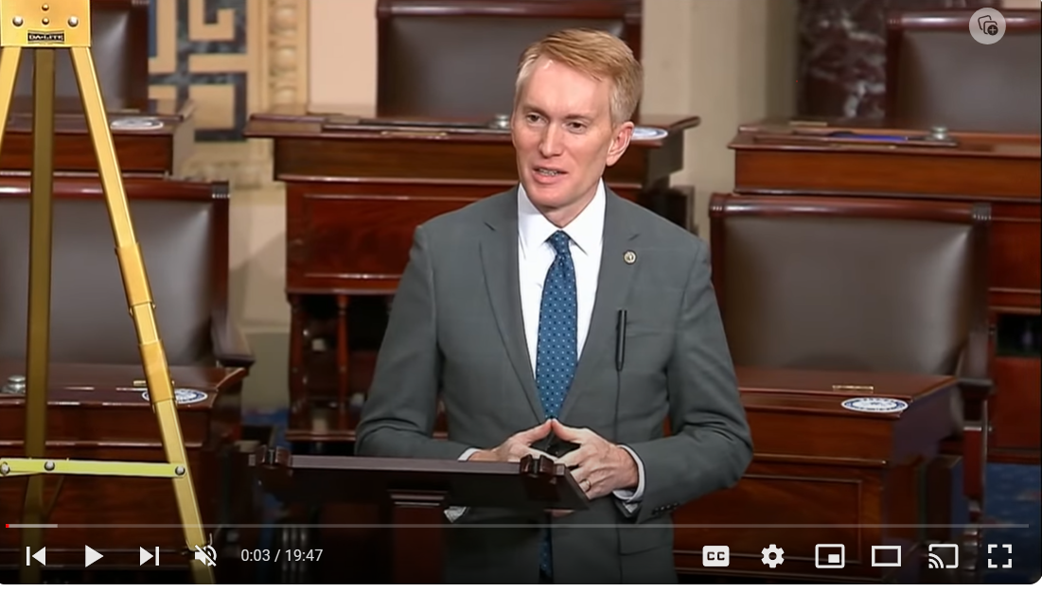
Senator Langford’s Speech
https://www.youtube.com/watch?v=5kdp2w6FrsY&list=PPSV

Slide 4
Recent Wall Street Journal Article on Abortion Strategy
In polling by [Angela] Kuefler’s firm, Global Strategy Group, majorities answered “yes” to both “Should we restore the rights we had under Roe v. Wade?” and “Should personal decisions like abortion be up to women rather than the government?” But the latter statement outperformed the former by a whopping 19-point margin, she noted, adding, “It’s the values language that allows us to win by such big margins.”
Notes:
How Abortion-Rights Backers Changed Their Message—and Started Winning - WSJ

Slide 5

Making Decisions
Inductive (vs. deductive): polls and votes decide beliefs and practices. “If abortion was really that bad, it wouldn’t be legal.” “Americans value their freedom…we can’t let the government take away our freedom to choose!”
Subjective (vs. objective): “reality” is based on each individual’s perceptions rather than on objective truth. With regard to pregnancy and abortion: “A woman has a right to bodily autonomy and medical privacy…no one has the right to use another’s body without consent.”
Experiential (vs. principled): “What is right for you is not necessarily right for me!” “It’s barbaric to give birth to a baby with a fatal abnormality.” “Consent to sex is NOT consent to pregnancy. Two different actions and both require ongoing consent. You could say that the man agreed to an abortion when he had consensual sex.”

Slide 6
The Casey Decision
“At the heart of liberty is the right to define one’s own concept of existence, of meaning, of the universe, and of the mystery of human life.”
(Planned Parenthood vs. Casey, 1992)

Slide 7
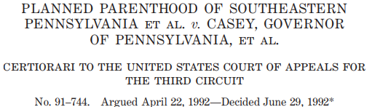
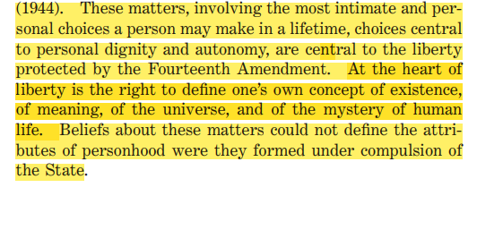

Slide 8
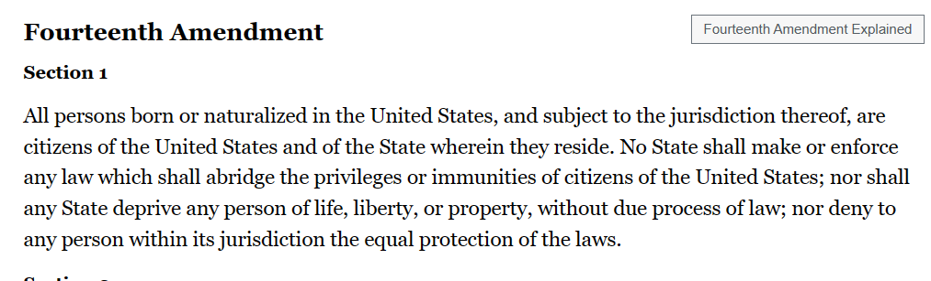

Slide 9
The Casey Decision
“At the heart of liberty is the right to define one’s own concept of existence, of meaning, of the universe, and of the mystery of human life.”
(Planned Parenthood vs. Casey, 1992)

Slide 10
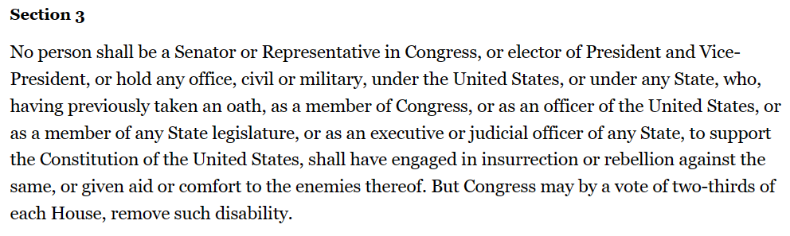

Slide 11
Recent Wall Street Journal Article on Abortion Strategy
In polling by [Angela] Kuefler’s firm, Global Strategy Group, majorities answered “yes” to both “Should we restore the rights we had under Roe v. Wade?” and “Should personal decisions like abortion be up to women rather than the government?” But the latter statement outperformed the former by a whopping 19-point margin, she noted, adding, “It’s the values language that allows us to win by such big margins.”
Notes:
How Abortion-Rights Backers Changed Their Message—and Started Winning - WSJ

Slide 12
The Law of Non-Contradiction
The Unborn Victims of Violence Act of 2004
The Unborn Victims of Violence Act of 2004 (Public Law 108-212) is a United States law that recognizes an embryo or fetus in utero as a legal victim, if they are injured or killed during the commission of any of over 60 listed federal crimes of violence. The law defines "child in utero" as "a member of the species Homo sapiens, at any stage of development, who is carried in the womb."^{[1]}
The law is codified in two sections of the United States Code: Title 18, Chapter 1 (Crimes), §1841 (18 USC 1841) and Title 10, Chapter 22 (Uniform Code of Military Justice) §919a (Article 119a). The law applies only to certain offenses over which the United States government has jurisdiction, including certain crimes committed on federal properties, against certain federal officials and employees, and by members of the military. In addition, it covers certain crimes that are defined by statute as federal offenses wherever they occur, no matter who commits them, such as certain crimes of terrorism. Due to the principles of federalism embodied in the United States Constitution, federal criminal law does not apply to crimes prosecuted by the individual U.S. states, although 38 states also recognize the fetus or "unborn child" as a crime victim, at least for purposes of homicide or feticide.^{[2]}

Slide 13
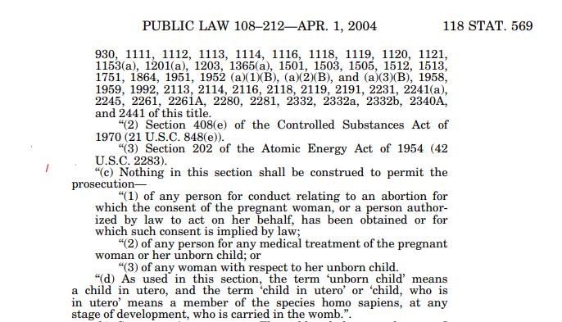
The Unborn Victims of Violence Act of 2004
How Abortion-Rights Backers Changed Their Message—and Started Winning - WSJ

Slide 14
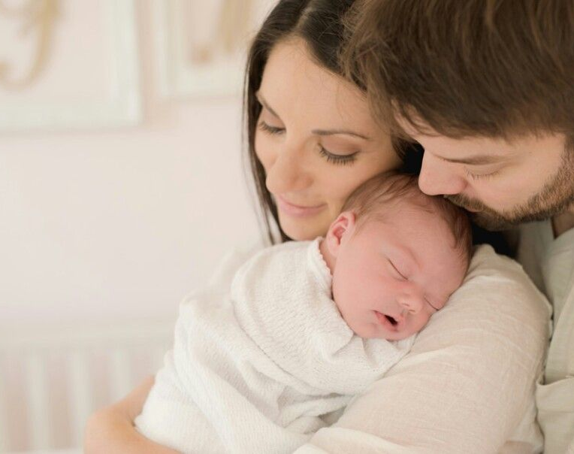
God’s Plan:
that each individual be loved into existence
via the
Marital Act!
Notes:
[Watch video from beginning to 9:50 mark: “Is that a baby?”] January 27, 2021
https://www.youtube.com/watch?v=5kdp2w6FrsY
(from beginning to about 8:24, after “we as a society…”)

Slide 15
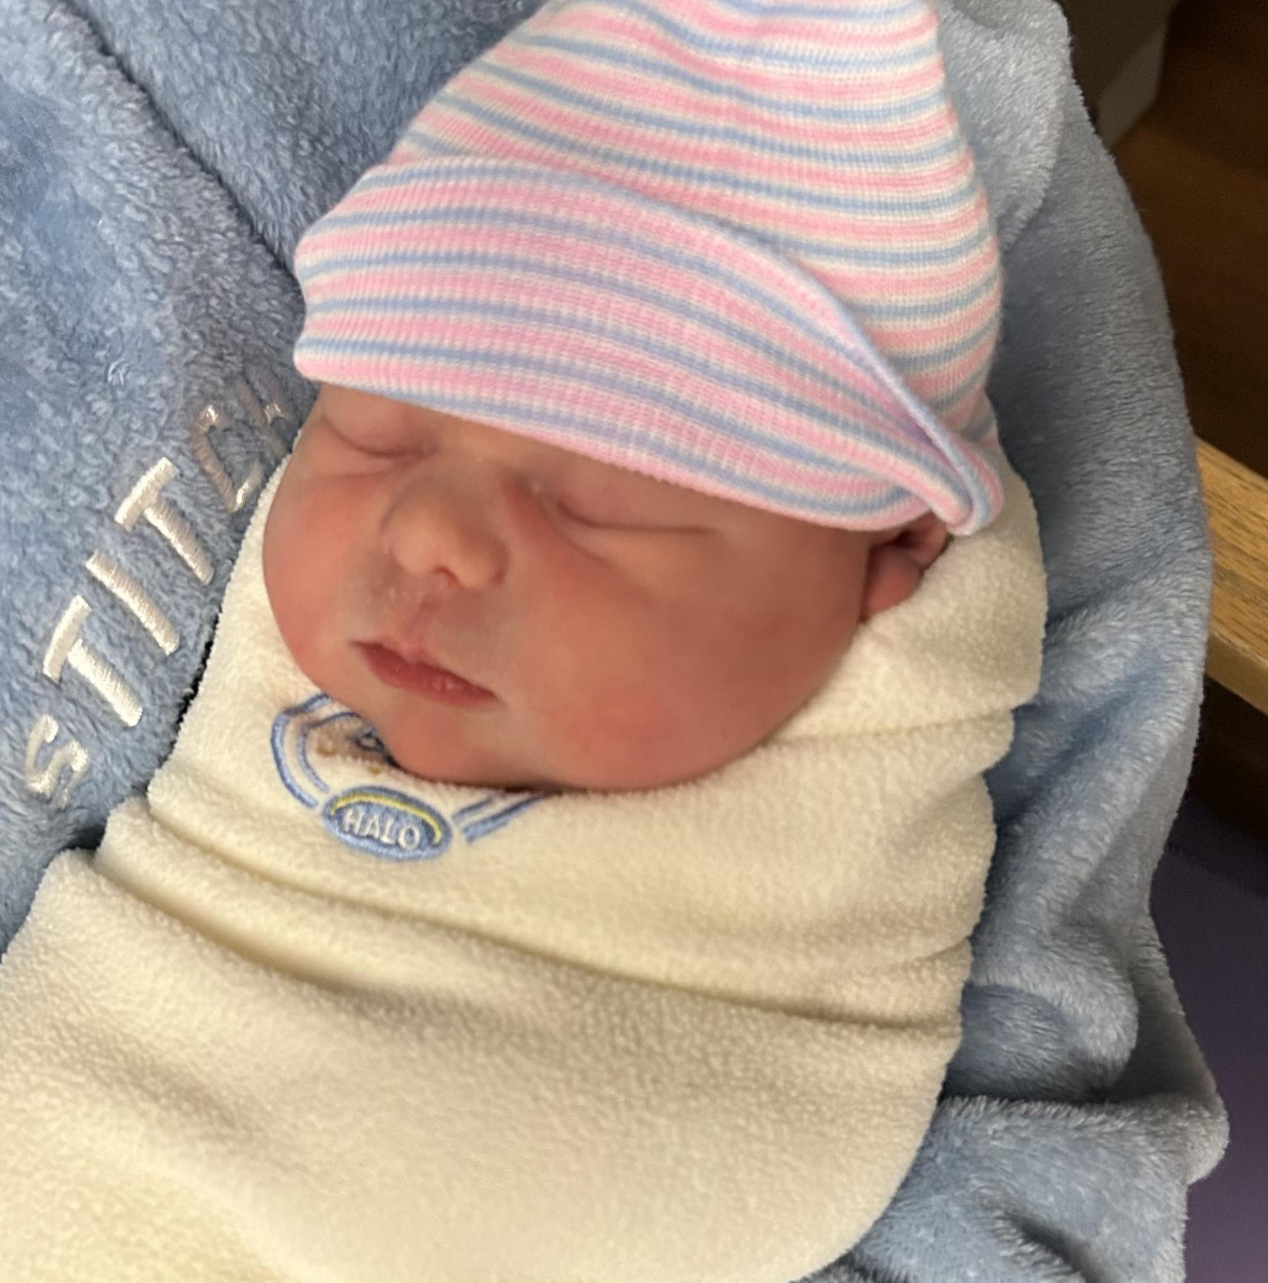

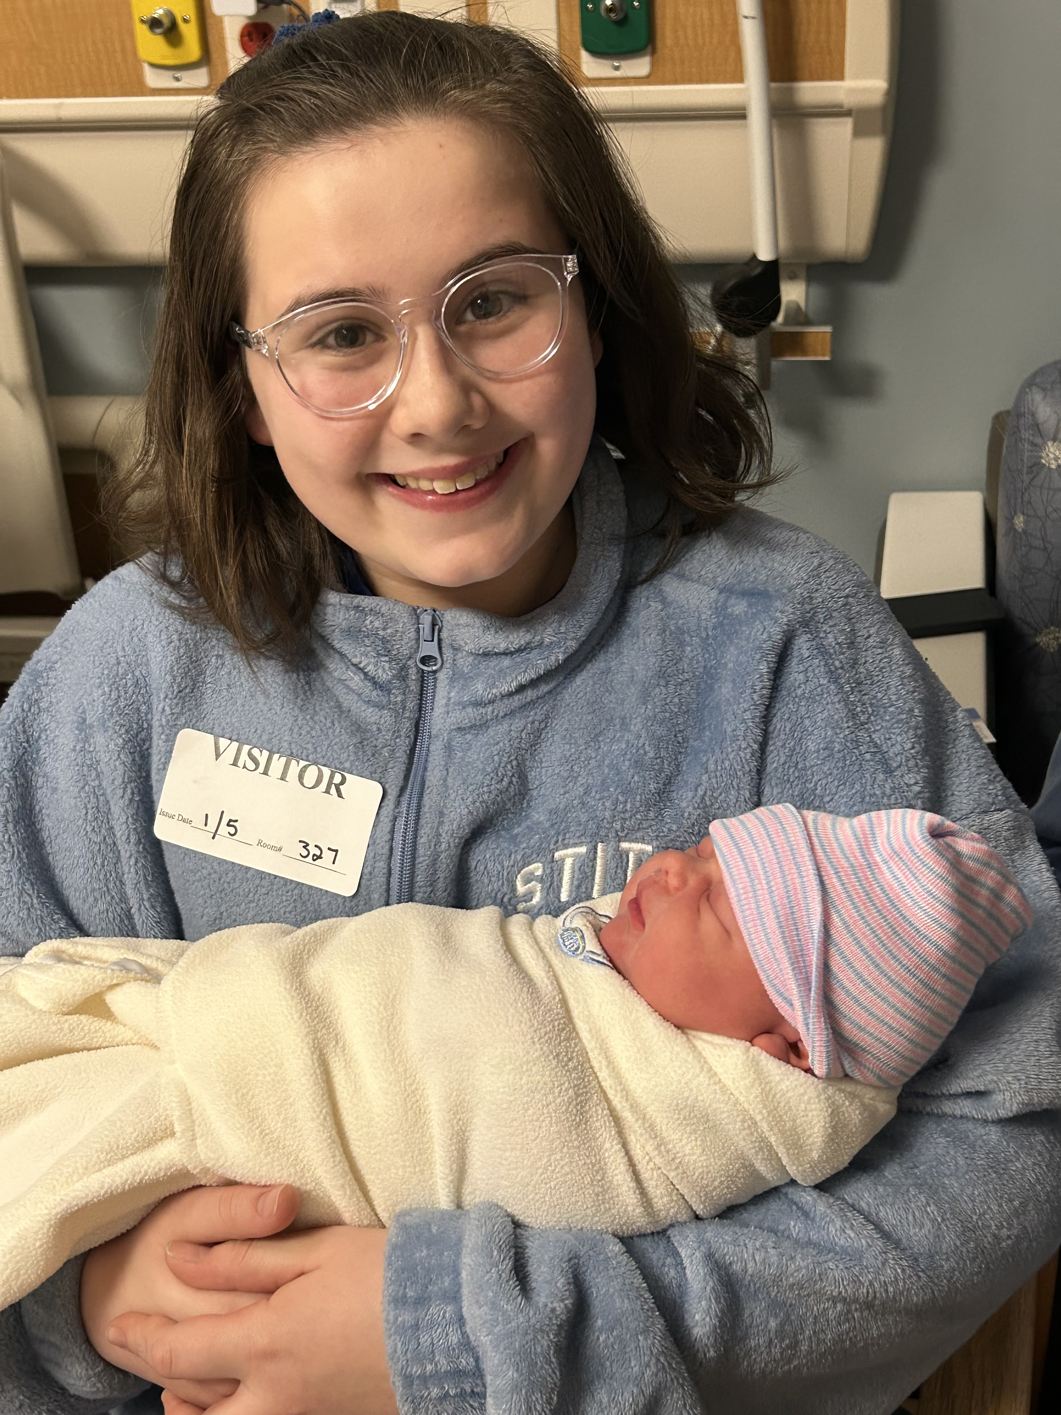
Love with a Name!

Slide 16

The Impact of Abortion on the Mother
Does a post-abortive girl/woman become a “non-mother?”
What about mother/baby bonding?
Notes:
Truth in 90 Seconds - Healing the Culture
https://healingtheculture.org/truth-in-90-seconds/
The impact of each individual abortion is far-reaching.
A woman aborts with the intent of becoming a “non-mother.” The pain hits hardest when she realizes that instead, she has become the mother of a dead child. Yet, there is no child over which to grieve; no body. If and when the family becomes a part of this trauma, they too will be changed.
The Miraculous Bond Between Mother and Child| National Catholic Register (ncregister.com)

Slide 17
Does Abortion Make a Mother Happy?
https://youtu.be/4odTgbvxk9Y

Slide 18
What About an Abortion to Protect the Mother’s Life?
https://www.youtube.com/watch?v=k5A4OAdml2Q

Slide 19

What about rape and incest?
Is it right to punish the child for the crime of the father?
Do the actions of our parents – good or bad – make us any more or less valuable than people born with different parents?
Notes:
https://healingtheculture.org/truth-in-90-seconds/
And what about rape?
Is it right to punish the child for the crime of his father? Where is justice? How will this bring comfort to the girl who went thru the trauma of a rape and then further trauma from the abortion, and the loss of the child that resulted from it?
Is rape just a physical attack…or does it affect a person’s emotions as well?
Is abortion just a physical attack, or does it affect the mother’s emotions as well?

Slide 20
What about an Abortion in the Case of Rape and Incest?
https://youtu.be/S-3I7O2C-7g

