Slide 1
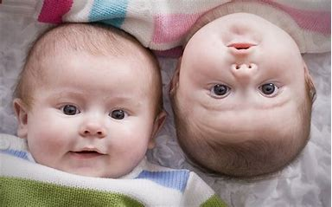
9th Grade Religious Education Class #15
January 21, 2024

Slide 2

“Jesus came with his disciples into the house. Again the crowd gathered, making it impossible for them even to eat. When his relatives heard of this they set out to seize him, for they said, ‘He is out of his mind.’”
(Mark 3: 20-21)

Slide 3
“The scribes who had come down from Jerusalem were saying, ‘Beelzebul is in him’ and , ‘It is through the pince of devils that he casts devils out’….’How can Satan cast out Satan?’ If a kingdom is divided against itself, that kingdom cannot last’.”
(Mark 3: 22-24)

Slide 4


Slide 5
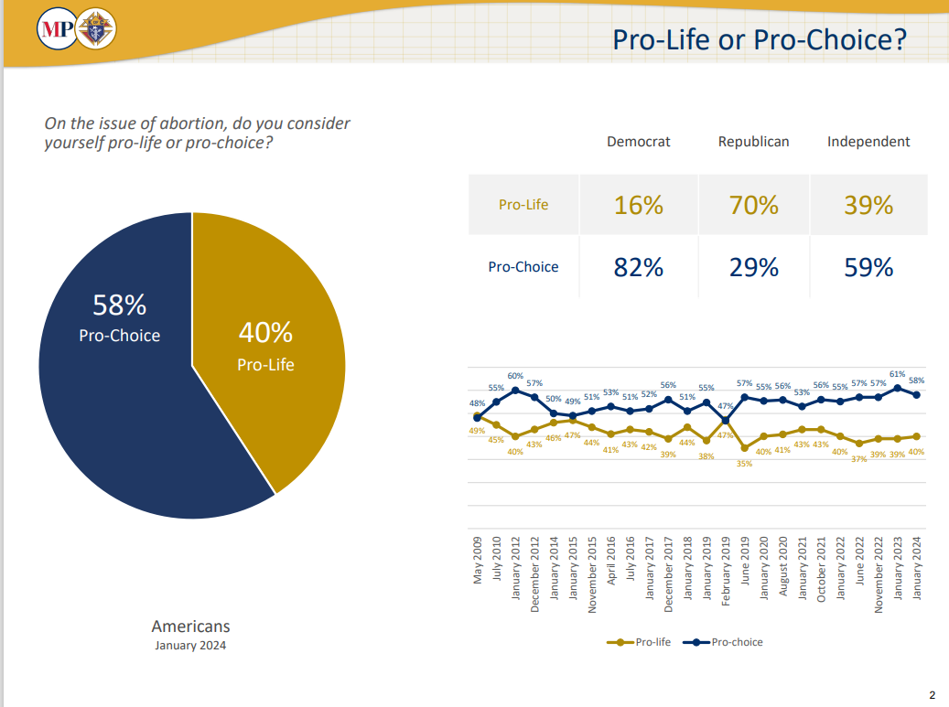

Slide 6
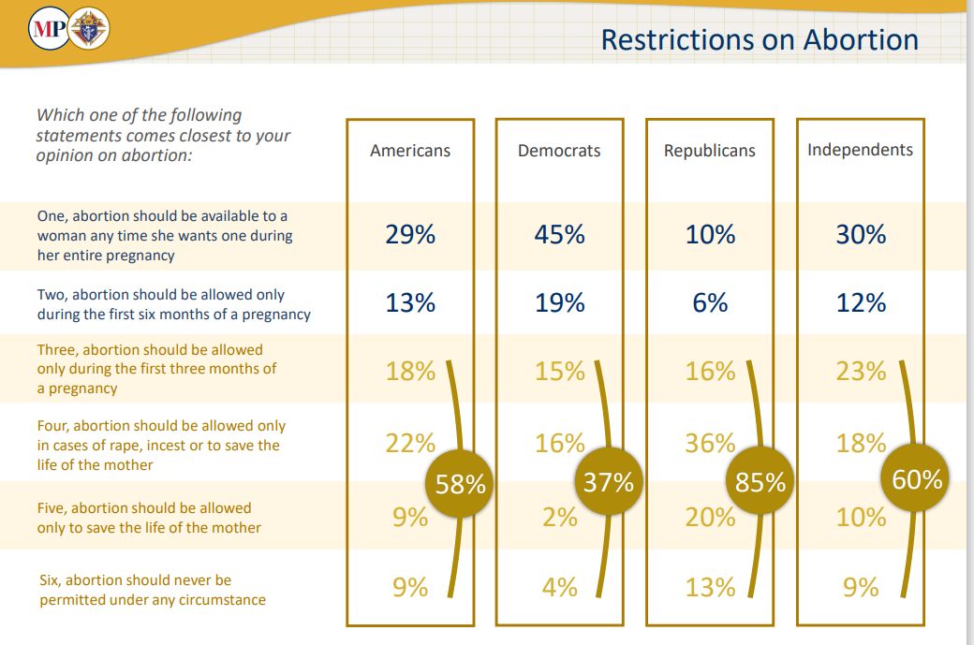

Slide 7
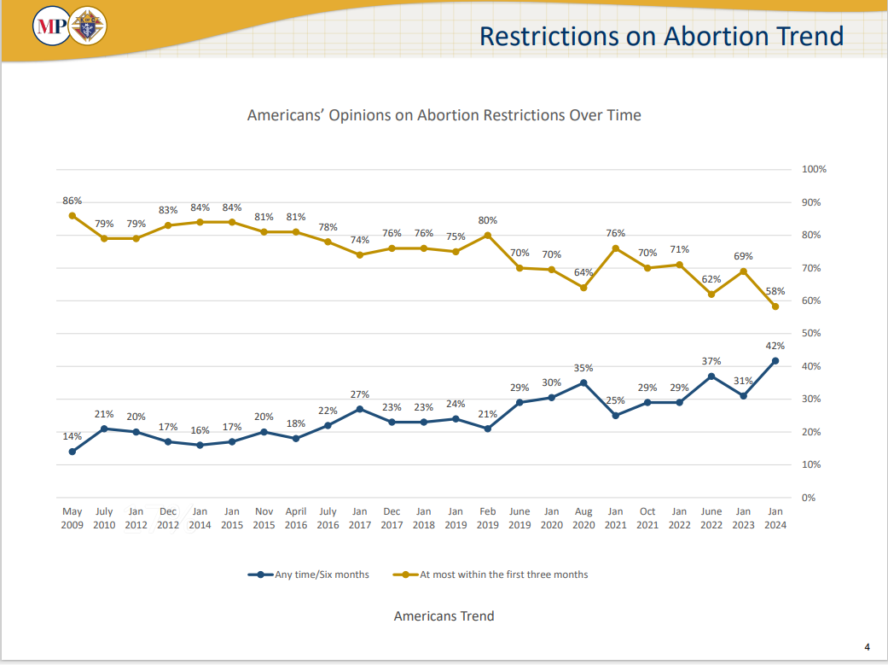

Slide 8

Recent Wall Street Journal Article on Abortion Strategy
In polling by [Angela] Kuefler’s firm, Global Strategy Group, majorities answered “yes” to both “Should we restore the rights we had under Roe v. Wade?” and “Should personal decisions like abortion be up to women rather than the government?” But the latter statement outperformed the former by a whopping 19-point margin, she noted, adding, “It’s the values language that allows us to win by such big margins.”
Notes:
How Abortion-Rights Backers Changed Their Message—and Started Winning - WSJ

Slide 9
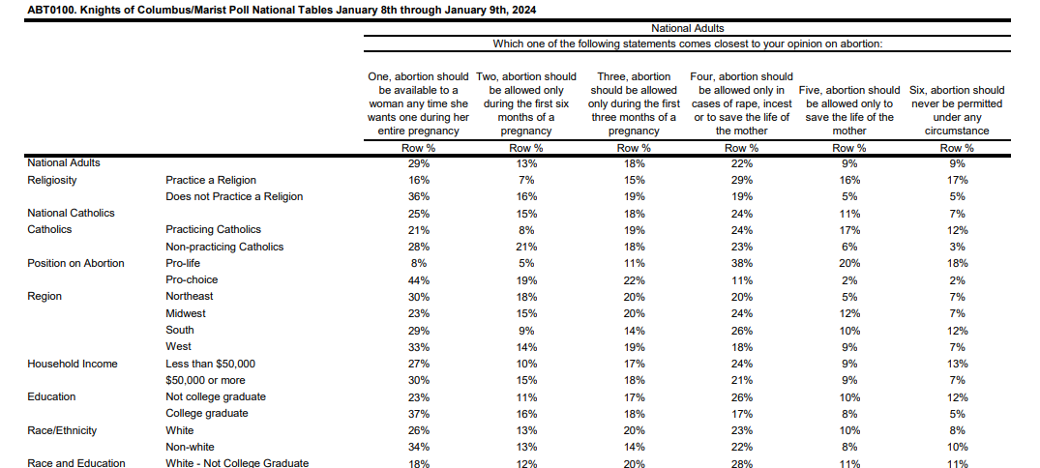

Slide 10
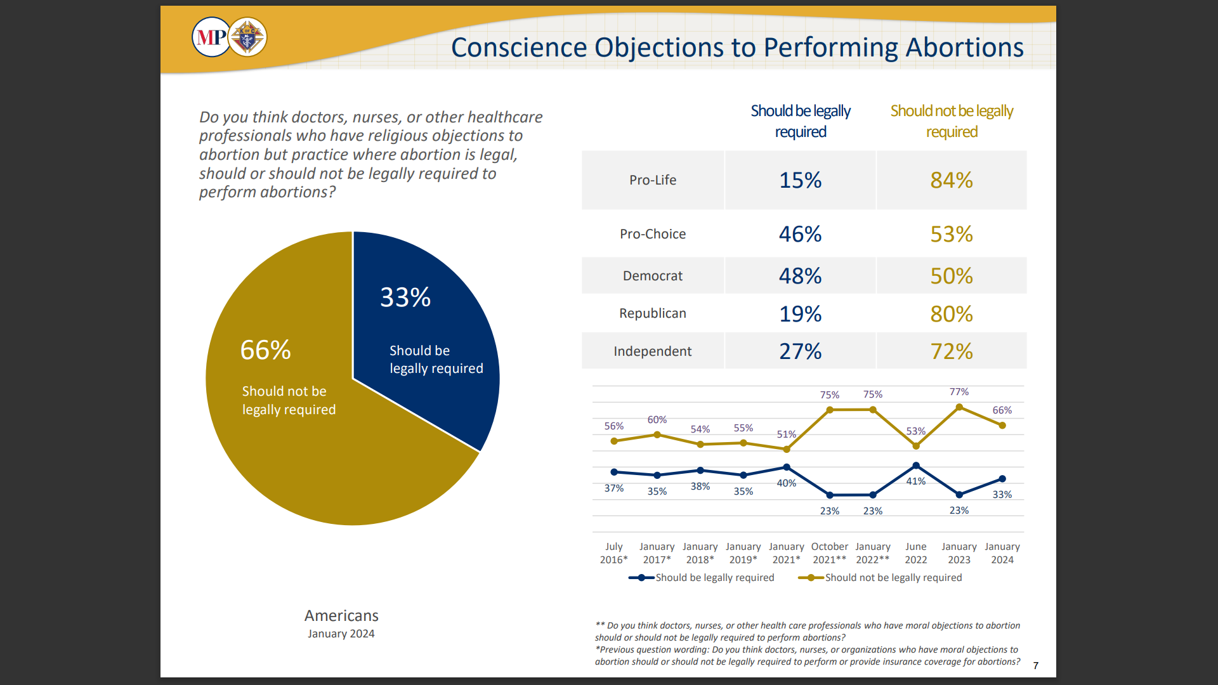

Slide 11
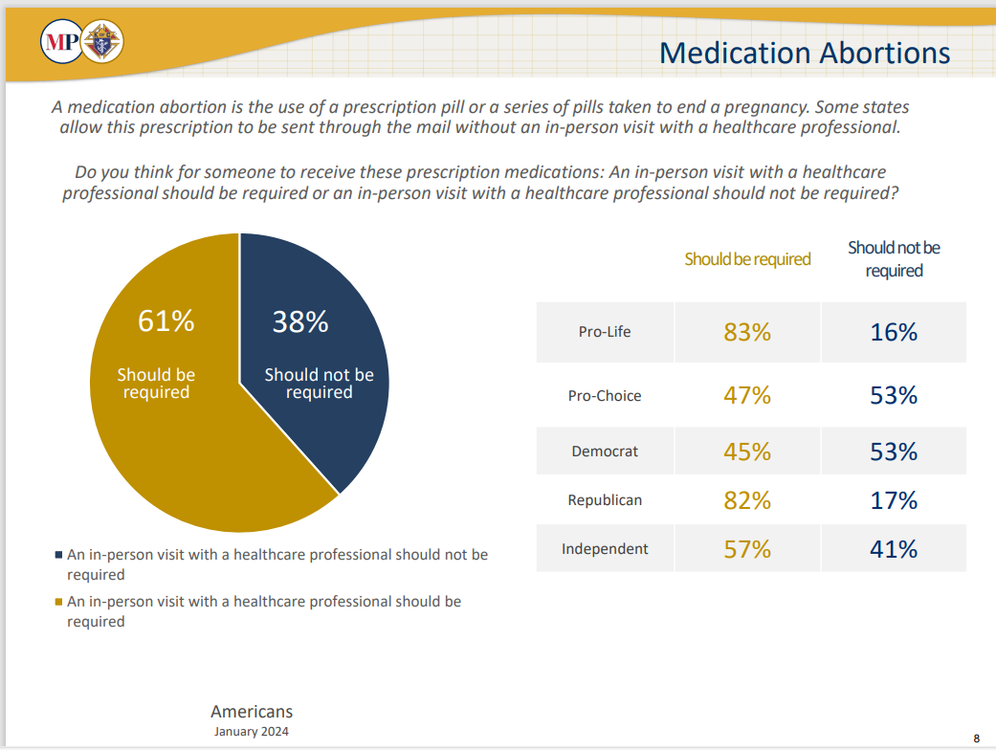

Slide 12
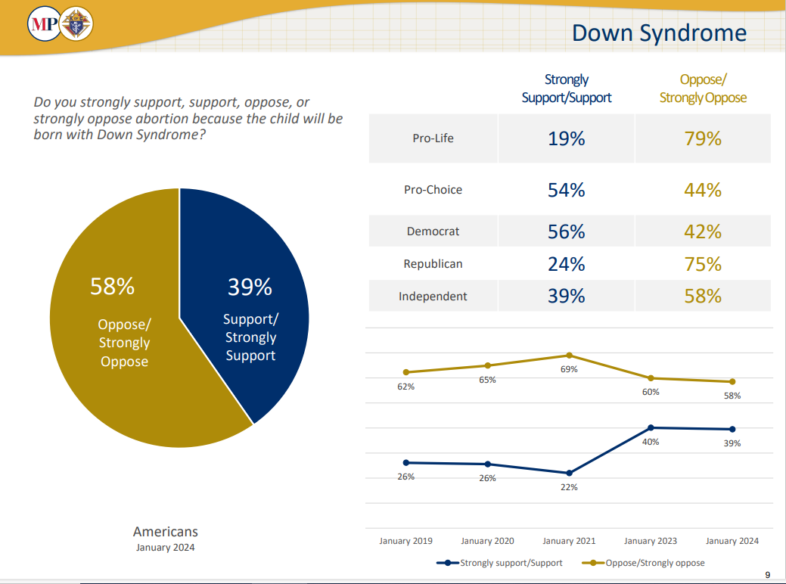

Slide 13
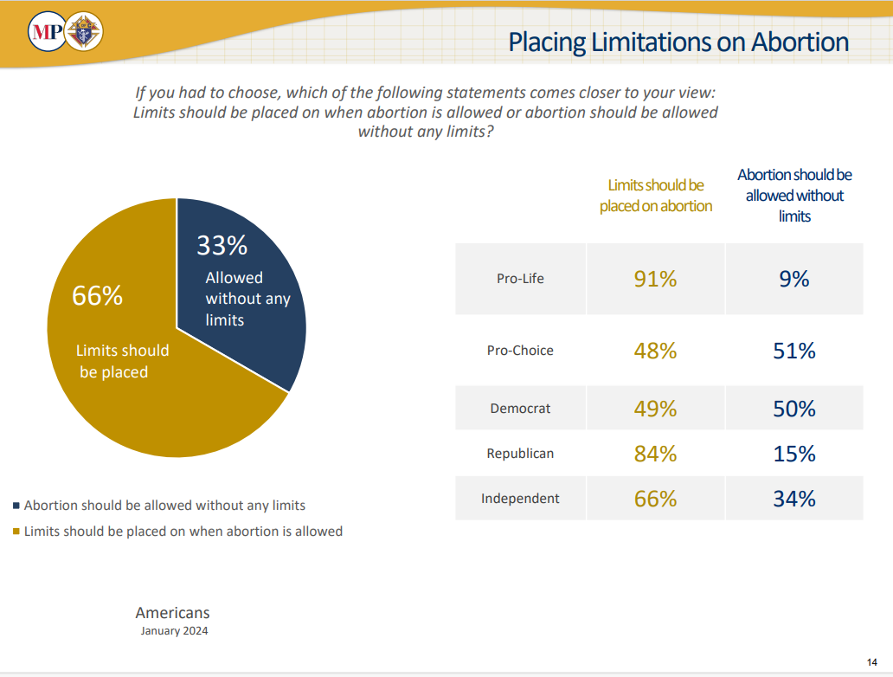

Slide 14

The South Dakota Right to Abortion Amendment
The South Dakota Right to Abortion Amendment may appear on the ballot in South Dakota as an initiated constitutional amendment on November 5, 2024.
The ballot initiative would provide a trimester framework for regulating abortion in the South Dakota Constitution:^{[1]}
During the first trimester of pregnancy, the state would be prohibited from regulating a woman's decision to have an abortion.
During the second trimester of pregnancy, the state may regulate abortion, but "only in ways that are reasonably related to the physical health of the pregnant woman."
During the third trimester of pregnancy, the state may regulate or prohibit abortion, except "when abortion is necessary, in the medical judgment of the woman's physician, to preserve the life and health of the pregnant woman."

Slide 15
The Law of Non-Contradiction
The Unborn Victims of Violence Act of 2004
The Unborn Victims of Violence Act of 2004 (Public Law 108-212) is a United States law that recognizes an embryo or fetus in utero as a legal victim, if they are injured or killed during the commission of any of over 60 listed federal crimes of violence. The law defines "child in utero" as "a member of the species Homo sapiens, at any stage of development, who is carried in the womb."^{[1]}
The law is codified in two sections of the United States Code: Title 18, Chapter 1 (Crimes), §1841 (18 USC 1841) and Title 10, Chapter 22 (Uniform Code of Military Justice) §919a (Article 119a). The law applies only to certain offenses over which the United States government has jurisdiction, including certain crimes committed on federal properties, against certain federal officials and employees, and by members of the military. In addition, it covers certain crimes that are defined by statute as federal offenses wherever they occur, no matter who commits them, such as certain crimes of terrorism. Due to the principles of federalism embodied in the United States Constitution, federal criminal law does not apply to crimes prosecuted by the individual U.S. states, although 38 states also recognize the fetus or "unborn child" as a crime victim, at least for purposes of homicide or feticide.^{[2]}

Slide 16
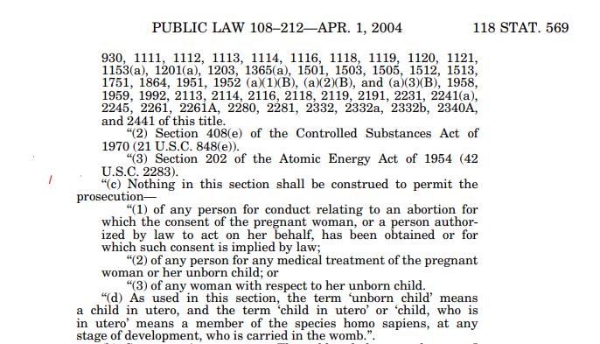
The Unborn Victims of Violence Act of 2004
How Abortion-Rights Backers Changed Their Message—and Started Winning - WSJ

Slide 17
Ohio’s New Abortion Constitutional Amendment
A. Every individual has a right to make and carry out one’s own reproductive decisions, including but not limited to decisions on:
contraception;
fertility treatment;
continuing one’s own pregnancy;
miscarriage care;
and abortion.
Article I, Section 22.
The Right to Reproductive Freedom with Protections for Health and Safety

Slide 18
Ohio’s New Abortion Constitutional Amendment
Article I, Section 22.
The Right to Reproductive Freedom with Protections for Health and Safety
B. The State shall not, directly or indirectly, burden, penalize, prohibit, interfere with, or discriminate against either:
An individual's voluntary exercise of this right or;
A person or entity that assists an individual exercising this right, unless the State demonstrates that it is using the least restrictive means to advance the individual's health in accordance with widely accepted and evidence-based standards of care.
However, abortion may be prohibited after fetal viability.
But in no case may such an abortion be prohibited if in the professional judgment of the pregnant patient’s treating physician it is necessary to protect the pregnant patient’s life or health.

Slide 19
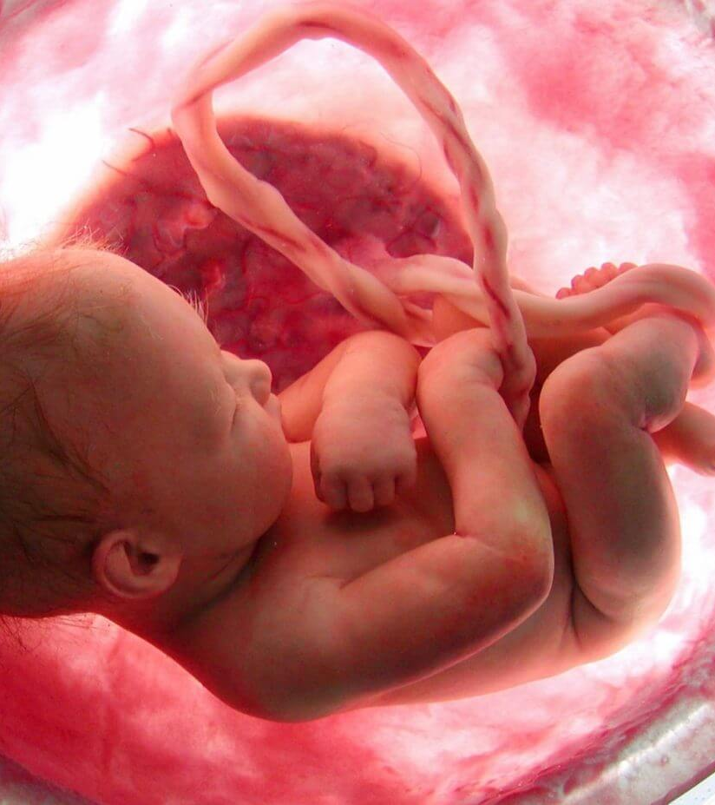
Ohio’s New
Abortion Constitutional Amendment
C. As used in this Section: “Fetal viability” means “the point in a pregnancy when, in the professional judgment of the pregnant patient's treating physician, the fetus has a
significant likelihood of survival outside the uterus with reasonable measures. This is determined on a case-by-case basis.”
“State” includes any governmental entity and any political subdivision.

Slide 20

“…when it is not possible to overturn or completely abrogate a pro-abortion law, an elected official, whose absolute personal opposition to procured abortion was well known, could licitly support proposals aimed at limiting the harm done by such a law and at lessening its negative consequences at the level of general opinion and public morality. This does not in fact represent an illicit cooperation with an unjust law, but rather a legitimate and proper attempt to limit its evil aspects…” (EV 73)

Slide 21
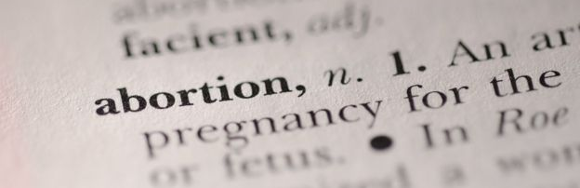

Should We Agree to Disagree on Abortion?
Notes:
https://healingtheculture.org/truth-in-90-seconds/

Slide 22
Should We Agree to Disagree on abortion?
https://youtu.be/nna9IBgFd-w

Slide 23

Impact of Abortion - Father
Loss of paternity
    Failure to protect HIS child and child’s mother
Helplessness
  Unable to prevent death of his child
Anger/aggression
Notes:
NOTE that most girls/women will abort EVEN IF THEY DON’T WANT TO, if the man wants it or remains silent.
NOTE THE MISCOMMUNICATION BETWEEN MALE AND FEMALE HERE:
*Silence from the father of her child is interpreted by the pregnant girl/woman to me he wants her to abort!!
*However, silence from the father of the child usually means he wants to support her decision, or doesn’t want her to abort but doesn’t know how to communicate that since it is HER body that is pregnant.

Slide 24

Impact of Abortion - Family
A “sudden death” in the family
Parents suffer – often in silence – and may become addicted, suicidal, homicidal
Their circle of support is permanently affected
Society applauds mother’s “choice”
Church must pick up the pieces
Notes:
Abortion is a sudden death in a family, and thus causes trauma.
As you saw on a previous slide, our bodies express who we are…we cannot separate our emotions from our physical self. After abortion, a woman’s hormones change…she may have a loss of appetite and become depressed…which in turn can lead to addiction and/or suicidal or homicidal behaviors. [Example: woman who called the Project Rachel office as soon as she got home from her unwanted abortion. She said she had a gun and was going to kill her boyfriend when he arrived and then kill herself. We contacted a suicide hotline and the police, and they arrived in time to stop her. She was very angry with us initially, but contacted us several days later to thank us for helping her grieve that loss of her child…and the loss of the relationship with the boyfriend.
Society will applaud her for exercising her right to choose; they may even offer her counseling – so she can move on with her life. But only the Church can offer her real healing – an opportunity to heal her entire person – physically, spiritually and emotionally.
Church must pick up the pieces.

Slide 25

Make it Personal
Can we agree that if you had been aborted, we would not be having this conversation?
OR
Can we agree that you would not be free to have this discussion if your mother had chosen abortion?
Notes:
“Personal freedom” to choose to take another person’s life, but not “personal freedom” for the other person??
“Forced birth”: What about forced abortions? What about taking responsibility for ones actions – sex leads to the creation of new life….that is natural.
“No one has the right to use another’s body without consent.”
“Consent to sex is NOT consent to pregnancy. Two different actions and both require ongoing consent. You could say that the man agreed to an abortion when he had consensual sex.”
Why is it “barbaric” to give birth to a baby with a fatal abnormality?
“A woman’s right to bodily autonomy and medical privacy.”
Ignorance regarding reality of late term abortions and post birth abortions. Many individuals seriously do not believe women are so cruel as to decide at 9 months to abort; nor do they believe that any medical doctor would so such a thing…they believe this is just a political argument!

Slide 26

Since end of Roe v Wade, abortion advocates reframe arguments as losing freedoms if they lose abortion rights…and people value their freedom; ”govt should not take away our freedoms..”
They further claim that they are the ones “helping families” by letting women use their “freedom” to make their own decisions without others telling them what to do…
Notes:
“Personal freedom” to choose to take another person’s life, but not “personal freedom” for the other person??
“Forced birth”: What about forced abortions? What about taking responsibility for ones actions – sex leads to the creation of new life….that is natural.
“No one has the right to use another’s body without consent.”
“Consent to sex is NOT consent to pregnancy. Two different actions and both require ongoing consent. You could say that the man agreed to an abortion when he had consensual sex.”
Why is it “barbaric” to give birth to a baby with a fatal abnormality?
“A woman’s right to bodily autonomy and medical privacy.”
Ignorance regarding reality of late term abortions and post birth abortions. Many individuals seriously do not believe women are so cruel as to decide at 9 months to abort; nor do they believe that any medical doctor would so such a thing…they believe this is just a political argument!

Slide 27
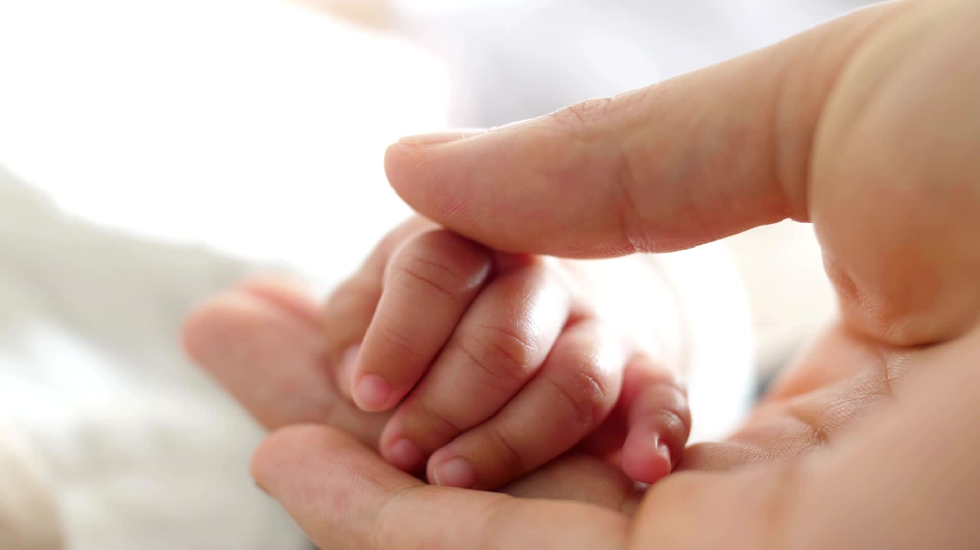

Where is Justice?
Consider the father of the child when the mother chooses to abort…
Consider the difference between abandoning the child before birth and after birth…
Consider the laws for adoption vs. the laws for abortion…
Notes:
*Father cannot legally prevent abortion, but can be held accountable if mother gives birth.
*If a child is abandoned and dies, mother/father prosecuted; but abortionist gets paid a lot of money to kill the child and that is legal.
*In Virginia, a woman cannot sign final papers for adoption until at least 3 days after the baby’s birth, and she has another 7 days in which to change her mind if she decides to mother her baby. HOWEVER, she can make an appointment to abort her child without any waiting period to think it over, get the facts, possibly change her mind.
NOTE: Waiting periods are designed to give the mother time to emotionally and physically recover from childbirth, reflect on her adoption decision, and allow any medications that may potentially could her judgement to leave her system.
Experts have found that separation anxiety (grief, depression, anxiety about whether or not the child was normal and healthy, etc.) was greatest if the child was immediately taken from the mom and placed with adoptive parents. They have noted that it seems to be critical that the mother see her baby, hold him/her if desired, and interact…before signing adoption papers…and yet in VA there is no waiting period for a girl/woman to seriously consider what it will mean for her to give consent for someone she doesn’t know to take the life of her own child.
Where is justice?

Slide 28
Is a Human Being a Human Person?
https://youtu.be/XthCarBDbHM
https://youtu.be/XthChttps://youtu.be/XthCarBDbHMarBDbHMhttps://youtu.be/XthCarBDbHM

Slide 29

Consider this…
Black Americans only make up 12% of the population but they make up over 27% of all abortions. Do you think this is good or bad?
Notes:
Abortion rates by race and ethnicity | Guttmacher Institute
https://www.guttmacher.org/infographic/2017/abortion-rates-race-and-ethnicity

Slide 30
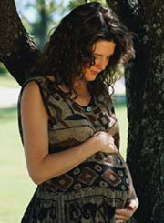
Abortion Hurts
  Cannot hurt the baby without hurting the mother.
  Cannot help the baby without helping the mother.
  Our outreach must be personal.
Notes:
So, the key to ending abortion is recognizing that the welfare of the mother and her unborn child are inseparable.
The fact that abortion hurts women demonstrates that one Cannot hurt the baby without hurting the mother.
The opposite is also true: one cannot help the baby without helping the mother.
Our outreach as Church needs to be “personal”. That’s where we are as a culture. That’s reality.
She must know that she is loved every bit as much as the child she carries. She must internalize her own personal dignity if we expect her to love her unborn with dignity – she cannot give what she herself does not have. She cannot love her child if she does not possess a healthy love of self…

Slide 31
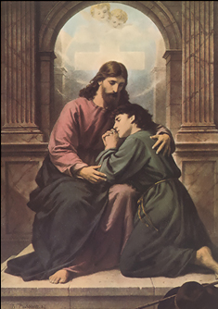
The Bottom Line
  We must be Christ-like:
    Meet each person where they are.
    Lift them up through healing.
    Challenge them to sin no more.
Notes:
We must be Christ-like: Like Christ in the Gospel, we must meet each person individually where they are, lift them up through healing and challenge them to sin no more.

Slide 32
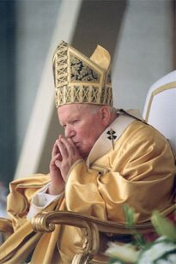
John Paul II’s Message
  “The Church is aware of the many factors which may have influenced your decision, and she does not doubt that in many cases it was a painful and even shattering decision.”
Notes:
Our Holy Father understands this challenge. As Catholic Americans, we need to internalize his message.
First, he reaches out with compassion by acknowledging that there are many reasons why abortion appears to be the solution. In Evangelium Vitae (EV) 99, he writes, “The Church is aware of the many factors which may have influenced your decision, and she does not doubt that in many cases it was a painful and even shattering decision.”

Slide 33
John Paul II’s Message
  “The wound in your heart may not have healed. Certainly what happened was and remains terribly wrong.”
Notes:
Next, he validates their pain, and he even states that it was wrong; but consider the context and wording he very carefully uses: “The wound in your heart may not yet have healed. Certainly what happened was and remains terribly wrong.”

Slide 34
John Paul II’s Message
  “But do not give in to discouragement and do not lose hope. Try rather to understand what happened and face it honestly.”
Notes:
He then very skillfully offers them hope and invites them to repent: “But do not give in to discouragement and do not lose hope. Try rather to understand what happened and face it honestly.”

Slide 35
John Paul II’s Message
  “If you have not already done so, give yourselves over with humility and trust to repentance. The Father of mercies is ready to give you his forgiveness and his peace in the Sacrament of Reconciliation.”
Notes:
If you have not already done so, give yourselves over with humility and trust to repentance. The Father of mercies is ready to give you his forgiveness and his peace in the Sacrament of Reconciliation.”

Slide 36
John Paul II’s Message
  “To the same Father and to His mercy you can with sure hope entrust your child.”
Notes:
He then restores their motherhood to them: “To the same Father and to his mercy you can with sure hope entrust your child.”
By restoring her motherhood, he has just given her back her own personhood as well – her own dignity.

Slide 37
John Paul II’s Message
  “With the friendly and expert help and advice of other people, and as a result of your own painful experience, you can be among the most eloquent defenders of everyone’s right to life.”
Notes:
Now, he challenges her to seek healing and to become a defender of life herself. In other words, he meets her in her brokenness – in her sinfulness; offers her hope and healing; and challenges her to go out and do likewise – to “sin no more.” In his words, “With the friendly and expert help and advice of other people, and as a result of your own painful experience, you can be among the most eloquent defenders of everyone’s right to life.”

