Slide 1
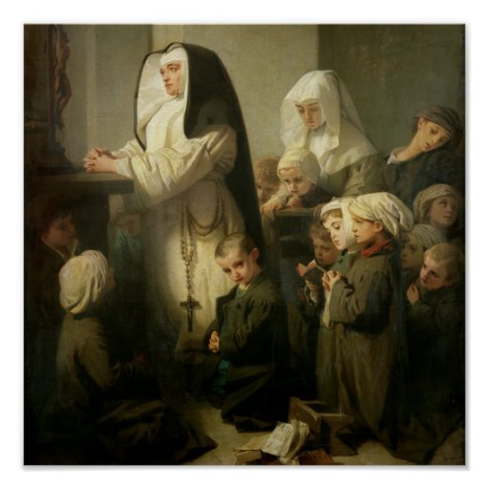
Ninth Grade
Religious Education Class #11
December 3, 2023
Prayer and Suffering
The dog in the photo was trained to identify life after earthquakes. His posture and the fact of staying fixed as seen in the image is the posture that tells the rescuer that there is life in that place. And look at nothing more and nothing less where and in front of who is placed: in front of Jesus as the Eucharistic bread in the tabernacle, the living God among us.

Slide 2
Our Lady of Guadalupe

Slide 3
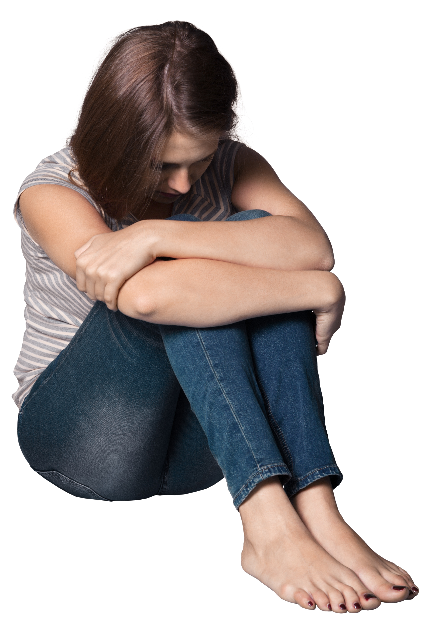
Why Does God Allow Suffering?
The dog in the photo was trained to identify life after earthquakes. His posture and the fact of staying fixed as seen in the image is the posture that tells the rescuer that there is life in that place. And look at nothing more and nothing less where and in front of who is placed: in front of Jesus as the Eucharistic bread in the tabernacle, the living God among us.
Notes:
7E-P7-A_032020 (crediblecatholic.com) (slides: 35-44; 46-83; 85-89)

Slide 4
Suffering and Freedom
“Freedom without choice is a logical contradiction. No choice; no freedom.”
“God is responsible for the fact of freedom. Humans are responsible for their acts of freedom.”

Slide 5
Why Do We Pray?
How Do We Pray?
To Whom Do We Pray?
Where Should We Pray?

Slide 6
Types of Prayer
What are the four types of prayer:
  Prayer of Petition
  Prayer of Intercession
  Prayer of Thanksgiving
  Prayer of Praise

Slide 7
Types of Prayer
Prayer of Petition (CCC 2629 – 2633)
  “Forgiveness, the quest for the Kingdom, and every true need are objects of the prayer of petition.” (CCC 2646)
Prayer of Intercession (CCC 2634 – 2636)
  “Prayer of intercession consists in asking on behalf of another. It knows no boundaries and extends to one’s enemies.” (CCC 2647)
Prayer of Thanksgiving (CCC 2637 – 2638)
  “Every joy and suffering, every event and need can become the matter for thanksgiving…” (CCC 2648)
Prayer of Praise (CCC 2639 – 2643)
  “Prayer of praise is entirely disinterested and rises to God, lauds him, and gives him glory for his own sake, quite beyond what he has done, but simply because HE IS.” (CCC 2649)

Slide 8
Prayer – Our Father
Our Father, who art in heaven,
Hallowed be Thy Name;
Thy kingdom come,
Thy will be done on earth as it is in heaven.
Give us this day our daily bread,
And forgive us our trespasses,
As we forgive those who trespass against us;
And lead us not into temptation,
But deliver us from evil.
Amen

Slide 9
Spontaneous Prayers in
Times of Suffering
“Lord, help me.”
“Abba, Father, all things are possible to you; remove this chalice from me; yet not what I will, but what you will” (Mk 14:36).
”Lord, do not let any of this suffering go to waste; make optimal good come out of it for me, others and Your Kingdom.”
”Lord, snatch victory from the jaws of defeat.”
“I give up – You take care of it.”
“Lord, push back this darkness and foreboding.”
“Lord, You are the just, wise, and merciful Judge – You take care of it.”
“Thank You.”

Slide 10
Spontaneous Prayers in Times of Suffering
“God, be merciful to me a sinner!” (Lk 18:13).
“Lord, save me” (Mt 14:30).
”Lord, I accept your forgiveness.”
“Lord, I will try with all my heart to walk in Your light and love.”
“Lord, make good come out of whatever harm I might have caused.”
“Thy loving will be done.”

Slide 11
The Origin and Meaning of Christmas Traditions
The Christmas Tree
Wreaths
Holly and Holly Tree
Lights and Candles
The Star
The poinsettia
Christmas bells
The giving of gifts
Santa Clause

