Slide 1
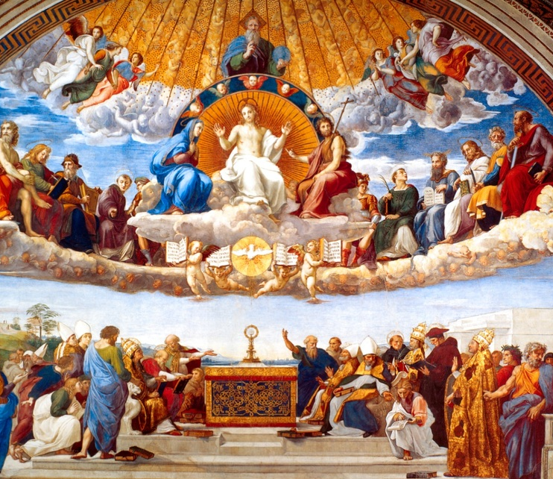
Ninth Grade CCD
Class #7
October 29, 2023
St. Raymond of Peñafort
Catholic Church

Slide 2
What is
All Saints Day?

Slide 3

What is
All Souls Day?

Slide 4
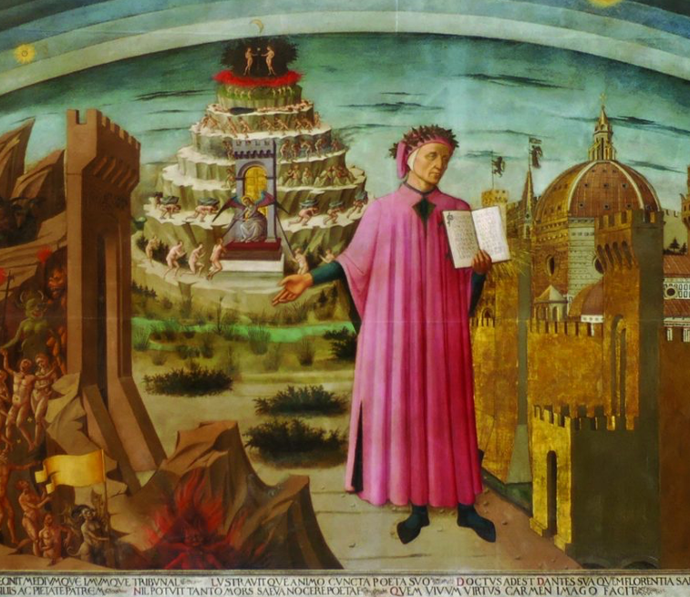
Midway in the journey of our life
I came to myself in a dark wood, for the straight way was lost.
Ah, how hard it is to tell the nature of that wood, savage, dense and harsh – the very thought of it renews my fear!
It is so bitter death is hardly more so.
But I set forth the good I found
I will recount the other things I saw.
How I came there I cannot really tell,
I was so full of sleep when I forsook the one true way.
Notes:
Dante wakes up to his predicament – he’s lost in a dark wood. As he soon discovers, he’s going to have to make a trip to the very bottom of Hell in order to understand the things that are keeping him from a life of virtue and holiness. He escapes from hell on to Purgatorio – we’ll see how sins are purged and virtues developed, and then in Paradiso, how the expansion of vision and the soul make us capable of the Beatific Vision.

Slide 5
Dante’s Divine Comedy

Slide 6
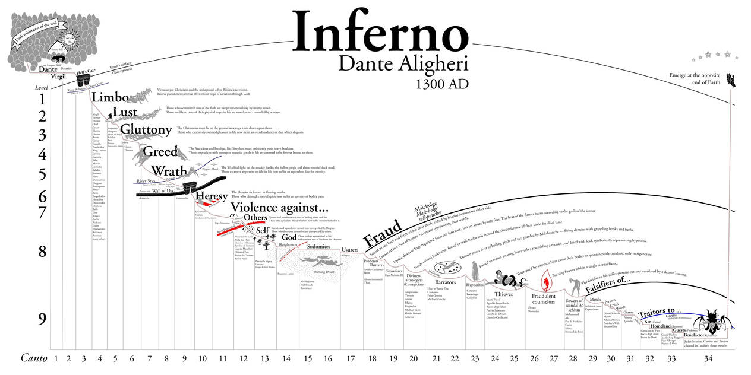

Slide 7
Seven Deadly Sins
Pride (an exaggerated opinion of oneself)
Avarice/Greed (uncontrolled desire for earthly things, such as money, clothes, etc.)
Envy (unhappiness or discontent over the good fortune or success of others)
Wrath/Anger (an uncontrolled feeling of displeasure and antagonism)
Lust (an uncontrolled desire for sexual pleasure)
Gluttony (an uncontrolled use of food and drink)
Sloth (laziness or carelessness in doing right and practicing virtue because of the work and effort needed to do so)

Slide 8
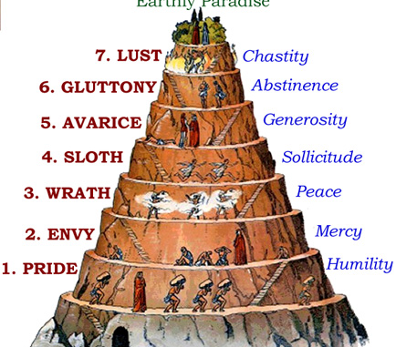
Dante’s Divine Comedy - Purgatory

Slide 9

How do we avoid these sins? Is this what we really want?

Slide 10
Ultimately, what is it that we really desire?

Slide 11
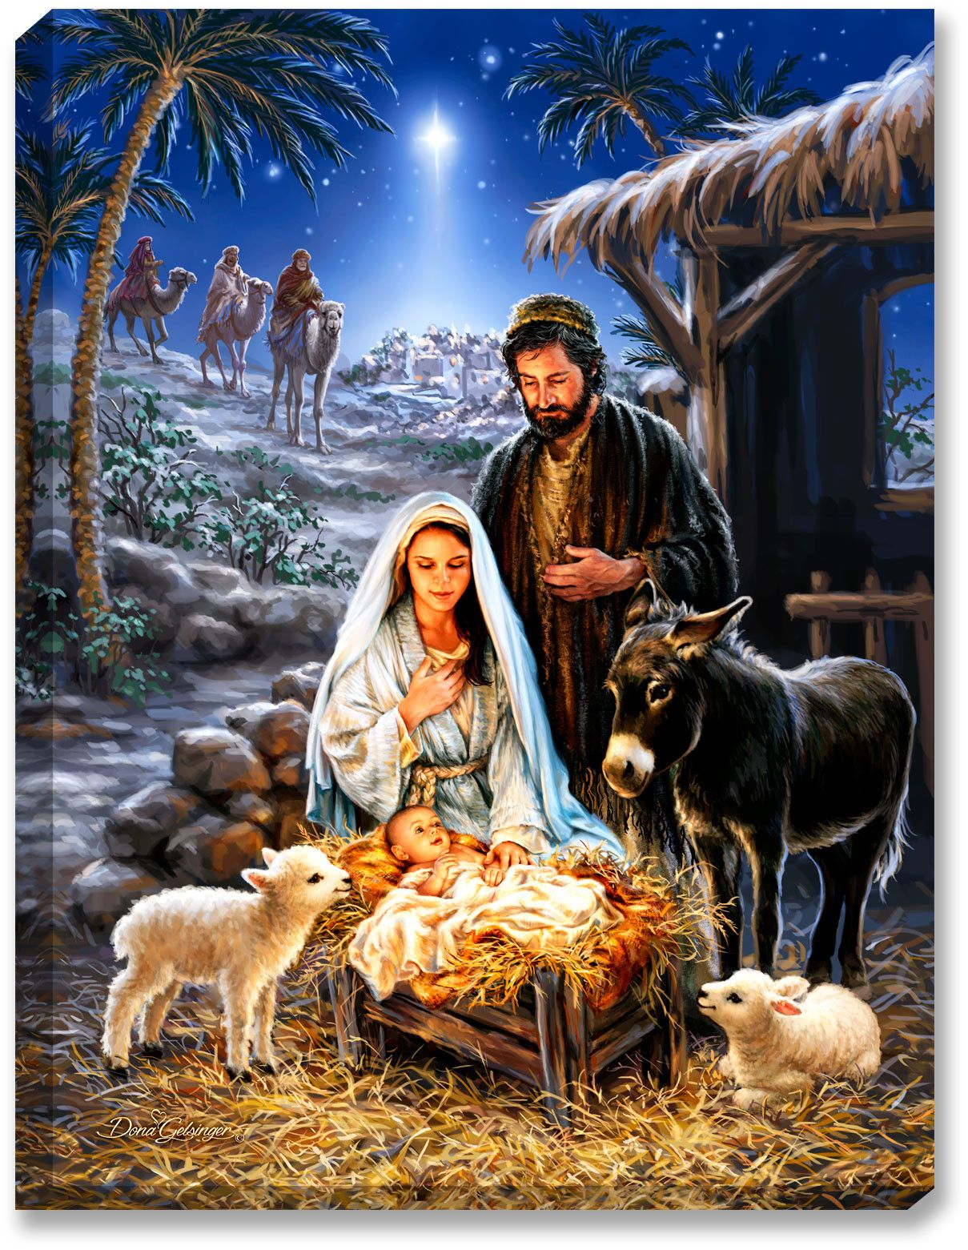
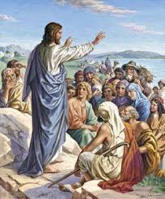
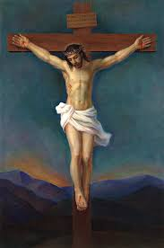



How Do We Know How God Acts?
Notes:
Play Father De Celles’ homily from today’s 9:00 a.m. Mass. Begin at 24:00 and end at 41:45.
VIEW MASS ONLINE - Saint Raymond of Penafort Catholic Church (straymonds.org)

Slide 12
Four Levels of Love
Love Level I – Love makes me feel good.
  Focuses on the physical. Love is a positive feeling. I love my dog because he is cute.
Love Level II – Love makes me feel good about myself.
  Love is equated with being admired. ”I love you because you think I’m pretty, talented, smart, strong.”
  I love it when I am recognized for an achievement.

Slide 13
Four Levels of Love
Love Level III – I love you more than I love myself.
  I put others’ needs in front of my own.
  I did the dishes without being asked because I could see my mother was tired.

Slide 14
Four Levels of Love
Love Level IV – Love sees the image of God in every person.
  We recognize that every person was made in the image and likeness of God.
  God manifested Himself as a human person in Jesus Christ.
  Jesus Christ’s life can be reduced to one four-letter word: “LOVE!”
  We are called to imitate Jesus by…
  Loving every person as if they were Jesus.

Slide 15
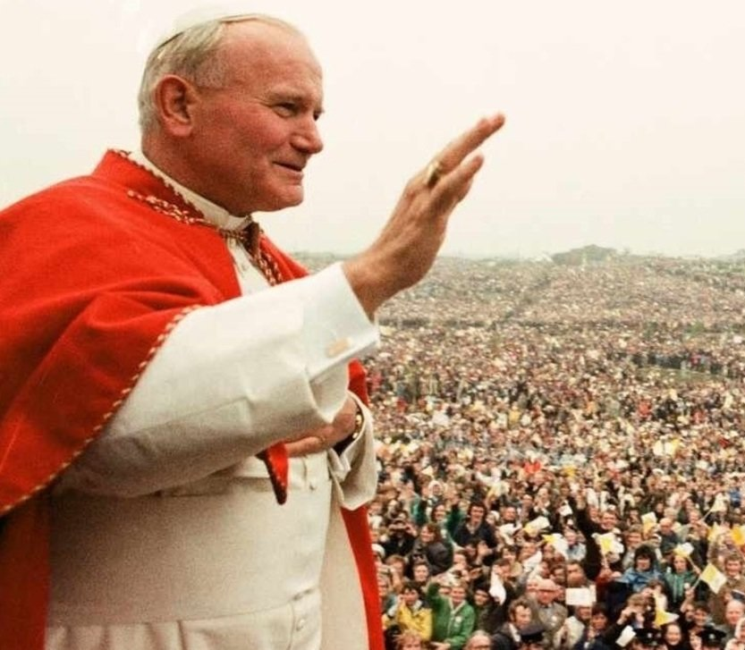
HAPPINESS
“It is Jesus that you seek when you dream of happiness…He is waiting for you when nothing else you find satisfies you; He is the beauty to which you are so attracted…It is He who reads in your hearts your most genuine choices, the choices that others try to stifle.”

Slide 16

Levels of Happiness
Notes:
https://www.crediblecatholic.com/12ppt/7E-P6-A/

Slide 17
Seven Deadly Sins
Pride (an exaggerated opinion of oneself)
Avarice/Greed (uncontrolled desire for earthly things, such as money, clothes, etc.)
Envy (unhappiness or discontent over the good fortune or success of others)
Wrath/Anger (an uncontrolled feeling of displeasure and antagonism)
Lust (an uncontrolled desire for sexual pleasure)
Gluttony (an uncontrolled use of food and drink)
Sloth (laziness or carelessness in doing right and practicing virtue because of the work and effort needed to do so)

Slide 18
Dante’s Divine Comedy - Purgatory

Slide 19
The Levels of Happiness vs.
The Seven Deadly Sins
Deadly Sins
Levels of Happiness
Pride
Avarice/Greed
Envy
Wrath/Anger
Lust
Gluttony
Sloth
I – Physical Pleasure and Material Possessions
II – Ego-Gratification
---------------------------------
III – Contribution and Self-Gift
IV – Faith in God’s Unconditional Love

Slide 20
The Levels of Happiness vs.
Moral Virtues
Virtues
Levels of Happiness
Faith
Hope
Charity
-----------------------------------
Prudence
Justice
Temperance
Fortitude
I – Physical Pleasure and Material Possessions
II – Ego-Gratification
---------------------------------
III – Contribution and Self-Gift
IV – Faith in God’s Unconditional Love

