Slide 1
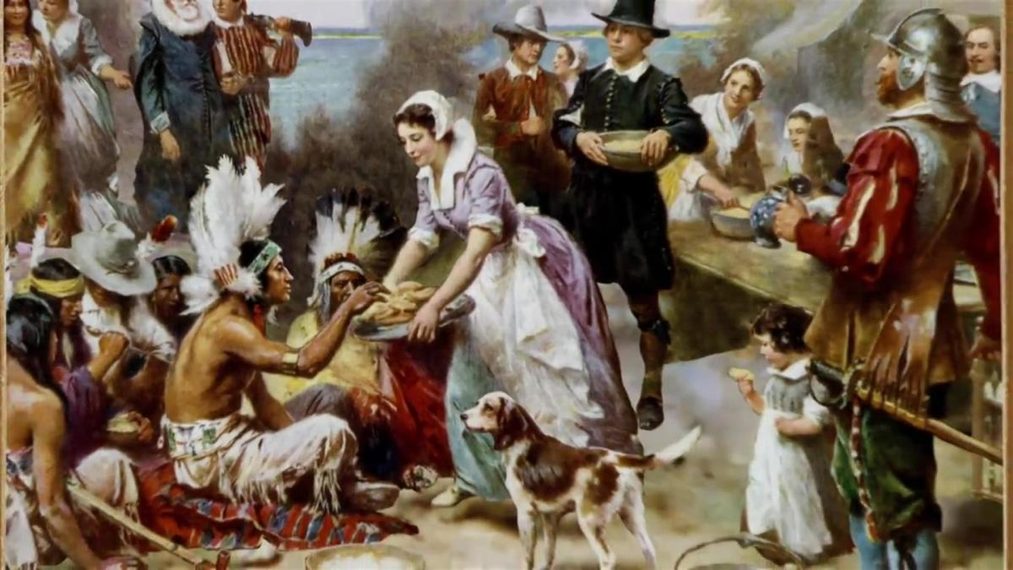
Ninth Grade
Religious Education Class #10
November 19, 2023
The dog in the photo was trained to identify life after earthquakes. His posture and the fact of staying fixed as seen in the image is the posture that tells the rescuer that there is life in that place. And look at nothing more and nothing less where and in front of who is placed: in front of Jesus as the Eucharistic bread in the tabernacle, the living God among us.

Slide 2
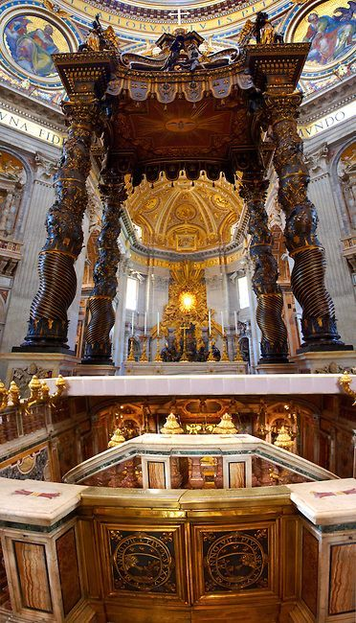
“Peter is Here”
“And I tell you, you are Peter, and on this rock I will build my Church, and the gates of hell shall not prevail against it.” (Matt 16:18)
Notes:
https://www.bing.com/videos/riverview/relatedvideo?&q=scavi+tour+vatican&&mid=313C58A4D11FE5ADB1E5313C58A4D11FE5ADB1E5&&FORM=VRDGAR

Slide 3
“Upon this Rock…”
How can a meteor strike off the Texas Gulf Coast have anything to do with the tomb and bones of St. Peter buried under St. Peter’s Basilica in Rome?
How can a wildcat oilman suddenly become the richest man in the world and then quietly, without anyone knowing about it, fund one of the most intriguing archeological digs in the twentieth century?
How does a pope not “leave well enough alone” but begin digging under a 16th century church just to prove that “Peter is here”?

Slide 4
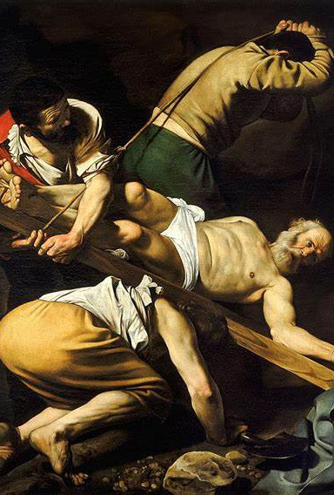
Some Background
July 18-19, 64 AD – the great fire of Rome. Rumor was that Nero wanted to build a large palace for himself and set fire to an area SE of Circus Maximus. Fire got out of control and destroyed most of the city. Nero had to blame someone so he blamed the Christians.
St. Peter was crucified upside down in Rome around 65 AD by Nero. Paul was crucified nearby.
St. Peter’s body was dumped in a landfill but Christians secretly recovered it and buried it on Vatican Hill.
It became a secret place of worship for Christians.

Slide 5
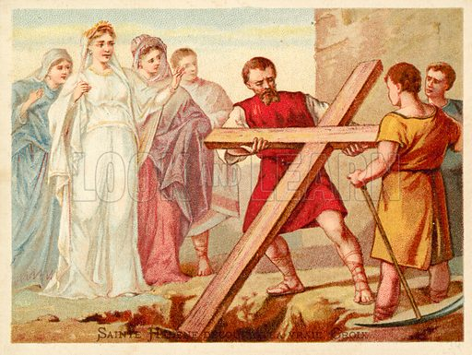
More Background
Christian persecution continued until Roman Emperor Constantine (300-337) rose to power.
Although he was pagan, his mother, Helena, was a devout Christian.
318-322 – He leveled Vatican Hill and allowed a church to be built there over the site of Peter’s tomb. This became known as the Constantine Church. Took about 40 years to build.

Slide 6
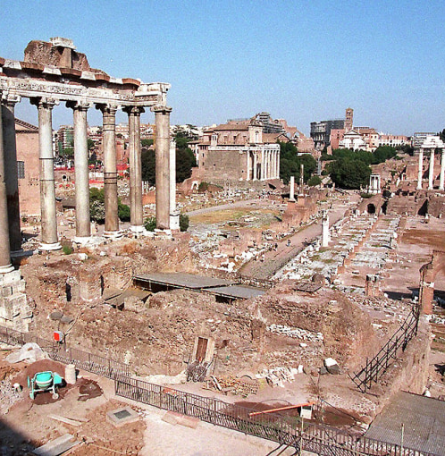
More History
Rome sacked many times throughout history
  410 Visigoth’s
  455 Vandals
  846 Saracens
  1527 Germans
Much of Rome was reduced to ruins (Colosseum half collapsed)
Except – the tombs that were covered to build the Constantine church were preserved intact as they had been in 337

Slide 7
“Upon this Rock…”
How can a meteor strike off the Texas Gulf Coast have anything to do with the tomb and bones of St. Peter buried under St. Peter’s Basilica in Rome?
How can a wildcat oilman suddenly become the richest man in the world and then quietly, without anyone knowing about it, fund one of the most intriguing archeological digs in the twentieth century?
How does a pope not “leave well enough alone” but begin digging under a 16th century church just to prove that “Peter is here”?

Slide 8
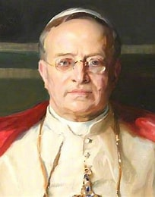
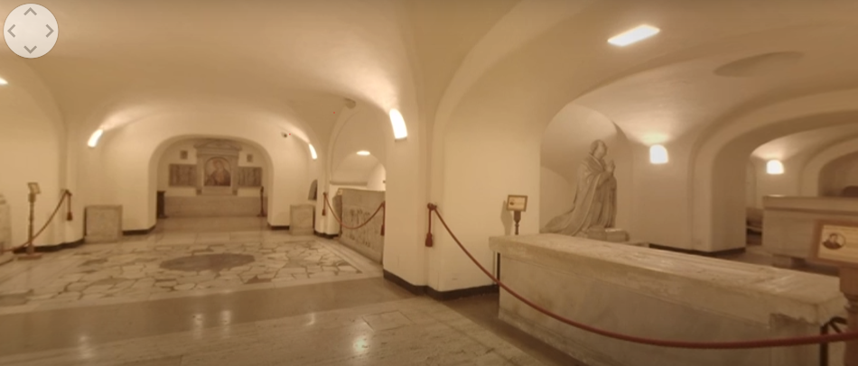
Pope Pius XI (Pope 1922-39)

Slide 9
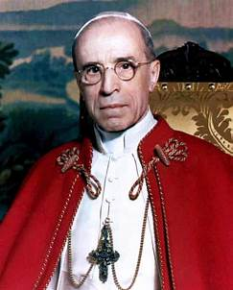
Pope Pius XII (Pope 1939-58)
Succeeded Pius XI and had to bury him.
Grew up in Rome
Was fascinated by stories about the early Roman martyrs
Heard stories that St. Peter was buried beneath the Vatican
Thought that he would check it out.
_________________________________
World War II had just begun
Due to the depression, Church was financially broke.

Slide 10
The Vatican Crypts

Slide 11
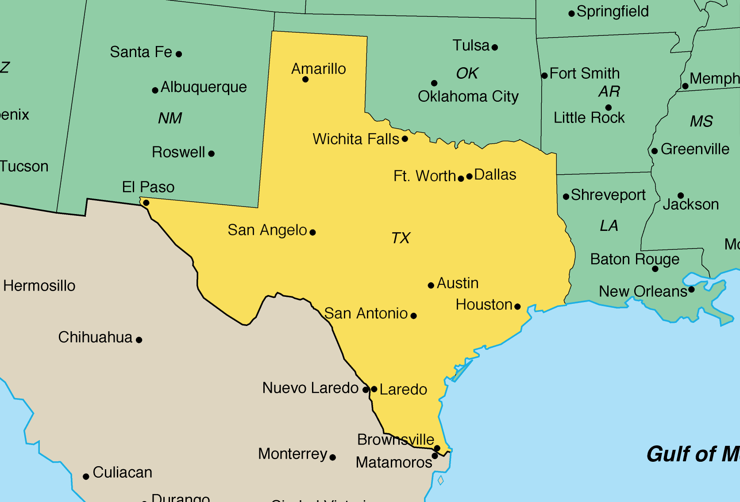
Conroe TX

Slide 12
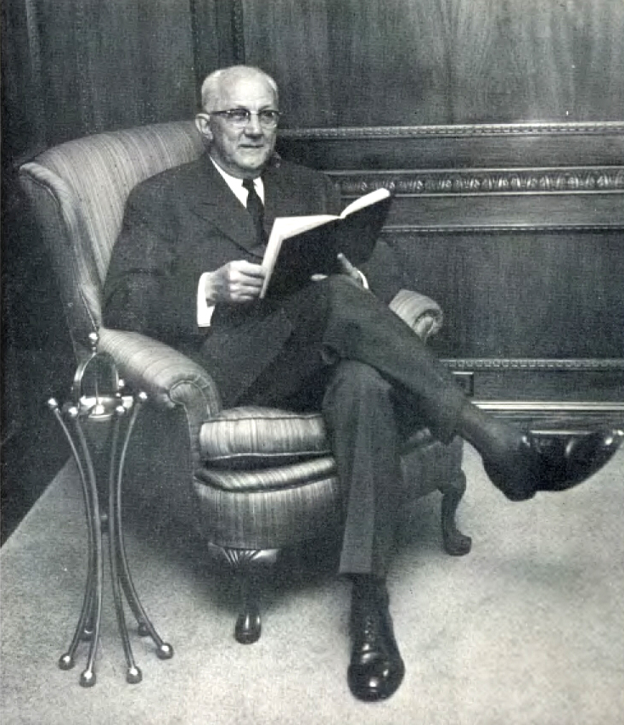
Notes:
Wildcat oilman, devote Catholic, believed that what he had really wasn’t his, but given to him by God to be used for others,

Slide 13
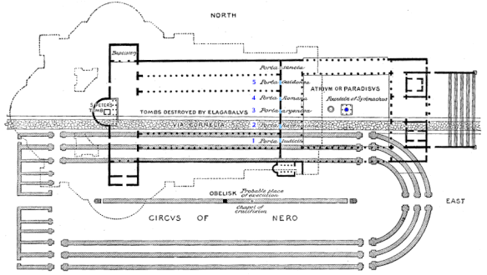

Slide 14
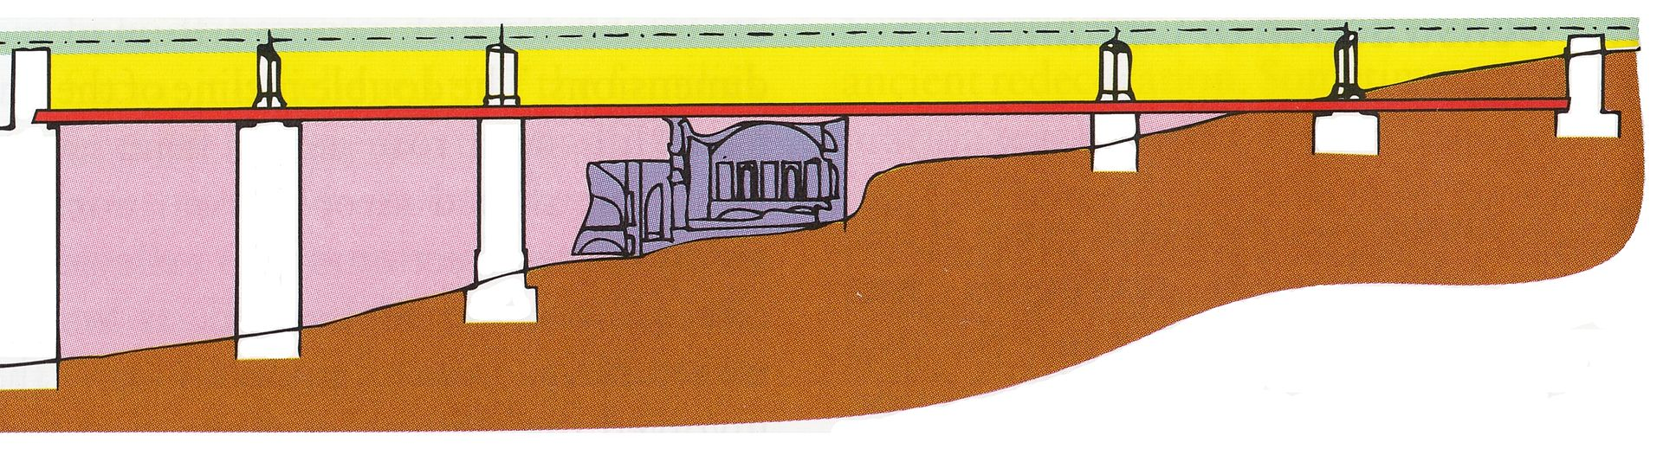

Slide 15
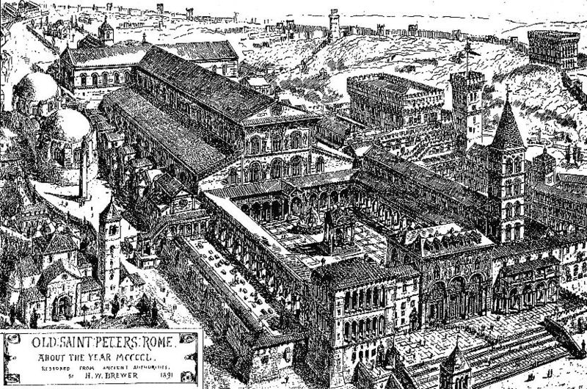
The Constantine Church (Old St. Peter’s) (1450)

Slide 16
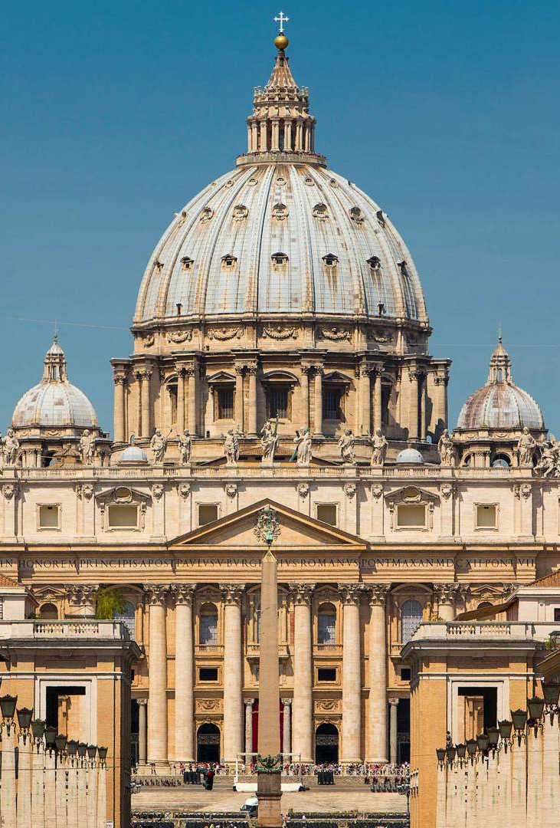
Current Basilica
Construction of the present basilica began on 18 April 1506 and was completed on 18 November 1626.
Designed principally by Donato Bramante, Michelangelo, Carlo Maderno and Gian Lorenzo Bernini.
St. Peter's is the most renowned work of Renaissance architecture and the largest church in the world by interior measure. While it is neither the mother church of the Catholic Church nor the cathedral of the Diocese of Rome (these equivalent titles being held by the Archbasilica of Saint John Lateran in Rome)
It has been described as "holding a unique position in the Christian world“ and as "the greatest of all churches of Christendom."

Slide 17
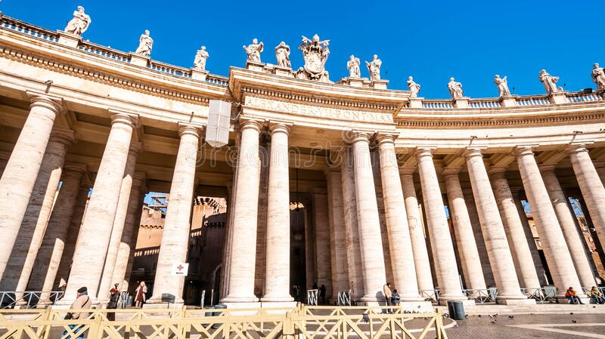
Bernini Columns – Vatican Piazza

Slide 18
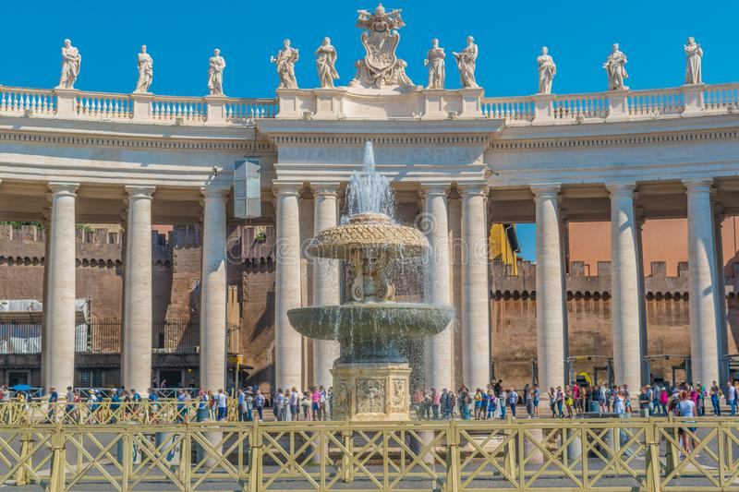
Bernini Columns From the Focal Point

Slide 19
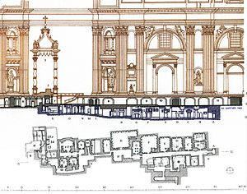
Cutaway
Current St. Peter’s Basilica
Papal Altar
Tomb of St. Peter

Slide 20
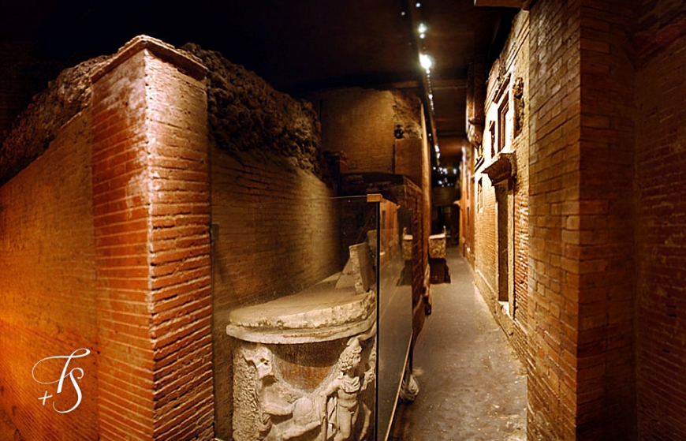

Slide 21
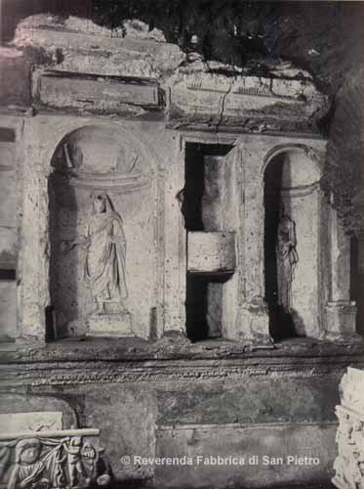
Tomb of Valerii
“Peter, pray for the holy men and women buried near your body.”

Slide 22
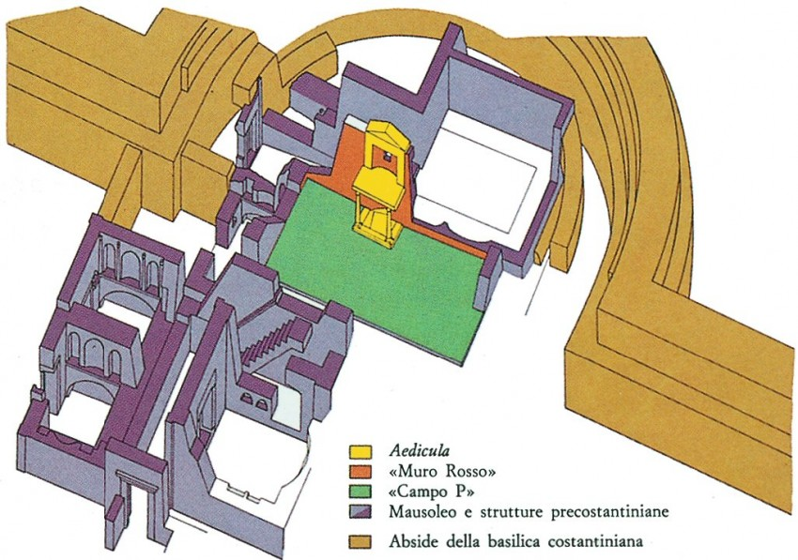
Notes:
Aedicula is a small shrine

Slide 23
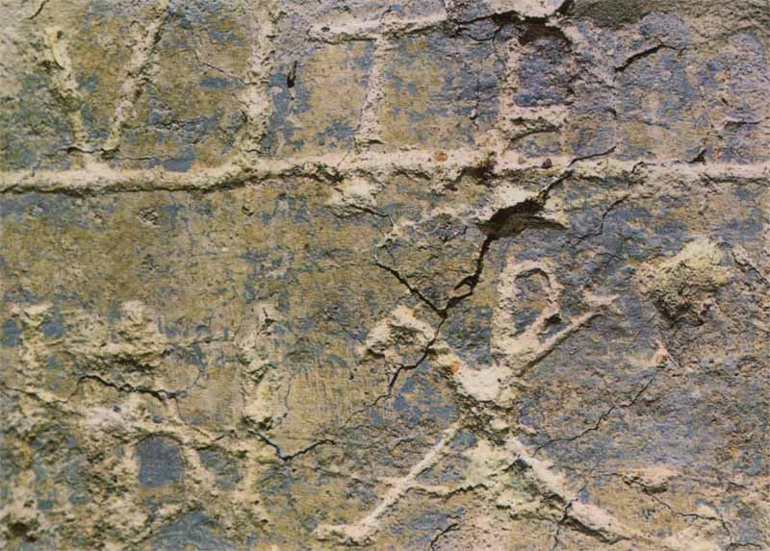
The Graffiti Wall
The significance of the symbol “P” and the symbol “X”.
At the base of the “P” are three lines. When put together, they become a key! “I will give you the keys to the kingdom of heaven.” (Mt. 16:19)
Alpha (Α or α) and omega (Ω or ω).
T symbolizes a cross
V for victory over the cross (resurrection) R
Notes:
https://www.youtube.com/watch?v=hCrSPOd74fI

Slide 24
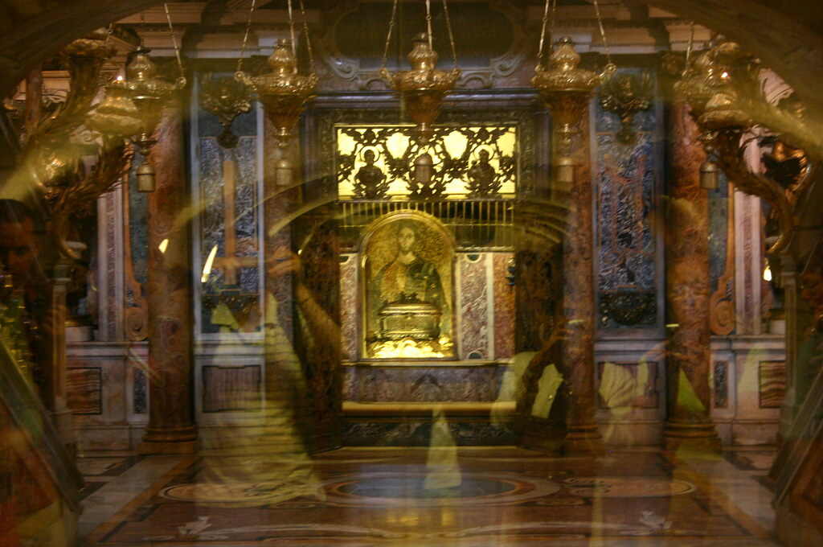

Slide 25
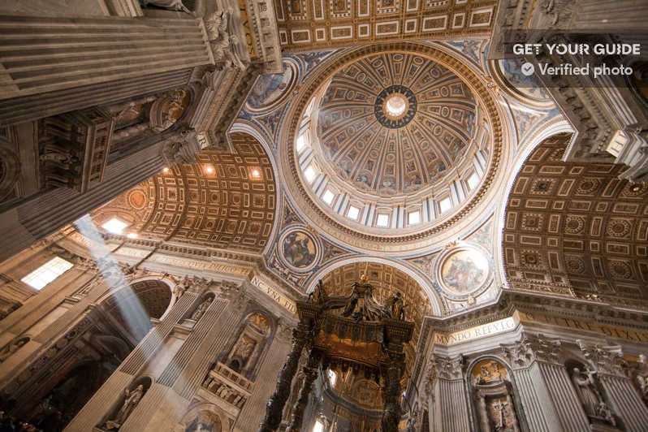

Slide 26
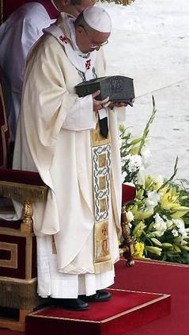

Slide 27
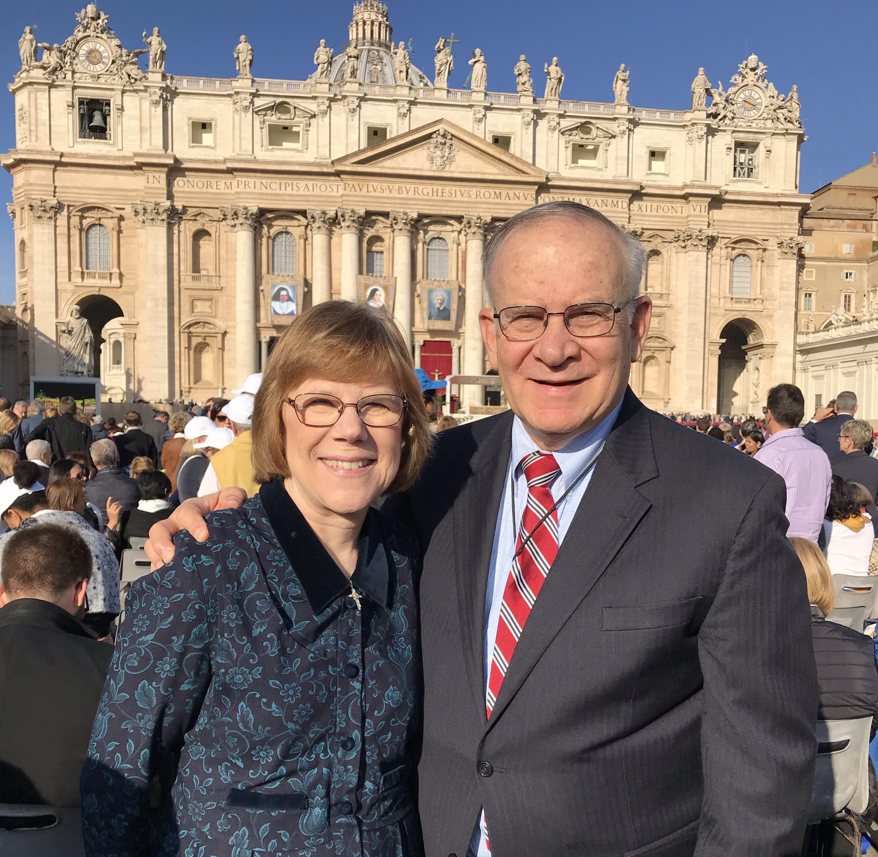
Current St. Peters

Slide 28
“And I tell you, you are Peter, and on this rock I will build my Church, and the gates of hell shall not prevail against it.” (Matt 16:18)
Notes:
https://www.bing.com/videos/riverview/relatedvideo?&q=scavi+tour+vatican&&mid=313C58A4D11FE5ADB1E5313C58A4D11FE5ADB1E5&&FORM=VRDGAR

Slide 29

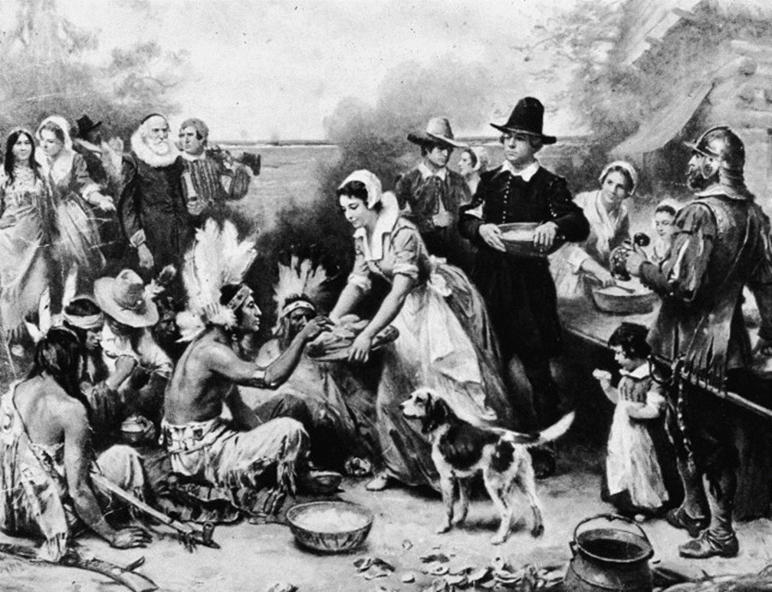
Why Thanksgiving?
Thanks to whom?
Thanks for what?

Slide 30

George Washington’s Thanksgiving Proclamation
WHEREAS it is the duty of all nations to acknowledge the providence of Almighty God, to obey His will, to be grateful for His benefits, and humbly to implore His protection and favor; and Whereas both Houses of Congress have, by their joint committee, requested me "to recommend to the people of the United States a DAY OF PUBLICK THANKSGIVING and PRAYER, to be observed by acknowledging with grateful hearts the many and signal favors of Almighty God, especially by affording them an opportunity peaceably to establish a form of government for their safety and happiness:"

Slide 31
George Washington’s Thanksgiving Proclamation
NOW THEREFORE, I do recommend and assign THURSDAY, the TWENTY-SIXTH DAY of NOVEMBER next, to be devoted by the people of these States to the service of that great and glorious Being who is the beneficent author of all the good …that we may then all unite in rendering unto Him our sincere and humble thanks for His kind care and protection of the people of this country previous to their becoming a nation…for the civil and religious liberty with which we are blessed…and, in general, for all the great and various favors which He has been pleased to confer upon us.

Slide 32
George Washington’s Thanksgiving Proclamation
And also, that we may then unite in most humbly offering our prayers and supplications to the great Lord and Ruler of Nations and beseech Him to pardon our national and other transgressions…to render our National Government a blessing to all the people by constantly being a Government of wise, just, and constitutional laws, discreetly and faithfully executed and obeyed…to promote the knowledge and practice of true religion and virtue, and… generally to grant unto all mankind such a degree of temporal prosperity as he alone knows to be best.

Slide 33
Thanksgiving
1593 – English parliament passed a law declaring that anyone absent from an Anglican service for more than one month could be imprisoned without bail until he/she complied. Aimed at Catholics and a smaller group known as Separatists (opposed to any organized church).
May 24,1607 – Jamestown colony founded by a London company (pioneers of fortune).
August 20,1620 – Speedwell and Mayflower left Southampton Harbor. Speedwell turned back and 101 passengers crammed onto the Mayflower.

Slide 34
Thanksgiving
December 21, 1620 – settled at Plymouth, MA.
Indians were friendly and helped settlers survive the winter (50% died).
April 1621 - Mayflower returned with more supplies.
October 1621 – they celebrated a thanksgiving feast.
1629 - Puritans, led by John Winthrop, obtained a charter from King of England and took it with them to America. Became the Massachusetts Bay Company (oligarchical government).

Slide 35
When was the Catholic Church founded?
Matt 16:18 “And I tell you, you are Peter, and on this rock I will build my Church, and the gates of hell shall not prevail against it.”
John 21:15 “Jesus said to Simon Peter, ‘Simon, son of John, do you love me more than these?’ He said to Him, “Yes, Lord; you know that I love you.’ He said to him, ‘Feed my lambs.’”

Slide 36
Why do we need a Church? Why do we need the Catholic Church?
Proving God’s existence by reason alone leaves many unanswered questions about Who God really is? Does He really love us? Does He have a purpose for us? These can’t be left to personal opinions.
We need a source of revelation and an authentic authority appointed by God to make sense of it and learn how to live in an ever-changing world.
We need a Church – a formal community guided by valid shepherds to help us know God as He is and how He wants us to know Him, worship Him, and have a relationship with Him.
Why the Catholic Church? To have one common interpretation of Scripture and Revelation.

Slide 37
Did Jesus Intend for the Church to Endure Beyond the Apostles?
Matthew 28:19-20
Mark 13:10
Jesus commissioned Peter
How could Jesus commission Peter to teach to the end of time without anticipating a means of succession?
Rock – Both in Hebrew and Greek it is foundational (ROCK) vs. a stone
My Church – replacing the temple of Jerusalem with the Universal Temple. Jesus uses the future tense, “I will build my church.”
The Powers of Death – “the power of death shall not prevail against it”
Authority to “Bind and Loose” – initially given to Peter and then to the others after Easter. Peter was the highest authority.
The Keys to the Kingdom – Given to Peter.

Slide 38
What is the Mission of the Catholic Church?
To continue Christ’s mission of salvation here on earth after He returned to His Father in Heaven.
To give believers different avenues to approach God:
  Teaching the proper interpretation of Scripture
  Holy Mass
  The lives and writings of the saints
  Retreats and devotions
  Prayerful reading of the Scriptures
  Works of art and music that lead us closer to Christ and the Blessed Virgin

Slide 39
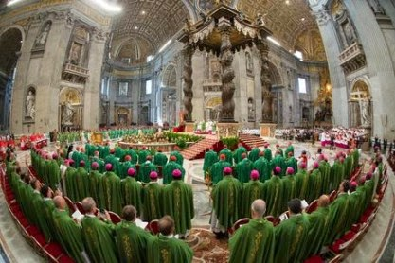
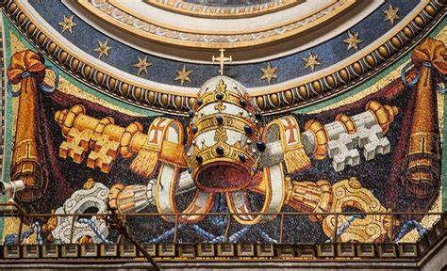
Teaching Authority of the Catholic Church
Questions
27. What is the Magisterium?
  The Magisterium is the teaching authority of the Church guided by the Holy Spirit. It is exercised by the Pope and the bishops united with him.
28. What is infallibility?
Infallible means incapable of error. Infallibility is a gift given by God to the pope and the bishops in union with him, that they cannot make mistakes when defining a doctrine concerning faith or morals because they are guided by the Holy Spirit. When the pope speaks EX CATHEDRA (“from the chair”) for the purpose of defining such a doctrine, his pronouncement is infallible.
In the history of the Church, there have been only two occasions where the pope has spoken EX CATHEDRA – in the years 1854 and 1950.

Slide 40
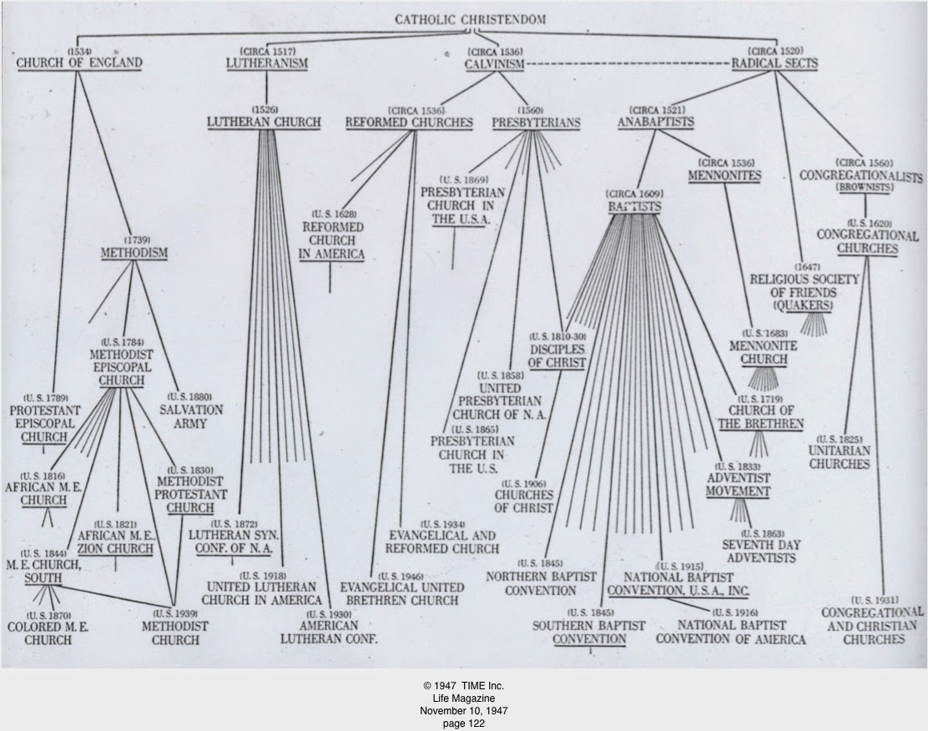
Breaking Away from the Catholic Church
Jesus commissioned Peter that upon this Rock He would build His Church.
Church is singular; not plural!
The Catholic Church is the longest-existing institution in the history of the world!

