Slide 1
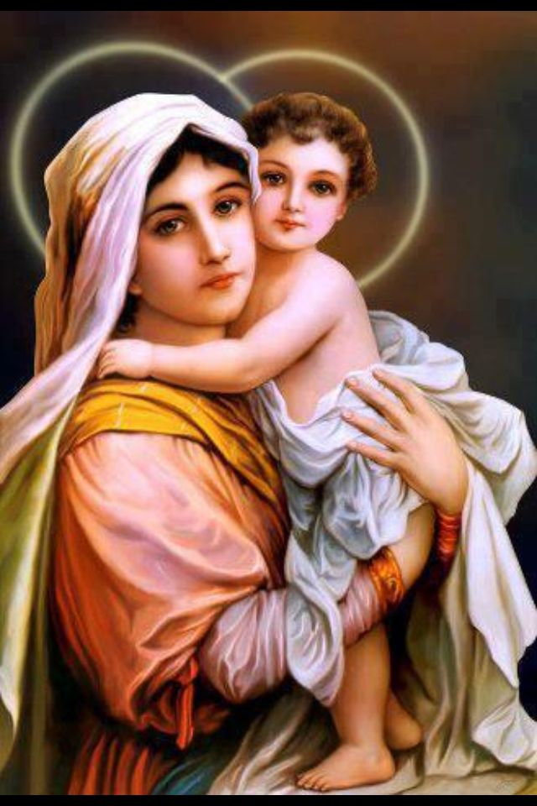
Ninth Grade CCD Class #8
November 5, 2023
The dog in the photo was trained to identify life after earthquakes. His posture and the fact of staying fixed as seen in the image is the posture that tells the rescuer that there is life in that place. And look at nothing more and nothing less where and in front of who is placed: in front of Jesus as the Eucharistic bread in the tabernacle, the living God among us.

Slide 2

Levels of Happiness Review
Level 1 – Pleasure
Level 2 – Ego-comparative
Level 3 – Contributive
Level 4 – Transcendent

Slide 3
Levels of Happiness Exercise
Pleasure (about things) Level 1 | Ego-Comparative (about me) Level 2 | Contributive (about others) Level 3 | Transcendent (about God) Level 4
1. Attending Youth Ministry
2. Raking Leaves at Parish
3. Caring for an ailing Grandmother
4. Going to Weekday Mass

Slide 4
Angels in the Nicene Creed
I believe in one God, the Father almighty, Maker of heaven and earth, and of all things, visible and invisible.

Slide 5
The Holy Spirit in the Nicene Creed
I believe in the Holy Spirit, the Lord, the giver of life, who proceeds from the Father and the Son, who with the Father and the Son is adored and glorified, and who has spoken through the prophets.

Slide 6
The Holy Spirit
Human persons
Rational and relational, yes
(Spirit and material beings)
Angels
Rational and relational, yes
(Pure Spirit)
God (3 persons)
1st and 3rd rational and relational, to the highest degree, yes
(Pure Spirit)
2nd rational and relational, to the highest degree, yes
(Spirit and material being)

Slide 7
Questions about the Holy Spirit
7th Grade Questions:
12.3 Who is the Holy Spirit?
The Holy Spirit is God, the Third Person of the Blessed Trinity, the sanctifier of souls.
19.2 When did Jesus institute the Sacrament of Confirmation?
The first Sacrament of Confirmation was received by the Apostles at Pentecost (fifty days after Easter), when God the Father sent the Holy Spirit to them. “Tongues of fire” rested upon their heads and the fire of God’s love filled their souls.

Slide 8
Holy Spirit in the Church Today
John 14:15-17, 26 (Sending the Holy Spirit)
John 16:13-15 (Holy Spirit in the Church today)
Matt 28:19-20 (Final commissioning of the Apostles)
Acts 2:1-4 (Descent of the Holy Spirit on the Apostles)
Acts 2:5-8 (Apostles Preaching)
Luke 1-35 “The Holy Spirit will come upon you and the power of the Most High will overshadow you…”

Slide 9
CCC 689
“The One whom the Father has sent into our hearts, the Spirit of his Son, is truly God. Consubstantial with the Father and the Son, the Spirit is inseparable from them, in both the inner life of the Trinity and his gift of love for the world. In adoring the Holy Trinity, life-giving, consubstantial, and indivisible, the Church’s faith also professes the distinction in persons. When the Father sends his Word, he always sends his Breath. In their joint mission, the Son and the Holy Spirit are distinct but inseparable. To be sure, it is Christ who is seen, the visible image of the invisible God, but it is the Spirit who reveals him.”

Slide 10
How the Holy Spirit is Active in the Church Today (from CCC 688)
When we listen to, read, and study the scriptures, and see his presence in the sacred writings;
When we read the lives of the saints and are inspired to holiness by their example, with the Holy Spirit’s help;
When we obediently accept the teaching authority of the Church, which we recognize is guided by the Holy Spirit;
When we receive the Sacraments, especially the Eucharist, and the Holy Spirit deepens our experience of God;
Whenever we pray, and the Holy Spirit prays with us and for us.

Slide 11
How the Holy Spirit is Active in the Church Today (from CCC 688)
6. When we support the missions and apostolates of the Church, which are aided by the work of the Holy Spirit;
7. When we recognize the gifts and charisms of the Holy Spirit that help build up the Church; and
8. When we consider Sacred Tradition, Church history, and its many holy witnesses, and realize the sustaining power of the Holy Spirit, who keeps the Church faithful and free of error in her teachings.

Slide 12
Gifts of the Holy Spirit
20.1 Name the seven gifts of the Holy Spirit. Describe briefly.
a. Wisdom: helps us to know God’s will for our lives and to see things as God sees them;
b. Understanding: gives us an insight into the mysteries of the faith and helps us explain it to others;
c. Knowledge: allows us to know God and to have a personal relationship with Him;
d. Fortitude: helps us to be courageous in the defense of our faith;
e. Counsel: aids us in making right judgments;
f. Piety: assists us in being prayerful, reverent, and holy; and
g. Fear of the Lord: is a holy awe and reverence for God.

Slide 13
The Fruits of the Holy Spirit
Love
Joy
Peace
Patience
Kindness
Generosity
Faithfulness
Gentleness
Self-control
Modesty
Chastity
Goodness

Slide 14
Prayer to the Holy Spirit – 7th grade Question
Come, Holy Spirit, fill the hearts of your faithful.
And kindle in them the fire of your love.
Send forth your Spirit and they shall be created.
And you will renew the face of the earth.
Lord, by the light of the Holy Spirit
you have taught the hearts of your faithful.
In the same Spirit
help us to relish what is right
and always rejoice in your consolation.
We ask this through Christ our Lord.
Amen.

Slide 15
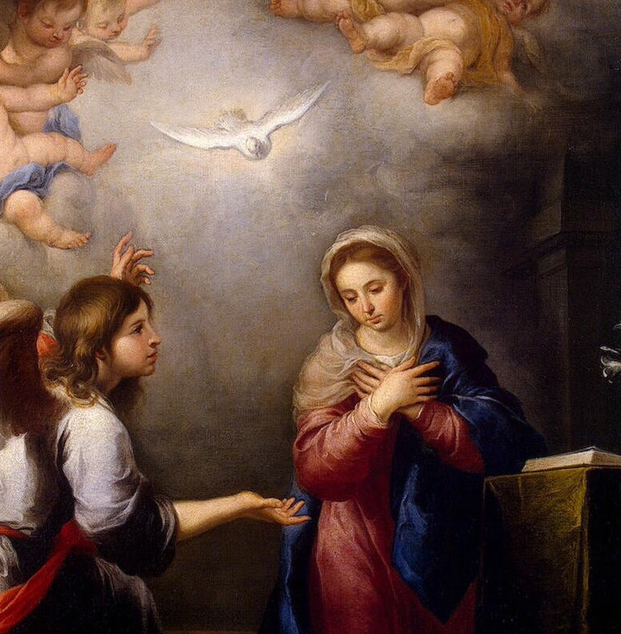
The Blessed Mother

Slide 16
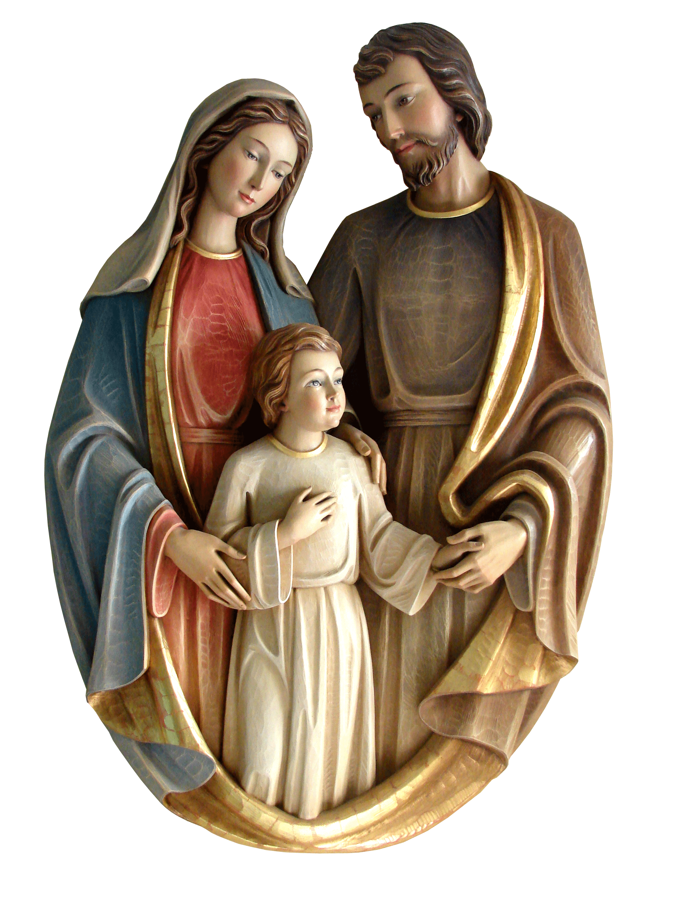
Questions
7.1 What is the Incarnation?
The Incarnation is when the Son of God (Jesus) became man, through the action of the Holy Spirit, in the womb of the Blessed Mother. Jesus was true God and true man.
7.2 Who is the Mother of God?
The Blessed Virgin Mary is the Mother of God because she is the mother of Jesus who is God.
7.3 Who is Saint Joseph?
St. Joseph was Jesus’ father on earth (foster father) and husband of Mary, the Blessed Mother.

Slide 17
Life of Blessed Mother
Immaculate Conception (CCC 491-492)
Born to Saints Joachim and Anne
Engaged to Joseph
Annunciation (Luke 1:26-38)
Visitation (Luke 1:39-56)
Birth of Jesus (Matt 1:18-25, 2:1, Luke 2:1-14)
Arrival of the Magi
Presentation in the Temple (Luke 2:21-38)
Flight into Egypt (Matt 2:13-18)

Slide 18
Life of Blessed Mother
Return to Nazareth (Matt 2:19-23)
Finding of Jesus in the Temple (Luke 2:41-50) (Chosen Video clip)
Hidden Life of Jesus (Luke 2:51-52)
Beginning of Jesus’ Public Ministry (Wedding Feast at Cana) (John 2:3-5,7-11) (Chosen Video Clip)
Passion, Crucifixion and Resurrection of Christ (John 19:25-27)
Descent of the Holy Spirit (Pentecost) (Acts 1:14)

Slide 19
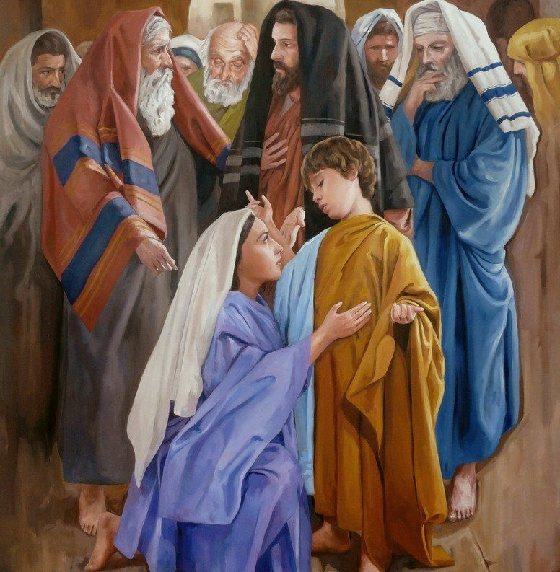
The Finding of Jesus in the temple Jesus in the Temple
Notes:
Watch The Chosen Season 1 Episode 5: The Wedding Gift on Angel Studios
https://www.angel.com/watch/the-chosen/episode/64956907-c5cb-4bdb-8ba1-e8528f74e4cf/season-1/episode-5/the-wedding-gift (1:00 minute mark)

Slide 20
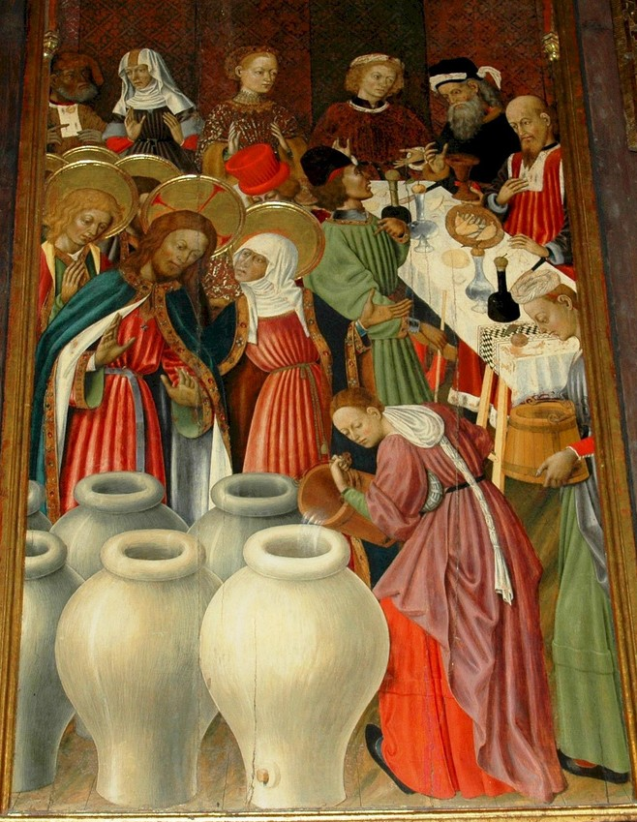
The Wedding Feast at Cana
Notes:
https://www.angel.com/watch/the-chosen/episode/64956907-c5cb-4bdb-8ba1-e8528f74e4cf/season-1/episode-5/the-wedding-gift (beginning ~37:50)

Slide 21
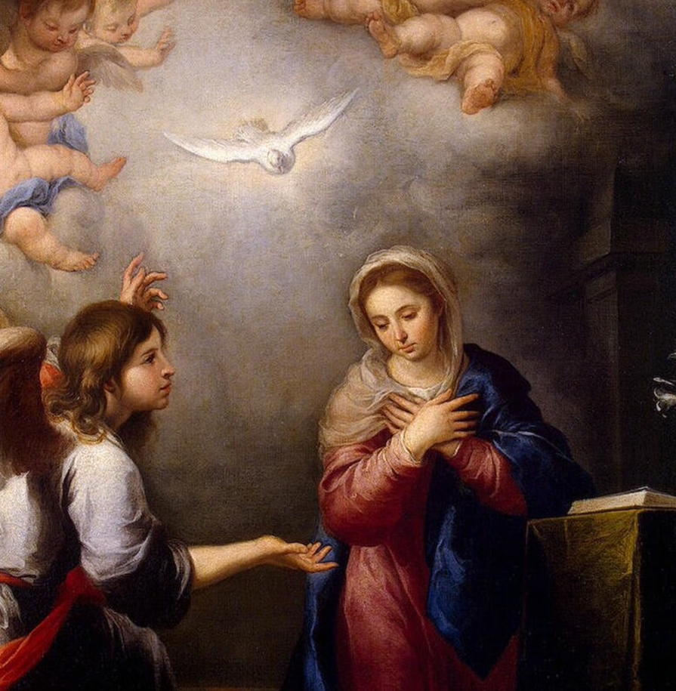
Central Teachings Concerning BVM
Question
47. What are the three central teachings of the Church concerning
the Blessed Virgin Mary?
- The Immaculate Conception: Mary was conceived without original sin
- Perpetual Virginity: Mary was and remained a virgin – before, during and after the
birth of Jesus
- The Assumption: at the end of her earthly life, Mary was assumed body and soul
into heaven

Slide 22
Selected Apparitions of the Blessed Mother
August 4, 400 Our Lady appeared to a couple and asked that a basilica be built on Mount Esquiline in Rome. She outlined the area with snow and became known as Our Lady of the Snow. (Today the basilica is called St. Mary Major)
1208 Our Lady appeared to St Dominic de Guzman, the founder of the Dominicans and introduced him to the rosary. She became known as Our Lady of the Rosary.
1226 Our Lady appeared to St Simon Stock on Mount Carmel and gave him the devotion to the brown scapular. She became known as Our Lady of Mount Carmel.
March 27, 1499 Our Lady of Perpetual Help was a copy of a painting attributed to St. Luke. Attributed with many miracles and is currently in St. Matthew’s Church in Rome (located between St. Mary Major and the church of St. John Lateran).
December 9, 1531 The Blessed Mother appeared to Juan Diego at Guadalupe, Mexico and became known Our Lady of Guadalupe and Patroness of the Americas.
Notes:
https://www.bing.com/videos/search?q=our+lady+of+guadalupe+youtube+video&cvid=b8103ea3ddf14232ba726c9fa5fbf425&aqs=edge.6.0l9j69i11004.10364j0j1&pglt=515&PC=DCTS&ru=%2fsearch%3fq%3dour%2blady%2bof%2bguadalupe%2byoutube%2bvideo%26cvid%3db8103ea3ddf14232ba726c9fa5fbf425%26aqs%3dedge.6.0l9j69i11004.10364j0j1%26pglt%3d515%26FORM%3dANNAB1%26PC%3dDCTS&view=detail&mmscn=vwrc&mid=46EC8EABEA847AB2186946EC8EABEA847AB21869&FORM=WRVORC

Slide 23
Selected Apparitions of the Blessed Mother
September 17, 1569 Pope asked Christians to pray the rosary for the success of the Christians against the Turks at Lepanto, Greece. The triumph of the fleet was attributed to Our Lady of the Rosary.
July 18, 1830 The Blessed Mother appeared to St. Catherine Laboure in a convent in France and asked her to strike a metal made after a model that she provided with the words, “Oh Mary, conceived without original sin, pray for us who have recourse to thee. She became known as Our Lady of the Miraculous Medal.
September 17, 1846 The Blessed Mother appeared to Melanie Mathieu in La Salette, France. She became known as Our Lady of La Salette.
December 8, 1858 The Blessed Mother appeared to Bernadette Soubirous stating, “I am the Immaculate Conception.”

Slide 24
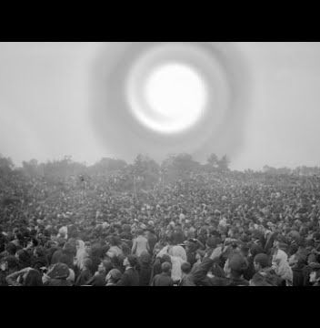
October 13, 1916
The Blessed Mother appeared to three children at Fatima, Portugal. On that day to prove to the world that she was meeting the children, she caused the “Sun to Dance.” She is known as Our Lady of Fatima.
Notes:
https://watch.formed.org/fatima-1/season:1/videos/the-great-miracle-of-the-sun
October 13, 1916 The Blessed Mother appeared to three children at Fatima, Portugal. On that day to prove to the world that she was meeting the children, she caused the “Sun to Dance.” She is known as Our Lady of Fatima.

Slide 25

Next Week, November 12
Father De Celles takes questions from high school students.
Students can bring questions with them or submit their questions to the Lairds (blaird48@gmail.com)

