Slide 1
9th Grade Religious Education
October 22, 2022
Class #6

Slide 2
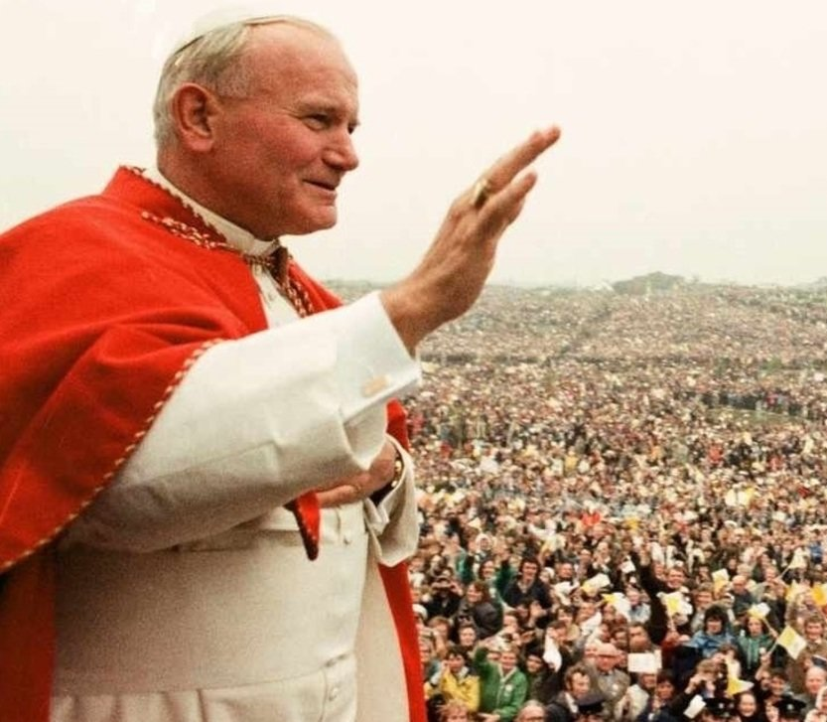
Saint of the Week: Pope Saint John Paul II
October 22nd

Slide 3
Facts about
Pope Saint John Paul II
Neither he nor John Paul I were expected to be chosen Pope in 1978.
Double Name: John Paul II
Three Popes in a single year: Not since 1648
First non-Italian Pope since 1523
From a Communist country
Extremely popular; drew upward to 2 million at some of his Masses
Most traveled pope
Assassination attempt
Theologian and philosopher
Significant influence on the Second Vatican Council

Slide 4
Facts about
Pope Saint John Paul II
Established a new Code of Canon Law
Influence and teaching brought down the Communist world in Europe
Created the first Catechism of the Catholic Church since the Counter-Reformation (Council of Trent in 1566)

Slide 5
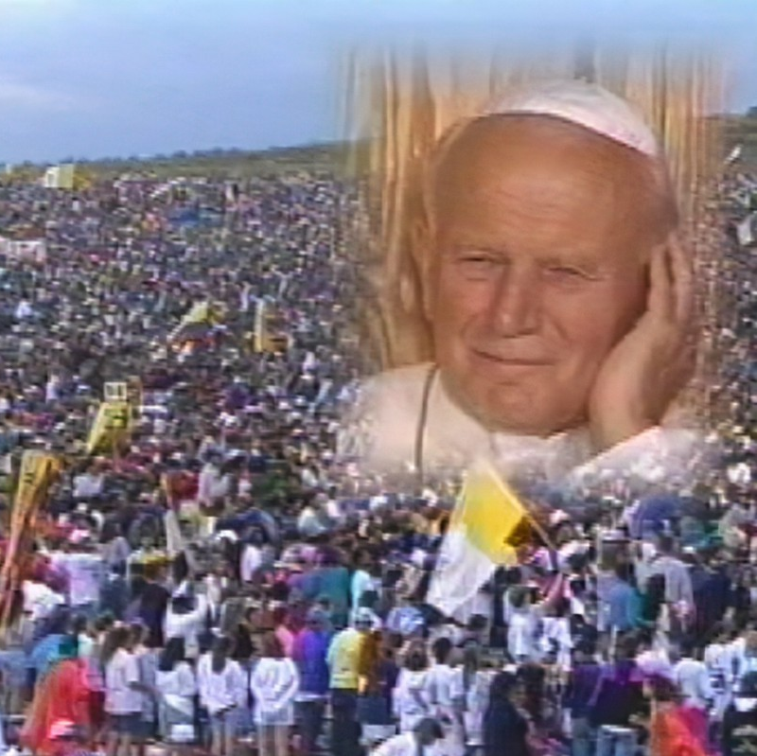
World Youth Day 1993
Cherry Creek Park, Denver, CO
1.5 million people attended the final vigil and final Mass

Slide 6
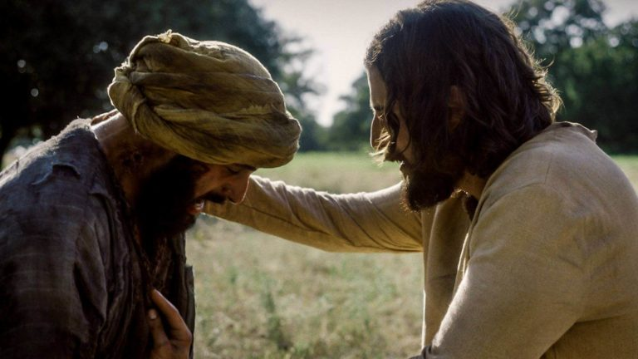
Healing of the Leper
Notes:
https://www.angel.com/watch/the-chosen/episode/bc63a65f-f50e-476d-8c9d-0bd836b8db23/season-1/episode-6/indescribable-compassion
(from 14:51-19:07)

Slide 7
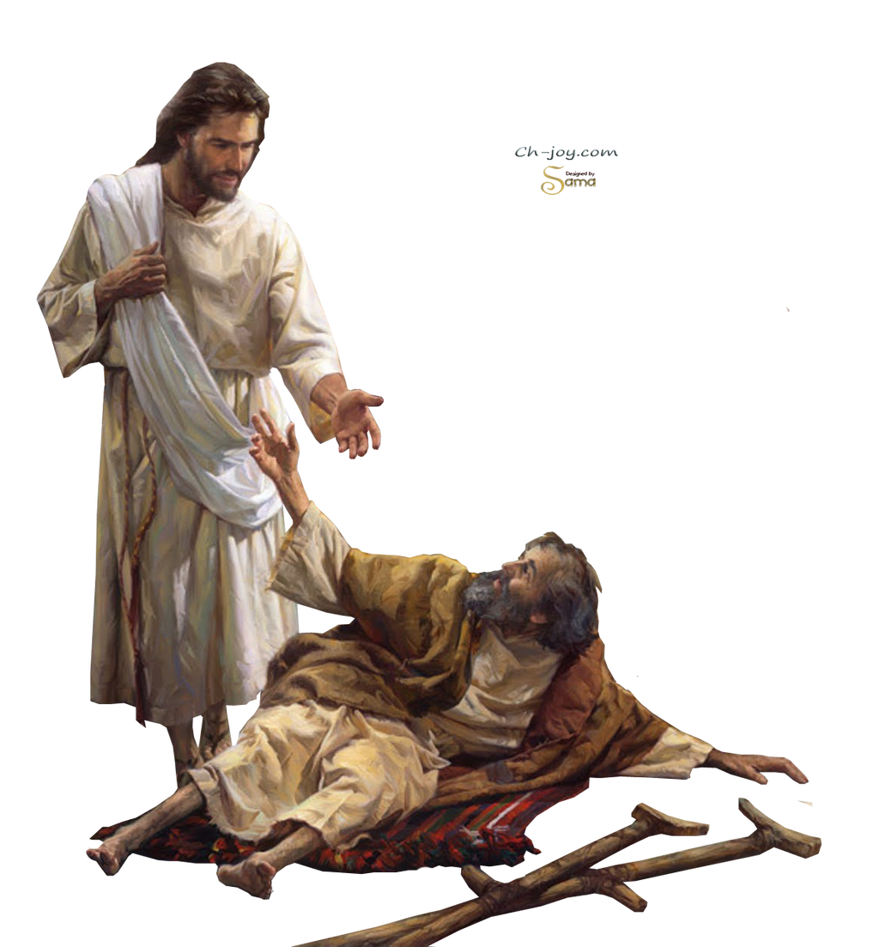
Healing of the Paralytic
Notes:
https://www.youtube.com/watch?v=dlBOmQ1PaMY
the Chosen season two: Jesus heals the paralytic at Bethesda - Video Search Results (yahoo.com)
https://video.search.yahoo.com/yhs/search?fr=yhs-imageadvan-imageadvan_004&ei=UTF-8&hsimp=yhs-imageadvan_004&hspart=imageadvan&p=the+chosen+season+two%3A+Jesus+heals+the+paralytic+at+bethesda&type=175_bc006_175_ext006_bc#id=1&vid=5e1d6084e25ecc20c24326b594f59e27&action=click

Slide 8
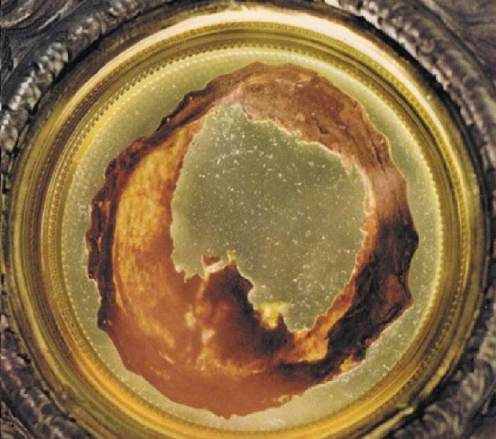
Eucharistic Miracles

Slide 9
“In persona Christi!”
Institution of the Eucharist: “Now as they were eating, Jesus took bread, and blessed, and broke it, and gave it to his disciples and said, ‘Take, eat; this is my body.’ And he took a chalice, and when he had given thanks he gave it to them, saying, ‘Drink of it, all of you; for this is my blood of the covenant, which is poured out for many for the forgiveness of sins. I tell you I shall not drink again from this fruit of the vine until that day when I drink it new with you in my Father’s kingdom.’” (Matt 26:26-29)
Institution of the priesthood: “This is my body which is given for you. Do this in remembrance of me.” (Lk 22:19)
The Mass: “Take this all of you, and eat of it, for this is my body, which will be given up for you.”….”Take this, all of you, and drink from it, for this is the chalice of my blood, the Blood of the new and eternal covenant, which will be poured out for you and for many for the forgiveness of sins. Do this in memory of me.”

Slide 10
Jesus is seen after His Resurrection
While we can show from the evidence of the Shroud of Turin that something miraculous happened at the time of the Resurrection of Jesus, eye-witness accounts also can verify that Christ is risen! Here are some accounts from the New Testament.
All the apostles saw the resurrected Jesus (Lk: 24:36-54; Jn 20:26-29)
Jesus appeared by the Sea of Tiberias (Jn 21:1-23)
Bodily nature of Jesus’ resurrection: (Lk 24:37-40; Jn 2:19, 21, 20:17, 27; 21:12-13)
Eleven in Galilee saw him Mt 28:16-20
Five hundred witnesses at once saw him: (1 Cor 15:6)
Mary Magdalene and other women saw him (Mt 28:9; Mk 16:9; Lk 23:55)
Paul saw the risen Jesus (Acts 9:27)
Thomas saw the risen Jesus (Jn 20:24-29)
Two disciples on the road to Emmaus saw him (Mk 16:12; Lk 24:13-32)

Slide 11
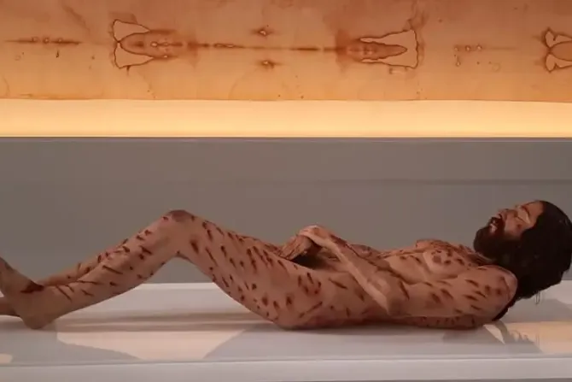
Body of Christ based on the Holy Shroud of Turin
(on exhibit in Spain)
Notes:
7E-P4-A_032120 (crediblecatholic.com) (slides 27 – 58)
The first hyper-realistic body of Christ based on the Holy Shroud is on exhibit in Spain | Catholic News Agency
https://www.catholicnewsagency.com/news/252551/the-first-hyper-realistic-body-of-christ-based-on-the-holy-shroud-is-on-exhibit-in-spain

Slide 12
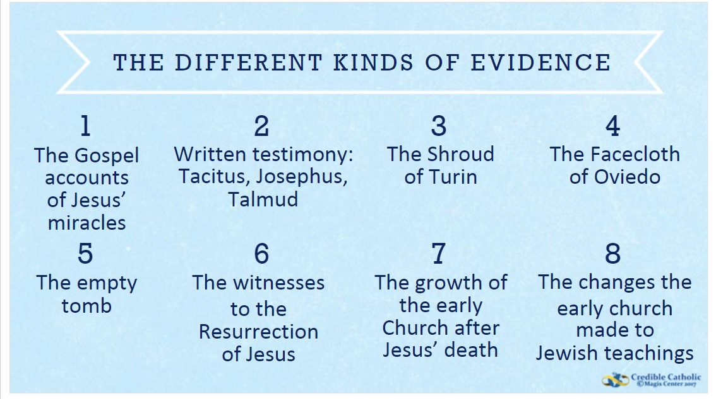

Slide 13
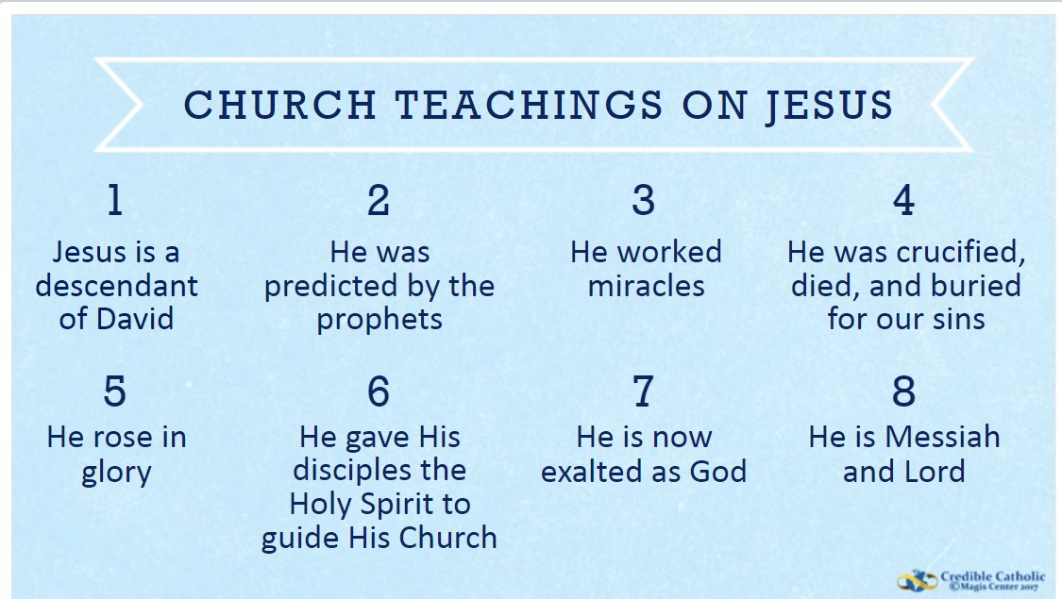

Slide 14
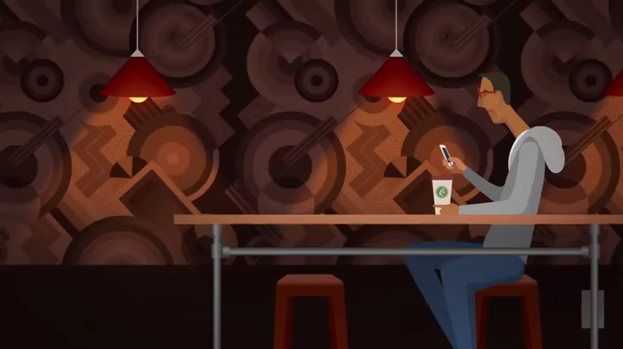

Slide 15
Shroud of Turin Recap
The image is limited to the uppermost surface of the cloth.
The image is also not scorched.
The image is a perfect photographic negative.
Parts of the frontal image – particularly the hands – show an image which is resolvable into three dimensions.
There is a double image on the frontal part of the cloth.
4. And 5. above imply that the cloth collapsed into and through the body
  We can reasonably infer that the Shroud is the burial cloth of Jesus which contains not only a relic of his crucifixion, but also his resurrection in glory.

Slide 16
The dog in the photo was trained to identify life after earthquakes. His posture and the fact of staying fixed as seen in the image is the posture that tells the rescuer that there is life in that place. The dog is trained to look at nothing more and nothing less.
Note where the dog is stationed: in front of Jesus as the Eucharistic bread in the tabernacle, the living God among us.
The dog in the photo was trained to identify life after earthquakes. His posture and the fact of staying fixed as seen in the image is the posture that tells the rescuer that there is life in that place. And look at nothing more and nothing less where and in front of who is placed: in front of Jesus as the Eucharistic bread in the tabernacle, the living God among us.

