Slide 1

9th Grade Religious Education Class #5
October 15, 2023

Slide 2
Human Persons
How do we define a “person?”
  A being with a mind and a will.
Is a body an essential part of a person?
  No, God and angels are persons.
What do these powers of the “mind and a will” allow a person to do?
  To think and to choose.
What does it mean to be a person with bodies?
  We manifest “personhood” to the visible world. Our bodies are the outward expression of our person.
Can angels do that?
  No!

Slide 3
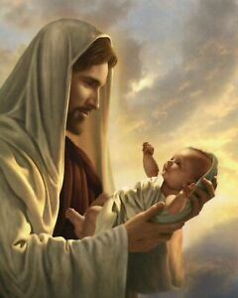
Made in God’s Image
“Then God said, ‘Let us make man in our image, after our likeness; and let them have dominion over the fish of the sea, and over the birds of the air, and over the cattle, and over all the earth, and over every creeping thing that creeps upon the earth.’”
(Gen 1:26)
“So God created man in his own image, in the image of God he created him; male and female he created them.” (Gen. 1:27)
Notes:
The transgender agenda is a lie because regardless of what an individual has in mind for his/her gender, it does not conform with reality that each individual was born either male or female and that cannot be changed because it is based on the DNA of the individual at the time of conception.
To assert that truth is subjective is inherently self-contradictory (stating that truth is subjective is to assert an objective truth). Asserting that truth is objective is coherent.

Slide 4
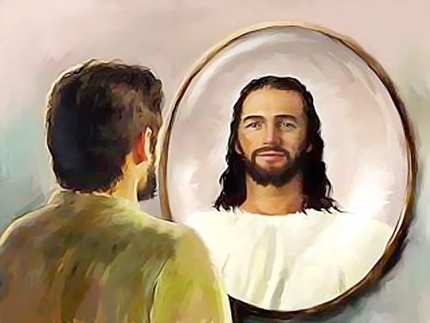
Human Persons
What does it mean to be ”made in the image and likeness of God?” Are we gods?
  We are not gods; but we are created to act like God would act.
  When we act as we ought (as God because we are images of God) and express those acts outwardly in and through our bodies, our bodies become, literally, physical icons of God.
So, what does that mean being “physical icons of God?”
  Our bodies are sacred and holy.
How do we think of our bodies?
  Need to lose weight, change hair styles, have more muscles, look better, etc.

Slide 5
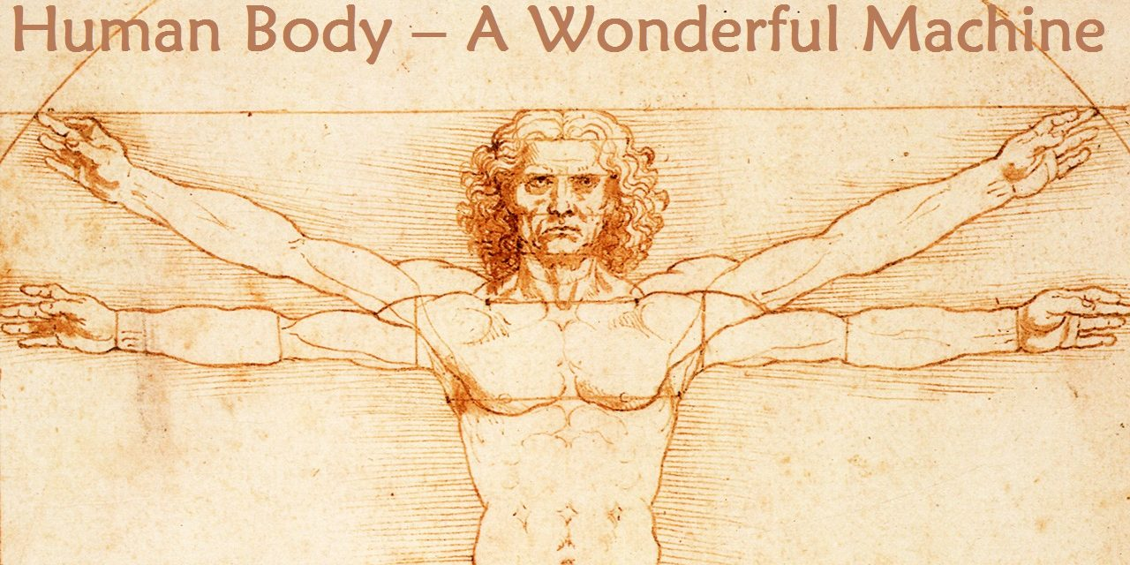
Human Persons
How does society today see bodies?
  Machines – Star Wars robots have “personalities” or Data on Star Trek that acts like a machine.
  In sports, expressions such as “he has all the tools for…” or about a pitcher, “His arm is like a rifle,” or a football wide receiver, “He has great wheels.”
  In medicine, “I need to have my plumbing replaced,” or referring to coffee as “fuel.”

Slide 6
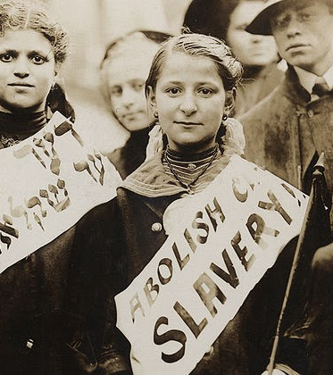
Human Persons
If we actually believe our bodies are machines, what does that imply?
  “It’s my body and I can do with it what I want.”
What does that imply?
  If we own our bodies, then someone else could also own them – slavery would become acceptable.
  If we own our bodies, then we could harm them; we could harm others.
  We could get rid of it. We could sell it to someone else.

Slide 7
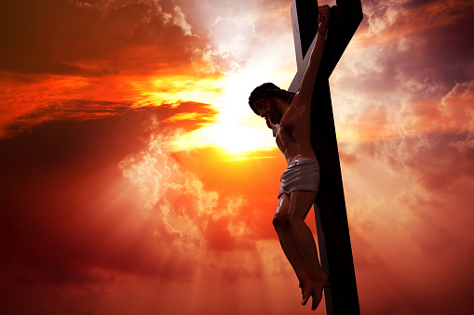
Fundamental Principle of Life:
We love people; we use things!
How do we know how God would act (and we are going to get into “acting” later in the course)?
  We can look to Jesus Christ as a model. After all, He is God.
How does Jesus act (hint: what was the difference between the Old Testament and New Testament miracles)?
  He loves.

Slide 8

“Made in God’s image!”
  When we express ourselves, our own persons, with our bodies, we also express God Himself.
  When we act as we ought, we act like God.
  We express those acts outwardly in and through our bodies, they make visible “what has been hidden in the invisible God for all eternity.”
  Our flesh and blood is a vehicle God has created for revealing Himself.

Slide 9
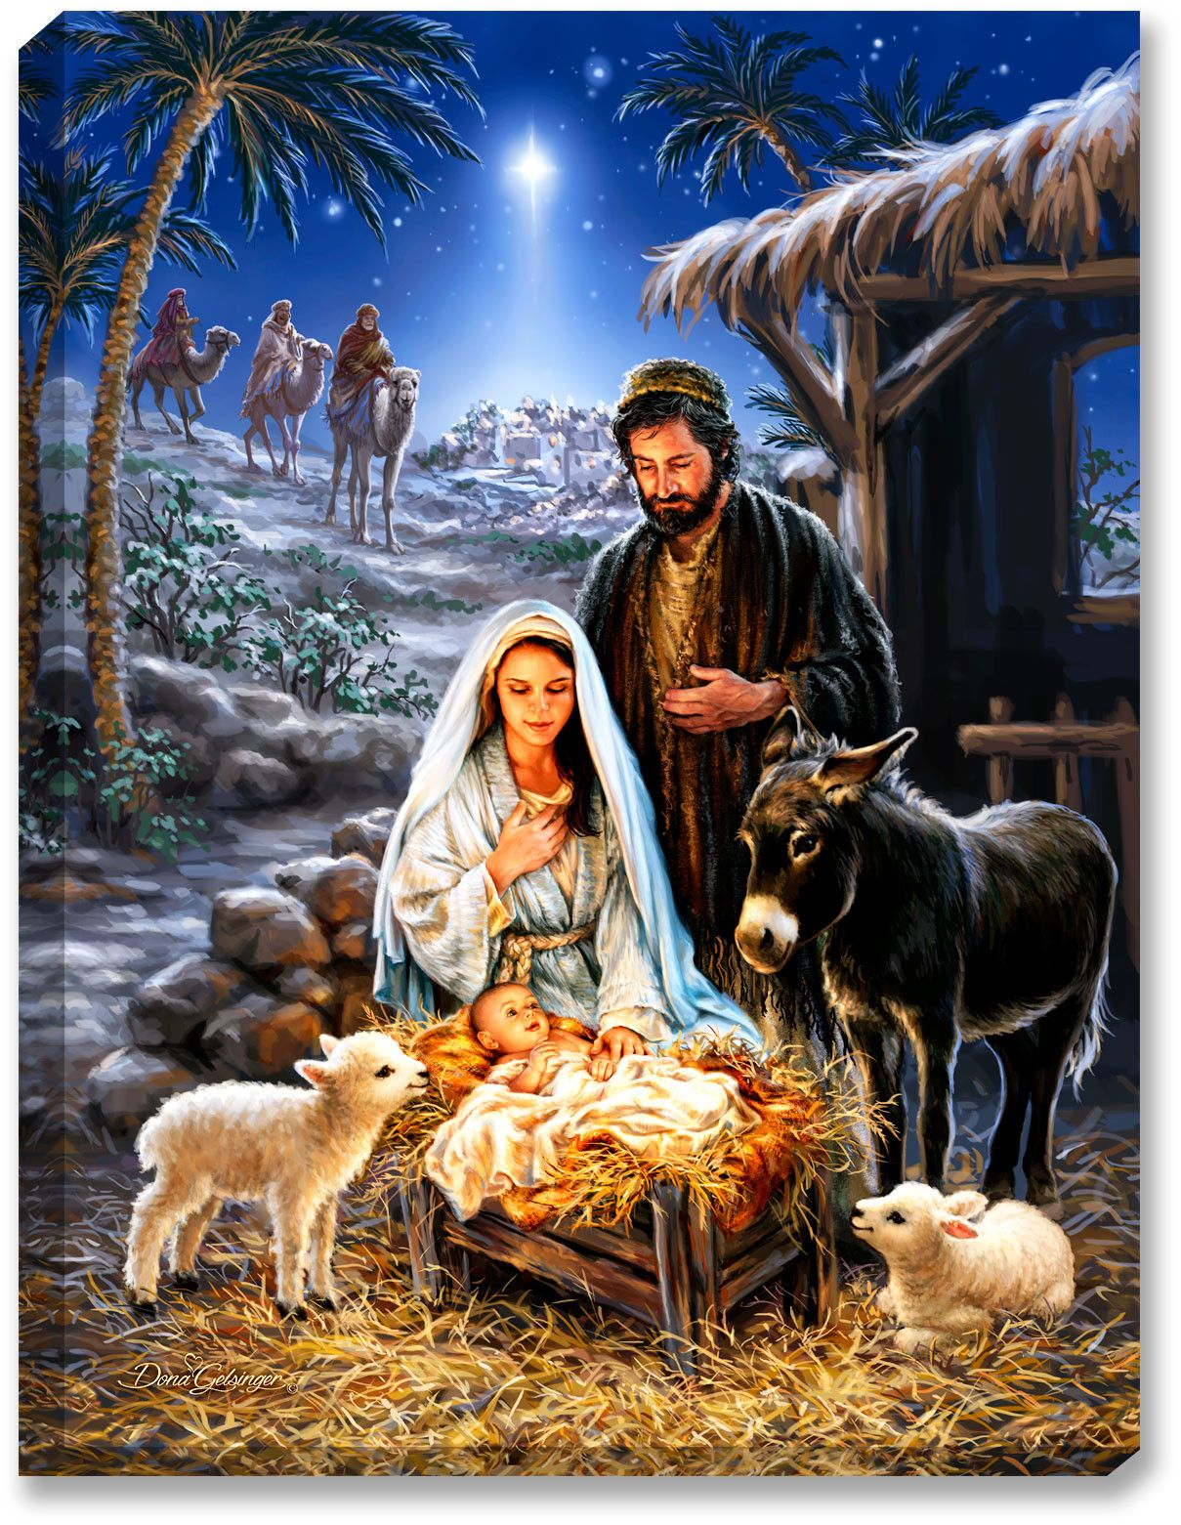
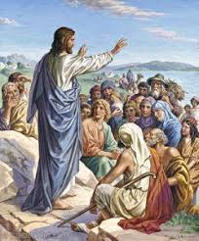
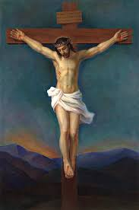
How Do We Know How God Acts?

Slide 10
Four Levels of Love
Love Level I – Love makes me feel good.
  Focuses on the physical. Love is a positive feeling. I love my dog because he is cute.
Love Level II – Love makes me feel good about myself.
  Love is equated with being admired. ”I love you because you think I’m pretty, talented, smart, strong.”
  I love it when I am recognized for an achievement.

Slide 11
Four Levels of Love
Love Level III – I love you more than I love myself.
  I put others’ needs in front of my own.
  I did the dishes without being asked because I could see my mother was tired.

Slide 12
Four Levels of Love
Love Level IV – Love sees the image of God in every person.
  We recognize that every person was made in the image and likeness of God.
  God manifested Himself as a human person in Jesus Christ.
  Jesus Christ’s life can be reduced to one four-letter word: “LOVE!”
  We are called to imitate Jesus by…
  Loving every person as if they were Jesus.

Slide 13
Who is Jesus?

Slide 14
The Jesus of History
Assume that we treat the gospels as ancient documents and give them the same sort of review that you would give any other ancient document.
What type of literature do we find in the gospels:
- Historical (facts about events with some interpretation)
There was a man named Jesus.
He claimed to be a messenger sent by God. (Mark 2:23-28; Matt 12:1-8)

Slide 15
The Jesus of History
3. He did enough to prove this by miracles such that there was a connection between the claim and the miracle. (Luke 11:14-20; Luke 8:41-56; Matt 8:5-13; Matt 9-27-29)
  (modern instances – Lanciano, Fatima, Guadalupe – miracles are possible because they are beyond science)
4. He has an inner circle to whom He spoke more often. (Matt 10:1-4) (Matt 25:14-29)
5. He told them to continue His work, His teaching. (Matt 28:16-20)
6. He promised that God would protect the teaching, “He who hears you hears me, and he who rejects you rejects me, and he who rejects me rejects him who sent me.” (Lk 10:16)

Slide 16
Who is Jesus Christ?
Jesus
  (Greek and Latin form of the Heb. Joshua) meaning Saviour.
  ” And behold, you will conceive in your womb and bear a son, and you shall call his name Jesus.”(Luke 1:31)
Christ
  Title meaning anointed, consecrated, sacred.
  “You are the Christ, the Son of the living God.” (Matt 16:16)
Messiah
  Hebrew meaning “anointed one.” Equivalent to the Greek “Christus.”
  To the woman at the well, “The woman said to him, ‘I know that Messiah is coming (he who is called Christ); and when he comes, he will show us all things.’ Jesus said to her, ’I who speak to you am he.’” (John 4:25-26)

Slide 17
Jesus of History
Assume that we treat the gospels as ancient documents and give them the same sort of review that you would give any other ancient document.
What type of literature do we find in the gospels:
- Historical (facts about events with some interpretation)

Slide 18
Jesus of History
Three non-Christian writers reported the following events of the time of Christ
  Tacitus – 1st century Roman historian – “Christ was executed by Pontius Pilate under the reign of Emperor Tiberius.”
  Flavius Tiberius - ~93 AD, Jewish historian – cites Jesus’ crucifixion and refers to Him as a “teacher and a wonder-worker.” (term for miracle worker)
  Babylonian Talmud – 2nd century document of Jewish teaching – several references to Jesus’ resurrection and supernatural powers.

Slide 19
Chronology of the Life of Christ
Conceived of the Holy Spirit – Nazareth
Born of the Virgin Mary – Bethlehem
Fled into Egypt
Lost and found in the Temple – age 12
Public Life of Jesus begins – age 30
Selects Apostles
Performs Miracles
Crucifixion and Death on the Cross – age 33
Resurrection from the dead
Ascension into heaven

Slide 20
The Catholic Church’s Teaching on Jesus
Jesus is a descendant of David.
Jesus was predicted by the prophets.
Jesus worked miracles.
Jesus was crucified, died and buried for our sins.
Jesus rose in glory.
Jesus gave His disciples the Holy Spirit to guide His Church.
Jesus is now exalted as God.
Jesus is the Messiah and Lord.

Slide 21
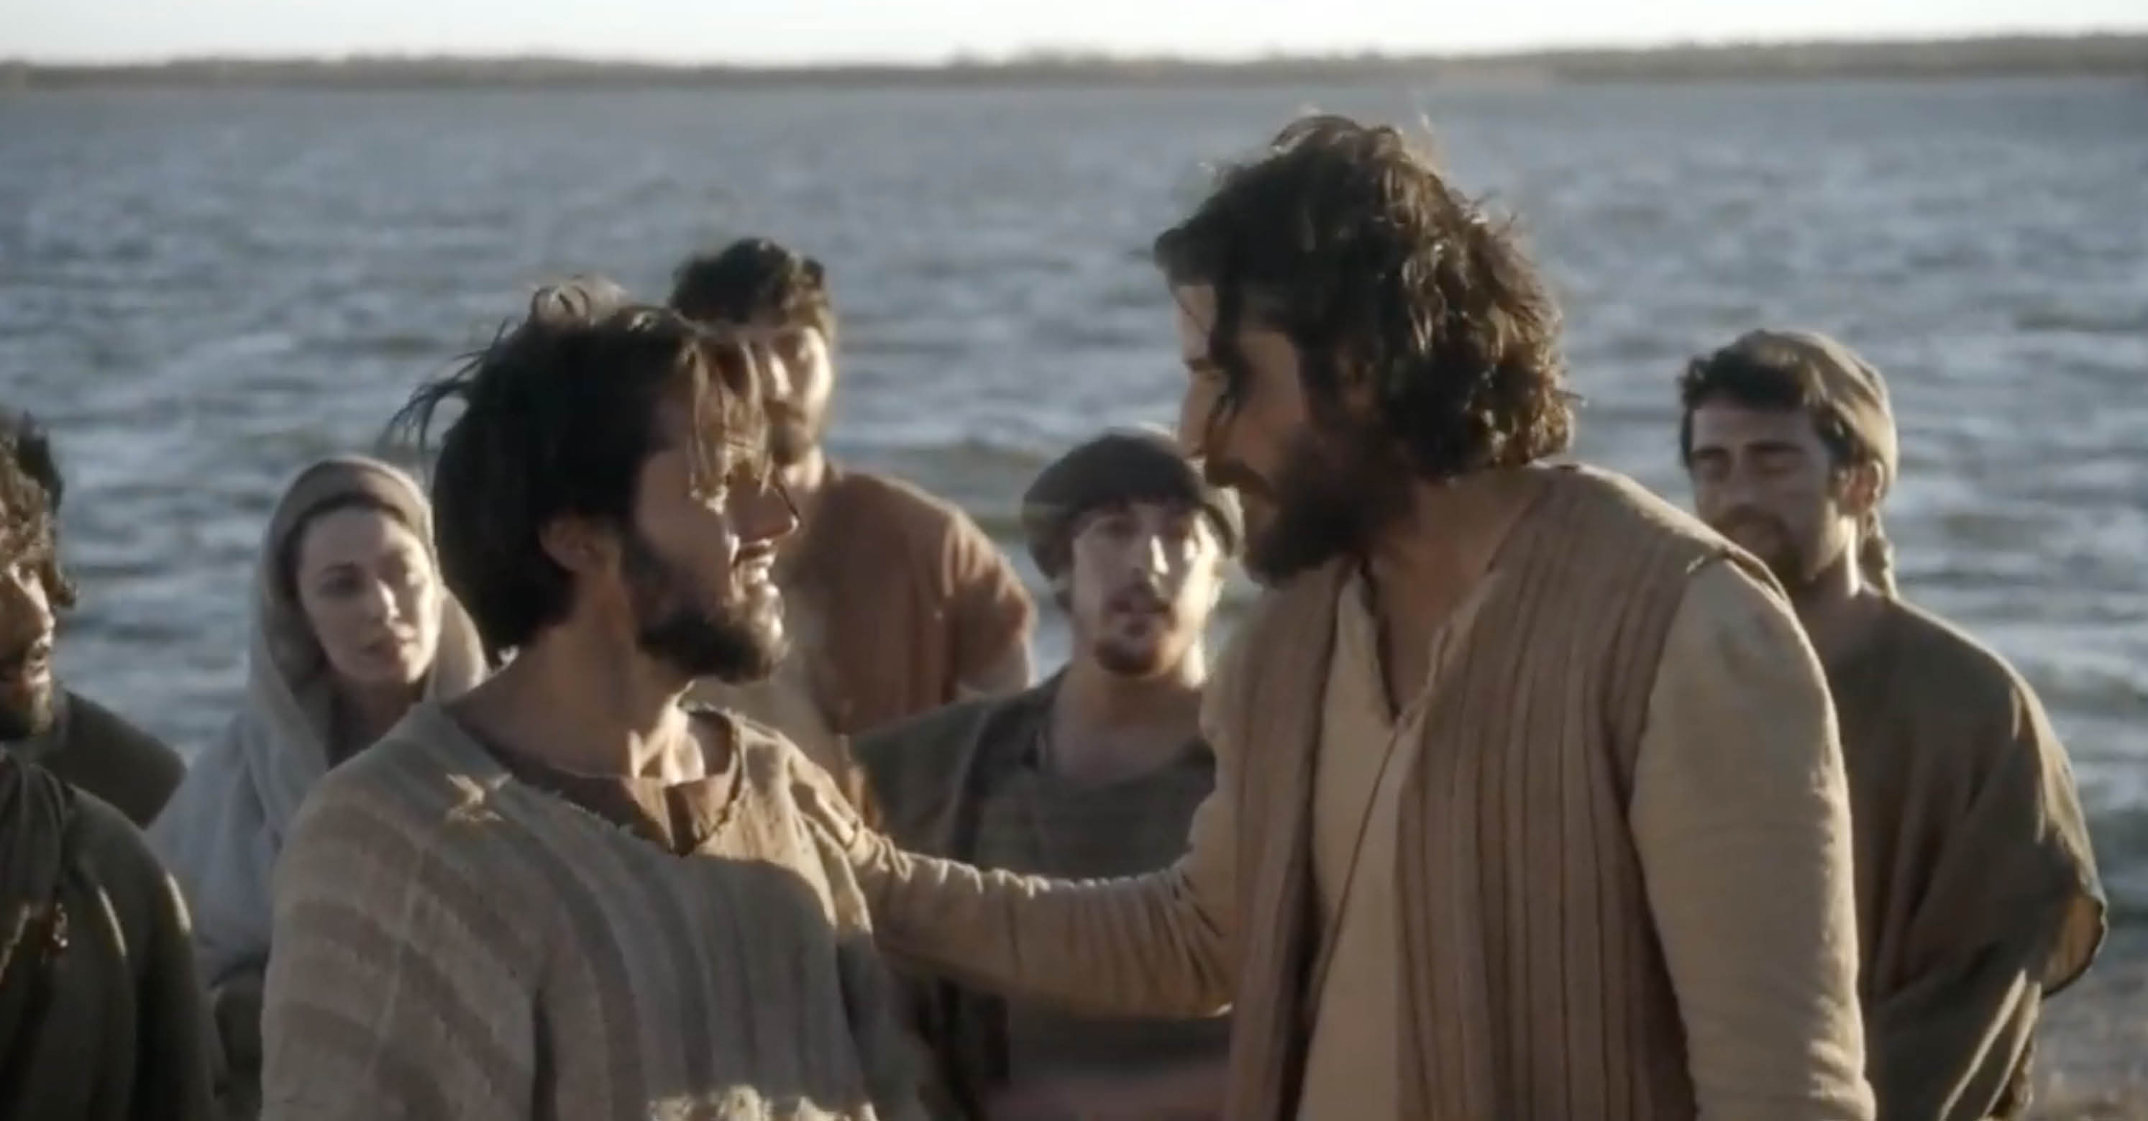
Jesus calls Peter, Andrew, James, & John
Notes:
The chosen episode when Jesus calls Simon - Yahoo Search Results Video Search Results (2:50 to end)
https://video.search.yahoo.com/yhs/search?fr=yhs-Lkry-SF3&ei=UTF-8&hsimp=yhs-SF3&hspart=Lkry&param1=mT_2r_ci1-nJq5b0MFtuAu7jXDjofreZiVi0BQtheQyFPfFTdmQz1-xPlAPMp-hx7CmO2zfhcwslY_jkkPCZ3pxwOQwuowUBJSIHC2l-ujhLQx4k9Pml3m8Gy0ewtcEjnrv_0ZKjQ0rAcn1-3UJcElSriwLJ0y9X-ZxEaeSDpaiSDLjVDFhprTr-IXj6j2Uu0uBWQhadH4he8huFc_4rFpt5tlpHjM1srBpmvP4eLDJyEiaZ7SE3pABKacu7irGyYIxVCWMCODezT4vOFMo4k-oTsoBRO75dGq-OiEB0mu7YPLvXgW0%2C&p=The+chosen+episode+when+Jesus+calls+Simon&type=BIZM_3010510111_12_%2458020_000000%24#id=1&vid=90bbc5723618d4611f4bea57f715712d&action=view

Slide 22
The Different Kinds of Evidence
The Gospel accounts of Jesus’ miracles.
Written testimony of non-Christians during this time in history.
The Shroud of Turin.
The face cloth of Oviedo.
The empty tomb.
The witnesses to the resurrection of Jesus.
The growth of the early Church after His death.
The changes the early Church made to Jewish teaching.

Slide 23
Miracles: Old Testament vs. New Testament
Old Testament:
  Moses and Joshua and the plagues (for examples)
  Exodus 7:8-13 and then the 10 plagues Exodus chapters 7-12
New Testament
  Jesus heals the blind men (Matt 9:27-31)
  Jesus heals the man possessed and mute (Matt 9:32-34)

Slide 24
Gospel Accounts of Jesus’ Miracles
His enemies did not deny that Jesus performed miracles.
  15 unique healings (Matt 9: 27-31 – Jesus heals two blind men)
  7 accounts of exorcism
  3 raised from the dead (Lazarus – John 11:17-44; Daughter of Jairus – Luke 8:40-56; Son of the widow of Nain – Luke 7:11-17)
Done in His own name (by His own authority)
  Matt 11:2-5; Luke 7:20-22 (Messengers from John); Mark 2:9-11 (Jesus heals the paralytic); Matt 7:29; John 5:30
They have the purpose of bringing the kingdom of God into the world, not showing His glory.
  OT miracles were about power and might; NT miracles were about power and love.

Slide 25
Gospel Accounts of Jesus’ Miracles
They always freed someone from affliction of evil.
  Jesus heals a paralytic (Matt 9:5-6)
  Jesus “healing every disease” (Matt 4:23-25)
They are combined with teaching (Matt 9:5-6)
The faith or free choice of the recipient is integral (Matt 8:1-3) (Mark 5:25-29)

