Slide 1
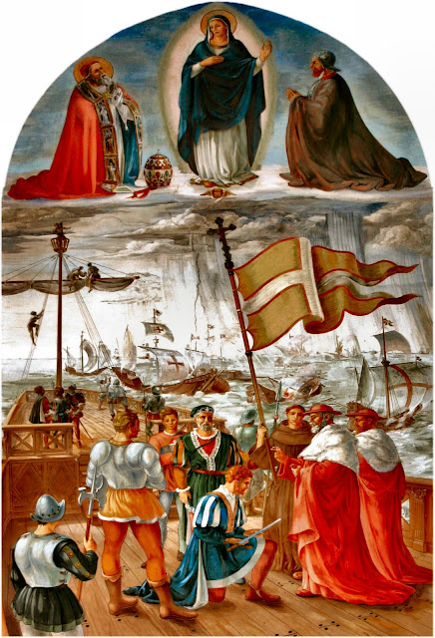
9th Grade Religious Education
Class #4
October 1, 2023

Slide 2
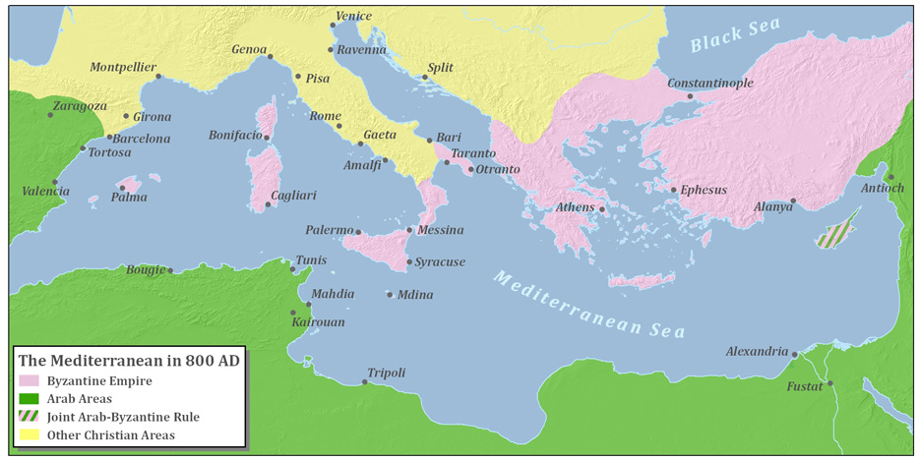

Slide 3
The Battle of Lepanto (1571)
The Feast of the Holy Rosary
This is the most significant naval (and military) battle of the Renaissance period of history pitting the combined fleet of the Holy League (Papal States, Venice, and Spain) against the Ottoman navy.
They met at Lepanto on the northern edge of the Gulf of Corinth, of western Greece. The Holy League was at a military disadvantage and Pope Pius V called for all of Europe to pray the rosary for victory. He personally led a rosary procession in Rome.
The Holy League forces, taking advantage of a mysterious change in direction of the wind, stopped the Ottoman navy and their advance. They wanted to control the entire Mediterranean Sea gaining access to the Atlantic. The result was the Ottoman remaining in control of the eastern Mediterranean.
Pope Pius V instituted the feast of Our Lady of Victory commemorating the victory at Lepanto which he attributed to the Blessed Virgin Mary. It later become the Feast of the Holy Rosary in 1573, and in 1716 Pope Clement XI made it a feast of the universal Church.

Slide 4
What is ”Truth”?
“Jesus said to the Jews who had believed in him, ‘If you continue in my word, you are truly my disciples, and you will know the truth, and the truth will make you free.” (John 8:31-32)
Truth is Objective (truth does not change with the observer)
  St. Thomas Aquinas: Truth is universal, immutable and can be known by human beings who diligently seek it.
  Truth conforms the mind to reality (nature): “I know the truth when what I have in my mind matches objective reality.”
Notes:
The transgender agenda is a lie because regardless of what an individual has in mind for his/her gender, it does not conform with reality that each individual was born either male or female and that cannot be changed because it is based on the DNA of the individual at the time of conception.
To assert that truth is subjective is inherently self-contradictory (stating that truth is subjective is to assert an objective truth). Asserting that truth is objective is coherent.

Slide 5

What is ”Truth”?
Can Truth be Subjective? (truth dependent upon the perspective of the observer)
  Justice Anthony Kennedy: “At the heart of liberty is the right to define one’s own concept of existence, of meaning, of the universe, and of the mystery of human life.” [from the majority opinion of Planned Parenthood v Casey (1992)].
  Why was Roe v. Wade overturned?
Notes:
The transgender agenda is a lie because regardless of what an individual has in mind for his/her gender, it does not conform with reality that each individual was born either male or female and that cannot be changed because it is based on the DNA of the individual at the time of conception.
To assert that truth is subjective is inherently self-contradictory (stating that truth is subjective is to assert an objective truth). Asserting that truth is objective is coherent.

Slide 6
What is ”Truth”?
Does freedom (liberty) determine truth?
Is it logically coherent to assert that truth is subjective? Give an example?
Notes:
The transgender agenda is a lie because regardless of what an individual has in mind for his/her gender, it does not conform with reality that each individual was born either male or female and that cannot be changed because it is based on the DNA of the individual at the time of conception.
To assert that truth is subjective is inherently self-contradictory (stating that truth is subjective is to assert an objective truth). Asserting that truth is objective is coherent.

Slide 7

Justice Kennedy Continues
In the narrow 5-4 court decision establishing redefining “marriage” as a relationship between two individuals of either or both sexes (Obergefell v. Hodges), Justice Kennedy continued his definition of truth:
“the Constitution promises liberty to all within its reach, a liberty that includes certain specific rights that allow persons, within a lawful realm, to define and express their identity.”

Slide 8
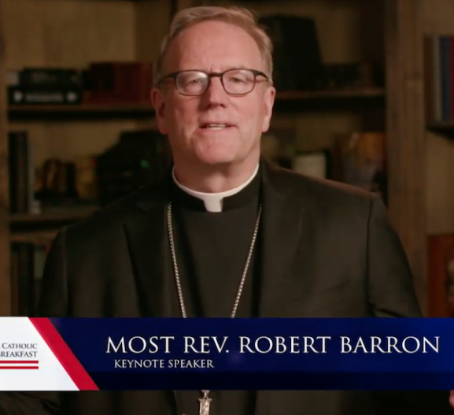
Bishop Barron at the
National Catholic Prayer Breakfast 9/23/20
Bishop Robert Barron is the founder of Word of Fire Ministry. He is an author, speaker, television and internet personality.
He was the keynote speaker at the National Catholic Prayer Breakfast three years ago.
Notes:
https://www.youtube.com/watch?v=tf5wj9WwMfI (1-6:20 mark)

Slide 9
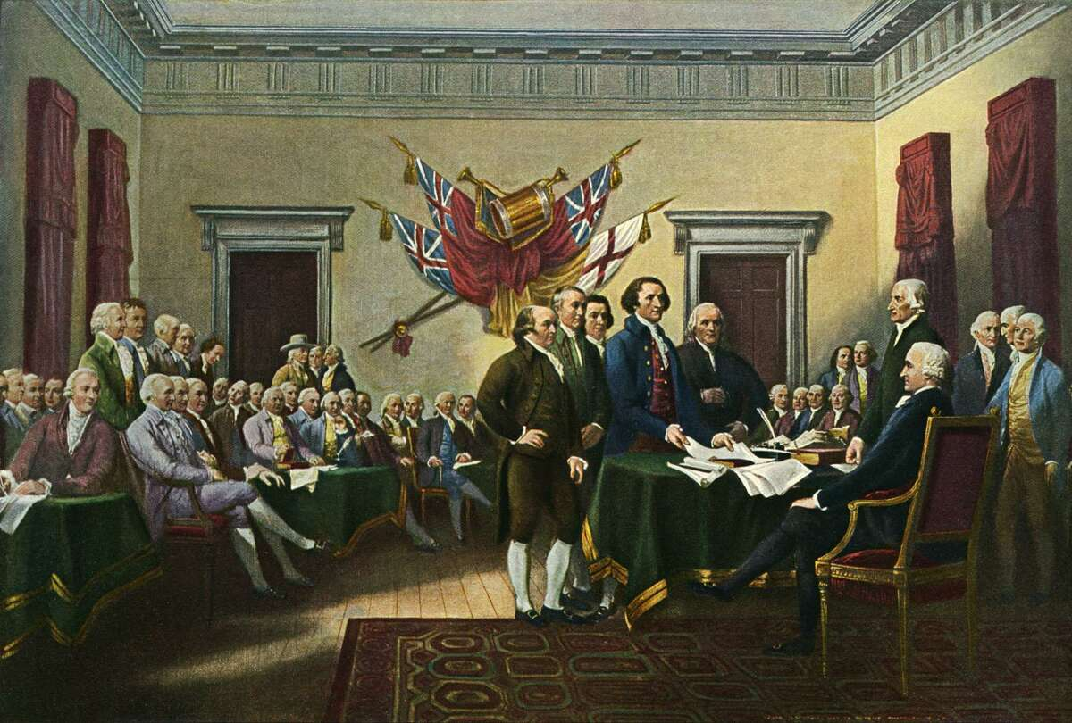
Declaration of Independence
We hold these truths to be self-evident, that all men are created equal, that they are endowed by their Creator with certain unalienable Rights, that among these are Life, Liberty and the pursuit of Happiness.—
That to secure these rights, Governments are instituted among Men, deriving their just powers from the consent of the governed.
Notes:
What’s so novel about Jefferson writing “all men are created equal?” What about “endowed by their Creator?”

Slide 10
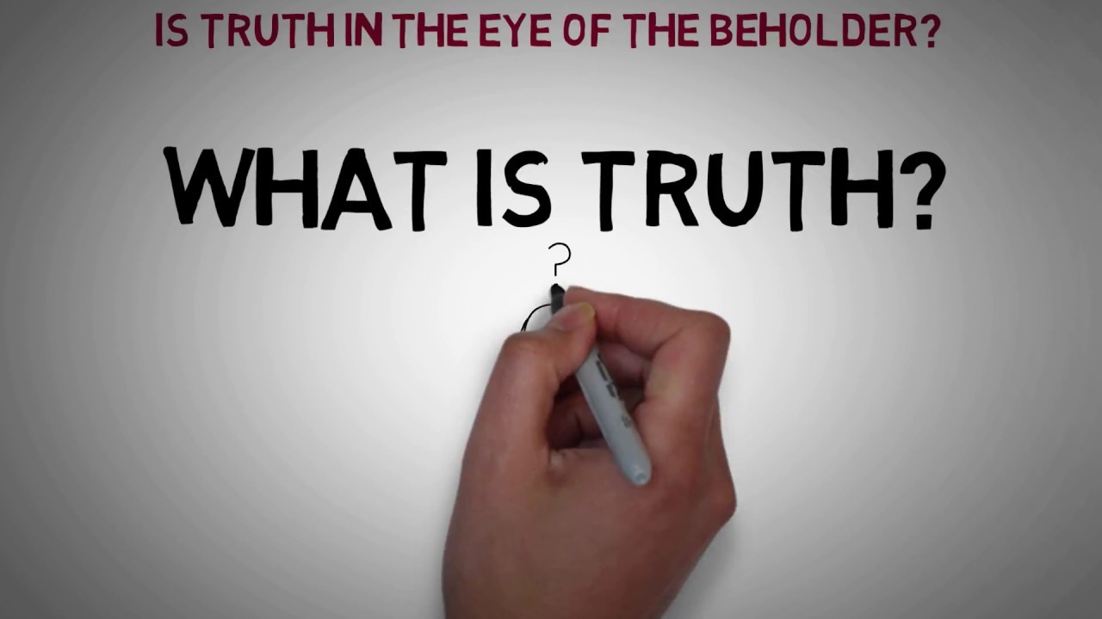
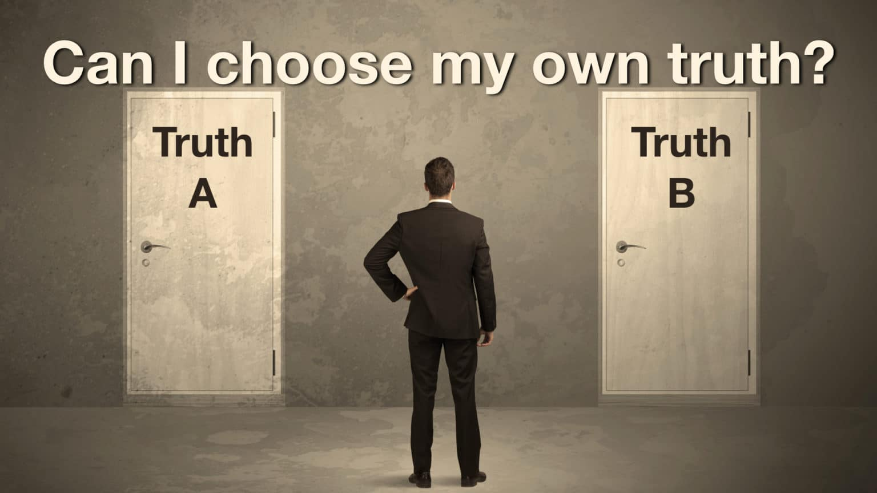
“Everyone has an equal voice and the opportunity to speak one’s truth directly to others.”
(“Petite Journeys, it’s time to Choose,” Sisters of St. Joseph of Northwestern Pennsylvania 2023 Chapter Outcomes)

Slide 11

The Human Person is an Agent of Truth!
The human person seeks the truth in things.
  The human person is a rational being having immaterial powers!
A thing?
  We look at things not as they look to our eye, but as they look to our mind.
  This gives substance to things.

Slide 12
Examples of Persons
Human persons
  Rational and relational, yes
  (Spirit and material beings)
Angels
  Rational and relational, yes
  (Pure Spirit)
God (3 persons)
  1st and 3rd rational and relational, to the highest degree, yes
  (Pure Spirit)
  2nd rational and relational, to the highest degree, yes
  (Spirit and material being)

Slide 13
Kinds of Souls
Plant (Vegetative/nutritive)
  Merely able to nourish and reproduce itself
Animal
  Powers of plant soul PLUS
  Powers flowing from bodily organs (sensations)
Human (rational/intellective)
  Powers of animal and plant soul PLUS
  Powers that transcend the body; i.e., immaterial powers

Slide 14
Hierarchy of Being
God | Pure Spirit
Angels | Pure Spirits
Human Persons | Spiritual and Material Beings / Rational Souls
Animals | Material Beings / Sensitive Souls
Plants | Material Beings / Vegetative Souls
Non-living Beings | Material Beings
“The human soul is a kind of horizon, and a boundary, as it were,
between the corporeal world and the incorporeal world.”
- St. Thomas Aquinas

Slide 15
What Happens When We Remove the spiritual from the Picture?
For example: when we only believe what we can scientifically prove?

Slide 16
Hierarchy of Being
God | Pure Spirit
Angels | Pure Spirits
Human Persons | Spiritual and Material Beings / Rational Souls
Animals | Material Beings / Sensitive Souls
Plants | Material Beings / Vegetative Souls
Non-living Beings | Material Beings
“The human soul is a kind of horizon, and a boundary, as it were,
between the corporeal world and the incorporeal world.”
- St. Thomas Aquinas

