Slide 1
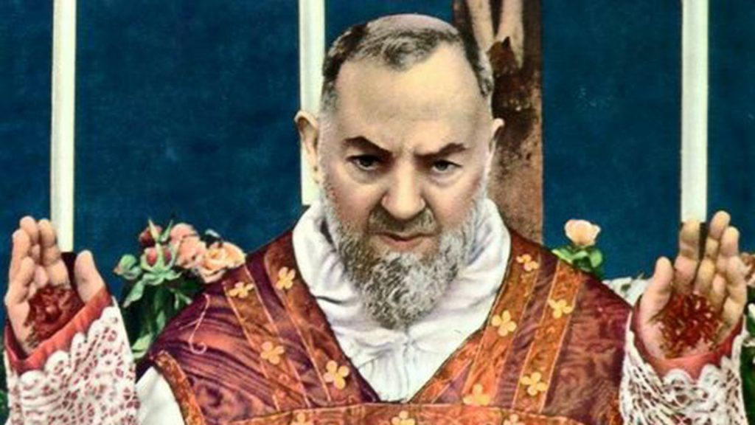
St. Raymond of Peñafort
Ninth Grade
Class 3
September 24, 2023

Slide 2
Saint Padre Pio (St. Pius of Pietrelcina)
Italian priest, confessor, and mystic.
Lived in small mountain village of Pietrelcina, NE of Naples in middle of Italy.
Known for his long hours in the confessional, reader of souls, bilocation, and his stigmata.
American soldiers in WWII, visited him as they moved up the boot of Italy.
"Pray, hope, and don't worry. Worry is useless. God is merciful and will hear your prayer."

Slide 3
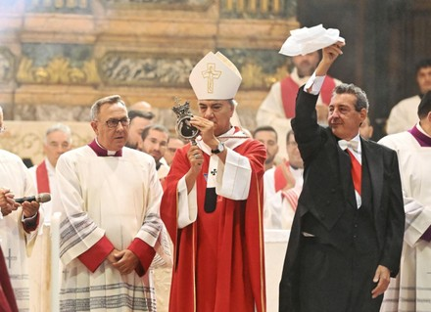
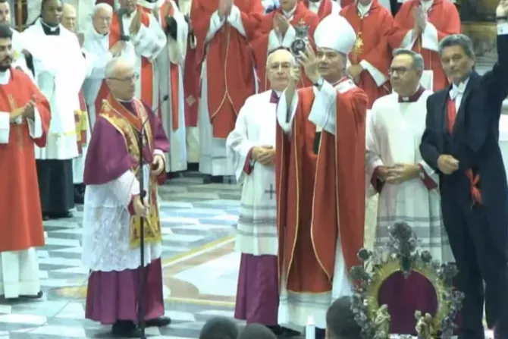
St. Januarius
September 19, 2022
September 19, 2023
Notes:
https://www.churchpop.com/st-januarius-blood-liquifies-on-his-feast-day-in-italy-watch-miraculous-the-video/
St. Januarius' Blood Liquifies on His Feast Day in Italy - Watch the Miraculous Video! (churchpop.com)
https://www.youtube.com/watch?v=g9x6-n3s_Pg

Slide 4

Classroom Exercise
There are ten statements on the left side. Each of these statements will fit under one of the columns on the right side. Mark the number of the statement in the corresponding column.
Which is it? Faith Alone; Faith and Reason; Reason Alone
1. God has a plan to save us.
2. The human soul will not die.
3. a. Jesus existed, b. He died, c. rose from the dead, and d. ascended into heaven.
4. Mars exists.
5. God is a Trinity of persons.
6. The Law of Gravity.
7. God Loves us.
8. The universe is arrayed in an orderly fashion.
9. Carbon is the most common element of planet Earth.
10. Leap year adds a day every 4 years to document the revolution of the earth around the sun more accurately.

Slide 5
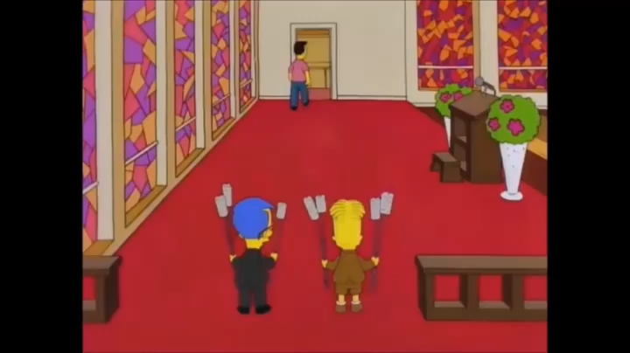
Does Heaven Exist?

Slide 6
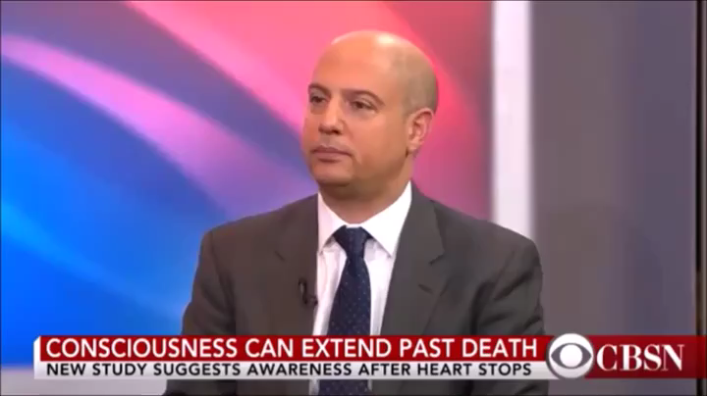

Slide 7
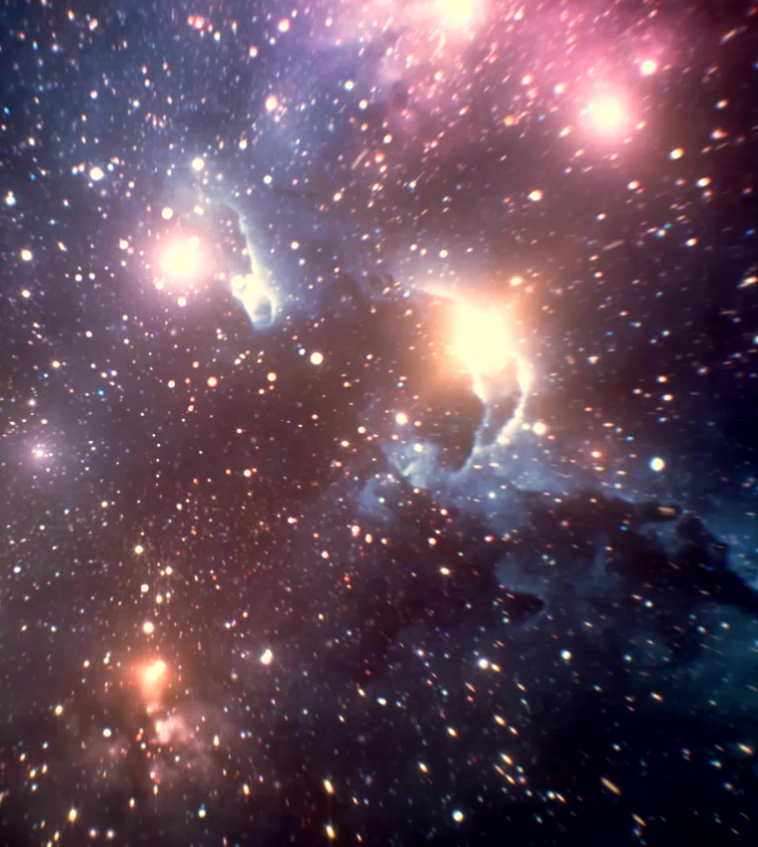
Review of the Last Class
What is significant about Bart Simpson’s view of a soul?
Were the near-death experiences convincing? Are they miracles?
What were the videos trying to prove?
Can we prove that a soul and heaven exist based on science and medicine?

Slide 8
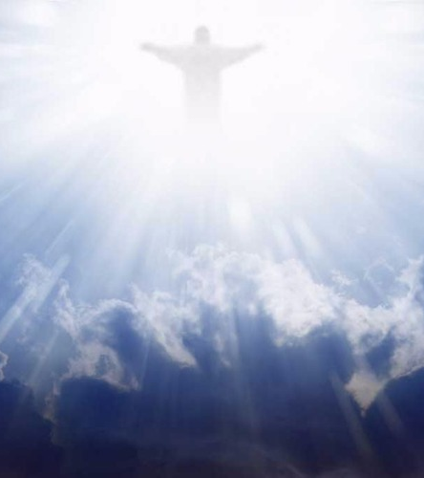
The Bottom Line from Last Class?
We each have a consciousness that is NOT
Dependent on
Our BRAINS or our BODIES.
CONCLUSION:
We have SOULS that survive bodily death
And we are DESTINED for an afterlife
of ETERNAL peace and joy.
(From Magis Center 12+ 7E Presentation 1)

Slide 9

The Bottom Line from last class?
Our WORTH and our VALUE come from OUR SOULS,
NOT
The condition of OUR BODIES
(From Magis Center 12+ 7E Presentation 1)
Notes:
12 Characteristics of the Soul

Slide 10
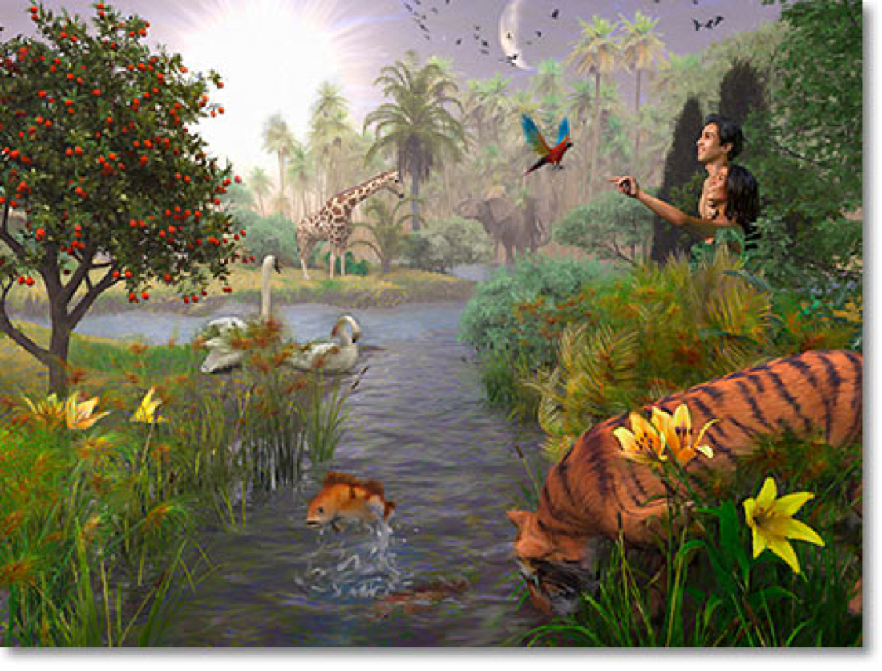
Adam and Eve Before the Fall
Created with sanctifying grace.
Had knowledge far superior to ours.
  God gave a substantial advantage to the call to holiness, love, and goodness.
Passions under control; no inclination toward sin.
Put under trial by God with one “commandment”
  Don’t eat the fruit of the tree!
Notes:
Who else was created with Sanctifying Grace? (BVM and Christ) What Name do with associate with the BVM with her creation with sanctifying grace?

Slide 11
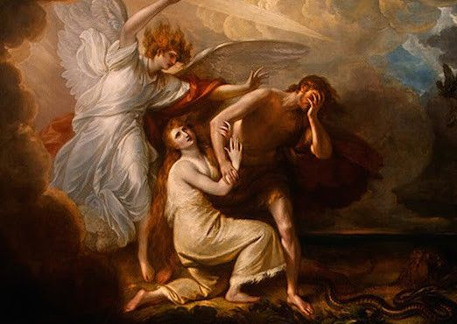
The Fall and Original Sin
What is meant by the Fall and Original Sin? (Genesis 3:1-11)
What was the sin of Adam and Eve?
What were the effects of the sin?
  Subject to death and suffering
  No sanctifying grace; no immediate right to heaven
  We have an inclination toward evil
God would not abandon us; but would send us a Savior.
Salvation history – is then the history from Adam – Noah – Abraham … to Christ!

Slide 12
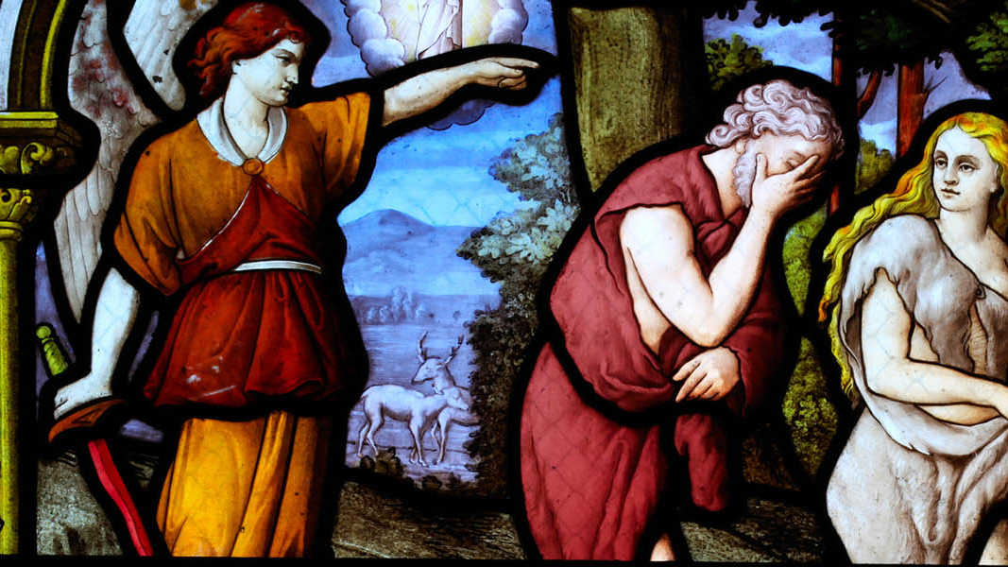
Consequences of Original Sin
Internal
External

Slide 13
Internal Consequences of Original Sin
Decreased awareness of God’s presence
  Harder for our free wills to move closer to God
Loss of focus on our transcendent calling
  Sensual and egocentric desires have more influence on us
  Decrease of self control
Pull of concupiscence
  Strong interest in power, worldly things, etc.
  More vulnerable to influence by the evil spirit
Why didn’t God just program each of us to do good and avoid evil?

Slide 14
External Consequences of Original Sin
Increased inclination to be selfish and indulge in evil desires
  Alienating us from our relationship with God, with one another, and nature
Societies were unable to move beyond awe and fear of God
  Leading to slavery and disregard for human life
Our relationship with nature was poisoned with superstition and a pervasive belief that the material world was evil
Loss of our exemption from death
It would take Christ and his mission of salvation for all humanity by incorporating us into the Church and strengthening us with the power of the Holy Spirit.

Slide 15
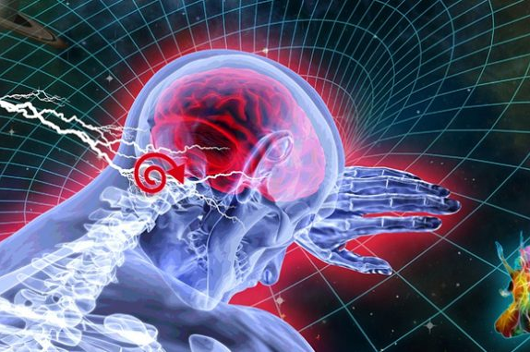
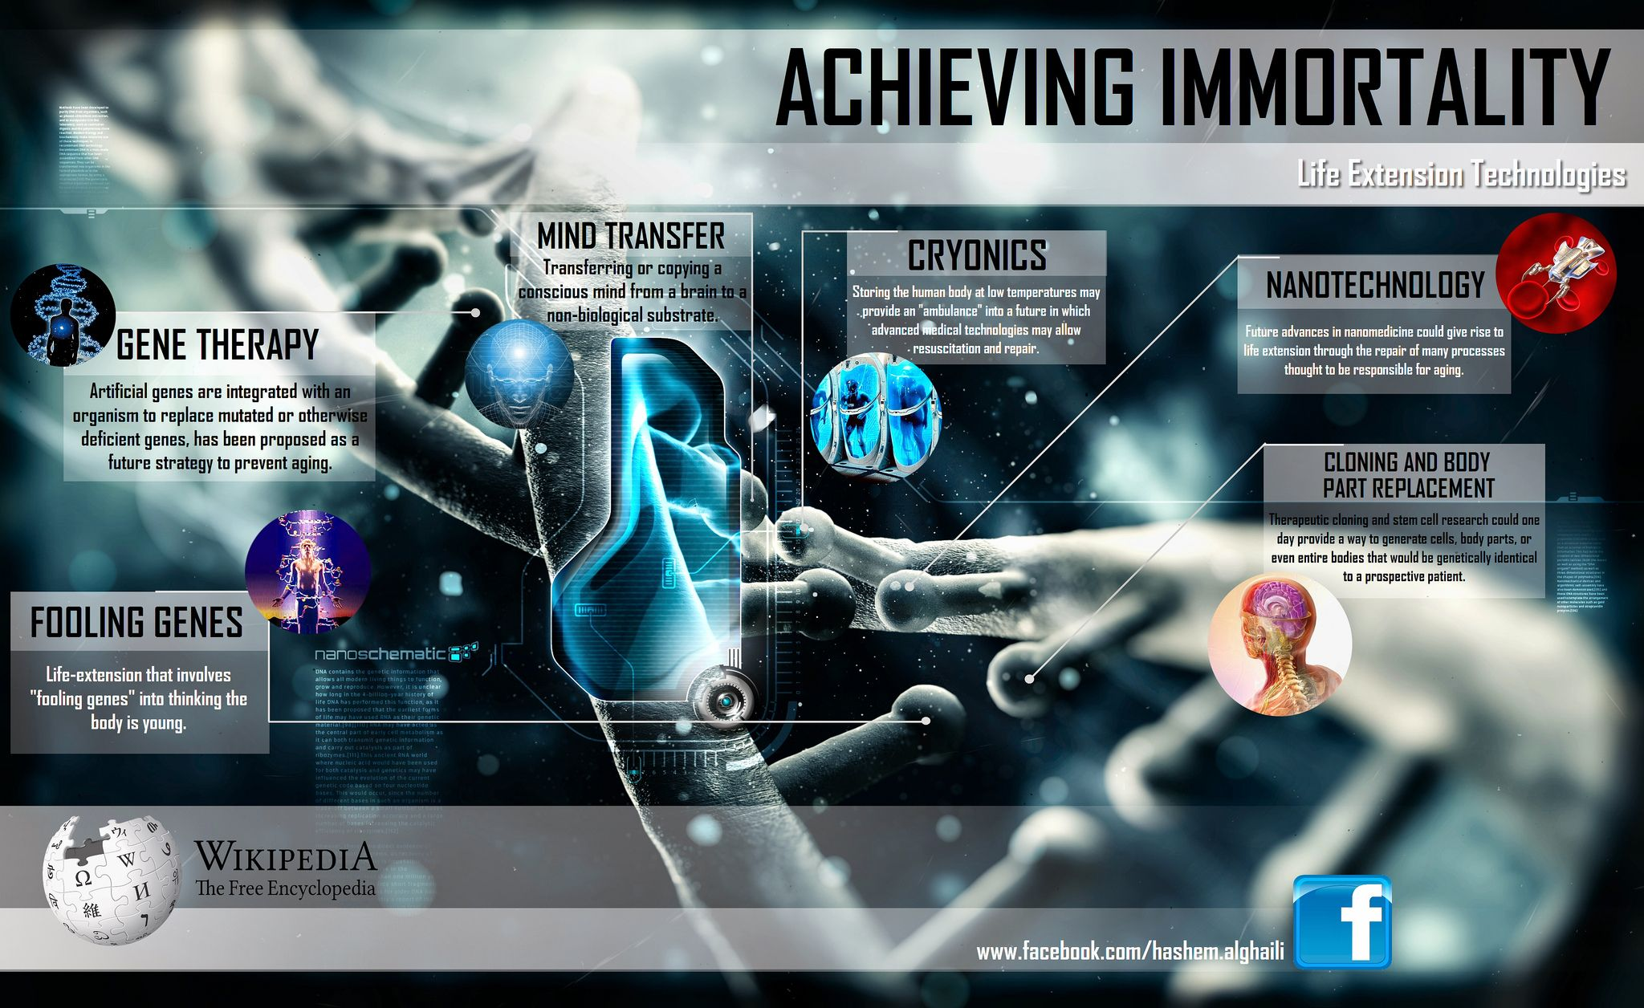

What about Transhumanism, Human Genetic Modification, and Age-Extension Technologies?
Notes:
Transhumanism is the belief that the human race can evolve beyond its current physical and mental limitations, especially by means of science and technology into a post-human state or “superior species.”
These include anti-aging, gene-editing, and age-extension technologies.
This is not an extension of the human race or an evolving of the human race, but a replacing the human race with a super-human race.

Slide 16
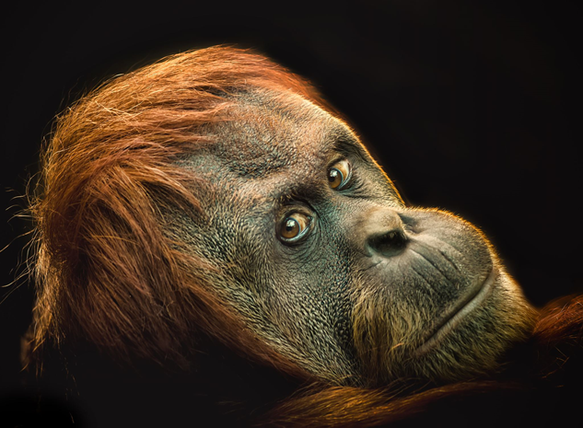
Persons
What is a person?
Comes from Latin persona, “a mark used by actors,” a “role.”
A being who is essentially relational & rational (mind and will; to think and choose).

