Slide 1
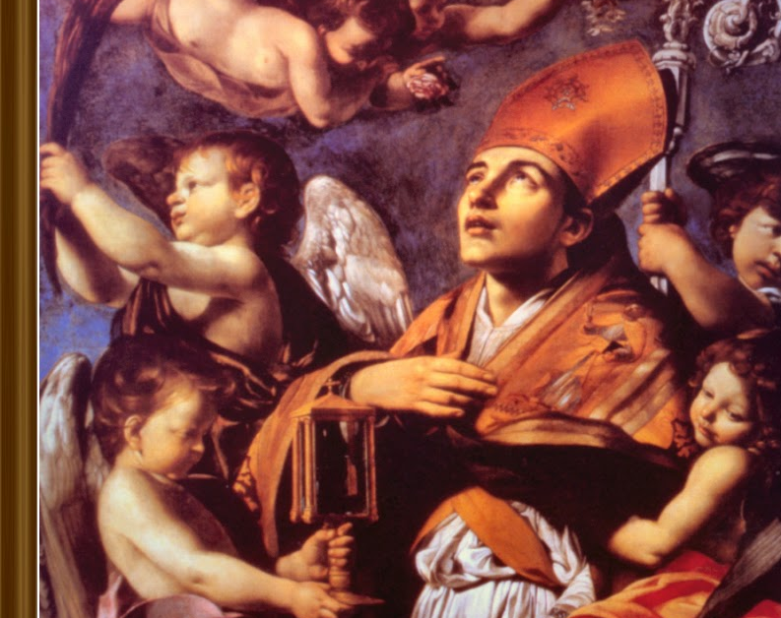
St. Raymond of Peñafort
Ninth Grade
Class 2
September 17, 2023

Slide 2
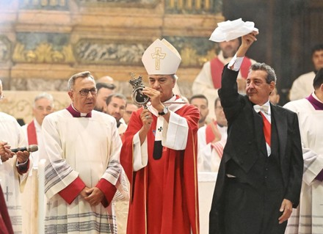
Story of St. Januarius, September 19th
Relatively obscure saint
5th century bishop of Naples, Italy
A woman preserved some of his blood which then dried.
Three times a year (including on September 19th) the dried blood liquifies.
Has been studied for centuries without a natural cause for this to happen.
Clearly a miracle – showing the presence of God in the world even today.
His blood on his Sept. 19, 2022, feast in Naples, Italy at 9:26 a.m. local time at Naples’ Cathedral of the Assumption of Mary during the celebratory Mass honoring him as the city’s patron saint.
Approximately 2,000 people in attendance cheered and applauded as Naples Archbishop Domenico Battaglia raised the ampoule containing the martyr’s liquified blood.
Notes:
https://www.churchpop.com/st-januarius-blood-liquifies-on-his-feast-day-in-italy-watch-miraculous-the-video/
St. Januarius' Blood Liquifies on His Feast Day in Italy - Watch the Miraculous Video! (churchpop.com)
https://www.youtube.com/watch?v=g9x6-n3s_Pg

Slide 3
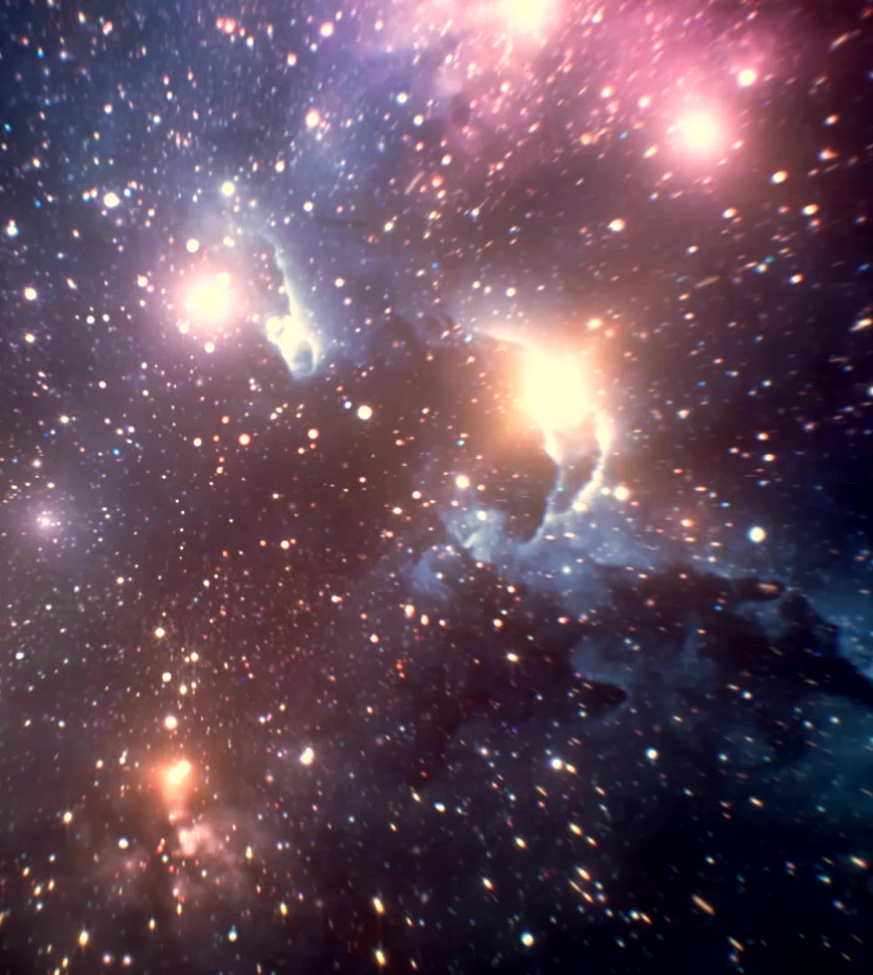
Review of the Last Class
What are the key take-aways from the long video about the origin of the universe?
What is the Doppler effect?
Why is the Doppler effect important?
What is the significance of an expanding universe regarding Creation?
Why is the speed of light important?

Slide 4


Slide 5
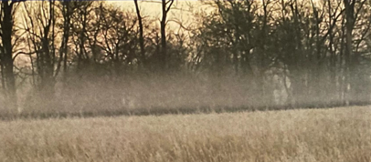
Wonders of Nature: Water
Notes:
Earlier this week, a space craft from India landed on the south pole of the moon…the pole that is always away from the sun. What was it seeking? Water. Why water, because if there is water, then there is a chance that life can be sustained.

Slide 6

Wonders of Nature: Water
Notes:
Earlier this week, a space craft from India landed on the south pole of the moon…the pole that is always away from the sun. What was it seeking? Water. Why water, because if there is water, then there is a chance that life can be sustained.

Slide 7
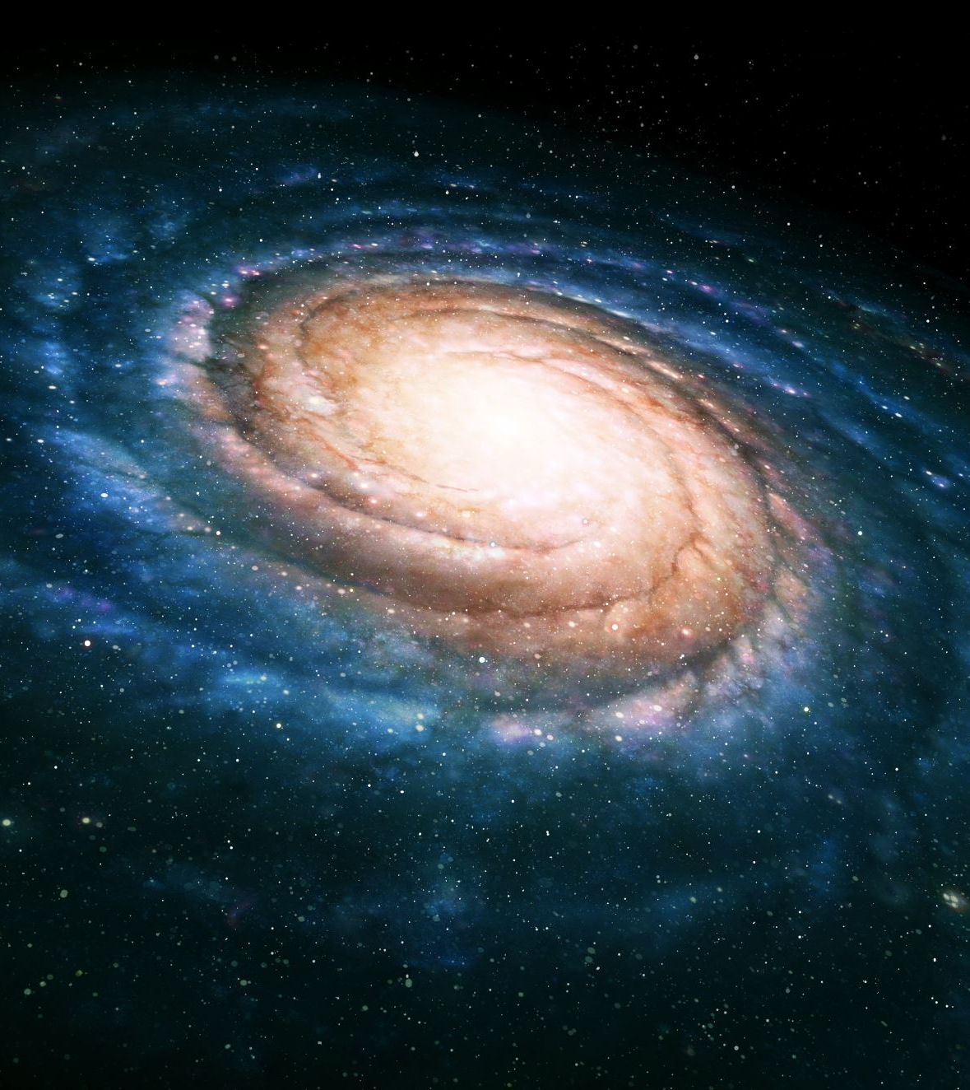
The Cosmological Argument
Whatever begins to exist has a cause. (TRUE)
The universe began to exist. (TRUE)
Therefore, the universe has a cause. That Cause had to exist outside of time and space and had to be Super Intelligent. (THEREFORE TRUE)
WHERE WAS GOD WHEN THE UNIVERSE CAME INTO EXISTENCE?
This is similar to St. Thomas Aquinas’ “The argument from causes.”

Slide 8

Myth 1: Science and faith are incompatible, and since science is true, it has replaced religion. NO: Science and faith are compatible because both have origins with God.
Myth 2: Human beings are like every other animal—merely a complex of atoms and molecules. We have no soul, no eternal destiny, and no transcendent nature. When we die, we die.
Myth 3: There is no evidence for Jesus as a historical figure, and therefore his resurrection or divinity. If Jesus did exist, he was just an interesting prophet, but not a Savior or the Son of God.
Myth 4: There is no explanation for why an all-loving God would allow suffering. Therefore, suffering is fundamentally negative, and a loving God probably does not exist.

Slide 9
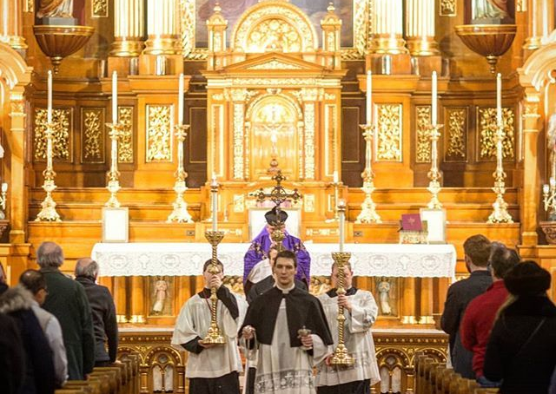
Where Does Our Faith Come From?
Sacred Scripture: The Bible: “Inspired word of God.”
Sacred Tradition: Teaching handed down to us. Written or oral, entrusted by Christ to the Apostles and their successors, which has been transmitted to us through Apostolic Succession
“Truth cannot contradict truth.” (from Pope St. JPII’s address to the Pontifical Academy of Science)
What if there is a contradiction?

Slide 10

Faith and Reason?
Notes:
Aquinas 101 – Thomasic Institute.org
St. Thomas on Faith and reason
https://aquinas101.thomisticinstitute.org/saint-thomas-on-faith-and-reason

Slide 11

What is “Sola Scriptura?”
Faith without works. (James 2:14-18)

Slide 12
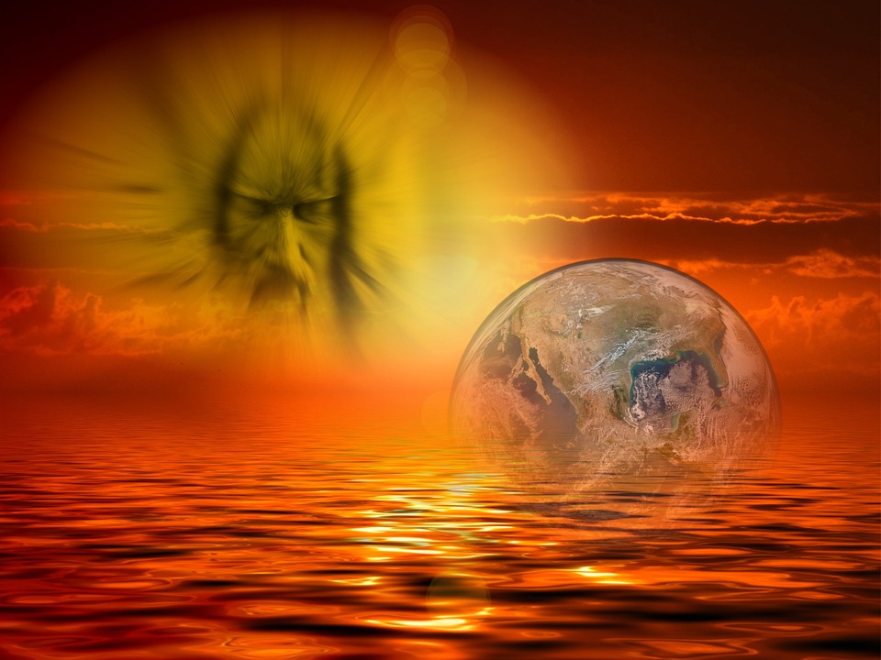
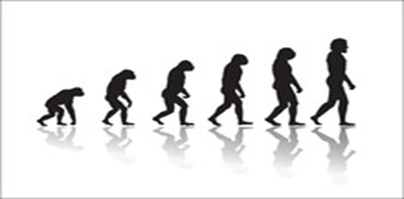
Creation and Evolution
Creation:
  God being infinitely perfect; created the universe from nothing. He could not make a mistake.
  Everything was in place the instant after the Big Bang (just needed time and space).
  Nothing happened haphazardly (Anthropic Coincidence).
Evolution:
  Charles Darwin, On the Origin of Species
    All living species in the world descended from a small number of common ancestors (plants, animals, etc.)
  Charles Darwin, The Descent of Man
    Proposes that man came into being the same way
  Natural selection, unlike animal or plant breeding; the best survive naturally

Slide 13
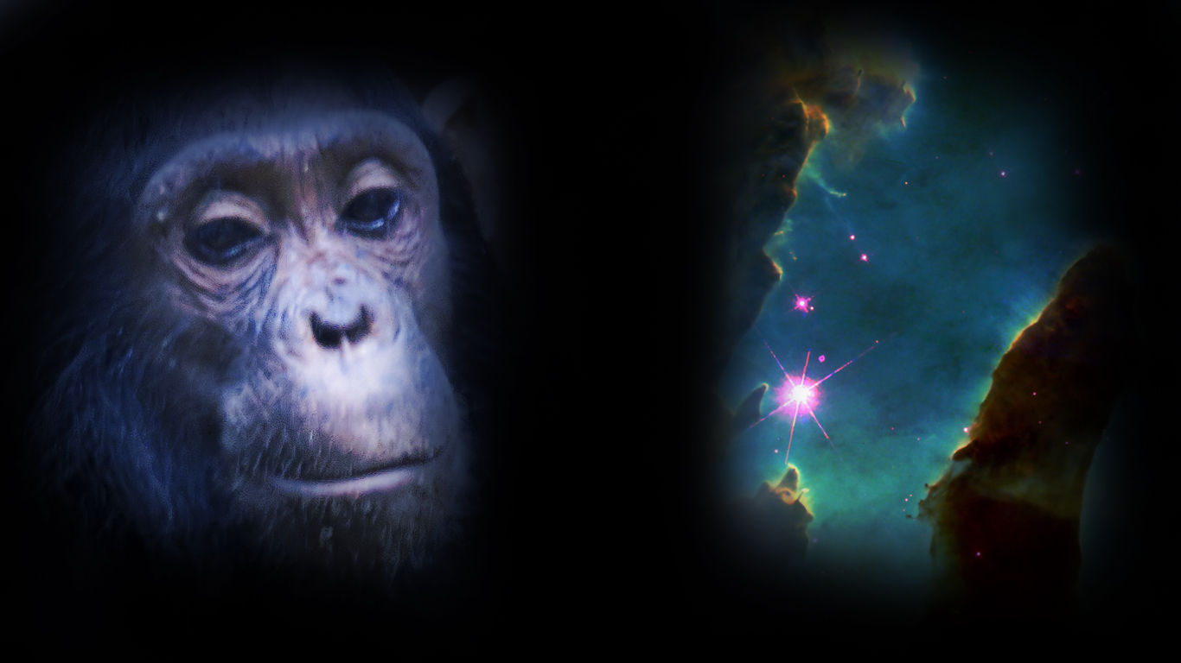
Are Evolution and Creation in Conflict?

Slide 14
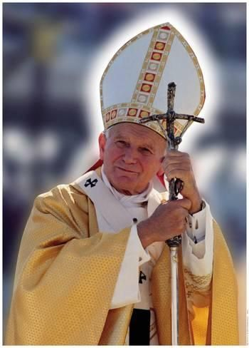
Pope John Paul II’s address to the Pontifical Academy of Science 10/22/1996
“Truth cannot contradict truth”
“There was no opposition between evolution and the doctrine of the faith about man…on condition that one did not lose sight of several indisputable points.”
  “…if the human body takes its origin from pre-existent living matter the spiritual soul is immediately created by God.”
“…theories of evolution which…consider the mind as emerging from the forces of living matter…are incompatible with the truth about man."
Notes:
Thus, God perfected the universe with the Big Bang allowing everything evolve from that first instant…except Man. “…if the human body takes its origin from pre-existent living matter the spiritual soul is immediately created by God.”

Slide 15
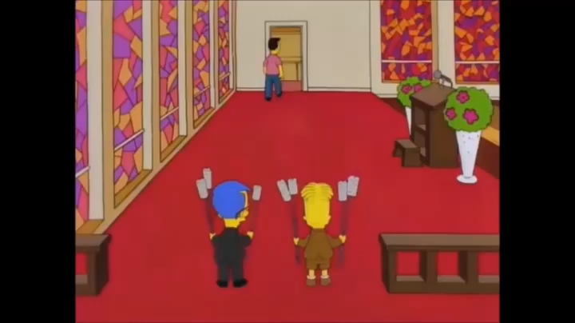
Does Heaven Exist?

Slide 16
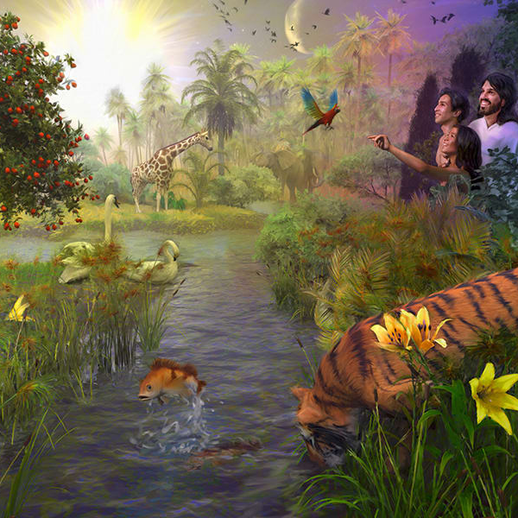
Kinds of Souls
Plant (Vegetative/nutritive)
  Merely able to nourish and reproduce itself
Animal
  Powers of plant soul PLUS
  Powers flowing from bodily organs (sensations)
Human (rational/intellective)
  Powers of animal and plant soul PLUS
  Powers that transcend the body; i.e., immaterial powers
  Why is the human soul important?

Slide 17
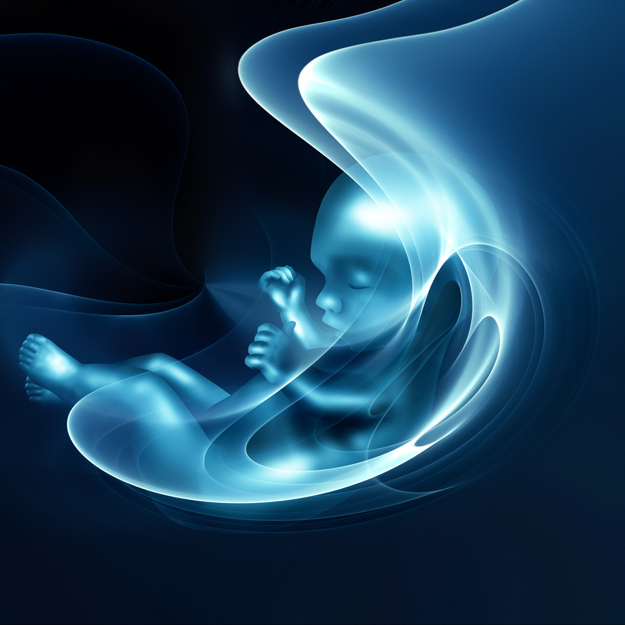
The Timeline of the Human Soul
Defines the person at the point of conception.
During life span, provides for rational judgment (conscience and will) of a person.
At death:
  Heaven
  Purgatory
  Hell

Slide 18
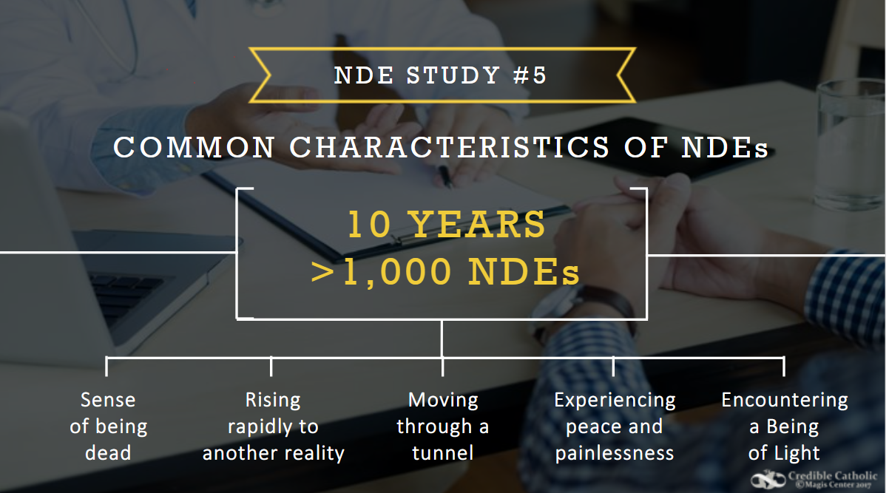

Slide 19
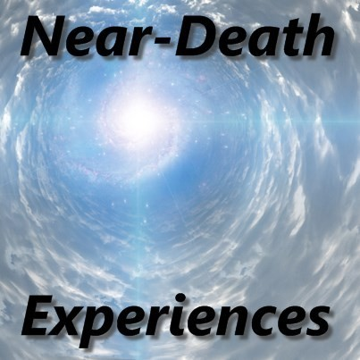
Near Death Experiences (NDE)
Medical Evidence
of a Human Soul
Near-Death Experiences (NDEs)
Notes:
https://www.crediblecatholic.com/12ppt/7E-P1-A/

Slide 20


Slide 21
HEAVEN IS FOR REAL VIDEO SEGMENT

Slide 22
Parallels between NDE Reports and Scripture
1. Jesus appears to His disciples after the Resurrection
John 20:19; Luke 24:3_________________________________________________
2. The disciples meet Jesus on the road to Emmaus
Luke 24:28-32:______________________________________________________
3. The Resurrection of the body
1 Cor. 15:42-44:______________________________________________________
4. Unconditional Love of Jesus
1 John 4:16-19 :______________________________________________________

Slide 23
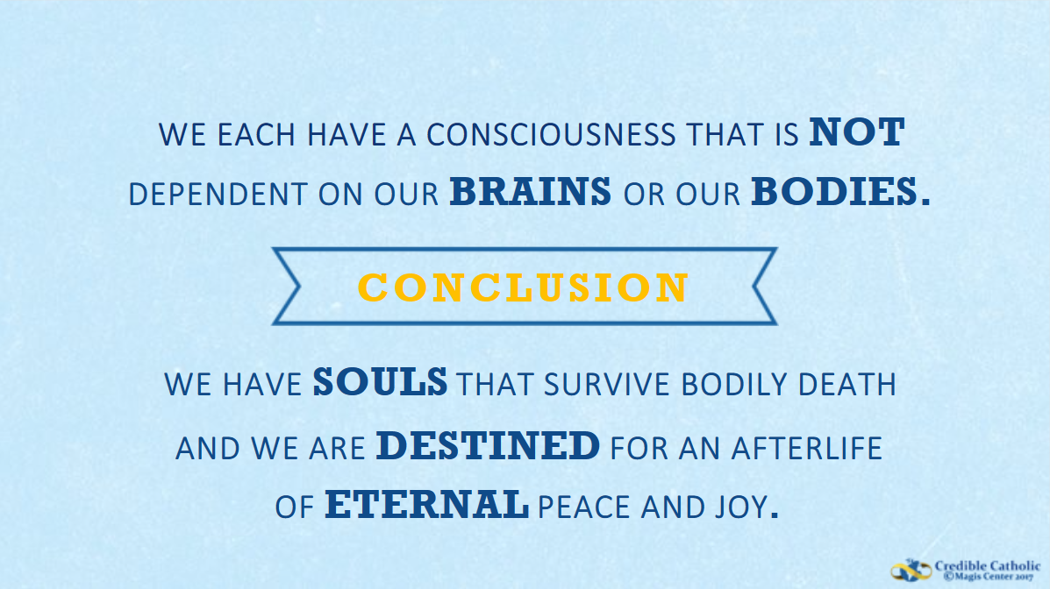

Slide 24
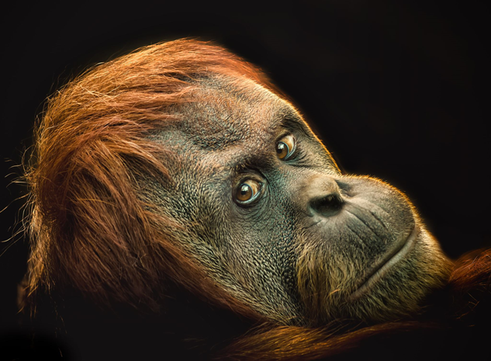
Evolution and the Bible

Slide 25

Who are Our First Parents?
The names Adam and Eve clearly have symbolic meaning (“formed from the earth” and “giver of life,” respectively) but what do we know about the individuals themselves? Catholics can believe that the first man and woman evolved from previous species provided that these two were the first to receive a unique transphysical soul from God, making them in His image. Interestingly, there is established evidence that the whole of humanity today has one common female ancestor—named “Mitochondrial Eve” —whose mitochondrial DNA is integral to the genome of every human being around the world (without exception). We also have a common male ancestor—named “Y chromosome Adam”—who is the origin of the male “Y” chromosome.

Slide 26
Who are Our First Parents?
Mitochondrial Eve and Y chromosome Adam probably lived around the same time (300,000 years ago) and came from a similar region (southwestern coastal Africa). Were these our first parents? It’s an interesting idea, though not definitive (these two might have only been the ancestors of the first man and woman to receive a transphysical soul). Linguistic studies suggest that language first appeared about 70,000 years ago without any obvious cause—this might have been the time that a transphysical soul was infused into our first parents.
The timing is still an open question for scientists to explore, but whenever they lived, we know that the original human couple was the first to receive a unique transphysical soul and were the first ancestors of the entire human race.

