Slide 1
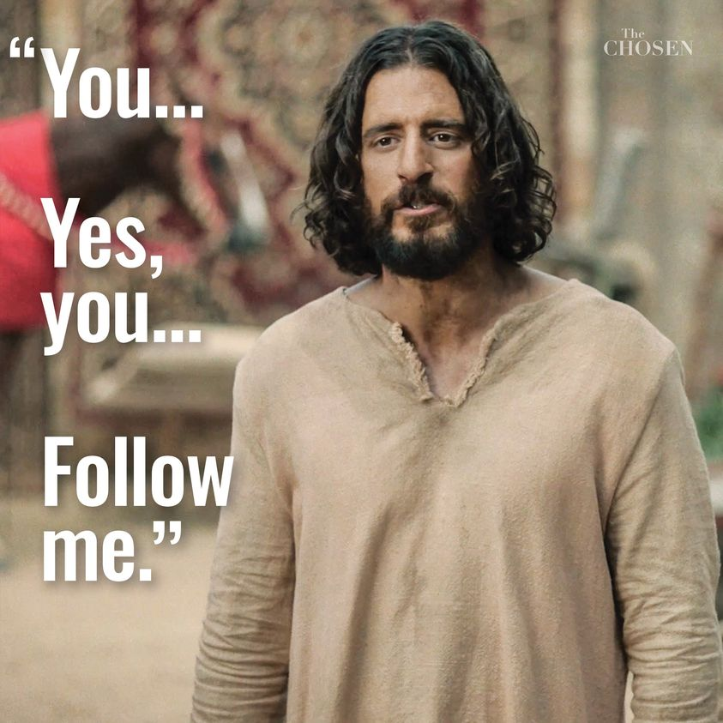
Ninth Grade CCD Class #26
May 1, 2022
The American Experiment and its Relation to our Catholic Faith: The “isms”

Slide 2
Anima Christi
Soul of Christ, sanctify me.
Body of Christ, save me.
Blood of Christ, inebriate me.
Water from the side of Christ, wash me.
Passion of Christ, strengthen me.
O Good Jesus, hear me.
Within your wounds hide me.
Permit me not to be separated from you.
From the wicked foe, defend me.
At the hour of my death, call me
and bid me come to you
That with your saints I may praise you
For ever and ever. Amen.

Slide 3
You Gov America Poll
(January 14-20, 2022)
How many Americans do you think are Catholic?
How many do you think are atheists?
Poll/Class
41%
22%
33%
3%

Slide 4
You Gov America Poll
(January 14-20, 2022)
How many Americans do you think are Catholic?
How many do you think are atheists?
Poll/Class
41%/34.6%
22%
33%/30.3%
3%

Slide 5
You Gov America Poll
How many American families have an annual income of over $500,000?
How many Americans have read a book in the past year?
26%
1%
50%
77%

Slide 6
You Gov America Poll
How many American families have an annual income of over $500,000?
How many Americans have read a book in the past year?
26%/13.8%
1%
50%/62%
77%

Slide 7
You Gov America Poll
How much of America’s population lives in New York City?
How much of the population lives in California?
30%
3%
32%
12%

Slide 8
You Gov America Poll
How much of America’s population lives in New York City?
How much of the population lives in California?
30%/11.9%
3%
32%/19.6%
12%

Slide 9
You Gov America Poll
How many Americans are gay or lesbian?
How many transgender people live in the U.S.?
30%/19.25%
3%
21%/7.16%
1%

Slide 10
Equity, Diversity, and Inclusion
Are these fundamental rights?
Bishop Barron on EDI
https://www.youtube.com/watch?v=hqY0O0xNZJA
Start at 0:40
End at 12:36
Notes:
For the parents note: https://www.youtube.com/watch?v=2_zLFQwlPNQ – “I don’t understand the Catholic faith.” “They don’t answer my questions!”
Not dumbing down the faith.

Slide 11
Protestantism
The remaking of Christianity “according to various theories of how the ‘primitive Church’ was lost amidst Catholic accretions but would now re-emerge through the action of the Holy Spirit in guiding the reformers.
The central Protestant principle of private judgment has had the devastating consequences of making Christianity an essentially individual endeavor unbound by any external authority.
  Private judgment meaning that God would lead each believer to correctly understand the Holy Scriptures apart from any ecclesiastical authority.

Slide 12
Protestant Understanding of the Eucharist
“This is My Body,” means that transubstantiation occurs, and the bread becomes the body of Christ.
Protestants believe that the Eucharist is a symbol of Christ, not actually the body of Christ.
This is a “protesting” of the authority of the Catholic Church and thus the authority of God. The Son of God taught with authority, “He who hears you hears me.” (Luke 10:16)

Slide 13
Jesus of History
1. There was a man named Jesus. (Matt 1:1)
2. He claimed to be a messenger sent by God. (Mark 2:23-28; Matt 12:1-8)
3. He did enough to prove this by miracles such that there was a connection between the claim and the miracle. (Luke 11:14-20; Luke 8:41-56; Matt 8:5-13; Matt 9-27-29)

Slide 14
Jesus of History
4. He has an inner circle to whom He spoke more often. (Matt 10:1-4) (Matt 25:14-29)
5. He told them to continue His work, His teaching. (Matt 28:16-20)
6. He promised that God would protect the teaching, “He who hears you hears me, and he who rejects you rejects me, and he who rejects me rejects him who sent me.” (Lk 10:16)

Slide 15
The Enlightenment
Began with Rene Descartes’ “Cogito, ergo sum” (1687) and ended with the French Revolution (1789)
Era which rejected “the God-centered understanding of creation and redemption and replace it with a man-centered perspective in which human genius would no long seek tto know the truth of creation but rather redefine reality.”

Slide 16
God | Pure Spirit
Angels | Pure Spirits
Human Persons | Spiritual and Material Beings / Rational Souls
Non-human Animals | Material Beings / Sensitive Souls
Plants | Material Beings / Vegetative Souls
Non-living Beings | Material Beings
Expressing God
Living in the world
“The human soul is a kind of horizon, and a boundary, as it were,
between the corporeal world and the incorporeal world.”
- St. Thomas Aquinas

Slide 17
St. John Henry Newman
“In proportion as you put off the yoke of Christ,
so does the world by a sort of instinct
recognize you and think well of you accordingly,
its highest compliment is to tell you that you disbelieve.”
“Discourse 8: Nature and Grace,” in Discourses to Mixed Congregations (1849), no. 166
https://www.newmanreader.org/works/discourses/discourse8.html

Slide 18
What Level of Happiness/Love are we at?
Level I
1
Level II
2
Level III
3
Level IV
4

Slide 19
Conflict of Interest
<- universal destination of goods vs. right to private property ->
The right to private property (justly acquired) does not do away with the original gift of the earth to the whole of mankind. (CCC 2403)
The universal destination of goods remains primordial, even if the promotion of the common good requires respect for the right to private property and its exercise. (CCC 2403)
What is the conflict of interest?
How can we resolve it?

Slide 20
Definitions
Totalitarianism – a form of government in which a single party controls all aspects of the government and suppresses any opposition.
Socialism – A form of government in which the state controls the marketplace by setting prices, providing services, redistributing wealth; private enterprises are permitted, but they are heavily regulated by price and production controls.
Marxism/Communism – A form of government in which the state owns all property and denies the ownership of any private property. The three steps toward communism are first totalitarianism, then socialism, and then communism.

Slide 21
Definitions
Woke ideology – a fundamentalist and increasingly militant pseudo-religion – to rising generations; makes it difficult for dissenters to challenge that ideology and, indeed, to survive without being subjected to discrimination and even “cancellation.” The survey from the last class is an example of “woke ideology”.
Cancellation or Cancel Culture – Usually pertains to a person, organization, business, or ideology whereby its existence is removed (cancelled) from all forms of liberal media. Suppressing opinions on Facebook, Twitter, etc.
Critical race theory - deploys a series of euphemisms including, “equity,” “social justice,” “diversity and inclusion,” and “culturally responsive teaching” to marginalize any history, culture, political program originating from, created by, or identified with white males. 1619 Project, rewriting history books, etc.
Notes:
Need to clean up these definitions and maybe even move them to later.

Slide 22
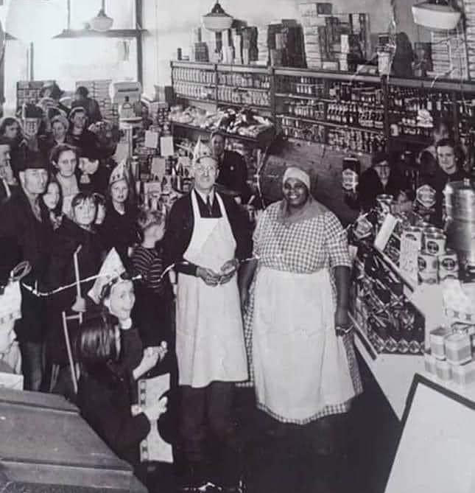

Example:
“Aunt Jemima”
Nancy Green: born a slave in 1834
Became a wealthy superstar in the advertising world
Was 56-yrs old when she was selected as spokesperson for a new ready-mixed, self-rising pancake flour
Made her debut in 1893 at a fair and exposition in Chicago
Was a good storyteller
Warm and appealing personality
Her financial freedom and stature as a national spokesperson enabled her to become a leading advocate against poverty and in favor of equal rights for all Americans.

Slide 23
Definitions
“Critical race theory” –It originates from identity-based Marxism which builds its political program on social and class conflict. Rahm Emmanuel, President Obama’s chief-of-staff, put it clearly, “You never let a crisis go to waste, and what I mean by that it’s an opportunity to do things that you think that you could not do before.”
Critical race theory deploys a series of euphemisms including, “equity,” “social justice,” “diversity and inclusion,” and “culturally responsive teaching” to marginalize any history, culture, political program originating from, created by, or identified with white males.
Here’s a radical example, “Brown U. professor proposed the creation of the Department of Antiracism, independent of the elected branches of government, having the power to veto, nullify, or abolish any law at any level of government that it deems insufficiently “antiracist.”

Slide 24
Critical Race Theory
“In contrast to equality, equity as defined and promoted by critical race theorists is little more than reformulated Marxism.”
Suspension of private property rights;
Seizing land and wealth redistribution along racial lines;
End private property, individual rights such as freedom of speech;
These would be replaced with race-based redistribution of wealth, group-based rights, active discrimination and omnipresent bureaucratic authority.

Slide 25
Critical Race Theory – How it works!
Government, industry, teacher workshops on it. Department of Homeland Security telling white employees they were committing “microinequities” and have been “socialized into oppressor roles.”
Disagreement with the program becomes irrefutable evidence of “unconscious bias,” or “internalized white supremacy.”
Dissenters are instructed to remain silent and to accept their “complicity in white supremacy.”
History classes begin to teach that America was founded on and defined by racism and that our founding principles, our Constitution, and our way of life should be overthrown.

Slide 26
Critical Race Theory – How to defeat it:
Governmental action, (Pres. Trump banned programs in fed govt., Pres. Biden rescinded the action the first day in office). Several states have banned it: preventing public institutions from conducting programs which stereotype, scapegoat, or demean people based on race. 14th Amendment provides equal protection under the law and the 1st Amendment guarantees free speech.
Grassroots mobilization – vote those in support of it out of office, and
Appeal to principle – “excellence beats diversity every time.”

Slide 27
“Can We Still Reason Together?”
“Where there is a mutual commitment to truth and truth-seeking, relationships can be built between religious believers and secularists, and they can indeed reason together.”
“The minimum condition is this: interlocutors, however wide and deep their substantive philosophical or other differences, need to share the conviction that business between them is to be conducted in the proper currency of intellectual discourse – namely reasons, evidence and arguments.”

Slide 28
“Can We Still Reason Together?”
“Father John Neuhaus, ‘Remember, our job is to be faithful – ever faithful – standing boldly and fighting for what’s right’ the victory will surely come, but His timing and terms are not up to us. We must stick to doing our job, and not try to do His. We are merely His instruments. So, however dark things may seem, never yield to despair. Leave the timing and terms of the victory to God. Be faithful – ever faithful.”

Slide 29
What is Socialism?
State controls the marketplace by setting prices, providing services, redistributing wealth.
Private enterprises are permitted, but they are heavily regulated by price and production controls.
Examples:
  Elements of the Affordable Care Act (ObamaCare) – nationalized healthcare.
  Government requirements that work only performed by businesses where the workers are unionized.
  Government takes over the power grids, the internet, etc.
  In schools?
  What else?

Slide 30
What is Socialism?
Pope Leo XIII in (Rerum Novarum 15) said that socialism is contrary to the natural right to own property and that “the main tenet of socialism, [the] community of goods, must be utterly rejected.”
May 2019 poll – (Can a Catholic be a Socialist? – pg. 91)
  1/3 of Americans associated socialism with equality, the government providing people with health care, housing and jobs, and ending poverty.
  1/5 didn’t know what socialism was.
  1/5 could not name the primary tenet of socialism: government ownership of the economy and the abolishment of private property.

Slide 31
What is Capitalism?
Capitalism allows for the free exchange of goods and services.
Dunkin Donuts values a donut at $1.00.
  I want to buy the donut because at this moment I value the donut more than I value the $1.00 so I am willing to exchange the $1.00 for the donut.
  Dunkin Donuts values the $1.00 more than their donut and are willing to part with the donut for $1.00.
Capitalism can be summarized as “give me what I want and I’ll give you what you want.”
Profit is a sign that a business is meeting the peoples’ needs by providing them with something that they want at a price that is higher than the cost of producing it. It’s an indicator of a healthy business, which benefits the business and the people who are associated with it.
Profits show that people are being benefited. Workers are getting paid and the consumers get what they want.
Capitalism is a good thing when it is properly ordered toward the common good.

Slide 32
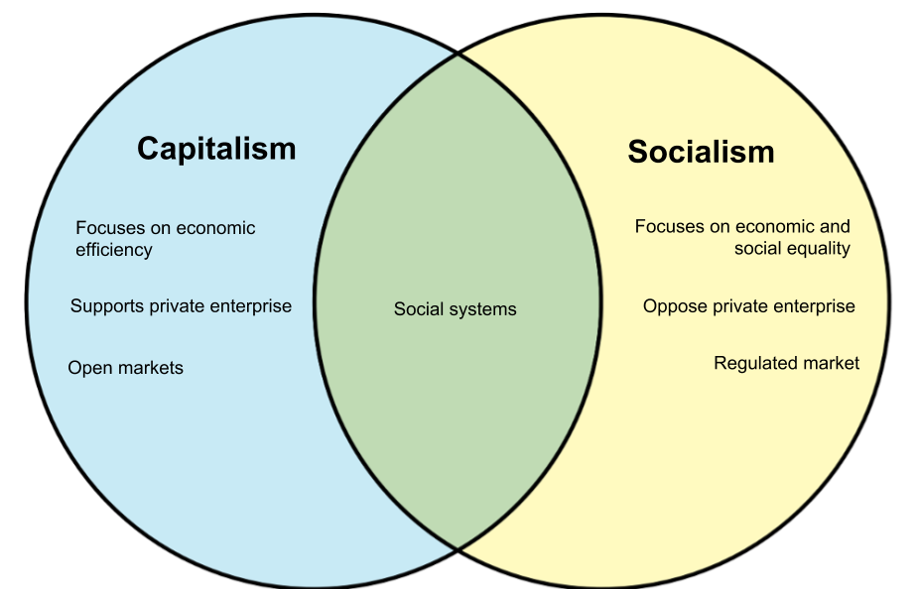

Slide 33
Communism/Marxism
Based on the writings of Karl Marx and Friedrich Engels.
Fundamental foundation based on a non-acceptance of God in the world nor of the afterlife.
Reduces man to an instrument of the state.
State/”community” ownership of all property and wealth distributed among the citizens.
No work incentives; government makes all economic decisions.
Notes:
I will be using the terms Marxism and communism interchangeably.

Slide 34
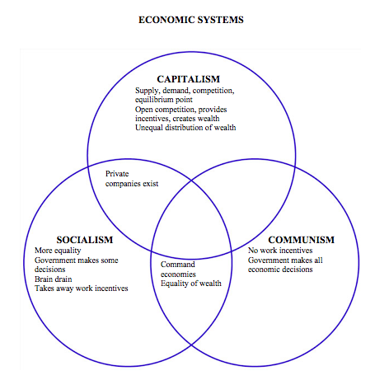

Slide 36
Communism
Social doctrine which affirms the community of goods and denies the right to ownership of private property.
The philosophy is dialectical materialism
  claims that matter and not spirit, and least of all the infinite Spirit who is God, is the primary reality in the universe;
  claims that material forces in conflict (dialectic) explain all the progress in the world.
Economics is the sole basis of human civilization, making all ethical, religious, philosophical, artistic, social, and political ideas the result of economic conditions.
The Communist strategy is a shifting expediency that defies analysis but has two constants that never really change:
  Massive indoctrination of the people, and
  Ruthless suppression of any ideas or institutions that threaten totalitarian control by the Party.

Slide 37
Steps toward a Marxist society
  Worker creates more value than he is paid for, and this surplus value goes to the employer, who exploits the worker to that extent.
  The employer puts this surplus value back into his business, and this constitutes capital. The lower the wages, the more capital for the capitalist.
  A basic premise of Marxism is that the rich get richer and the poor get poorer.
  Capitalism then collapses; the masses revolt and seize the means of production and establish a dictatorship of the proletariat.
  Within this dictatorship, Communist utopia will exist because class struggles will cease because all classes of society will have disappeared.
See Pope Pius XI, Divini Redemptoris, 1937.

Slide 38
Marxism According to Solzhenitsyn
How could it happen? There are 8 levels of control:
Healthcare – Control healthcare and you control the people.
Poverty – Increase the poverty level as high as possible, poor people are easier to control and will not fight back if you are providing everything to them.
Debt – Increase the debt to an unsustainable level. Then you will be able to increase taxes, and that will produce more poverty.
Gun Control – Remove the ability to defend themselves from the government. That way you are able to create a police state.

Slide 39
Marxism According to Solzhenitsyn
5. Welfare – Take control of every aspect (food, housing, income) of their lives because that will make them fully dependent on the government.
6. Education – Take control of what people read and listen to and take control of what children learn in school.
7. Religion – Remove the belief in God from the government and schools because the people need to believe ONLY that the government knows what is best for the people.
8. Class Warfare – Divide the people into the wealthy and the poor. Eliminate the middle class. This will cause more discontent and it will be easier to tax the wealthy with the support of the poor.”

Slide 40
Steps to Communism
Abolition of property in land and application of all rents of land to public purposes.
A heavy progressive or graduated income tax.
Abolition of all right of inheritance.
Confiscation of the property of all emigrants and rebels.
Centralization of credit in the hands of the State by means of a national bank with State capital and an exclusive monopoly.
Centralization of the means of communication and transport in the hands of the State.

Slide 41
Steps to Communism
Extension of factories and instruments of production owned by the State, the bringing into cultivation of waste lands, and the improvement of soil generally in accordance with a common plan.
Equal liability of all to labor. Establishment of industrial armies, especially for agriculture.
Combination of agriculture with manufacturing industries; gradual abolition of the distinction between town and country by a more equitable distribution of the population over the country.
Free education for all children in public schools.

Slide 42
Resisting Marxism According to Solzhenitsyn*
Don’t think like a Marxist:
“If only there were evil people somewhere insidiously committing evil deeds, and it were necessary only to separate them from the rest of us and destroy them, but the line dividing good and evil cuts through the heart of every human being. And who is willing to destroy a piece of his own heart?”
Be willing to destroy the footholds of Marxism in our own hearts!
*Taken from “How to Resist Marxism According to Solzhenitsyn” by Jane Stannus, Crisis Magazine online, 2/25/2021

Slide 43
Resisting Marxism According to Solzhenitsyn
2. Do remember that we, not Marxists, are the friends of humanity.
The term “anti-communism” is a poorly designed expression, invented to make “it appear as though communism were something original, something basic, something fundamental.”
“That which is against communism is for humanity. Not to accept, to reject this inhuman Communist ideology is simply to be a human being.”

Slide 44
Resisting Marxism According to Solzhenitsyn
3. Don’t lick out bowls.
“A man can live here, just like anywhere else. Know who croaks first? The guy who licks out bowls, puts his faith in the sick bay, or squeals to godfather [camp slang for the resident informer].”
Marxism is material atheism. Dignified behavior counters it by silently, but powerfully, testifying to the existence and nobility of the soul.

Slide 45
Resisting Marxism According to Solzhenitsyn
4. Do support traditional forms of authority.
“Mediocrity triumphs with the excuse of restrictions imposed by democracy.”
This is important for Catholics who are understandably horrified by the moral and doctrinal deviancy of certain members of the hierarchy to consider.
We can’t turn against all authority because some leaders are bad. Of course, it’s legitimate to distance oneself from an authority that’s moving, wittingly or unwittingly, in a bad direction. But it is nonetheless necessary to uphold the principle of personal authority.
Otherwise, when a good man does become a leader, how will things change?

Slide 46
Resisting Marxism According to Solzhenitsyn
5. Don’t tell lies.
“The simplest, the most accessible key to our liberation” from Marxism: “a personal nonparticipation in lies! Even if all is covered by lies, even if all is under their rule, let us resist in the smallest way: Let their rule hold not through me!”
It’s never too late to start telling the truth!

Slide 47
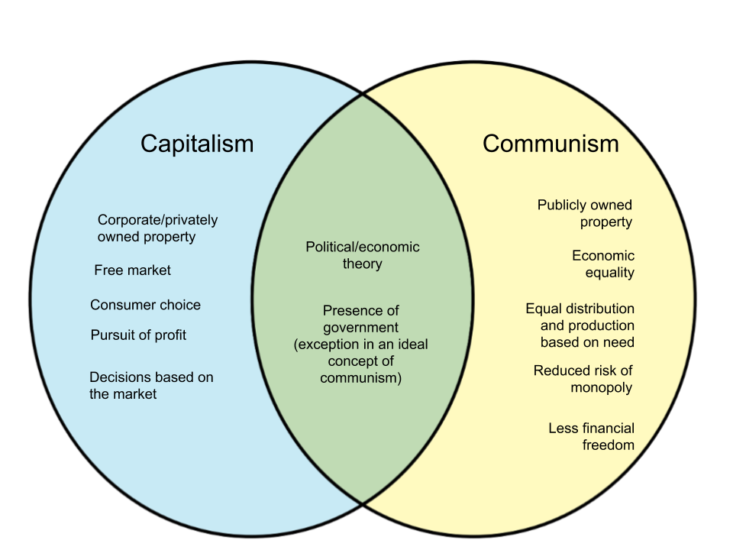
Capitalism vs Communism

Slide 48
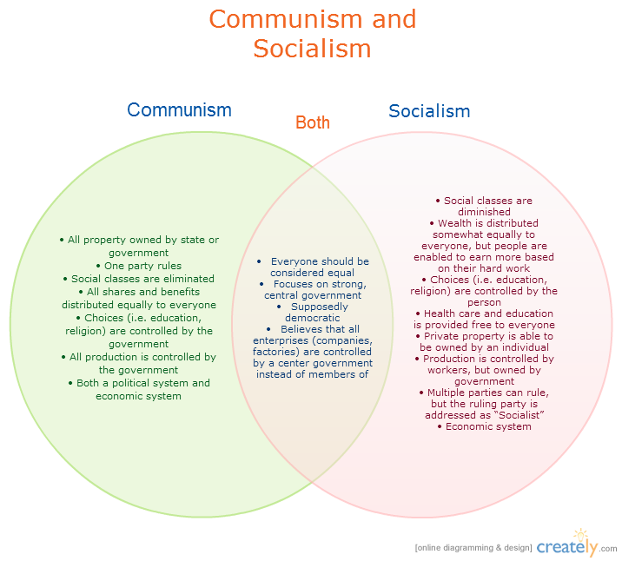

Slide 49
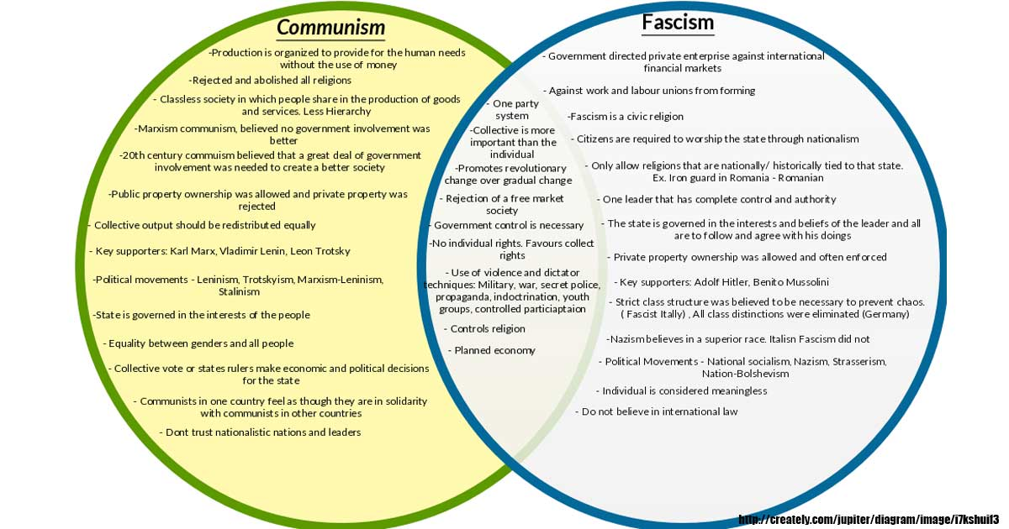

Slide 50
Major Principles of Catholic Social Teaching
The pursuit of the good in the spirit of service.
The development of justice with particular attention to situations of poverty and suffering.
Respect for the autonomy of earthly realities.
The principle of subsidiarity (matters ought to be handled by the smallest, lowest or least centralized competent authority).
The promotion of dialogue and peace in the context of solidarity.
The intrinsic dignity (worth) of every human being.

Slide 51
The Bottom Line
I don’t need to know how an iPhone work in order to make a call.
With regard to Catholic doctrine, just because you don’t understand something doesn’t mean that you can’t believe it.
  God raised up great saints such as Thomas Aquinas, Augustine, and others to explain things to us.
  You can find the answers, but your faith doesn’t require you to have their same level of knowledge to believe.
The Risen Lord’s words to Thomas resound, “Blessed are those who have not seen and yet believe.” (Jn 20:29)

Slide 52
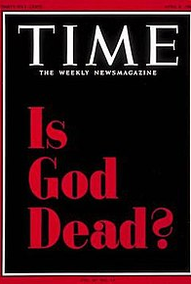
Three Questions
Can you prove that there is a God?
Is Jesus really present in the Eucharist? And don’t tell me that the Bible says so?
Why do you say that yours is the true religion? Why can other religions make the same claim?

Slide 53
Is God Dead?
Everything hinges on the door of that tomb.
Were the Apostles crazy?
If dying for a cause is evidence of insanity, then military graveyards from Arlington to Normandy are the final resting places not of heroes, but of lunatics.
Like any good soldier for any good cause, each Apostle willingly accepted the fact that he might die in the course of his mission, but his mission was never to die—and there is a world of difference between the two.

Slide 54
Is God Dead?
It must have infuriated the persecutors of Christians they could not find the body of Jesus. Where was it?
It also must have infuriated the Christian persecutors that they could not find the body of Jesus’ Mother. Christians were known as having a powerful devotion to the bodies of the saints—considering them relics—and yet the body of Mary was nowhere to be found. We know where most of the Apostles are buried. Where is Mary buried? Where is Christ buried?

