Slide 1
Ninth Grade CCD Class #24
April 10, 2022
Eighth Commandment
&
More

Slide 2
Anima Christi
Soul of Christ, sanctify me.
Body of Christ, save me.
Blood of Christ, inebriate me.
Water from the side of Christ, wash me.
Passion of Christ, strengthen me.
O Good Jesus, hear me.
Within your wounds hide me.
Permit me not to be separated from you.
From the wicked foe, defend me.
At the hour of my death, call me
and bid me come to you
That with your saints I may praise you
For ever and ever. Amen.

Slide 3
Eighth Commandment
Thou shall not bear false witness against thy neighbor.
The eighth commandment forbids misrepresenting the truth in our relations with others. This moral prescription flows from the vocation of the holy people to bear witness to their God who is the truth and wills the truth.
- - - CCC 2464

Slide 4
Eighth Commandment
Do you think the media and/or our government ever misrepresent the truth?
What happens when we make major decisions based on perceptions rather than reality?
Jussie Smollett
George Floyd

Slide 5
You Gov America Poll
(January 14-20, 2022)
How many Americans do you think are Catholic?
How many do you think are atheists?

Slide 6
You Gov America Poll
How many American families have an annual income of over $500,000?
How many Americans have read a book in the past year?

Slide 7
You Gov America Poll
How much of America’s population lives in New York City?
How much of the population lives in California?

Slide 8
You Gov America Poll
How many Americans are gay or lesbian?
How many transgender people live in the U.S.?

Slide 9
You Gov America Poll
(January 14-20, 2022)
How many Americans do you think are Catholic?
How many do you think are atheists?
41%
22%
33%
3%

Slide 10
You Gov America Poll
How many American families have an annual income of over $500,000?
How many Americans have read a book in the past year?
26%
1%
50%
77%

Slide 11
You Gov America Poll
How much of America’s population lives in New York City?
How much of the population lives in California?
30%
(nearly 100 million people)
3%
32%
(about 100 million people)
12%

Slide 12
You Gov America Poll
How many Americans are gay or lesbian?
How many transgender people live in the U.S.?
30%
3%
21%
1%

Slide 13
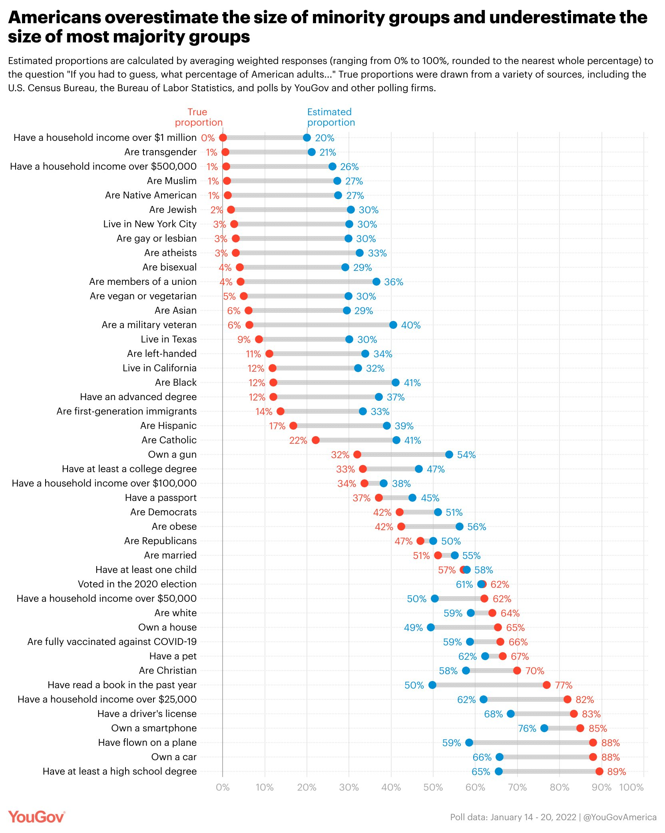

Slide 14
8th Commandment - Lying
Definition:
  A lie is a harmful untruth (by word or deed) told to one who has the right to the truth.
Lies can impact both individuals or society at large.
  Individuals?
  Society?
“One who has the right to know the truth” means?

Slide 15
Lies in History
Russia and the Ukraine invasion
1962 Cuban Missile Crisis
Breaking the German and Japanese codes in WWII

Slide 16
8th Commandment – Helpful Lies
Three types or levels of lies:
  Helpful lies,
  Jocose lies, and
  Harmful lies.
Helpful lie
  The “white lie”
  Intended to help oneself or someone else to get out of a difficult situation or to avoid embarrassment.
  Examples:
    Breaking the Japanese codes in WWII.
    Breaking the Nazi Enigma code in WWII.
  Sinful?

Slide 17
8th Commandment – Jocose Lies
Three types or levels of lies:
  Helpful lies,
  Jocose lies, and
  Harmful lies.
Jocose lie
  A lie told merely for amusement – an exaggeration.
  Examples:
  Sinful?

Slide 18
8th Commandment – Harmful Lies
Three types or levels of lies:
  Helpful lies,
  Jocose lies, and
  Harmful lies.
Harmful lie
  A lie aimed at hurting someone or damaging their reputation.
  Examples:
    Lying under oath
    Calumny (inventing lies to ruin the reputation of another person)
  Nazi propaganda
  Chernobyl nuclear accident – April 1986
  Sinful?

Slide 19
8th Commandment – Mental Reservations
What about concealing the truth for a good reason?
Mental restriction or a mental reservation
  A mental reservation is a statement that can be understood in a true sense, but probably will be understood by the hearer in another sense.
  Example: “Is Mr. Laird in?”
    “Mr. Laird is not here!”
    “Mr. Laird is unavailable right now!”
    “Mr. Laird is out!”
  Example: “Did you have a chance to look at my letter?”
    “No!” or “Give me 5 minutes!” or “I’m behind and I’ll get to it later today.”
    Lie: “Yes!”
    Mental reservation: “It’s right here on my desk!”

Slide 20
8th Commandment – Mental Reservations
What about concealing the truth for a good reason?
Examples of: Mental restriction or a mental reservation
  To the press secretary, “What is the president’s position on China?”
    “He’s been briefed.”

Slide 21
8th Commandment – Gravity of Sins
Nature of the object of the lie
Intention
Circumstances
Effects

Slide 22
8th Commandment - Calumny
Calumny – the injuring of another’s good name by lying about him or her.
  It’s a sin against truth because a lie is told.
  It’s a sin against charity because it’s a flagrant violation of Christ’s command, “Love thy neighbor.”
  It’s a sin against religion, which cannot thrive in an atmosphere of lying and slander.
  It’s a sin against justice because it harms a person’s good name and reputation.
Calumny requires restitution.
  Cannot just confess the sin; but must right the wrong.
  Pillow story…sometimes it is nearly impossible to pull the calumny back.
  CCC 2487

Slide 23
8th Commandment - Detraction
Detraction
  The sin of detraction involves making known the hidden faults of another when there is no good reason to do so.
  Again, there is a need to undo the wrong.
  Press is often guilty of this; front page story; vs. small print retraction.
  Shakespeare in Othello:
  Who steals my purse steals trash; this something, nothing
  Twas mine, ‘tis his, and has been slave to thousands;
  But he that filches from me my good name,
  Robs me of that which not enriches him
  And makes me poor indeed.

Slide 24
8th Commandment – Rash Judgment
Rash judgment is the willingness to believe, without sufficient evidence, that a person is guilty of some evil.
  Also known as ‘jumping to conclusions’ or ‘passing judgment.’
This is why Jesus warned us not to judge others. We only see the outward appearance of an action and not the inner person.
Hallmark movie – A Royal Winter.

Slide 25
Eighth Commandment – Secrets and Promises
A natural secret is one which by its very nature ought to be kept from others.
  Neighbor is an alcoholic
  Relative out of work and your family is supporting them.
A promised secret is one that must be kept because the person promised to do after he became aware of the secret.
  Pending award; announcements of bishops; surprise birthday party.
An official or professional secret is one which comes within the scope of a person’s job or profession.
  Doctor with patient confidentiality.
  Priests and the seal of confession.
  Official academic records.
  Lawyer – client relationships.
Eavesdropping – trying to discover other’s secrets is also wrong.

Slide 26
Conclusion
“Whether we are rich and famous or poor and obscure, the best biographer we have is the Father, as we know Him through our brother, Jesus. If we keep up a conversation with Jesus and are responsive to the graces of the Holy Spirit, He will always plead our cause. He will inspire us to honesty and goodwill, and openhearted charity. He will bring us to repentance. He will tidy up our reputations.”

Slide 27
Conclusion
“Jesus will protect our reputations even when we are under the assault of the devil’s opposition research: “Blessed are you when men revile you and persecute you and utter all kinds of evil against you falsely on my account. Rejoice and be glad, for your reward is great in heaven.” (Mt. 5:12) (Fr. Jerry Pokorsky)

