Slide 1
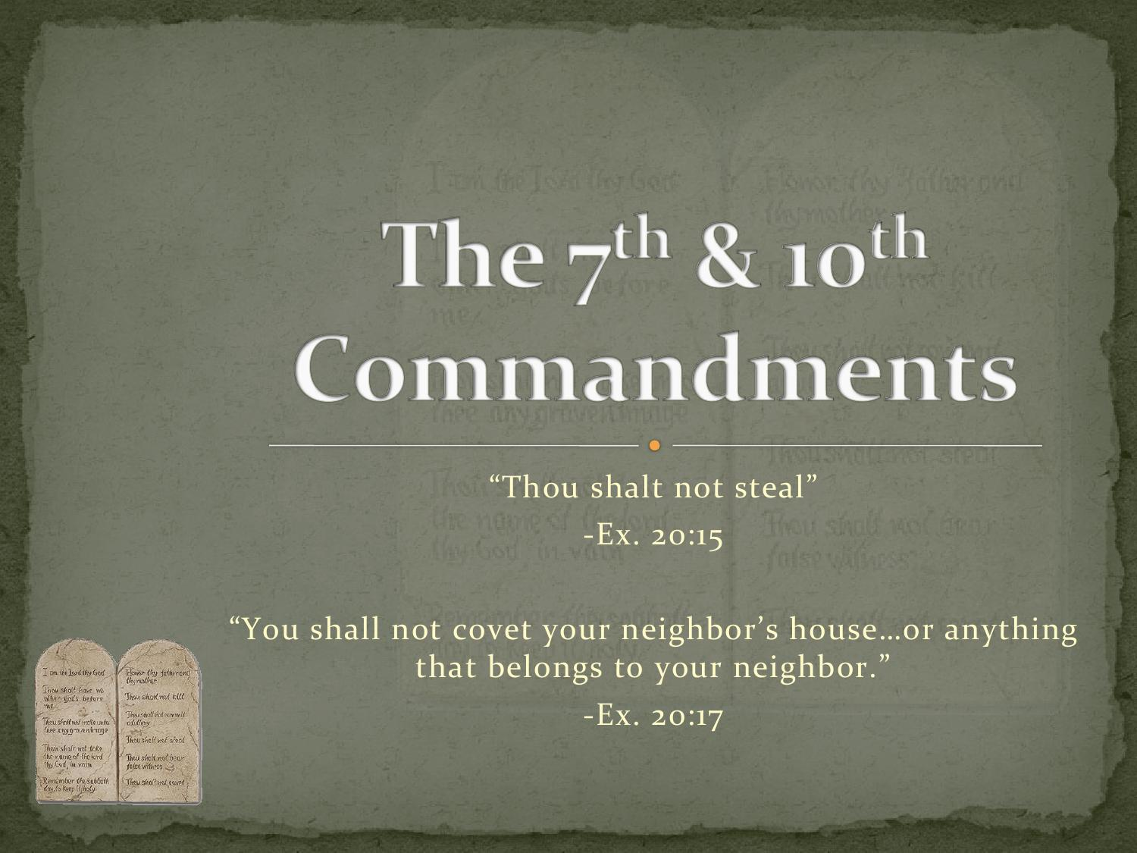
Ninth Grade CCD
Class #23
March 27, 2022
Catholic Social Teaching

Slide 2
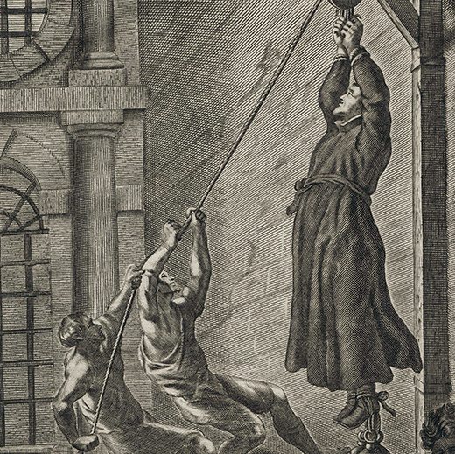
St. Nicholas Owen, The Martyred Carpenter Saint of the English Persecution
The English martyr, whose feast day is on March 22nd, built ‘priest holes’ to protect persecuted clergy in the 16th and 17th centuries.

Slide 3
“Can you provide a definition for the word ‘woman’?”
"I’m not a biologist.” (Supreme Court Nominee Ketanji Brown Jackson)
"As is so often the case, science cannot settle what are really social questions. In any particular case of sex categorization, whether in law or in science, it is necessary to build a definition of sex particular to context.“ (Sarah Richardson, a Harvard scholar, historian and philosopher of biology who focuses on the sciences of sex and gender and their policy dimensions)
In other words, whether a human person is male/female depends on the “context?” Thoughts??

Slide 4
Seventh and Tenth Commandments
Thou shall not steal.
Thou shall not covet your neighbors’ goods.
Part of the 2nd Greatest Commandment
“Love thy neighbor as thyself!
[Both the 7th and 10th Commandments are concerned not only with the sin of theft, but also with the broader moral questions regarding the correct possession and use of goods.]

Slide 5
Common Good vs. Individual Liberties
What is the principle of the Common Good?
  The responsibility of every person to participate in the advancement of conditions that allows each individual to flourish and respond to his or her divine vocation. This is exercised through personal responsibility, political responsibility, and societal responsibility.
What are individual liberties?
  The intrinsic transcendent dignity of every human person.
Which takes precedence?

Slide 6
Example
Many of the 9th grade religious education students remain afterward for youth ministry; others have siblings in religious education classes on Sunday evening in the parish hall.
Mr. and Mrs. Laird decide that the class would be held in their home rather than in the parish hall.
What is best for the common good?

Slide 7
What do you think?
When a legislator is elected to office,
Should he/she represent the common good of the state/nation?
Or
Should he/she represent the individuals who elected them in their state/nation?

Slide 8
What do you think?
When a legislator is elected to office,
Should he/she represent the common good
of the individuals and the special interest groups who elected him?
Or
Should he/she represent the common good of the individuals in the state/nation?

Slide 9
Pork-Barrel projects!
The U.S. House of Representatives and the Senate just passed the 2021-2022 budget. One commentator noted that it was “filled with pork-barrel projects.”
For example: Sen. Schumer got $5.8 million for a harbor project in Dunkirk, NY. The administration asked for $680K. Sen. Masta got $3M for a project at Lake Mead that the administration asked for $595K.
People are so pleased when their legislator “brings home the bacon” – federal money earmarked for special little projects in a local community. Is this working for the common good of the nation or for the private interests of his constituents?

Slide 10
More on “Pork-barrel” projects
If everyone “lards up” the budget with “pork,” then what happens?
Government goes bankrupt because someone has to pay for them.
Is this an example of:
Common Good
Or
Individual Private Interests?

Slide 11
Application to Ukraine
Why are Ukrainians defending their country or returning from abroad to defend their country?
Are they serving the:
Common Good
Or
Individual Interests?

Slide 12
The purpose of the state?
Personal self-interests of the collective citizens?
Or
An ordered unity serving the common good?

Slide 13
In Summary
Source: “Ukraine’s Challenge – to Us”, by Randall Smith, March 23, 2022, www.the Catholic thing.org
“Ask not what your country can do for you, but what you can do for your country.” (President J.F. Kennedy’s inaugural address, 1/20/1961)
Or
“Ask not what you can do for your country, but what your country can do for you.”

Slide 14
Seventh and Tenth Commandments
7th
What is the extent of stealing?
10th
What are your neighbor’s goods?

Slide 15
Seventh Commandment
Forbids
unjustly taking or keeping the goods of one’s neighbor,
Wronging him in any way w/r to his goods.
Commands charity in the:
Care of earthly goods,
Fruits of men’s labor.
Requires respect for:
The universal destination of goods,
Respect for the right to private property. (CCC 2401)

Slide 16
Behaviors and Actions Contrary to
Human Dignity
Theft, deliberate retention of goods borrowed, or objects lost or business fraud (cf. Dt. 25:13-16)
Unjust wages (cf. Dt. 24:14-15)
Increasing prices by trading on the ignorance or hardship of another (cf. Am 8:4-6)
Misappropriation and private use of corporate property of an enterprise
Work badly done
Tax fraud
Forgery of checks and invoices
Excessive expenses
Waste

Slide 17
Behaviors and Actions Contrary to
Human Dignity
Actions or enterprises which
  Lead to enslavement of human beings
  Disregard the personal dignity of human beings
  Buy or sell human beings like merchandise
Reducing persons to a source of profit (Veritatis Splendor, 100)

Slide 18
Covet/Greed/Avarice/Envy
Covetousness - excessive desire for goods of others
Greed - “desire to amass earthly possessions without limit” (CCC 2536)
Avarice – “passion for riches and their attendant power” (CCC 2536)
Envy – “sadness at the sight of another’s goods and the immoderate desire to acquire them for oneself, even unjustly. When it wishes grave harm to a neighbor it is a mortal sin.” (CCC 2539)

Slide 19
Examples in Today’s World
Excessive accumulation of goods?
Work badly done?
Unjust wages?

Slide 20

Stewardship and Private Property
“Behold, I have given you every plant yielding seed which is upon the face of all the earth, and every tree with seed in its fruit: you shall have them for food.” (Gen 1:29)
“The love of money is the root of all evil. Some men in their passion for it have strayed from the faith and have come to grief amid great pain.” (1 Timothy 6:10)
The parable of the dishonest steward who was wasting goods when the master called him to account for them. (Luke 16: 1-13)

Slide 21
Major Principles of Catholic Social Teaching
The intrinsic transcendent dignity (worth) of every human being.
The principle of the common good,
The universal destination of goods,
The principle of subsidiarity (matters ought to be handled by the smallest, lowest or least centralized competent authority),
Participation in democracy, and
The principle of solidarity.

Slide 22
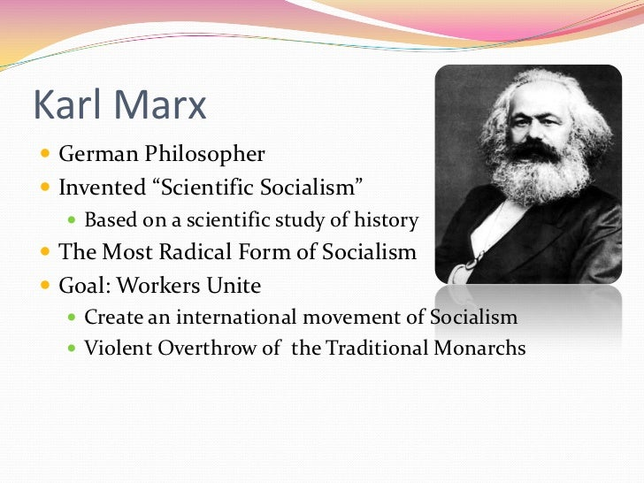
Socialism/Marxism/Communism
https://www.youtube.com/watch?v=IqOmAdVCc0k
Father Robert Spitzer on Socialism (start at 8:00 – 13:30 mark)

Slide 23
Principles of Catholic Moral Teaching
Three levels of authoritative pronouncements within the Catholic Church:
  Extraordinary Magisterium – which is infallible and needed for salvation.
  Ordinary Magisterium – not infallible; subject to limited error, but even if it is in error, it cannot lead away from salvation.
  Prudential Judgement – not infallible; subject to change or error; not needed for salvation per se.
  It is well understood that the principles of Catholic social teaching are part of the ordinary magisterium of the Catholic Church

Slide 24
Intrinsic Transcendent Dignity of Every Human Person
(Matt 25: 40, 45) “Truly, I tell you, whatever you did for one of the least of these brothers and sisters of mine, you did for me…Truly I tell you, whatever you did not do for one of the least of these, you did not do for me.”
Jesus equates Himself to the least of his brothers and sisters.
Jesus elevates everyone including slaves, prisoners, poorest of the poor to His own inestimable Divine dignity.
Which level of authoritative pronouncement would this be? (Infallible, ordinary, or prudential judgement)

Slide 25
Principle of the Common Good
“The principle of the common good, to which every aspect of social life must be related if it is to attain its fullest meaning, stems from the dignity, unity and equality of all people.”
“The sum total of social conditions which allow people, either as groups or as individuals to reach their fulfilment more fully and more easily.”
Examples:
  Sound judicial system
  Organization of state’s powers
  Provision of essential services to all
  Personal and group actions

Slide 26
Universal Destination of Goods
This expression refers to the fact that God wills that His creation of the earth (and its fruits) sustain all people.
All people have the right to share the earth’s goods in order to meet their needs (and their families’ needs) (right to private property).
These include sustenance, shelter, safety.
Also include personal fulfillment such as work, community, education, and culture.
Is this collectivism or socialism?

Slide 27
Universal Destination of Goods: Collectivism or Socialism?
Just the opposite
  Advocacy of the universal right to share in the earth’s goods as well as the right to private property and the right to participate in the free market.
  These economical rights could be in conflict when taken to extremes, but
  The Church advocates that they be kept in balance.
  The right to private property and participation in the free market are deprived in collectivism and Marxism.
  How free is the free market? Is it just for Walmart Superstore to force itself into a community taking the business away from smaller retail stores?
  What about monopolies? What about workers being exploited so that the owner can make a profit?

Slide 28
Conflict of Interest
<- universal destination of goods vs. right to private property ->
The right to private property (justly acquired) does not do away with the original gift of the earth to the whole of mankind. (CCC 2403)
The universal destination of goods remains primordial, even if the promotion of the common good requires respect for the right to private property and its exercise. (CCC 2403)
Is this a conflict of interest?
How can we resolve it?

Slide 29
Conflict of Interest
“When reality is the subject of careful attention and proper interpretation, concrete and effective choices can be made.
“However, an absolute value must never be attributed to these choices because no problem can be solved once and for all. ‘Christian faith has never presumed to impose a rigid framework on social and political questions, conscious that the historical dimension requires men and women to live in imperfect situations, which are also susceptible to rapid change’.”
(Compendium of Catholic Social Doctrine 2005, Section 568.)

Slide 30
Principle of Subsidiarity
No higher (larger) social unit should determine and absorb any lower (smaller) social unit
The preference for action within society should always be given to the lowest (smallest) social unit that can accomplish it.
Why does the Church care?
  Interested in the autonomy of individuals as essential to their intrinsic dignity as being made in God’s image.
  Church is interested in the family as a “little Church” and the basic unit of society.
  Church is interested in protecting community autonomy – they are better suited to solving local problems.

Slide 31
Principle of Solidarity
Like subsidiarity
Most fundamental social principle affecting every citizen’s participation in social and civil structures as well as those social and civil structures themselves.
“A concern and determination to orient social and civil structures toward justice and the common good – to find ways to change unjust social structures that are contrary to the common good.”

Slide 32
Participation in Democracy
Democracy requires:
Solidarity
The intrinsic transcendent dignity of every human person.
Democracy breaks down when:
Individuals do not participate in the democratic process (e.g., voting)
Individuals allow people of influence to receive unfair and unearned privileges.
Government centralizes decision-making and the production of goods
Subsidiarity

Slide 33
Doctrine or Prudential Judgement?
The intrinsic transcendent dignity (worth) of every human being.
The principle of the common good,
The universal destination of goods,
The principle of subsidiarity),
Participation in democracy, and
The principle of solidarity.

Slide 34
Doctrine or Prudential Judgement?
Three levels of authoritative pronouncements within the Catholic Church:
  Extraordinary Magisterium – which is infallible and needed for salvation.
  Ordinary Magisterium – not infallible; subject to limited error, but even if it is in error, it cannot lead away from salvation.
  Prudential Judgement – not infallible; subject to change or error; not needed for salvation per se.
  It is well understood that the principles of Catholic social teaching are part of the ordinary magisterium of the Catholic Church.

Slide 35
Capitalism vs. Socialism
https://www.youtube.com/watch?v=IqOmAdVCc0k
(universal destination of goods start at 16:45 – 18:30)

Slide 36
Stewardship
“All that we have received from God - life itself as well as material goods – does not belong to us but is given to us for our use. Generosity in giving must always be enlightened and inspired by faith: then we will truly be more blessed in giving than in receiving.” (Redemptoris Missio, 81)

