Slide 1
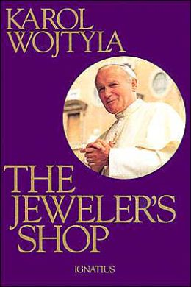
Class #22
Sixth and Ninth Commandments

Slide 2
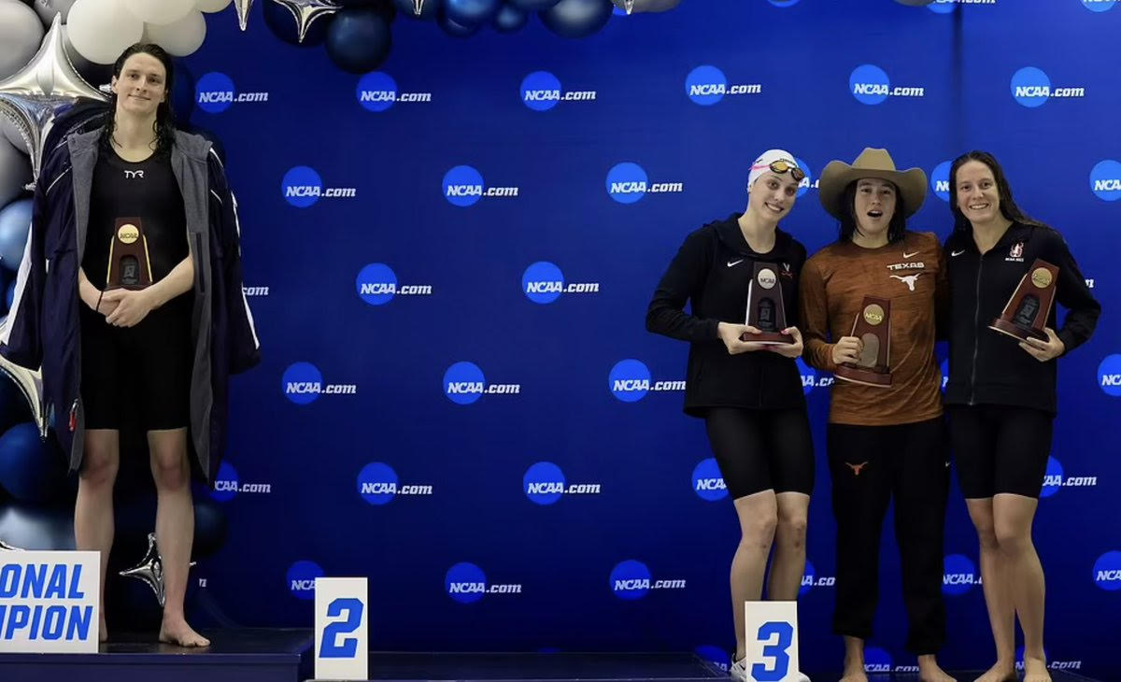

Slide 3
6th /9th Commandments
Thou shall not commit adultery.
Thou shall not covet thy neighbor’s wife.

Slide 4
Chastity as a Virtue
Cardinal Virtues
  Prudence
  Justice
  Temperance
    Chastity
  Fortitude
The Lord’s Prayer and Virtues
Faith – Our Father…thy name.
Hope – Thy kingdom come.
Charity – Thy will… in heaven
Temperance – Give us…bread;
Justice - and forgive…against us;
Prudence – And lead us not into temptation.
Fortitude – But deliver us from evil. Amen.

Slide 5
Sins Against the 6th and 9th Commandment
Sins against chastity for married and unmarried
  Impure thoughts and desires
  Viewing pornography
  Masturbation
  Premarital sex
  Prostitution
  Rape
  Homosexual acts

Slide 6
Living Out Chastity vs. State of Life
State of Life | Ways to Live Chastity
Single | Refrain from sexual activity while unmarried, as well as from sins against chastity.
Married | Live a loving, faithful, exclusive chaste sexual union.
Consecrated Celibacy | Freely renounce marriage, and refrain from sins against chastity.
Engaged to be Married | Refrain from sexual activity until marriage.

Slide 7
Pope Pius XII on Faith and Purity
“To live today in our great cities without loss of faith and purity requires no less heroism than was needed in the days of bloody persecution.”

Slide 8
Freedom From…being ruled by our passions
…using self/others as things
abortion
contraception
sterilization
pornography
fornication/adultery
in vitro fertilization
surrogate motherhood
homosexual behaviors
transgender
prostitution

Slide 9
Freedom To…
…develop virtue
…give and receive love

Slide 10
Why is Humanae vitae significant today?
Humanae Vitae was prophetic. Pope Paul VI predicted grave consequences if methods of artificial birth control were accepted, and his predictions ring true today:
“Let [upright men] consider, first of all, how wide and easy a road would thus be opened up towards conjugal infidelity and the general lowering of morality. . . . It is also to be feared that the man, growing used to the employment of anticonceptive practices, may finally lose respect for the woman and, no longer caring for her physical and psychological equilibrium, may come to the point of considering her as a mere instrument of selfish enjoyment, and no longer as his respected and beloved companion.”
Pope Paul VI, HV #17.

Slide 11
Why is Humanae vitae significant today?
“Let it be considered also that a dangerous weapon would thus be placed in the hands of those public authorities who take no heed of moral exigencies. Who could blame a government for applying to the solution of the problems of the community those means acknowledged to be licit for married couples in the solution of a family problem? Who will stop rulers. . . from imposing. . . the method of contraception which they judge to be most efficacious?”
HV #17.

Slide 12
Satan does NOT understand LOVE!
“…Jesus’ plan is to give His whole self over to His enemies in unconditional self-sacrificial love which He will offer to the Father as the perfect means to wipe out the finite sins and indiscretions of humanity…” BECAUSE THIS IS THE WILL OF GOD THE FATHER!! Thus, Jesus’ obeys God the Father out of LOVE.
“…Satan wants only one thing [when he tempts Jesus in the desert]—for Jesus to be disobedient to His Father…” He wants to bring God’s Son down to his level of disobedience.”

Slide 13
Why is this significant?
“…[Satan] is completely blind to the intentions, actions, and outcomes of love, and so he cannot possibly see the true outcome of Jesus’ self-sacrificial act until it has already come to pass…”
SATAN DOES NOT UNDERSTAND LOVE!!! This is a power we have over him because we ARE capable of loving.

Slide 14
Four Levels of Love
Level
Level 1
Love makes me feel good.
Level
Level 2
Love makes me feel good about myself.
Level
Level 3
I love you more than I love myself.
Level
Level 4
Love sees the image of God in every person.

Slide 15
Level 1 Love
Love makes me feel good
  The focus is on the physical
  It’s a positive feeling
  Generally shallow and unfulfilling
  It often substitutes love for lust, and we end up thinking of our ‘beloved’ as an object, rather than as a unique person made by God.
  In reality, Level 1 “love” is self-centeredness

Slide 16
Level 2 Love
Love makes me feel good about myself
  Equates ‘love’ with ‘being admired.’
  You love me because I’m ‘pretty’, ‘talented’, ‘smart’, ‘strong.’
  Our ‘lover’ is a ‘trophy’ rather than a ‘beloved.’
  Wanting to keep options open in case ”something better comes along.”

Slide 17
Level 3 Love
I love you more than I love myself
  Focuses on the needs of the other person.
  ”I love you; therefore, I’m willing to put your needs ahead of mine.”
  Looks beyond the superficial.
  The matrimonial commitment solidifies this relationship keeping the other-centered love in check and not using the other person as an object for a level 2 love.

Slide 18
Level 4 Love
Love sees the image of God in every person.
  The ability to see the image of God in every person despite his/her faults and weaknesses, and because of that, we want that person’s greatest, ultimate good.
  We recognize that each person is made in God’s image and we value and protect that person regardless of wealth, status, ability, age, etc.

Slide 19
Love and Fidelity
Cannot be reduced to emotions or feelings. They must be deeper than that.

Slide 20

Jeweler Shop
Written by Karol Wojtyla and published in 1960.
It is a poetic play which tells the inner story of three marriages.
  One with the husband being a casualty of war leaving Teresa to raise their infant son alone, Christopher.
  Another with the couple falling into mutual indifference and then hostility. Their relationship scars their daughter, Monica.
  Christopher and Monica carry the pain of their families, but also embody the hope of redemption for themselves and their parents.
  Teresa intervenes on behalf of her son and Monica
Marriage is not an off-and-on relationship but a transformation of each other - the self-giving love.

Slide 21
The Jeweler’s Shop
When Anna tries to sell her ring after she reaches the end of her rope with Stefan, The Jeweler weighs it and responds:
“This ring does not weigh anything.
The needle does not move from zero
And I cannot make it show
Even a milligram.
Your husband must be alive,
In which case neither of your rings, taken separately,
Will weigh anything – only both together will register.
My jeweler’s scales have this peculiarity
That they weigh not the metal
But man’s entire being and fate.”

