Slide 1
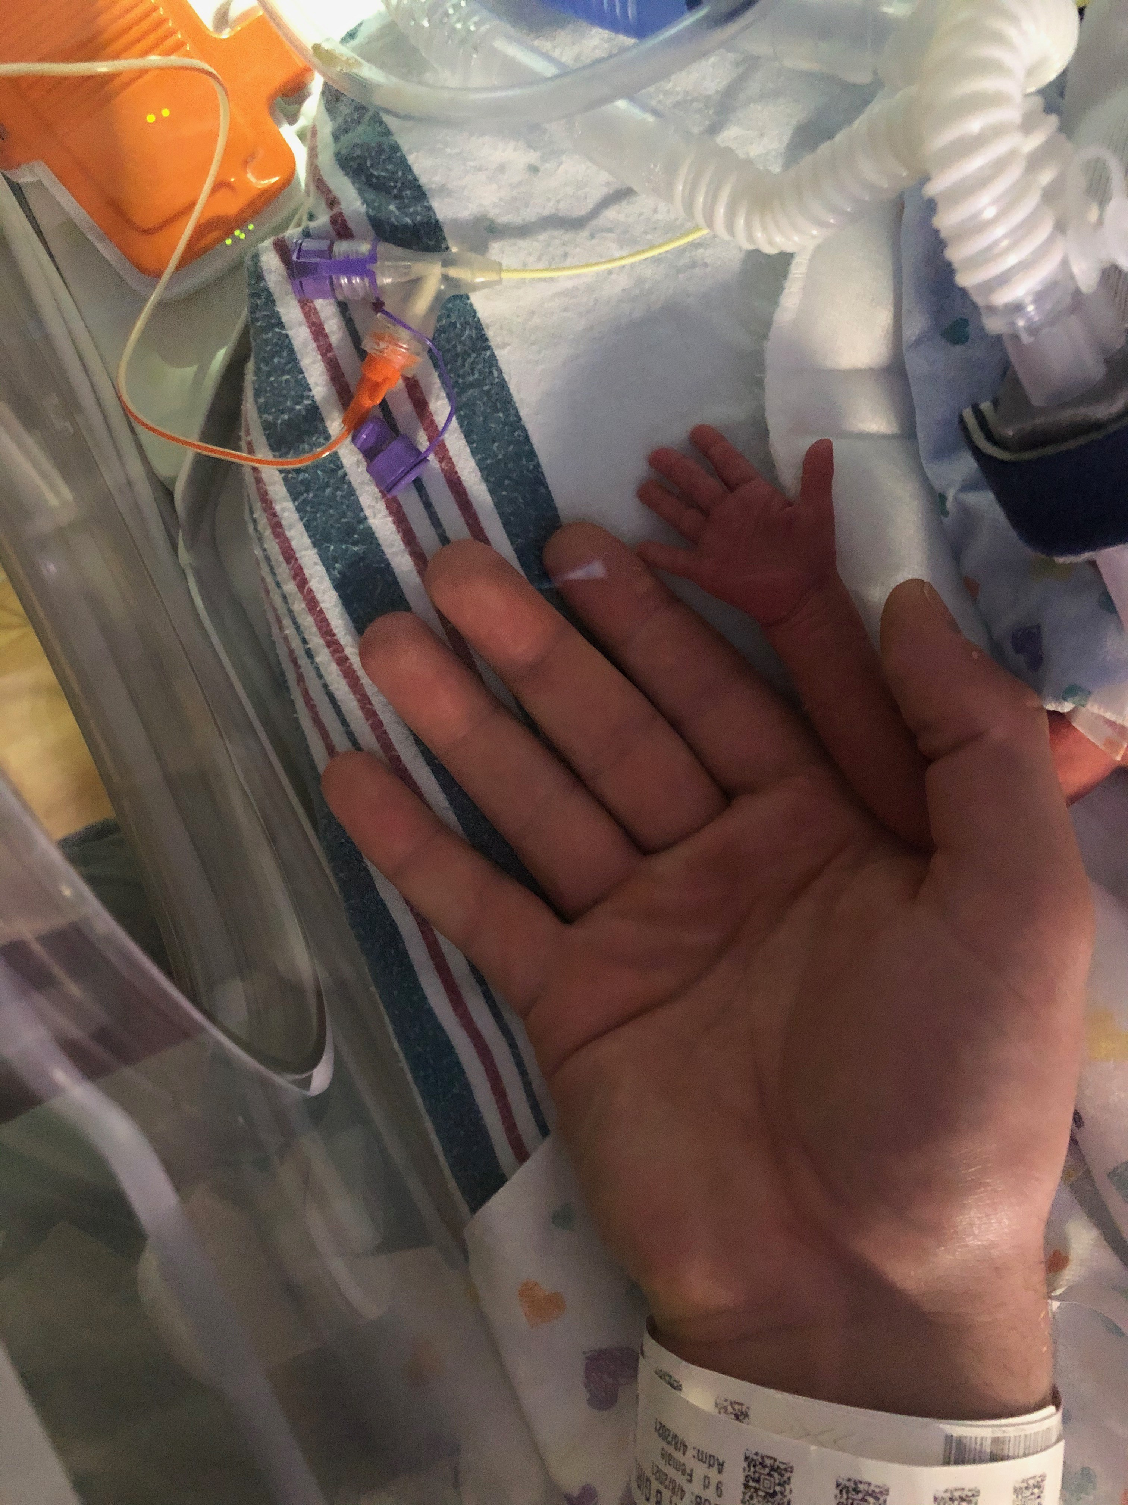
Ninth Grade Religious Education Class #21
March 13, 2022

Slide 2
Soul of Christ, sanctify me.
Body of Christ, save me.
Blood of Christ, inebriate me.
Water from the side of Christ, wash me.
Passion of Christ, strengthen me.
O Good Jesus, hear me.
Within your wounds hide me.
Permit me not to be separated from you.
From the wicked foe, defend me.
At the hour of my death, call me
and bid me come to you
That with your saints I may praise you
For ever and ever. Amen.

Slide 3
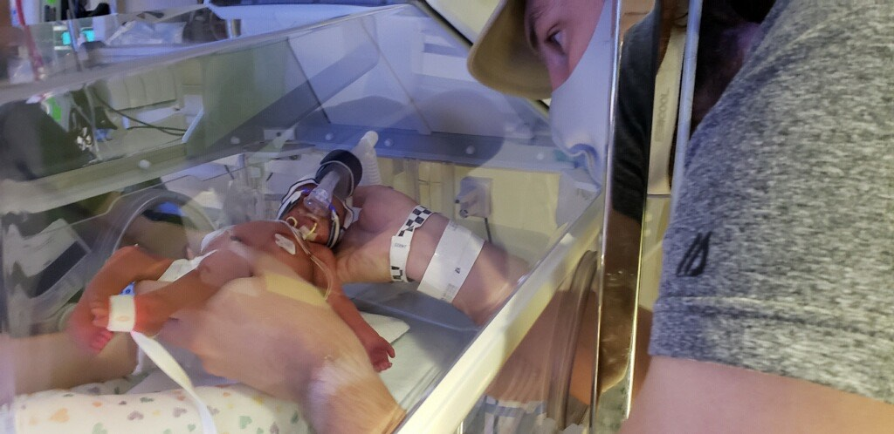
Wrap up: 5th Commandment
Twin born at 28 weeks “in utero”

Slide 4
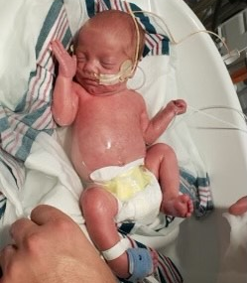
Newborn
Twin
28 weeks
“in utero"

Slide 5
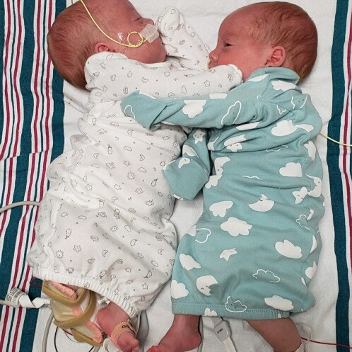
Twins at 37 weeks “in utero”
Birth weights:
2 lbs 9 ozs
2 lbs 13 ozs

Slide 6
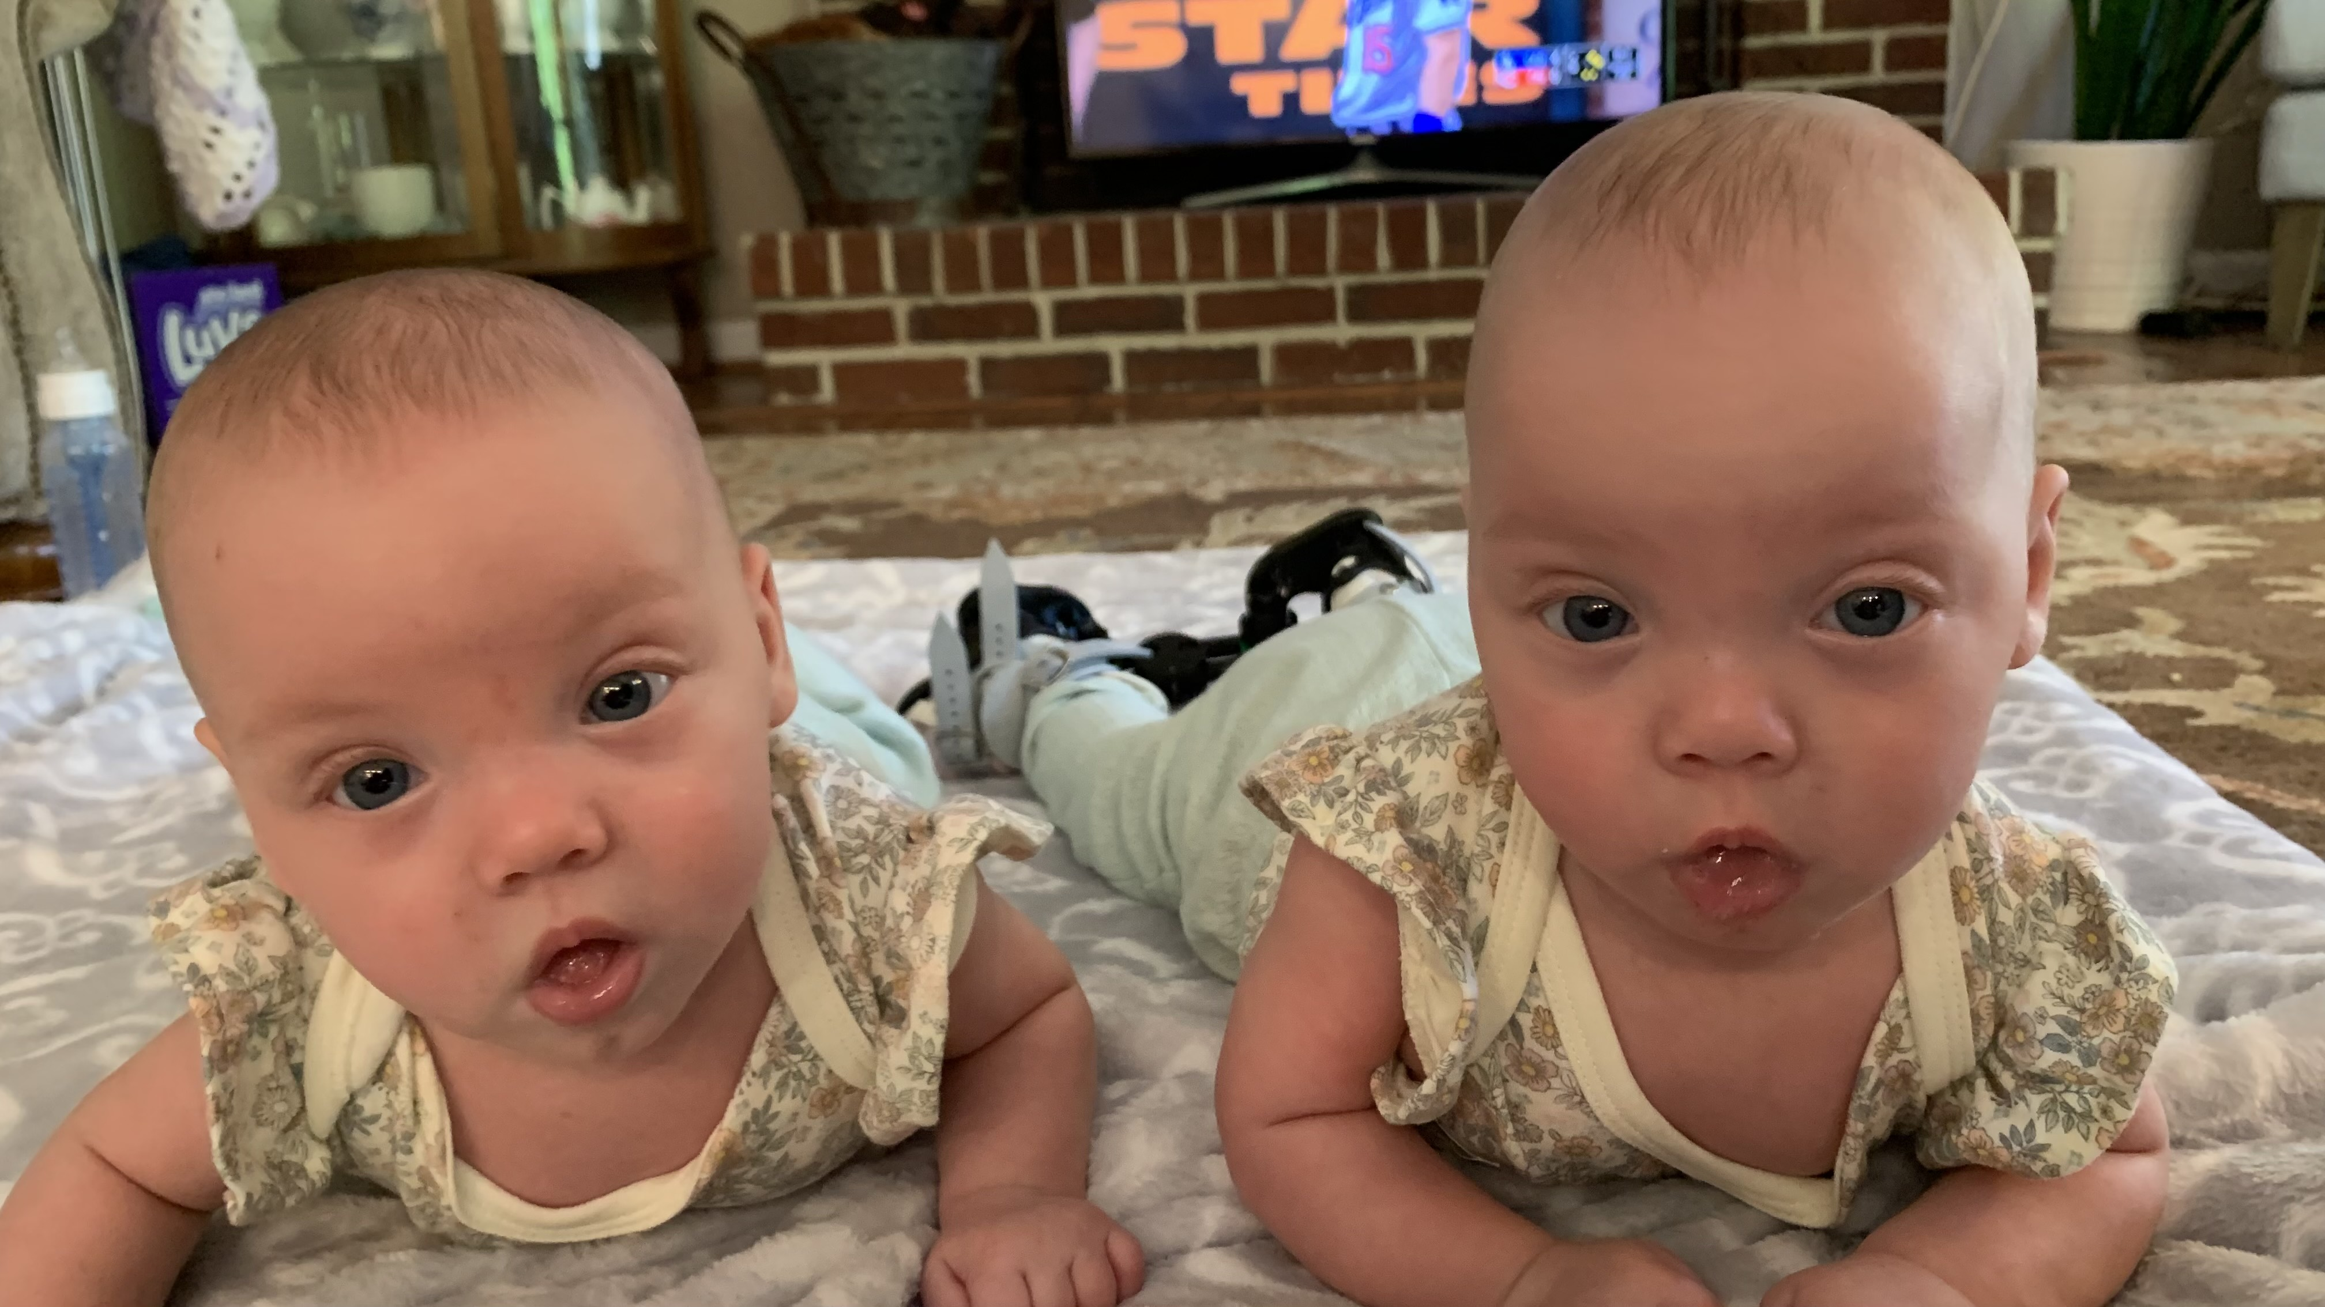
Twins 5 months old

Slide 7
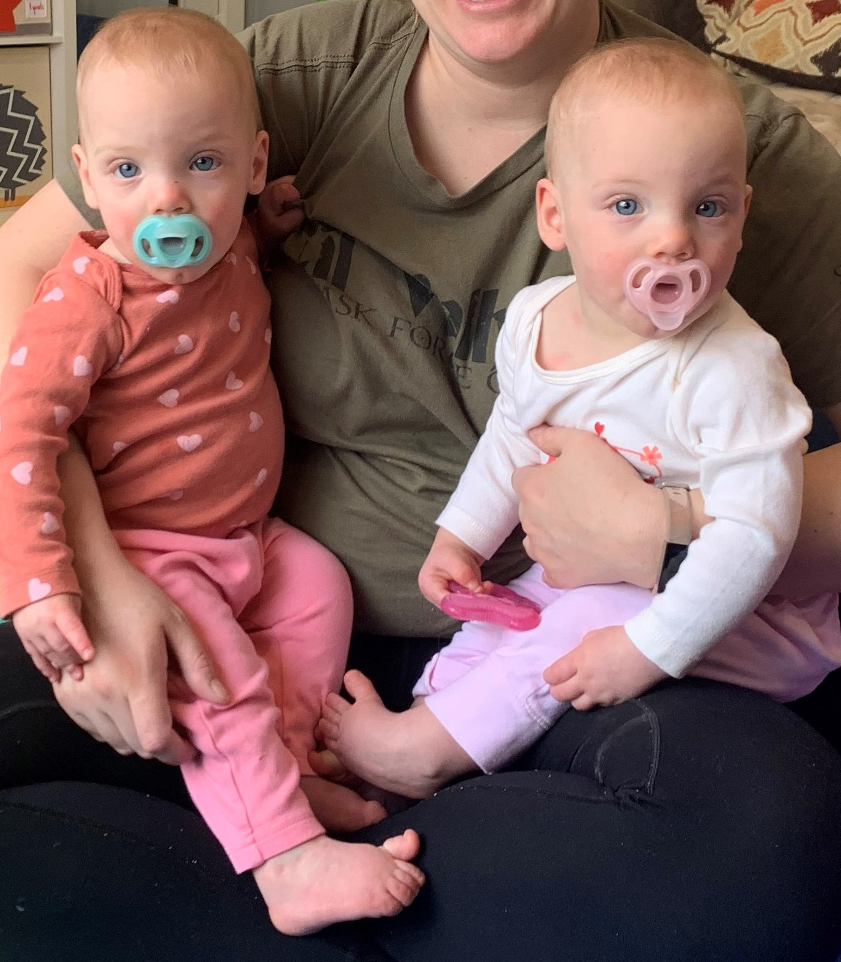
Twins
Now
11 months old,
and each weighs
19 lbs

Slide 8
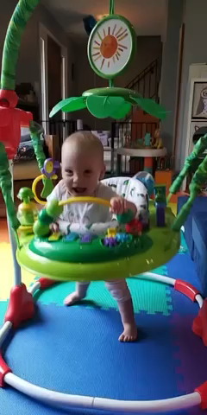

Slide 9
Impact of Abortion - Family
A “sudden death” in the family
Parents suffer – often in silence – and may become addicted, suicidal, homicidal
Their circle of support is permanently affected
Society applauds mother’s “choice”
Church must pick up the pieces
Notes:
Abortion is a sudden death in a family, and thus causes trauma.
As you saw on a previous slide, our bodies express who we are…we cannot separate our emotions from our physical self. After abortion, a woman’s hormones change…she may have a loss of appetite and become depressed…which in turn can lead to addiction and/or suicidal or homicidal behaviors. [Example: woman who called the Project Rachel office as soon as she got home from her unwanted abortion. She said she had a gun and was going to kill her boyfriend when he arrived and then kill herself. We contacted a suicide hotline and the police, and they arrived in time to stop her. She was very angry with us initially, but contacted us several days later to thank us for helping her grieve that loss of her child…and the loss of the relationship with the boyfriend.
Society will applaud her for exercising her right to choose; they may even offer her counseling – so she can move on with her life. But only the Church can offer her real healing – an opportunity to heal her entire person – physically, spiritually and emotionally.
Church must pick up the pieces.

Slide 10
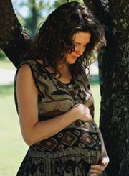
Abortion Hurts
  Cannot hurt the baby without hurting the mother.
  Cannot help the baby without helping the mother.
  Our outreach must be personal.
Notes:
So, the key to ending abortion is recognizing that the welfare of the mother and her unborn child are inseparable.
The fact that abortion hurts women demonstrates that one Cannot hurt the baby without hurting the mother.
The opposite is also true: one cannot help the baby without helping the mother.
Our outreach as Church needs to be “personal”. That’s where we are as a culture. That’s reality.
She must know that she is loved every bit as much as the child she carries. She must internalize her own personal dignity if we expect her to love her unborn with dignity – she cannot give what she herself does not have. She cannot love her child if she does not possess a healthy love of self…

Slide 11
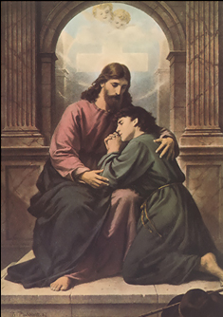
The Bottom Line
  We must be Christ-like:
    Meet each person where they are.
    Lift them up through healing.
    Challenge them to sin no more.
Notes:
We must be Christ-like: Like Christ in the Gospel, we must meet each person individually where they are, lift them up through healing and challenge them to sin no more.

Slide 12
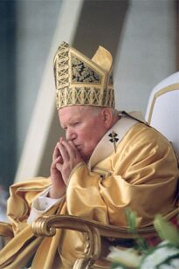
John Paul II’s Message
  “The Church is aware of the many factors which may have influenced your decision, and she does not doubt that in many cases it was a painful and even shattering decision.”
Notes:
Our Holy Father understands this challenge. As Catholic Americans, we need to internalize his message.
First, he reaches out with compassion by acknowledging that there are many reasons why abortion appears to be the solution. In Evangelium Vitae (EV) 99, he writes, “The Church is aware of the many factors which may have influenced your decision, and she does not doubt that in many cases it was a painful and even shattering decision.”

Slide 13
John Paul II’s Message
  “The wound in your heart may not have healed. Certainly what happened was and remains terribly wrong.”
Notes:
Next, he validates their pain, and he even states that it was wrong; but consider the context and wording he very carefully uses: “The wound in your heart may not yet have healed. Certainly what happened was and remains terribly wrong.”

Slide 14
John Paul II’s Message
  “But do not give in to discouragement and do not lose hope. Try rather to understand what happened and face it honestly.”
Notes:
He then very skillfully offers them hope and invites them to repent: “But do not give in to discouragement and do not lose hope. Try rather to understand what happened and face it honestly.”

Slide 15
John Paul II’s Message
  “If you have not already done so, give yourselves over with humility and trust to repentance. The Father of mercies is ready to give you his forgiveness and his peace in the Sacrament of Reconciliation.”
Notes:
If you have not already done so, give yourselves over with humility and trust to repentance. The Father of mercies is ready to give you his forgiveness and his peace in the Sacrament of Reconciliation.”

Slide 16
John Paul II’s Message
  “To the same Father and to His mercy you can with sure hope entrust your child.”
Notes:
He then restores their motherhood to them: “To the same Father and to his mercy you can with sure hope entrust your child.”
By restoring her motherhood, he has just given her back her own personhood as well – her own dignity.

Slide 17
John Paul II’s Message
  “With the friendly and expert help and advice of other people, and as a result of your own painful experience, you can be among the most eloquent defenders of everyone’s right to life.”
Notes:
Now, he challenges her to seek healing and to become a defender of life herself. In other words, he meets her in her brokenness – in her sinfulness; offers her hope and healing; and challenges her to go out and do likewise – to “sin no more.” In his words, “With the friendly and expert help and advice of other people, and as a result of your own painful experience, you can be among the most eloquent defenders of everyone’s right to life.”

Slide 18
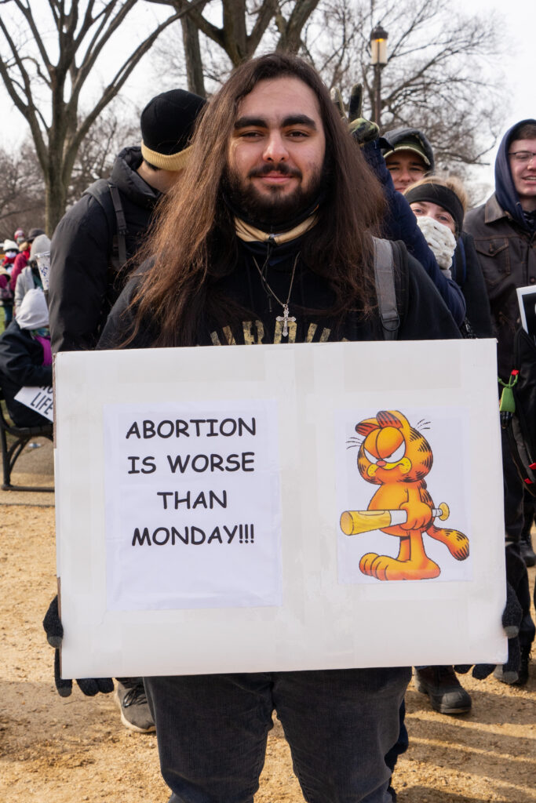
Disarming abortion supporters
What is an abortion?
Why do you support abortion?
How do they actually do an abortion?

Slide 19
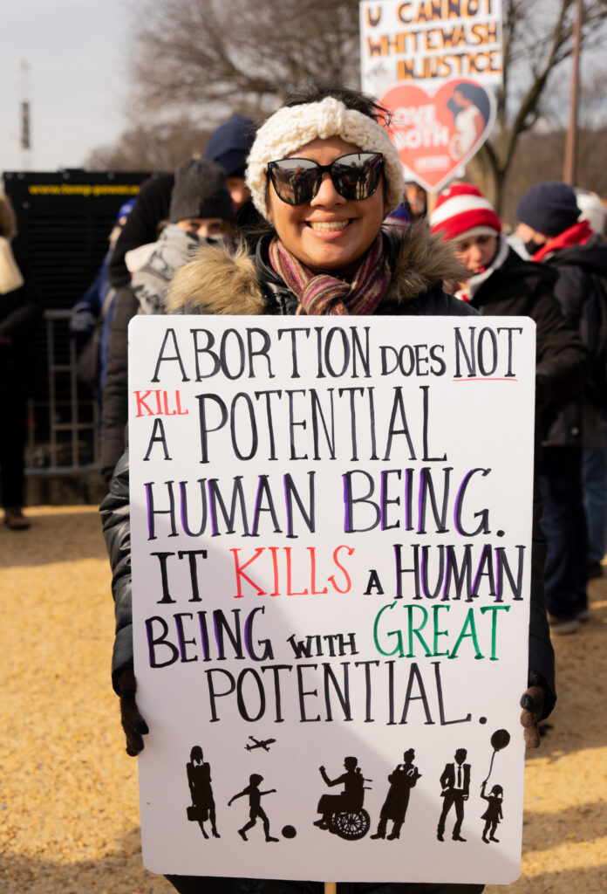
Disarming abortion supporters
Is your support for abortion based on science or more of a “gut” feeling?
Is there a point in pregnancy when you would oppose abortion?

Slide 20
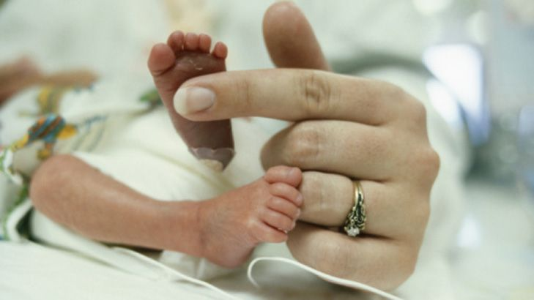
Disarming abortion supporters
Are you okay with doing surgery on a 22-week-old viable baby in the womb to improve his life…

Slide 21
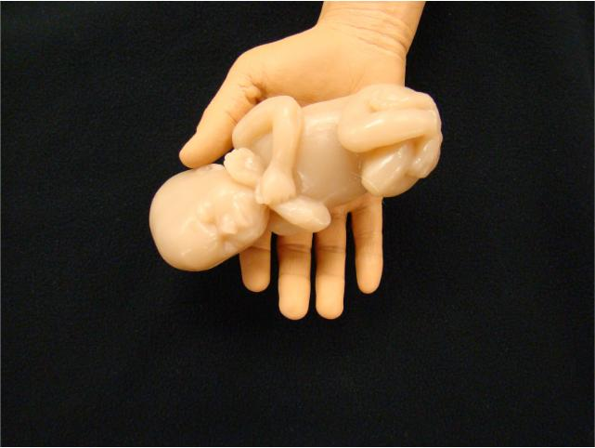
Disarming abortion supporters
…but aborting a baby girl in the womb at the same age?

Slide 22
Disarming abortion supporters
Do you think that the human dignity of babies in the womb increases over time?
Do you believe that babies who are born into poverty are less valuable than babies born into wealth?
Do you think babies in the womb with disabilities are stronger candidates for abortion?
Black Americans only make up 12% of the population but they make up 40% of all abortions. Do you think this is good or bad?

Slide 23
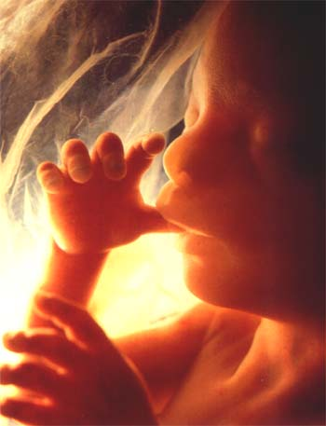
Disarming abortion supporters
Should baby girls and boys who survive abortion attempts get care if they cannot breathe on their own?
Do you think infanticide is ever justified?
Does everyone really deserve a chance at life, or can circumstances change that?

