Slide 1
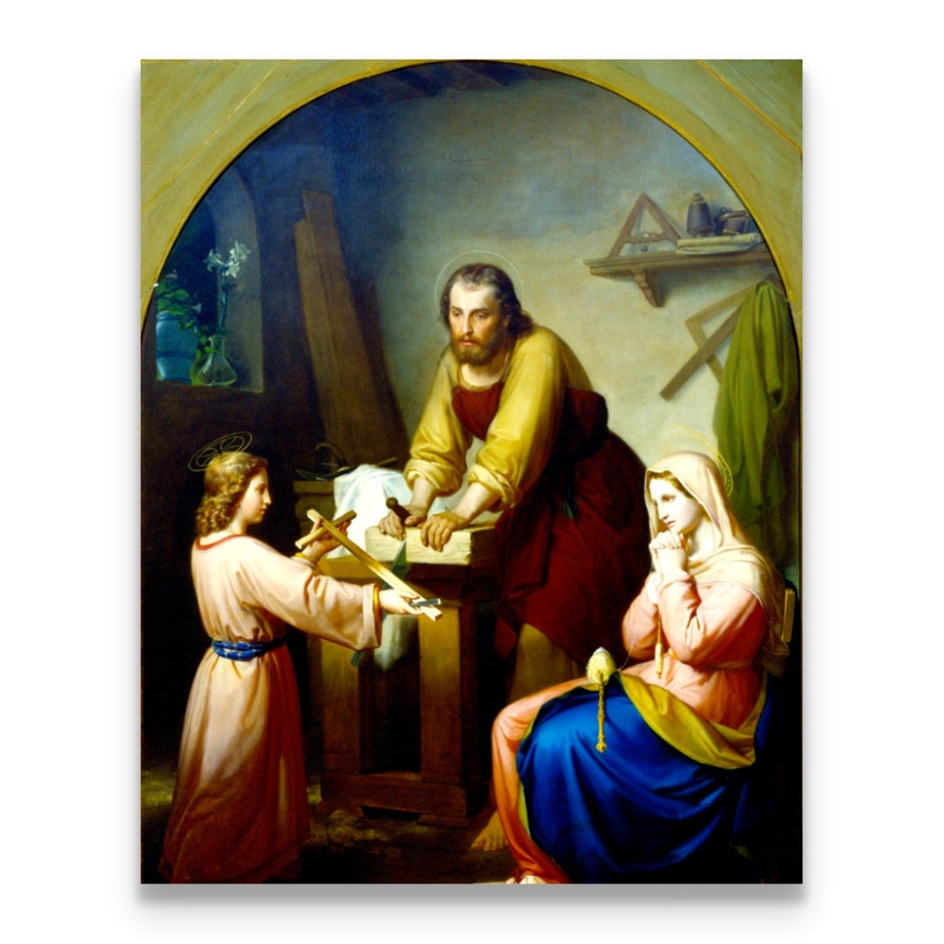
Ninth Grade CCD Class #18
February 13, 2022
Fourth Commandment &
More

Slide 2
Anima Christi
Soul of Christ, sanctify me.
Body of Christ, save me.
Blood of Christ, inebriate me.
Water from the side of Christ, wash me.
Passion of Christ, strengthen me.
O Good Jesus, hear me.
Within your wounds hide me.
Permit me not to be separated from you.
From the wicked foe, defend me.
At the hour of my death, call me
and bid me come to you
That with your saints I may praise you
For ever and ever. Amen.

Slide 3
Perfection
“So be perfect, just as your heavenly Father is perfect.” (Matt. 5:48)
https://straymonds.org/view-mass-online/
15:00 minute mark
Notes:
We need to either find the actual clip from a year ago or delete the slide.

Slide 4


FAMILY:
“Building the smallest democracy at the heart of society”

Slide 5


FAMILY
A
Little
Church

Slide 6
What is the Fourth Commandment?
Honor Your Father and Mother!
Chosen (Finding of Jesus in the Temple; 0-2:06)
The Chosen Episode 5 - Bing video
https://www.bing.com/videos/search?q=the+chosen+episode+5+youtube&docid=608047072037504964&mid=4A1D51F797356009BCE24A1D51F797356009BCE2&view=detail&FORM=VIRE
Chosen (Wedding Feast at Cana; 38:25-39:35)
The first miracle of Jesus • The Chosen | Jesus turns water to wine | Download “The Chosen” app now - YouTube

Slide 7

What Is the Expanded Meaning of the Fourth Commandment?
Direct Relationships:
  The Fourth Commandment requires us to honor and obey our parents and all legitimate authority.
Reciprocal Relationships:
  The Fourth Commandment requires:
    Parents to protect their children
    Civil authorities and citizens to protect children

Slide 8
Mark Twain
“When I was a boy of fourteen,
my father was so ignorant I could hardly stand to have the old man around.
But when I got to be twenty-one,
I was astonished at how much the old man had learned in seven years.”

Slide 9
Hmmm…are parents perfect?
We owe our parents love and respect simply because:
  They are our parents; and
  They gave us life.
We honor our parents by:
  Always being courteous to them;
  Helping with family activities and household chores; and
  Striving to be good sons and daughters who make them proud.
The Mathematics of the Family

Slide 10
Social Units in a Healthy Society
Basic unit of a healthy society is the family. (CCC 2207)
Families gather to form communities.
Communities gather to form states.
States gather to form nations.
“The well-being of the individual person and of both human and Christian society is closely bound up with the healthy state of conjugal and family life.” (GS 47 §1)

Slide 11
The Positive Aspects of the Family of Today
Role of the Christian Family in the Modern World (Familiaris Consortio)
There is more lively awareness of:
1. personal freedom and greater attention to the quality of interpersonal relationships in marriage,
2. the dignity of women,
3. responsible procreation, and
4. the education of children.

Slide 12
The Negative Aspects of the Family of Today
Role of the Christian Family in the Modern World (Familiaris Consortio)
There are signs of disturbing degradation of some fundamental values:
A mistaken theoretical and practical concept of the independence of the spouses in relation to each other;
Serious misconceptions regarding the relationship of authority between parents and children;
The concrete difficulties that the family itself experiences in the transmission of values;
The growing number of divorces;
The scourge of abortion;
The ever more frequent recourse to sterilization; and
The appearance of a truly contraceptive mentality.

Slide 13

What Does This Have to Do With the Fourth Commandment?
“As long as a child lives at home with his parents, the child should obey his parents in all that they ask of him when it is for his good or that of the family. ‘Children, obey your parents in everything, for this pleases the Lord.’ (Col 3:20)
Children should also obey the reasonable directions of their teachers and all to whom their parents have entrusted them.
But if a child is convinced in conscience that it would be morally wrong to obey a particular order, he must not do so. (CCC 2217)
Notes:
There is also a responsibility for parents to guide their children toward the truth .

Slide 14
Fourth Commandment – Examination of Conscience
Did I disobey my parents?
Did I neglect to help my parents when my help was needed?
Did I treat my parents with little affection or respect?
Did I react proudly when I was corrected by my parents?
Did I have an excess desire for independence?
Did I do my chores?

Slide 15
Fourth Commandment and the Mathematics of the Family

Slide 16
The Fourth Commandment and the Extended Family
Family bonds extend beyond your parents
The Catechism describes the extensive familial and social obligations of the Fourth Commandment (CCC 2199)

Slide 17
The Fourth Commandment and the Extended Family
The Catechism (CCC 2199)
Honor, affection, and gratitude toward elders. It extends to:
  Pupils to teachers,
  Employees to employers,
  Subordinates to leaders,
  Citizens to their country, and
  Citizens to those who administrate or govern it.
The opposite is also true. The 4th Commandment includes and presupposes the duties of parents, instructors, teachers, leaders, magistrates, those who govern, all who exercise authority over others or over a community of persons.

Slide 18
Fourth Commandment Wrap Up
“Honor your father and your mother.” (Deut 5:16; Mk 7:10)
Family: “Marriage and family are ordered to the good of the spouses, to the procreation and the education of children.” (CCC 2249)
”Children owe their parents respect, gratitude, just obedience, and assistance.” (CCC 2251)
“Parents have the first responsibility for the education of their children in the faith, prayer, and all the virtues. They have the duty to provide as far as possible for the physical and spiritual needs of their children.” (CCC 2252)
“Parents should respect and encourage their children’s vocations.” (CCC 2253)

Slide 19
Fourth Commandment Wrap Up
“Public authority is obligated to respect the fundamental rights of the human person and the conditions for the exercise of his freedom.” (CCC 2254)
“It is the duty of citizens to work with civil authority for building up society in the spirit of truth, justice, solidarity, and freedom.” (CCC 2255)
“Citizens are obligated in conscience not to follow the directives of civil authorities when they are contrary to the demands of the moral order. ‘We must obey God rather than man’ (Acts 5:29).” (CCC 2256)

Slide 20
Survey of Abortion Attitudes in America
Marist College and Knights of Columbus Annual Survey
  Annual survey conducted for the past many years.
  Especially significant this year because of the pending Supreme Court case Dobbs v. Jackson Women’s Health Organization.
    The Gestation Age Act of March 2018 is a Mississippi law passed in March 2018 which prohibits abortions after the first 15 weeks of pregnancy.
    Jackson Women’s Health Organization challenged the law. Thomas Dobbs was the State Health Officer in the Mississippi Department of Health.
    It has worked its way through the U.S. District Court (ruling for the clinic), and then in the U.S. 5th Circuit Court of Appeals (which also ruled for the clinic).
    The State appealed to the U.S. Supreme Court (SCOTUS)
    Oral arguments were made before the SCOTUS in November 2021.
    The ruling is expected by June 30, 2022 (the end of this SCOTUS term).

Slide 21
The Significance of Dobbs v. Jackson Women’s Health
With the addition of Justice Amy Barrett and based on the questioning during the oral arguments, “court watchers” believe that 6 justices (of 9) were in favor of upholding the Mississippi law.
Chief Justice Roberts seemed inclined to give states the right to set restrictions on abortions up to as early as 15 weeks. This would in effect, uphold the fundamentals of the two previous court decisions (Roe v. Wade) and (Planned Parenthood v. Casey) while giving states the right to set restrictions on abortions up to as early as 15 weeks.
Some Justices appear to want to overturn Roe and Casey entirely.

Slide 22
The Significance of Dobbs v. Jackson Women’s Health
4. On September 1, 2021, SCOTUS blocked a legal challenge to the Texas Heartbeat Act which made abortions illegal after the sign of a fetal heartbeat – around six weeks after pregnancy. The court acted quickly after hearing the oral arguments in this case.
5. More extensive details of the history of abortion law in the United States can be found at Heritage Foundation website. At www.heritage.org start typing “Dobbs” and you will get this file.
https://www.heritage.org/sites/default/files/2021-11/LM293.pdf

Slide 23
Survey of Abortion Attitudes in America
If you ask the question, are you pro-life or pro-choice, 55% say they are pro-choice and 40% say they are pro-life. BUT,
Almost three quarters of Americans (71%), including a majority who identify themselves as pro-choice, want significant restrictions on abortion…permitting it only during the first two trimesters.
Only 17% are in favor of abortion throughout the entire pregnancy.
54% oppose or strongly oppose using tax dollars to pay for a woman’s abortion.
75% say that health care professionals who have religious objections to abortion should not be forced to perform them.

