Slide 1
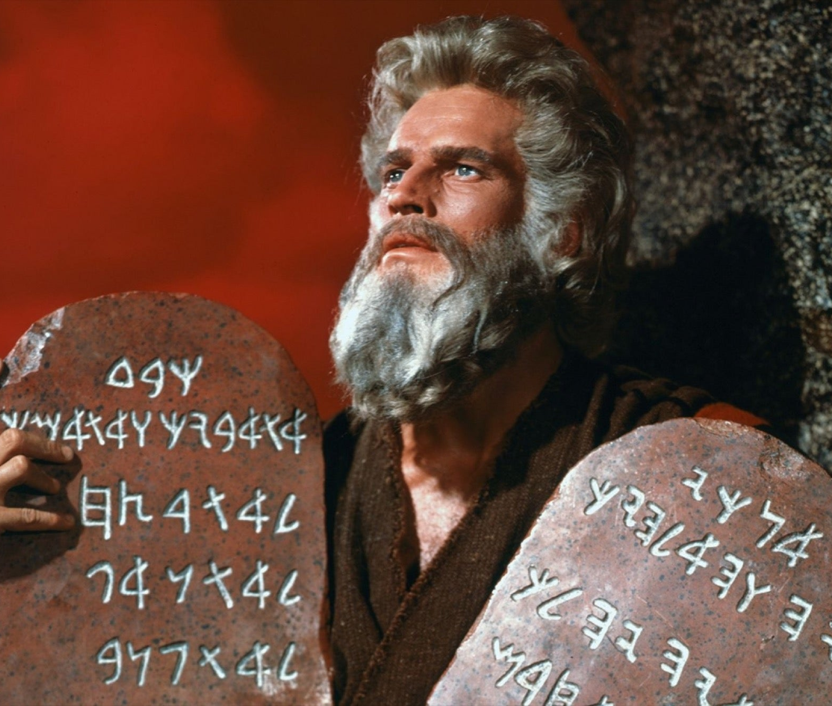
Ninth Grade Religious Education Class #17
February 6, 2022

Slide 2
Anima Christi
Soul of Christ, sanctify me.
Body of Christ, save me.
Blood of Christ, inebriate me.
Water from the side of Christ, wash me.
Passion of Christ, strengthen me.
O Good Jesus, hear me.
Within your wounds hide me.
Permit me not to be separated from you.
From the wicked foe, defend me.
At the hour of my death, call me
and bid me come to you
That with your saints I may praise you
For ever and ever. Amen.

Slide 3
Pascal’s Wager
Heads =“God is,” or Tails = “God is not.”
1. If I believe that God exists and my wager comes up “heads,” then I lose nothing.
2. If I believe that God exists and my wager comes up “tails,” then I still lose nothing.
3. If I believe that God does not exist and my wager comes up “heads,” then I lose everything.
4. If I believe that God does not exist and my wager comes up “tails,” then I lose nothing.

Slide 4
Pascal’s Wager in Practice
From Peter Kreeft’s Forty Reasons I am a Catholic (Reason 15) (pg. 51)
I know that I am going to die. The Church teaches me how to die.
When I die, I will either (1A) not meet God at all, because He doesn’t exist, or (1B) meet Him, because He exists.
If He does exist, and I meet Him, I will either (2A) meet Him without Jesus Christ or (2B) meet Him in Christ.
If I meet God with Christ, I will do so either (3A) as a non-Catholic, without His visible Church and her sacraments or (3B) as a Catholic, as a member of His Church and with her sacraments.

Slide 5
Pascal’s Wager in Practice (cont.)
Even if I cannot prove the three B options (and I think I can – but I could be wrong), Pascal’s Wager tells me that B is a wiser choice than A each time.
Let me put it in very crude terms: Faith is the gift of a free, eternal fire-insurance policy.
Now this offer is either true or false. If it is true, I gain everything and lose nothing. If it is false, I gain nothing, but also lose nothing.

Slide 6
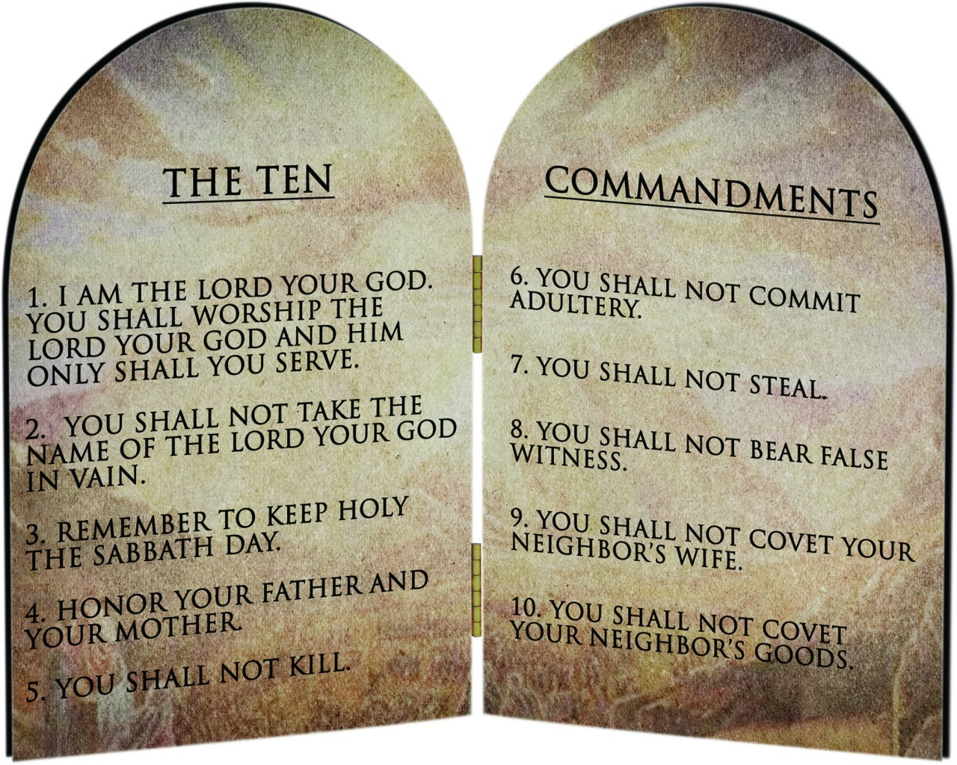
The Commandments/Beatitudes/
Precepts of the Church

Slide 7
Jesus Meets the Leper!
Read the story: Mark 1:40-45.
Review the Jewish law for lepers: Lev 13:40-46; 14:19-20.
Q: What is the role of the Jewish “priest” (rabbi)?
A: The priest determines if the leper is unclean; the priest determines if the leper is clean.
View the video https://www.bing.com/videos/search?q=the+chosen+episode+where+Jesus+meets+the+leper&&view=detail&mid=45FA29B63C361A9FE27145FA29B63C361A9FE271&&FORM=VDRVSR
Discussion
Bottom Line: This is an example of an application of the New Law.

Slide 8
The Commandments/Beatitudes/
Precepts of the Church
Q: The Commandments are groups under two separate classes. What are they?
A: 1 - 3 -- pertain to love of God; 4 – 10 – pertain to love of neighbor.
Q: The Commandments are known as elements of the Old Law: The Sermon on the Mount is known as the basis for the New Law. What concepts of the New Law were introduced by Christ in the Sermon on the Mount?
A: Christ introduced the Beatitudes.
Q: Read Matt 5:17-19. What do the Beatitudes represent?

Slide 9
The Commandments,
Beatitudes,
Precepts of the Church
Q: What kind of law are the 10 Commandments?
A: A summary of the principles of the natural law.
Q: Read CCC 2070-2071. “From the beginning!”
Q: Read CCC 2072.
Q: Which of the commandments is not found in natural law?
A: Third Commandment - ”Remember the sabbath day, to keep it holy.” (Ex 20:8)
Q: If the Third Commandment is not found in natural law, why are we compelled to obey it.?
A: It is a divine positive law which is found in the Precepts of the Church

Slide 10
First Commandment
“I am the Lord your God; you shall not have strange gods before me.”
Q: Each of the commandments contains positive commands and negative commands! What are some of the positive commands?
A: You shall worship God alone! Is this an absolute requirement?
Q: What about atheists?
Q: What are some of the negative commands?
A: You shall not worship strange gods like….

Slide 11
First Commandment and the Theological Virtues
What are the theological virtues?
  Faith - belief
  Hope - trust
  Charity - love

Slide 12
Sins against the First Commandment
Sins against Faith
Apostasy – rejection of the Christian faith by a baptized person.
Heresy – obstinate denial of one or more truths of divine revelation.
Indifferentism – theory that all religions are the same or are equally good and true.
Sins against Hope
Despair – doubt that God will save us.
Presumption – expecting God will save us without doing our part.
Sins against Charity
Hatred for God or for other people.

Slide 13
Sins against the First Commandment
Other Sins against the First Commandment
Sacrilege – Contemptuous treatment or abuse of any sacred person, place, or thing
Superstition – Giving a creature or object some power that belongs to God alone
Spiritualism – Belief that we can contact deceased relatives or others in the spiritual world
Obsession by the Devil

Slide 14
Second Commandment
”Thou shalt not take the name of the Lord thy God in vain.”
What is in a name?
In the Old Testament, the name of the Lord was never uttered.
Moses at the Burning Bush (Read Exodus 2: 13-14)
“I am who I am.” -- YHWH or Yahweh! So sacred to the Jewish faith it is never pronounced by orthodox Jews.
For Christians, the most beloved name is “Jesus Christ.”
”Jesus” means “Savior.”
“Christ” means “The anointed one.”
Our Lord was anointed as the Son of God, The Messiah. (Read Phil 2:10-11)

Slide 15
Sins against the Second Commandment
Blasphemy – Insulting or abusive language that expresses contempt for God either directly or indirectly through his saints, through those consecrated to his service, or through holy objects.
Cursing – Calling down evil on someone or something.
Profanity – Using the name of God or Jesus to express anger, fear, surprise, impatience, or without proper reverence.
Perjury – Making a false oath or lying under oath.

