Slide 1

Ninth Grade CCD Class #13
January 9, 2022
Mr. Anthony Hansen,
11th-12th Grade CCD
The dog in the photo was trained to identify life after earthquakes. His posture and the fact of staying fixed as seen in the image is the posture that tells the rescuer that there is life in that place. And look at nothing more and nothing less where and in front of who is placed: in front of Jesus as the Eucharistic bread in the tabernacle, the living God among us.

Slide 2
Agenda
Opening Prayer
Happiness: A review
Making Moral Decisions
  Truth
  Laws
  Conscience
  Rights and duties

Slide 3
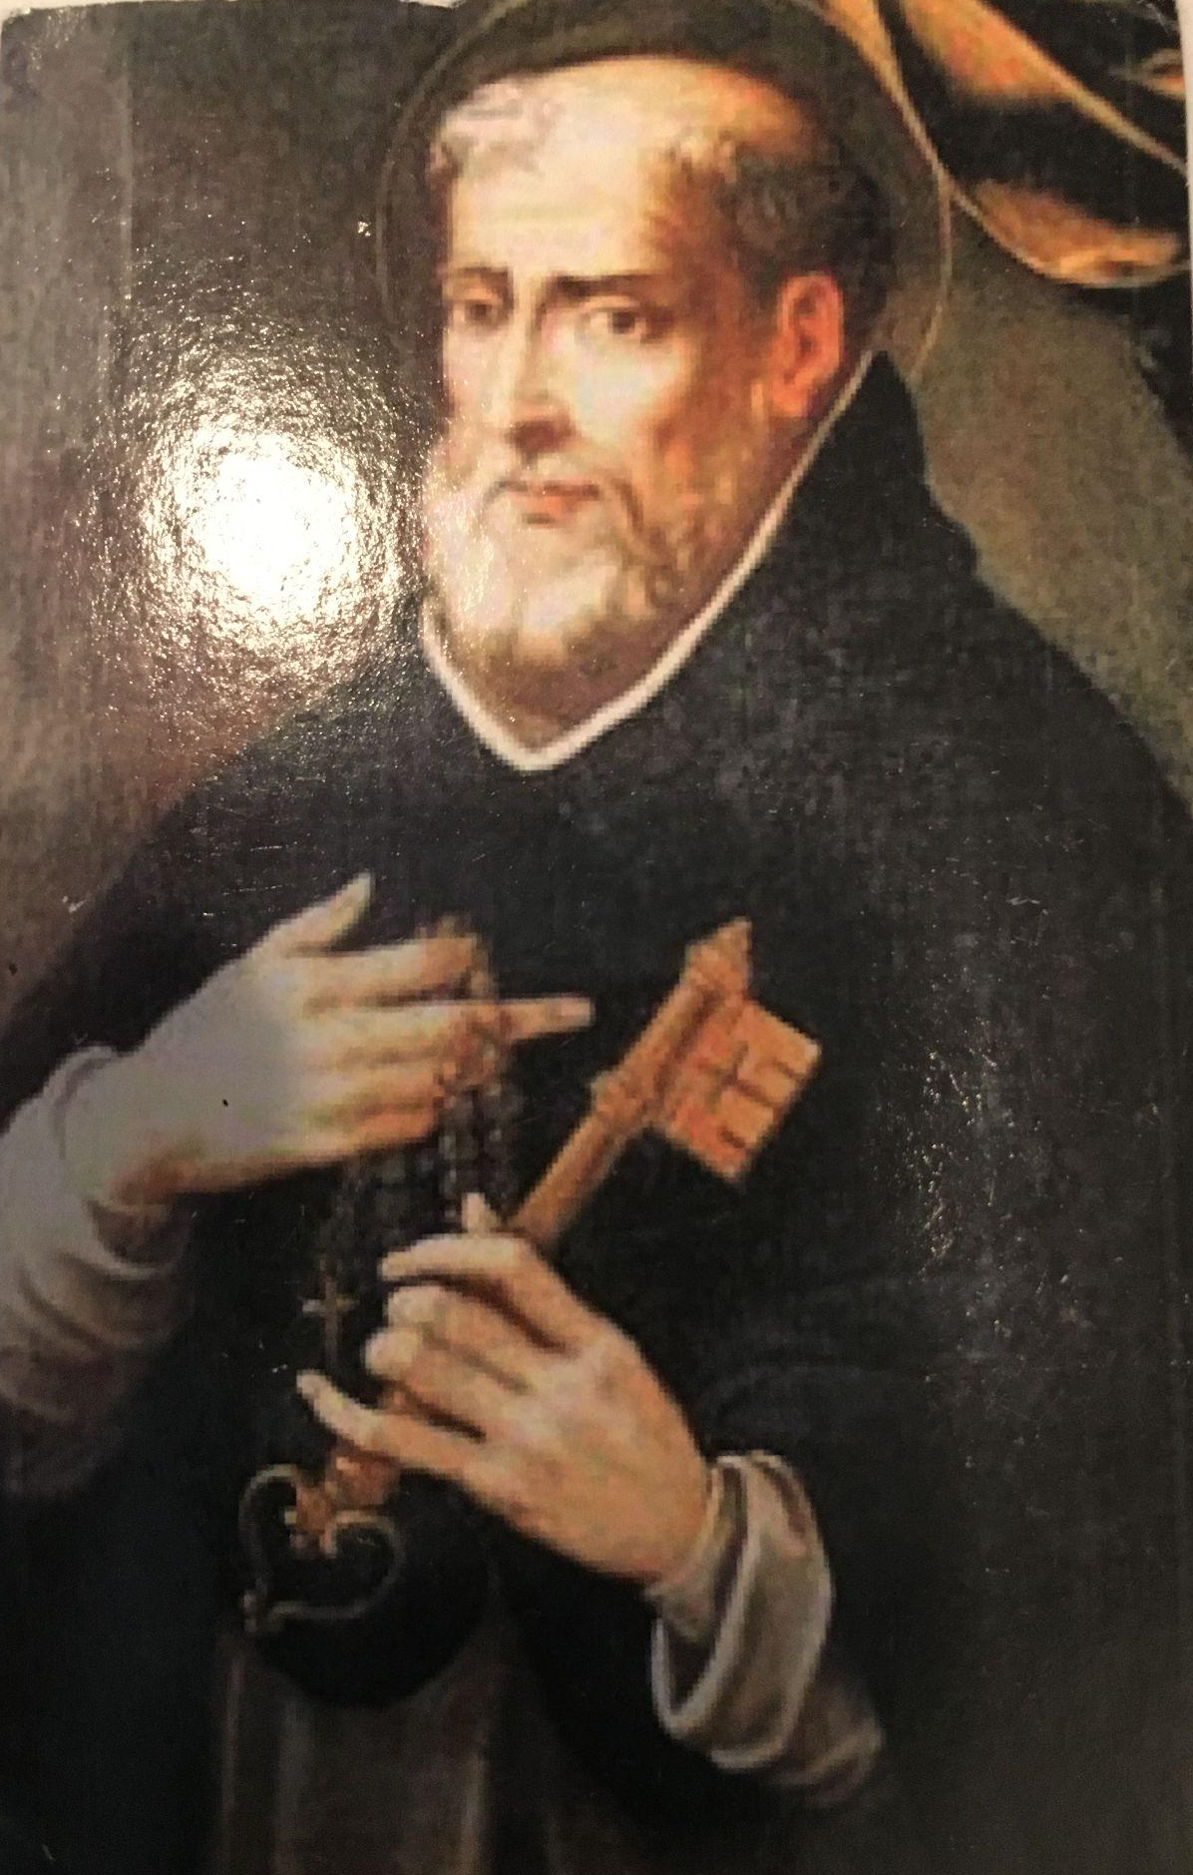
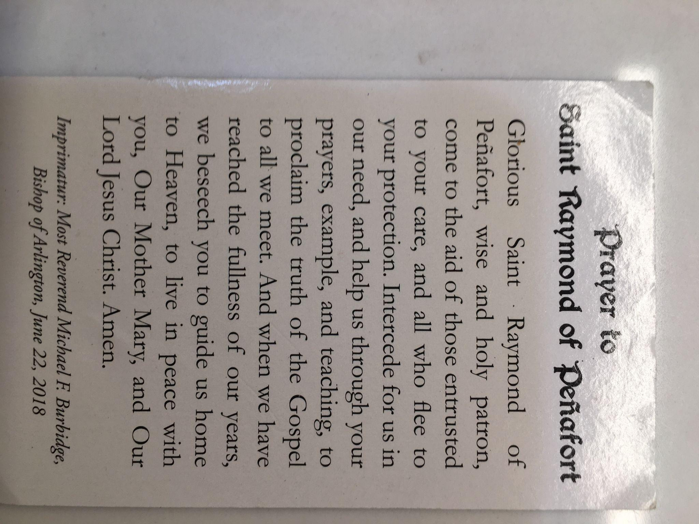

Slide 4



Slide 5

Review: Four Levels of Happiness
Pleasure – basic needs and wants
Ego-Comparative - it’s all about me!
Contributive – it’s all about others!
Transcendent – it’s all about God!
Notes:
See Sister’s of Life Imprint Winter 2017 issue – What Makes you Happy?

Slide 6
What does the Church teach about making moral decisions?
“God created man a rational being, conferring on him the dignity of a person who can initiate and control his own actions.” [CCC 1730]
“Freedom is the power, rooted in reason and will, to act or not to act, to do this or that, and so to perform deliberate action on one’s own responsibility. [CCC 1731]
“Freedom makes man responsible for his acts to the extent that they are voluntary.” [CCC 1734]
“The right to the exercise of freedom, especially in religious and moral matters, is an inalienable requirement of the dignity of man. But the exercise of freedom does not entail the putative right to say or do anything.” [CCC 1747]
“Human acts, that is, acts that are freely chosen in consequence of a judgement of conscience, can be morally evaluated. They are either good or evil. [CCC 1749]
“Faced with a moral choice, conscience can make either a right judgment in accordance with reason and the divine law or, on the contrary, an erroneous judgment that departs from them. [CCC 1786]
“A well-formed conscience is upright and truthful. If formulates its judgement in accordance with reason and the true good willed by the wisdom of the Creator.” [CCC 1798]
Notes:
Source book for the materials for this class

Slide 7
What is ”Truth”?
“Jesus said to the Jews who had believed in him, ‘If you continue in my word, you are truly my disciples, and you will know the truth, and the truth will make you free.” (John 8:31-32)
Truth is Objective (truth does not change with the observer)
  St. Thomas Aquinas: Truth is universal, immutable and can be known by human beings who diligently seek it.
  Truth conforms the mind to reality (nature): “I know the truth when What I have in my mind matches objective reality”
Truth is Subjective (truth is dependent upon the perspective of the observer)
  Justice Anthony Kennedy: “At the heart of liberty is the right to define one’s own concept of existence, of meaning, of the universe, and of the mystery of human life.” [from the majority opinion of Planned Parenthood v Casey (1992)].
Does freedom (liberty) determine truth?
Is subjective truth consistent with the scientific method?
Is it logically coherent to assert that truth is subjective?
Notes:
To assert that truth is subjective is inherently self-contradictory (stating that truth is subjective is to assert an objective truth). Asserting that truth is objective is coherent.

Slide 8
Aquinas’ Definition of “Law”
Law is nothing else than an ordinance of reason for the common good, promulgated by him who has the care of the community.¹
An ordinance – “an order or a command given by someone who is in a position of authority….It imposes an obligation and has binding force.”
Of reason – “must be reasonable; must be just.” It can’t contradict higher laws. It must be observable, enforceable, and useful for achieving the ends that are designated.
For the common good – not given to an individual; but given to a community as a whole.
Promulgated - made known.
By him who has the care of the community – the one who gives the law must have the authority to do so. He must be a legitimate superior within the jurisdiction to make the law.
¹ St. Thomas Aquinas, Summa Theologiae, I-II,q.90, a.4.

Slide 9
Categories of Laws
Origin (who established the law)
Promulgation (how are they established)
Duration (how long do they last)

Slide 10
According to Origin
Eternal Law
Natural Moral Law
Divine Law
Natural Physical Law
According to Origin
Divine Positive Law
Civil Law (Laws of the States)
Human Law
Ecclesiastical Law (Laws of the Church)

Slide 11
According to Promulgation
Natural Physical Law (Laws of nature, i.e., gravity)
Natural (laws made known by the very nature of the creature it governs)
Natural Moral Law (natural law)
According to Promulgation
Divine Positive (i.e., 10 Commandments)
Positive (law which is “laid down”)
Human Law (i.e., Constitution)

Slide 12
According to Duration
According to Duration
Eternal Law – unchanging order of things as it exists in the mind of God.
Temporal Law - Laws with a duration.
Natural Law - applies to rational creatures
Laws of nature - applies to non-rational creatures.

Slide 13
Exercises – What Kind of Law(s) are involved?
You are a high jump coach seeking to get your athletes to jump higher. What is your hindrance? What type of law is impeding your efforts.
You are driving back to college on the Sunday after Thanksgiving. You get an early start and don’t get to Mass before you leave. You arrive at 4:00 p.m. and there is a 5:00 p.m. Mass at school. Must you attend it? What type of law governs?
Your cat is chewing the leg of your parent’s wooden kitchen table. You shoo it away, but it returns and continues chewing. What law is involved here?
You are on a kayaking trip on the Shenandoah River. You see another kayaker in distress. What law influences you in helping him?
Your parents have an outdoors bird feeder a squirrel keeps climbing. You are tempted to take your high-powered bb gun and teach the squirrel a lesson. What law influences you to carry that out or not carry it out?
A woman argues that abortion is legal because “it’s my body and I can do with it what I want.” What laws are involved?
Notes:
Natural law; legal (civil law – although immoral); divine law; positive law
Gravity (natural physical law)
Mass – Divine Law

Slide 14
Evaluating Laws
DC law allows the DDOT to set speed limits on local roads. On May 29,, 2020, the following public announcement was made: “As DC begins reopening today, Mayor Murial Bowser announced that the city will lower the default speed limit on local roads to 20 MPH, down from 25. The change will go into effect on Monday, June 1.”
What type of law?
Does it beneficial to the common good?
Does the one making the law have the authority to do so?
Does it imposes an obligation?
Does it conflict with higher laws?
Was it promulgated? Was it made known to all impacted by it?
Is it reasonable? Is it just?
Is it mandatory?
Notes:
This is a good example to discuss a moral law. For some of these, there is no right or wrong answer. Here are mine.
Mandatory – Yes
Reasonable – Questionable in that what does lowering the speed limit have to do with opening up DC after being shut down for COVID. Was the mayor using COVID as a reason for lowering the speed limit?
Beneficial to the common good? Questionable – see above.
Promulgated? Note that this had two days to take effect. Was the city going to change all of the speed limit signs in those two days.
Authorative? Yes, mayor has authority to do it. But does having the authority give her the right to do it?
So, is it a legitimate law?

