Slide 1
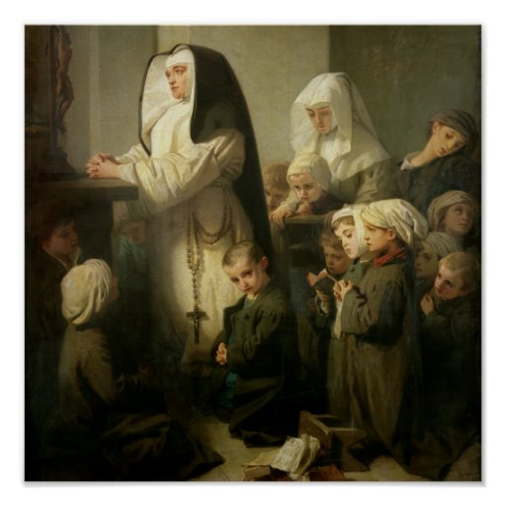
Ninth Grade
Religious Education Class #12
December 12, 2021
Prayer and Suffering
The dog in the photo was trained to identify life after earthquakes. His posture and the fact of staying fixed as seen in the image is the posture that tells the rescuer that there is life in that place. And look at nothing more and nothing less where and in front of who is placed: in front of Jesus as the Eucharistic bread in the tabernacle, the living God among us.

Slide 2
Anima Christi
Soul of Christ, sanctify me.
Body of Christ, save me.
Blood of Christ, inebriate me.
Water from the side of Christ, wash me.
Passion of Christ, strengthen me.
O Good Jesus, hear me.
Within your wounds hide me.
Permit me not to be separated from you.
From the wicked foe, defend me.
At the hour of my death, call me
and bid me come to you
That with your saints I may praise you
For ever and ever. Amen.

Slide 3
What is Prayer?
“Prayer is the raising of one’s mind and heart to God or the requesting of good things from God.” (St. John Damascene)
“For me, prayer is the surge of the heart; it is a simple look turned toward heaven, it is a cry of recognition and of love, embracing both trial and joy. (St. Therese of Lisieux)
“…when we pray, do we speak from the height of our pride and will, or “out of the depths” of a humble and contrite heart??” (CCC 2559)

Slide 4
Why Do We Pray?
Prayer is privileged time with God.
A five-minute chat with a famous person.
“The Lord of glory, Himself unending joy, beauty, and goodness, would invite us to communicate with him and then begin the conversation with his inspired Word, which welcomes our responses, is an unimaginable blessing.”

Slide 5
Places Favorable to Prayer
“The church, the house of God, is the proper place for the liturgical prayer of the parish community. It is also the privileged place for adoration of the real presence of Christ in the Blessed Sacrament.”
”For personal prayer, this can be a ‘prayer corner’ with the Sacred Scripture and icons, in order to be there in secret, before our Father. In a Christian family, this kind of little oratory fosters prayer in common.”
Monasteries…
Pilgrimages…

Slide 6
Types of Prayer
Prayer of Petition (CCC 2629 – 2633)
  “Forgiveness, the quest for the Kingdom, and every true need are objects of the prayer of petition.” (CCC 2646)
Prayer of Intercession (CCC 2634 – 2636)
  “Prayer of intercession consists in asking on behalf of another. It knows no boundaries and extends to one’s enemies.” (CCC 2647)
Prayer of Thanksgiving (CCC 2637 – 2638)
  “Every joy and suffering, every event and need can become the matter for thanksgiving…” (CCC 2648)
Prayer of Praise (CCC 2639 – 2643)
  “Prayer of praise is entirely disinterested and rises to God, lauds him, and gives him glory for his own sake, quite beyond what he has done, but simply because HE IS.” (CCC 2649)

Slide 7
Prayer - Blessing
In the name of the Father;
And of the Son;
And of the Holy Spirit.
Amen.
“No one can say, ‘Jesus is Lord’ except through the Holy Spirit.” Every time we begin to pray to Jesus it is the Holy Spirit who draws us on the way to prayer by his prevenient grace. Since he teaches us to pray by recalling Christ, how could we not pray to the Spirit too? That is why the Church invites us to call upon the Holy Spirit every day, especially at the beginning and the end of every important action.” (CCC 2670)

Slide 8
Prayers - Hail Mary
Hail Mary full of grace the Lord is with thee.
Blessed art thou among women; and blessed is the fruit of thy womb, Jesus.
Holy Mary, Mother of God,
Pray for us sinners now and at the hour of our death.
Amen.

Slide 9
Prayer – Salve, Regina
(Hail Holy Queen)
Hail, holy Queen, mother of mercy, our life, our sweetness, and our hope.
To you do we cry, poor banished children of Eve.
To you do we send up our sighs, mourning and weeping in this valley of tears.
Turn then, O most gracious advocate, your eyes of mercy toward us, and after this our exile show unto us the blessed fruit of your womb, Jesus.
O clement, O loving, O sweet Virgin Mary.
Pray for us, O holy Mother of God,
That we may be made worthy of the promises of Christ.

Slide 10
Prayer – Our Father
Our Father, who art in heaven,
Hallowed be Thy Name;
Thy kingdom come,
Thy will be done on earth as it is in heaven.
Give us this day our daily bread,
And forgive us our trespasses,
As we forgive those who trespass against us;
And lead us not into temptation,
But deliver us from evil.
Amen

Slide 11
Prayer, Kyrie
Kyrie, eleison.
Kyrie, eleison.
Kyrie, eleison.

Slide 12
Prayer, Gloria
Glory to God in the highest, and on earth peace to people of good will.
We praise you, we bless you, we adore you, we glorify you, we give thanks for your great glory, Lord God, heavenly King, O God, almighty Father.
Lord Jesus Christ, Only Begotten Son, Lord God, Lamb of God, Son of the Father, you take away the sins of the world, have mercy on us; you take away the sins of the world, receive our prayer; you are seated at the right hand of the Father, have mercy on us.
For you alone are the Holy One, you alone are the Lord, you alone are the Most High, Jesus Christ, with the Holy Spirit, in the glory of God the Father.
Amen.

Slide 13
Prayer – Act of Contrition
O my God I am heartily sorry for having offended Thee,
And I detest all of my sins because of their just punishment; but most of all because they offend Thee, my God. Who art all Good and worthy of all my love.
I firmly resolve with the help of Thy grace,
To sin no more and to avoid the near occasions of sin.
Amen.

Slide 14
Prayers
St. Raymond, pray for us!

Slide 15
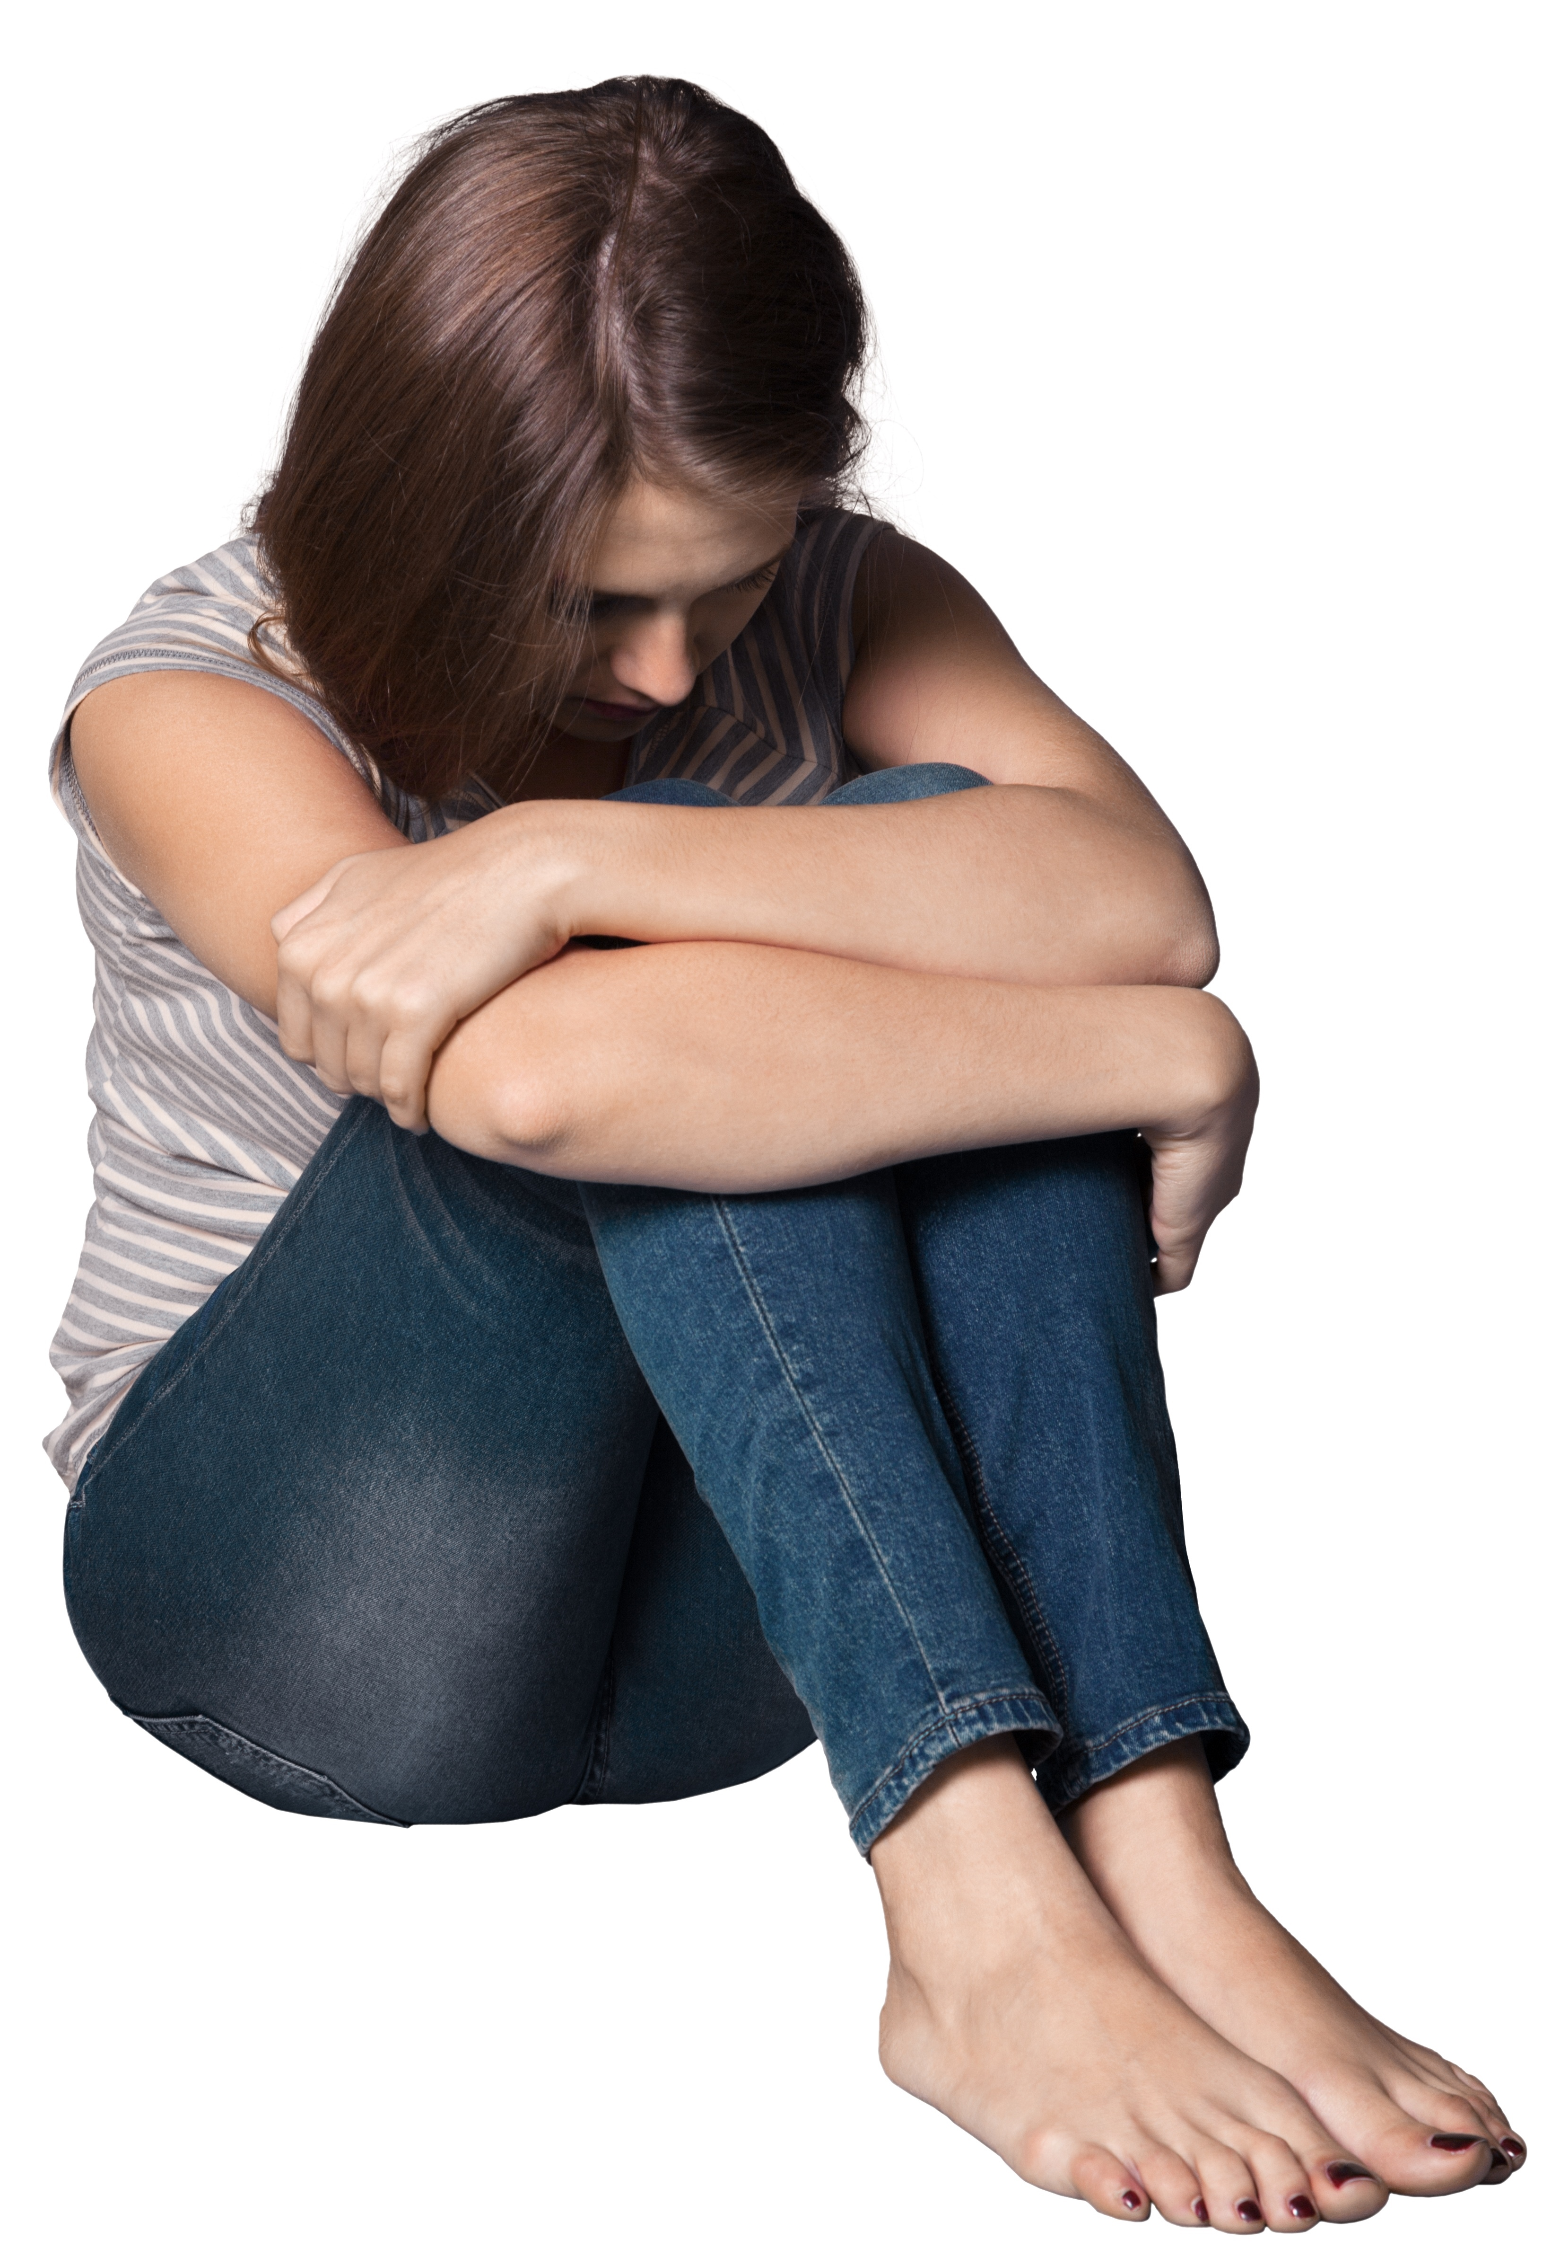
Why Does God Allow Suffering?
7E-P7-A_032020 (crediblecatholic.com)
(slides: 35-38; 40; 42-44; 46-89)
The dog in the photo was trained to identify life after earthquakes. His posture and the fact of staying fixed as seen in the image is the posture that tells the rescuer that there is life in that place. And look at nothing more and nothing less where and in front of who is placed: in front of Jesus as the Eucharistic bread in the tabernacle, the living God among us.

Slide 16
Suffering and Freedom
“Freedom without choice is a logical contradiction. No choice; no freedom.”
“God is responsible for the fact of freedom. Humans are responsible for their acts of freedom.”

Slide 17
Spontaneous Prayers in
Times of Suffering
“Lord, help me.”
“Abba, Father, all things are possible to you; remove this chalice from me; yet not what I will, but what you will” (Mk 14:36).
”Lord, do not let any of this suffering go to waste; make optimal good come out of it for me, others and Your Kingdom.”
”Lord, snatch victory from the jaws of defeat.”
“I give up – You take care of it.”
“Lord, push back this darkness and foreboding.”
“Lord, You are the just, wise, and merciful Judge – You take care of it.”
“Thank You.”

Slide 18
Spontaneous Prayers in Times of Suffering
“God, be merciful to me a sinner!” (Lk 18:13).
“Lord, save me” (Mt 14:30).
”Lord, I accept your forgiveness.”
“Lord, I will try with all my heart to walk in Your light and love.”
“Lord, make good come out of whatever harm I might have caused.”
“Thy loving will be done.”

