Slide 1
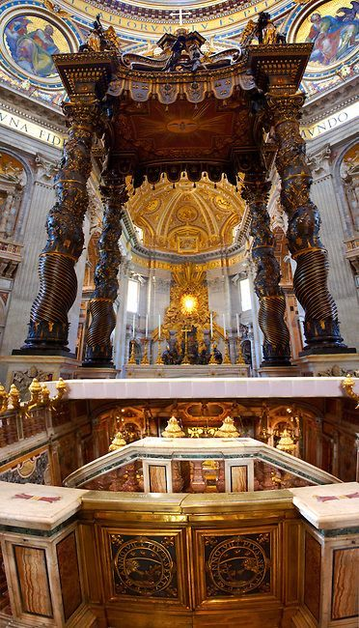
“Upon this Rock, I will build my Church”
Ninth Grade
Religious Education Class #11
December 5, 2021

Slide 2
Anima Christi
Soul of Christ, sanctify me.
Body of Christ, save me.
Blood of Christ, inebriate me.
Water from the side of Christ, wash me.
Passion of Christ, strengthen me.
O Good Jesus, hear me.
Within your wounds hide me.
Permit me not to be separated from you.
From the wicked foe, defend me.
At the hour of my death, call me
and bid me come to you
That with your saints I may praise you
For ever and ever. Amen.

Slide 3
December 8th
December 12th

Slide 4
The Origin and Meaning of Christmas Traditions
The Christmas Tree
Wreaths
Holly and Holly Tree
Lights and Candles
The Star
The poinsettia
Christmas bells
The giving of gifts
Santa Clause

Slide 5
Are We Predestined for either Heaven or Hell?
1 Tim 2:4 God our Savior “who desires all men to be saved and to come to the knowledge of the truth.”
Gen 1:27 “God created man in his own image, in the image of God he created him; male and female he created them.”
Rom 8:28-29 “We know that in everything God works for good with those who love him, who are called according to his purpose. For those whom he foreknew he also predestined to be conformed to the image of his Son, in order that he might be the first-born among many brethren.”

Slide 6
Are We Predestined for either Heaven or Hell?
God wills all men to be saved (1 Tim 2:4 and Gen 1:27).
Some men so persistently resist his graces that they cannot be saved (i.e., they remove themselves from the set of men to be saved).
Others (those remaining in the set of men to be saved are saved).

Slide 7
How did Christ Establish His Church?
“And I tell you, you are Peter (Greek Petros), and on this rock (Greek petra) I will build my Church, and the gates of Hades shall not prevail against it. I will give you the keys to the kingdom of heaven, and whatever you bind on earth shall be bound in heaven, and whatever you loose on earth shall be loosed in heaven.” (Mt 16:18-19)

Slide 8
How did Christ Establish his Church?
The Gospels give us some observable facts:
There was a man named Jesus;
He claimed to be a messenger sent by God;
He did enough to prove this by miracles in contexts such that a connection was established between the claim and the miracle.
He had an inner circle to whom He spoke more;
He told them to continue His work, His teaching; and
He promised that God would protect their teaching: “He who hears you, hears me” (Lk 10:16).

Slide 9
“And I tell you, you are Peter, and on this rock I will build my Church, and the gates of hell shall not prevail against it.” (Matt 16:18)

Slide 10
Some Background
July 18-19, 64 AD – the great fire of Rome. Rumor was that Nero wanted to build a large palace for himself and set fire to an area SE of Circus Maximus. Fire got out of control and destroyed most of the city. Nero had to blame someone so he blamed the Christians.
St. Peter was crucified upside down in Rome around 65 AD by Nero. Paul was crucified nearby.
St. Peter’s body was dumped in a landfill but Christians secretly recovered it and buried it on Vatican Hill.
It became a secret place of worship for Christians.

Slide 11
More Background
Christian persecution continued until Roman Emperor Constantine (300-337) rose to power.
Although he was pagan, his mother, Helena, was a devout Christian.
318-322 - He allowed a church to be built on Vatican Hill over the site of Peter’s tomb. This became known as the Constantine Church. Took about 40 years to build.

Slide 12
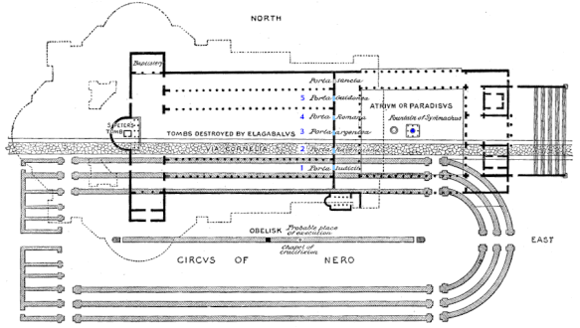

Slide 13
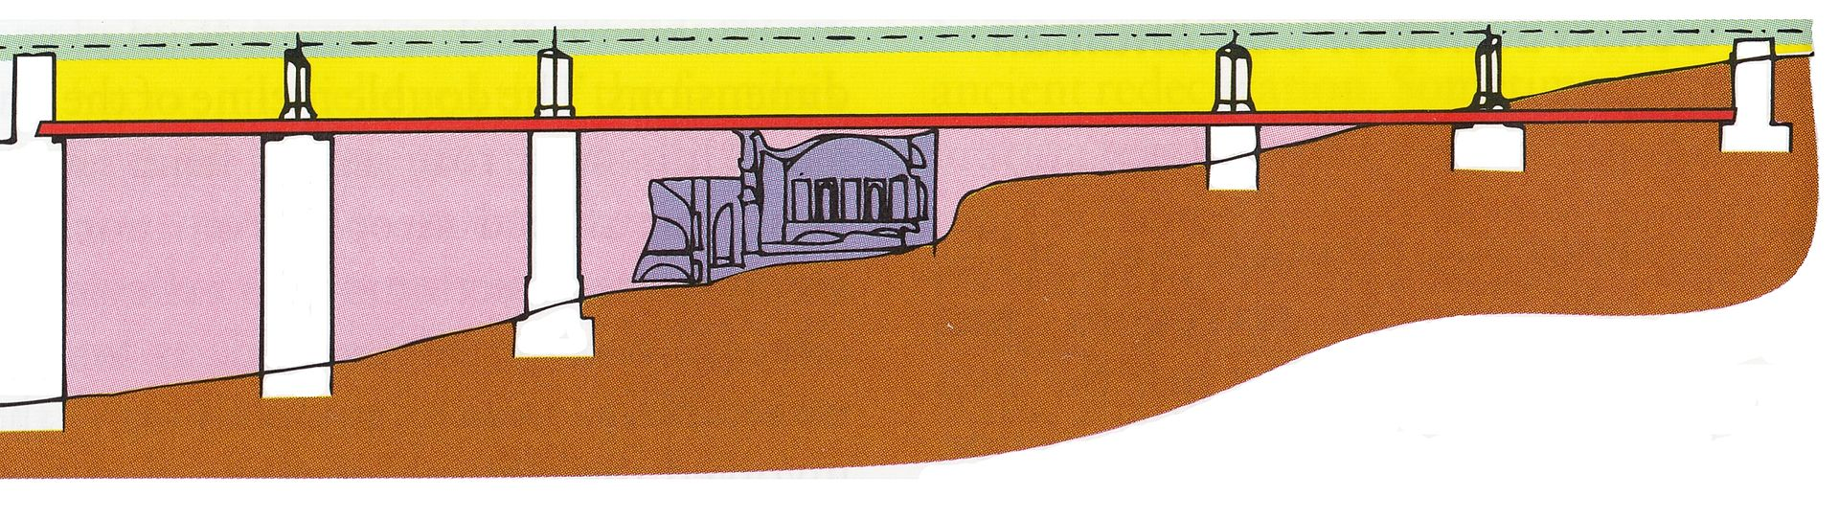

Slide 14
More History
Rome sacked many times throughout history
  410 Visigoth’s
  455 Vandals
  846 Saracens
  1527 Germans
Much of Rome was reduced to ruins (Colosseum half collapsed)
Except – the tombs there were covered to build the Constantine church were preserved intact as they had been in 337

Slide 15
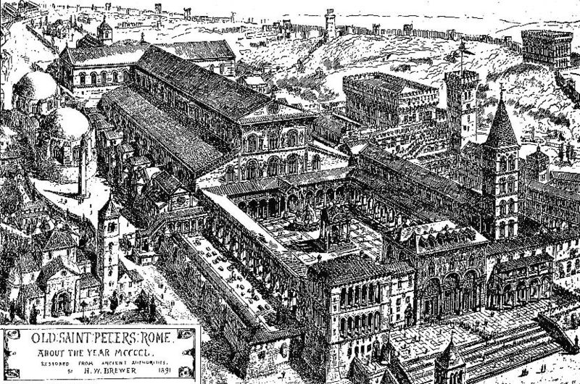
The Constantine Church (Old St. Peter’s) (1450)

Slide 16
Current Basilica
Construction of the present basilica began on 18 April 1506 and was completed on 18 November 1626.
Designed principally by Donato Bramante, Michelangelo, Carlo Maderno and Gian Lorenzo Bernini.
St. Peter's is the most renowned work of Renaissance architecture and the largest church in the world by interior measure. While it is neither the mother church of the Catholic Church nor the cathedral of the Diocese of Rome (these equivalent titles being held by the Archbasilica of Saint John Lateran in Rome)
It has been described as "holding a unique position in the Christian world“ and as "the greatest of all churches of Christendom."

Slide 17
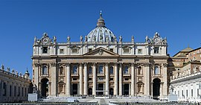
Current St. Peters

Slide 18
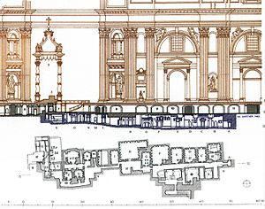
Cutaway
Current St. Peter’s Basilica
Papal Altar
Tomb of St. Peter

Slide 19
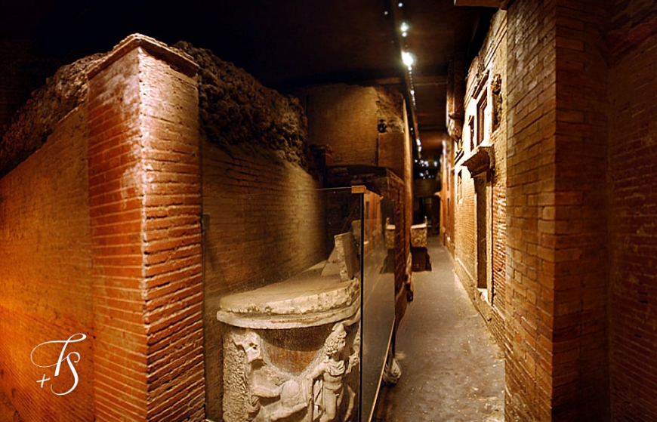

Slide 20
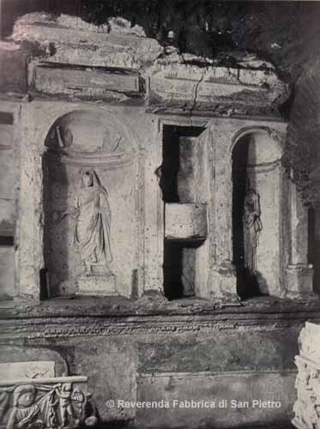
Tomb of Valerii
“Peter, pray for the holy men and women buried near your body.”

Slide 21
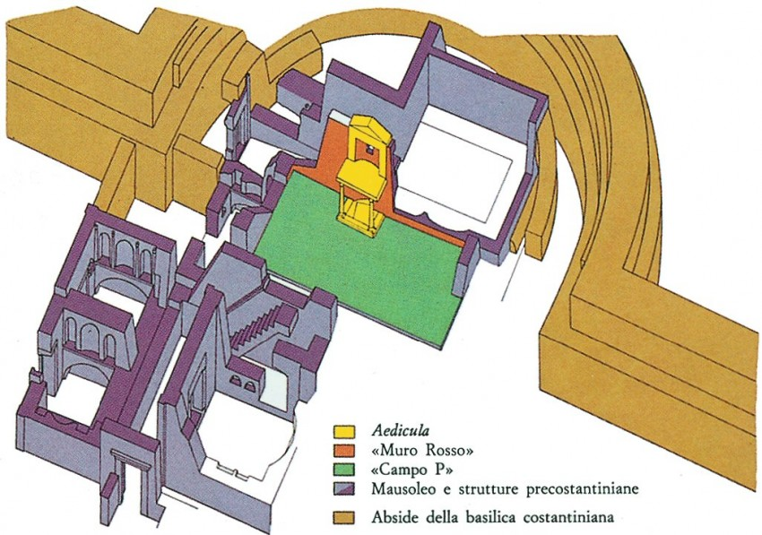
Notes:
Aedicula is a small shrine

Slide 22
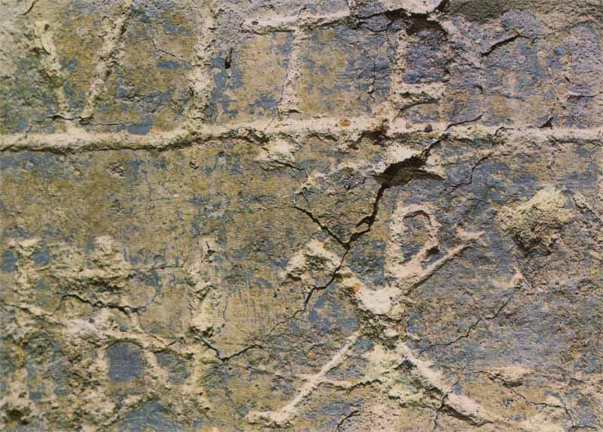
The Graffiti Wall
The significance of the symbol “P” and the symbol “X”.
At the base of the “P” are three lines. When put together, they become a key! “I will give you the keys to the kingdom of heaven.” (Mt. 16:19)
Alpha (Α or α) and omega (Ω or ω).
T symbolizes a cross
V for victory over the cross (resurrection) R

Slide 23
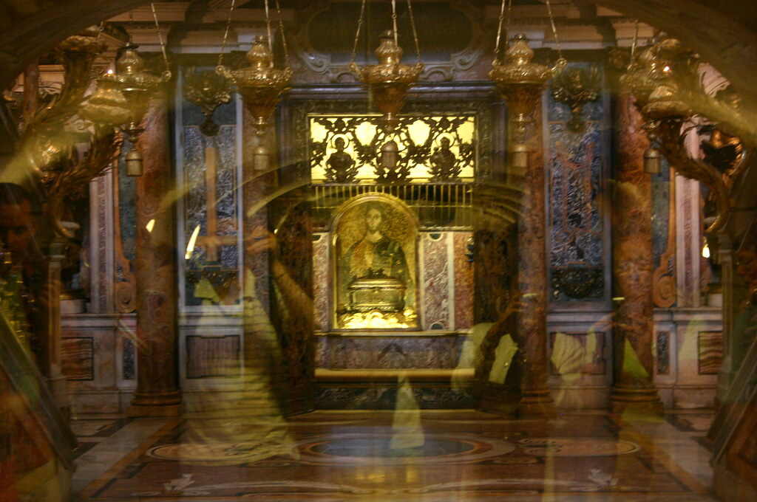

Slide 24
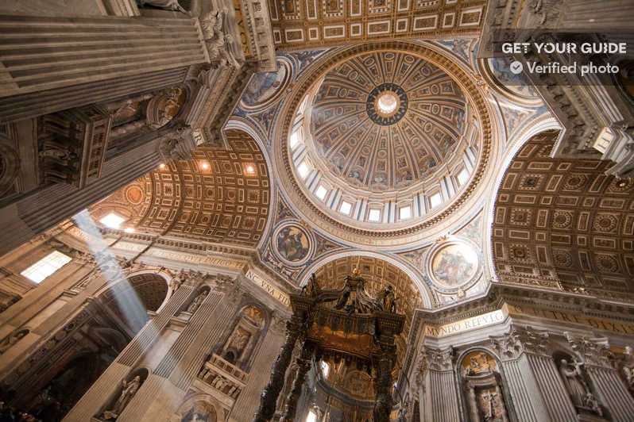

Slide 25
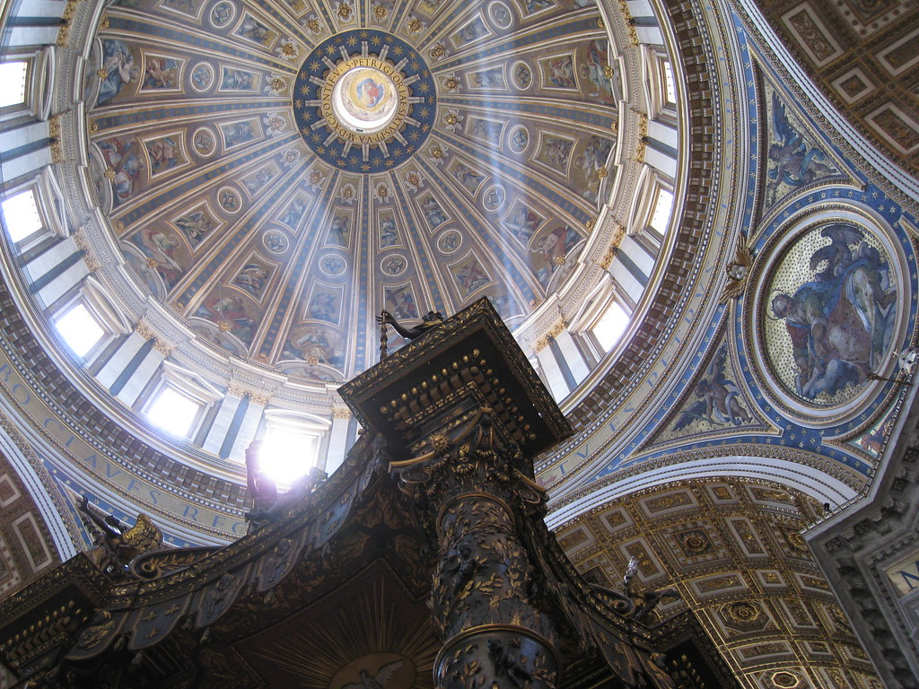

Slide 26
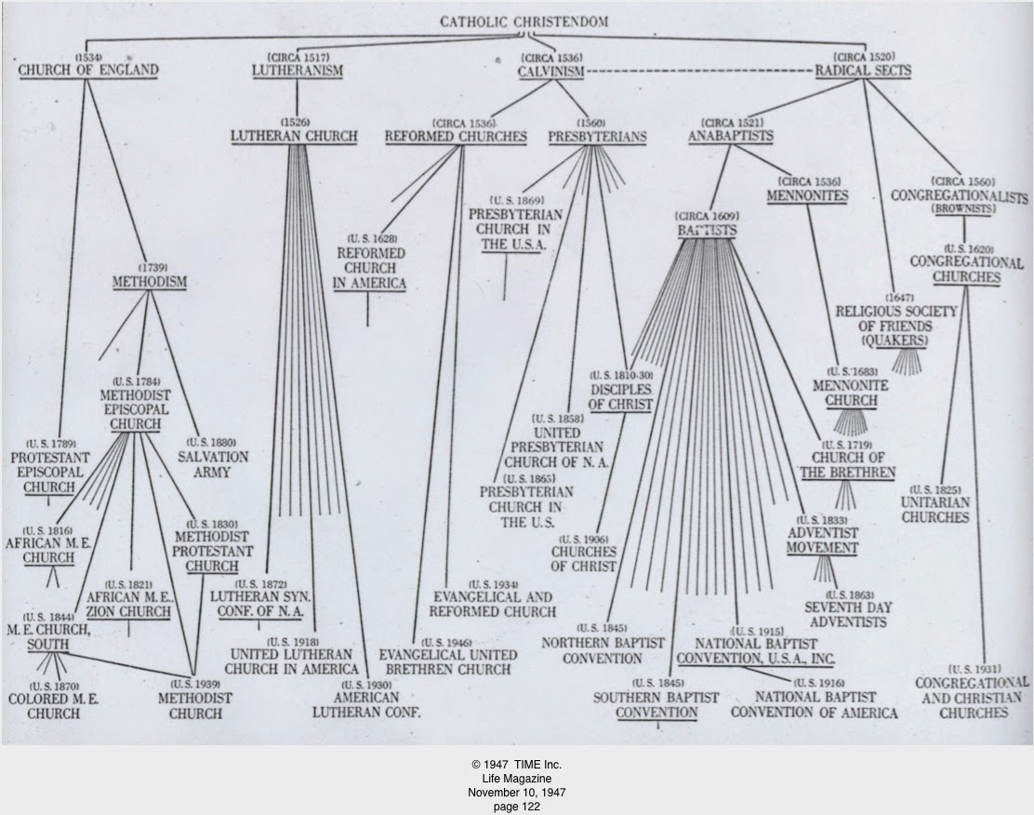
Breaking Away from the Catholic Church
Jesus commissioned Peter that upon this Rock He would build his Church.
Church is singular; not plural!
The Catholic Church is the longest-existing institution in the history of the world!

Slide 27
“Peter is Here”
“And I tell you, you are Peter, and on this rock I will build my Church, and the gates of hell shall not prevail against it.” (Matt 16:18)

Slide 28
360 Video: Inside the Tomb of St. Peter at the Vatican – YouTube
(3:30) https://www.youtube.com/watch?v=aQNchugB3hc
Scavi Presentation by Fr. Christopher Brashears - YouTube
(50:43) https://www.youtube.com/watch?v=hCrSPOd74fI

