Slide 1
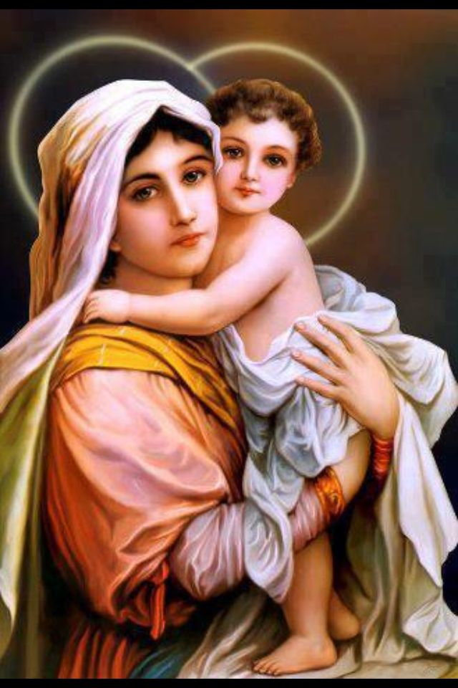
Ninth Grade CCD Class #8
November 7, 2021
The dog in the photo was trained to identify life after earthquakes. His posture and the fact of staying fixed as seen in the image is the posture that tells the rescuer that there is life in that place. And look at nothing more and nothing less where and in front of who is placed: in front of Jesus as the Eucharistic bread in the tabernacle, the living God among us.

Slide 2
Anima Christi
Soul of Christ, sanctify me.
Body of Christ, save me.
Blood of Christ, inebriate me.
Water from the side of Christ, wash me.
Passion of Christ, strengthen me.
O Good Jesus, hear me.
Within your wounds hide me.
Permit me not to be separated from you.
From the wicked foe, defend me.
At the hour of my death, call me
and bid me come to you
That with your saints I may praise you
For ever and ever. Amen.

Slide 3
Levels of Happiness Review
Level 1 – Pleasure
Level 2 – Ego-comparative
Level 3 – Contributive
Level 4 – Transcendent
In Class Exercise

Slide 4
Levels of Happiness Exercise
Attending Youth Ministry
Raking Leaves at Parish
Pleasure (about things) Level 1 | Ego-Comparative (about me) Level 2 | Contributive (about others) Level 3 | Transcendent (about God) Level 4

Slide 5
Saint/Beatitude Exercise
The Nine Beatitudes
Blessed are the poor in spirit; for theirs is the kingdom of heaven.
Blessed are those who mourn, for they shall be comforted.
Blessed are the meek, for they shall inherit the earth.
Blessed are those who hunger and thirst for righteousness, for they shall be satisfied.
Blessed are the merciful, for they shall obtain mercy.
Blessed are the pure in heart, for they shall see God.
Blessed are the peacemakers, for they shall be called sons of God.
Blessed are those who are persecuted for righteousness’ sake, for theirs is the kingdom of heaven.
Blessed are you when men revile you and persecute you and utter all kinds of evil against you falsely on my account. Rejoice and be glad, for your reward is great in Heaven.

Slide 6
The Holy Spirit
Human persons
Rational and relational, yes
(Spirit and material beings)
Angels
Rational and relational, yes
(Pure Spirit)
God (3 persons)
1st and 3rd rational and relational, to the highest degree, yes
(Pure Spirit)
2nd rational and relational, to the highest degree, yes
(Spirit and material being)

Slide 7
The Holy Spirit in the Nicene Creed
I believe in the Holy Spirit, the Lord, the giver of life, who proceeds from the Father and the Son, who with the Father and the Son is adored and glorified, and who has spoken through the prophets.

Slide 8
Holy Spirit in the Church Today
John 14:15-17, 26 (Sending the Holy Spirit)
John 16:13-15 (Holy Spirit in the Church today)
Matt 28:19-20 (Final commissioning of the apostles)
Acts 2:1-4 (Descent of the Holy Spirit on the Apostles)
Acts 2:5-8

Slide 9
CCC 689
“The One whom the Father has sent into our hearts, the Spirit of his Son, is truly God. Consubstantial with the Father and the Son, the Spirit is inseparable from them, in both the inner life of the Trinity and his gift of love for the world. In adoring the Holy Trinity, life-giving, consubstantial, and indivisible, the Church’s faith also professes the distinction in persons. When the Father sends his Word, he always sends his Breath. In their joint mission, the Son and the Holy Spirit are distinct but inseparable. To be sure, it is Christ who is seen, the visible image of the invisible God, but it is the Spirit who reveals him.”

Slide 10
How the Holy Spirit is Active in the Church Today (from CCC 688)
When we listen to, read, and study the scriptures, and see his presence in the sacred writings;
When we read the lives of the saints and are inspired to holiness by their example, with the Holy Spirit’s help;
When we obediently accept the teaching authority of the Church, which we recognize is guided by the Holy Spirit;
When we receive the Sacraments, especially the Eucharist, and the Holy Spirit deepens our experience of God;
Whenever we pray, and the Holy Spirit prays with us and for us.

Slide 11
How the Holy Spirit is Active in the Church Today (from CCC 688)
6. When we support the missions and apostolates of the Church, which are aided by the work of the Holy Spirit;
7. When we recognize the gifts and charisms of the Holy Spirit that help build up the Church; and
8. When we consider Sacred Tradition, Church history, and its many holy witnesses, and realize the sustaining power of the Holy Spirit, who keeps the Church faithful and free of error in her teachings.

Slide 12
Gifts of the Holy Spirit
Wisdom
Understanding
Counsel
Fortitude
Knowledge
Piety
Fear of the Lord

Slide 13
The Fruits of the Holy Spirit
Love
Joy
Peace
Patience
Kindness
Generosity
Faithfulness
Gentleness
Self-control
Modesty
Chastity
Goodness

Slide 14
Prayer to the Holy Spirit
Come, Holy Spirit, fill the hearts of your faithful.
And kindle in them the fire of your love.
Send forth your Spirit and they shall be created.
And you will renew the face of the earth.
Lord, by the light of the Holy Spirit
you have taught the hearts of your faithful.
In the same Spirit
help us to relish what is right
and always rejoice in your consolation.
We ask this through Christ our Lord.
Amen.

Slide 15
The Blessed Mother

Slide 16
The Blessed Mother in Christ’s Life
Conceived of the Holy Spirit (Nazareth)
Born of the Virgin Mary (Bethlehem)
Fled into Egypt
Lost and found in the Temple age 12 (Jerusalem)
Public Life of Jesus begins – age 30 (Galilee)
Selects Apostles
Performs Miracles
Institution of the Eucharist
Crucifixion and Death on the Cross – age 33
Resurrection from the dead
Ascension into heaven

Slide 17
Annunciation/Immaculate Conception
Luke 1-26 – 38
What’s the significance of the angel Gabriel’s salutation that Mary is “full of grace”? (LG 56)
What does this announcement have to do with the celebration of the “Immaculate Conception?” (CCC 490-492)
When was the feast of the Immaculate Conception proclaimed?
Did Mary know at that time what she was getting into?
    “Behold, I am the handmaid of the Lord; let it be [done] to me according to your word.”

Slide 18
Life of Blessed Mother
Immaculate Conception (CCC 491-492)
Annunciation (Luke 1:26-38)
Visitation (Luke 1:39-56)
Birth of Jesus (Matt 1:18-25, 2:1, Luke 2:1-14)
Presentation in the Temple (Luke 2:21-38)
Flight into Egypt (Matt 2:13-18)

Slide 19
Life of Blessed Mother
Return to Nazareth (Matt 2:19-23)
Finding of Jesus in the Temple (Luke 2:41-50) (Chosen Video clip)
Hidden Life of Jesus (Luke 2:51-52)
Beginning of Jesus’ Public Ministry (Wedding Feast at Cana) (John 2:3-5,7-11) (Chosen Video Clip)
Passion, Crucifixion and Resurrection of Christ (John 19:25-27)
Descent of the Holy Spirit (Pentecost) (Acts 1:14)

Slide 20
Finding of Jesus in the Temple
Finding in the Temple
The Chosen : The Finding AT The Temple Scene – YouTube
https://www.youtube.com/watch?v=x_62gx1qYYE

Slide 21
Selected Apparitions of the Blessed Mother
August 4, 400 Our Lady appeared to a couple and asked that a basilica be built on Mount Esquiline in Rome. She outlined the area with snow and became known as Our Lady of the Snow. (Today the basilica is called St. Mary Major)
1208 Our Lady appeared to St Dominic de Guzman, the founder of the Dominicans and introduced him to the rosary. She became known as Our Lady of the Rosary.
1226 Our Lady appeared to St Simon Stock on Mount Carmel and gave him the devotion to the brown scapular. She became known as Our Lady of Mount Carmel.
March 27, 1499 Our Lady of Perpetual Help was a copy of a painting attributed to St. Luke. Attributed with many miracles and is currently in St. Matthew’s Church in Rome (located between St. Mary Major and the church of St. John Lateran).
December 9, 1531 The Blessed Mother appeared to Juan Diego at Guadalupe, Mexico and became known Our Lady of Guadalupe and Patroness of the Americas.

Slide 22
Selected Apparitions of the Blessed Mother
September 17, 1569 Pope asked Christians to pray the rosary for the success of the Christians against the Turks at Lepanto, Greece. The triumph of the fleet was attributed to Our Lady of the Rosary.
July 18, 1830 The Blessed Mother appeared to St. Catherine Laboure in a convent in France and asked her to strike a metal made after a model that she provided with the words, “Oh Mary, conceived without original sin, pray for us who have recourse to thee. She became known as Our Lady of the Miraculous Medal.
September 17, 1846 The Blessed Mother appeared to Melanie Mathieu in La Salette, France. She became known as Our Lady of La Salette.
December 8, 1858 The Blessed Mother appeared to Bernadette Soubirous stating, “I am the Immaculate Conception.”

Slide 23
Selected Apparitions of the Blessed Mother
October 13, 1916 The Blessed Mother appeared to three children at Fatima, Portugal. On that day to prove to the world that she was meeting the children, she caused the “Sun to Dance.” She is known as Our Lady of Fatima.
https://watch.formed.org/fatima-1/season:1/videos/the-great-miracle-of-the-sun

Slide 24
Grace
Grace is a totally gratuitous gift from God to the human race on which man has absolutely no claim. It is a supernatural gift that God, of his free benevolence, bestows on rational creatures for their eternal salvation. The gifts of grace are essentially supernatural.
Mary had extra graces to stay without sin.
At baptism we are made members of the Church – remove original sin and gain sanctifying grace.

Slide 25
Next Week
Father De Celles takes questions from high school students.
Submit questions to the Lairds (blaird48@gmail.com) by November 11, 2021

