Slide 1
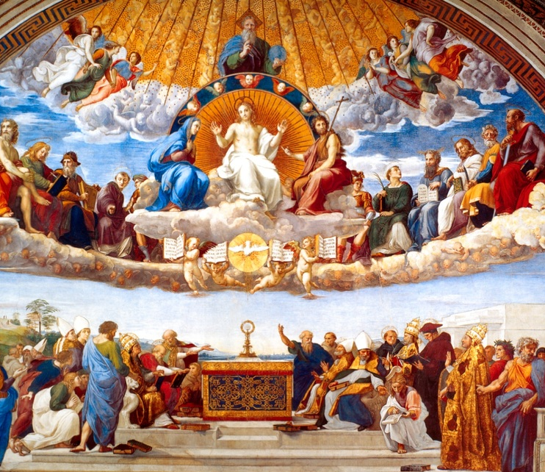
Ninth Grade CCD
Class 7
October 31, 2021
St. Raymond of Peñafort
Catholic Church

Slide 2
Anima Christi
Soul of Christ, sanctify me.
Body of Christ, save me.
Blood of Christ, inebriate me.
Water from the side of Christ, wash me.
Passion of Christ, strengthen me.
O Good Jesus, hear me.
Within your wounds hide me.
Permit me not to be separated from you.
From the wicked foe, defend me.
At the hour of my death, call me
and bid me come to you
That with your saints I may praise you
For ever and ever. Amen.

Slide 3
What is
All Saints Day?

Slide 4
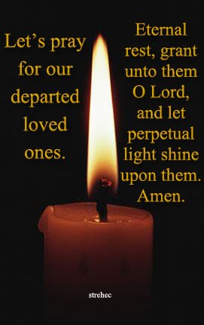
What is
All Souls Day?

Slide 5
You were born into a culture in which…
You can define your own reality!
You can decide for yourself whether certain behaviors are good or bad.
You can decide for yourself when life begins, or what gender you want to be.
You can decide what is sin and what isn’t!

Slide 6
We no longer accept that we are made in the image and likeness of God, so there is great confusion about…
what it means to be a human person
what it means to be male and female
what it means to be a family (father/mother/children)…
BUT..

Slide 7
God placed you here for a reason…
  at this time in history,
  in your particular family.
  SO

Slide 8

How do we keep from getting trapped into believing that we can define our own existence…our own reality?
What are we seeking? What do we want?

Slide 9
No matter what we “think” we desire, what are we really desiring?
What is the one thing we desire…
only for itself?

Slide 10
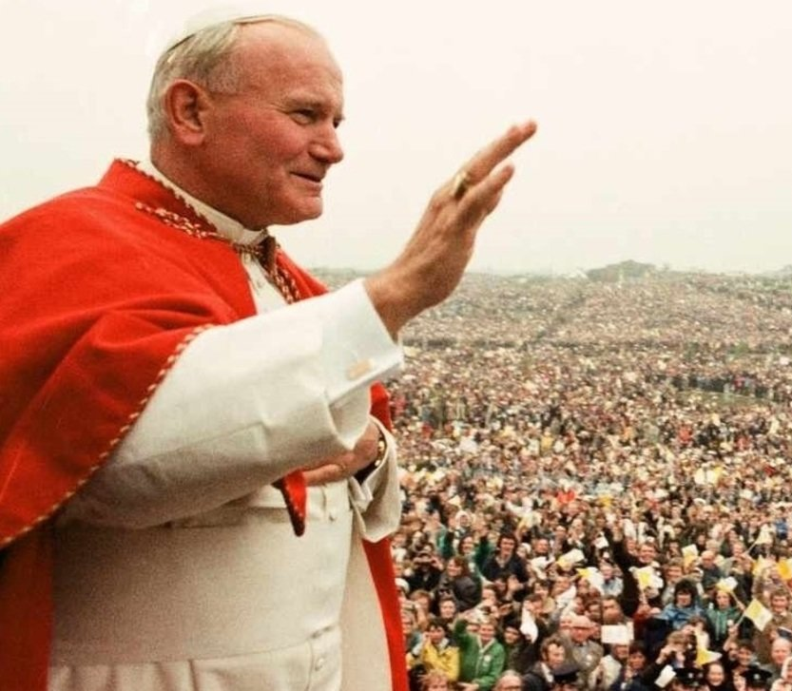
HAPPINESS
“It is Jesus that you seek when you dream of happiness…He is waiting for you when nothing else you find satisfies you; He is the beauty to which you are so attracted…It is He who reads in your hearts your most genuine choices, the choices that others try to stifle.”

Slide 11
Levels of Happiness
7E-P6-A_032020 (crediblecatholic.com)
https://www.crediblecatholic.com/12ppt/7E-P6-A/

