Slide 1

Ninth Grade CCD
Class 6
October 24, 2021
St. Raymond of Peñafort Catholic Church

Slide 2
Anima Christi
Soul of Christ, sanctify me.
Body of Christ, save me.
Blood of Christ, inebriate me.
Water from the side of Christ, wash me.
Passion of Christ, strengthen me.
O Good Jesus, hear me.
Within your wounds hide me.
Permit me not to be separated from you.
From the wicked foe, defend me.
At the hour of my death, call me
and bid me come to you
That with your saints I may praise you
For ever and ever. Amen.

Slide 3
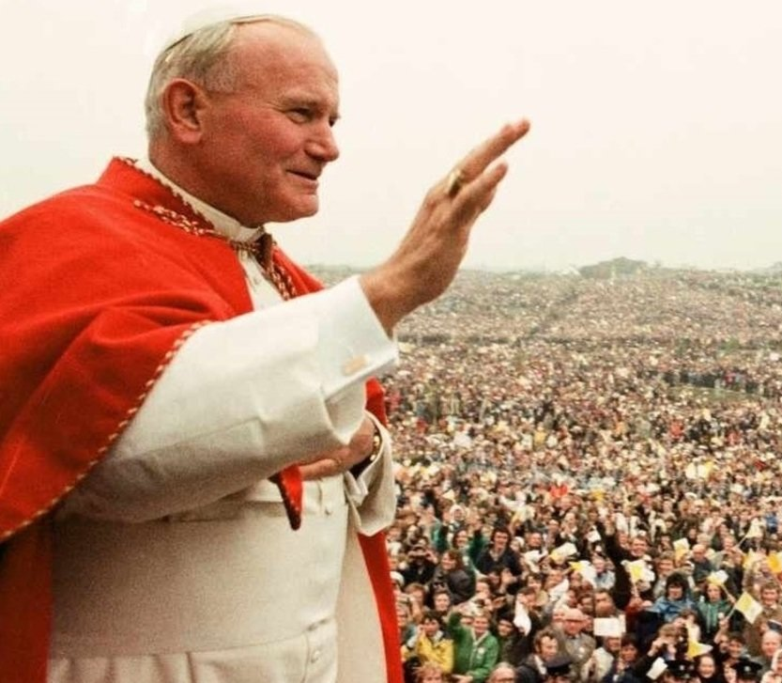
Saint of the Week
Pope Saint John Paul II

Slide 4
Facts about
Pope Saint John Paul II
Neither he nor John Paul I were expected to be chosen Pope in 1978.
Double Name: John Paul II
Three Popes in a single year: Not since 1648
First non-Italian Pope since 1523
From a Communist country
Extremely popular; drew upward to 2 million at some of his Masses
Most traveled pope
Assassination attempt
Theologian and philosopher
Significant influence on the Second Vatican Council

Slide 5
Facts about
Pope Saint John Paul II
Established a new Code of Canon Law
Influence and teaching brought down the Communist world in Europe
Created the first Catechism of the Catholic Church since the Counter-Reformation (Council of Trent in 1566)

Slide 6
Hierarchy of Being
God | Pure Spirit
Angels | Pure Spirits
Human Persons | Spiritual and Material Beings / Rational Souls
Non-human Animals | Material Beings / Sensitive Souls
Plants | Material Beings / Vegetative Souls
Non-living Beings | Material Beings
“The human soul is a kind of horizon, and a boundary, as it were,
between the corporeal world and the incorporeal world.”
- St. Thomas Aquinas

Slide 7
Human Persons
How do we define a “person?”
  A being with a mind and a will.
Is a body an essential part of a person?
  No, God and angels are persons.
What do these powers of the “mind and a will” allow a person to do?
  To think and to choose.
What does it mean to be a person with bodies?
  We manifest “personhood” to the visible world. Our bodies are the outward expression of our person.
Can angels do that?
  No!

Slide 8
Made in God’s Image
“Then God said, ‘Let us make man in our image, after our likeness; and let them have dominion over the fish of the sea, and over the birds of the air, and over the cattle, and over all the earth, and over every creeping thing that creeps upon the earth.’”
(Gen 1:26)
“So God created man in his own image, in the image of God he created him; male and female he created them.” (Gen. 1:27)

Slide 9
Human Persons
What does it mean to be ”made in the image and likeness of God?” Are we gods?
  We are not gods; but we are created to act like God would act.
  When we act as we ought (as God because we are images of God) and express those acts outwardly in and through our bodies, our bodies become, literally, physical icons of God.
So, what does that mean being “physical icons of God?”
  Our bodies are sacred and holy.
How do we think of our bodies?
  Need to lose weight, change hair styles, have more muscles, look better, etc.

Slide 10
Human Persons
How does society today see bodies?
  Machines – Star Wars robots have “personalities” or Data on Star Trek that acts like a machine.
  In sports, expressions such as “he has all the tools for…” or about a pitcher, “His arm is like a rifle,” or a football wide receiver, “He has great wheels.”
  In medicine, “I need to have my plumbing replaced,” or referring to coffee as “fuel.”
If we actually believe our bodies are machines, what does that imply?
  ”It’s my body and I can do with it what I want.”
What does that imply?
  If we own our bodies, then someone else could also own them – slavery would become acceptable.
  If we own our bodies, then we could harm them; we could harm others.
  We could get rid of it. We could sell it to someone else.

Slide 11
Human Persons
How do we know how God would act (and we are going to get into “acting” later in the course)?
  We can look to Jesus Christ as a model. After all, He is God.
How does Jesus act (hint: what was the difference between the Old Testament and New Testament miracles)?
  He loves.
Fundamental Principle of Life:
We love people; we use things!

Slide 12
Human Persons
“Made in God’s image!”
  When we express ourselves, our own persons, with our bodies, we also express God Himself.
  When we act as we ought, we act like God.
  We express those acts outwardly in and through our bodies, they make visible “what has been hidden in the invisible God for all eternity.”
  Our flesh and blood is a vehicle God has created for revealing Himself.
This is why we are each so precious in the eyes of God!
  We are each made in His image and likeness.
  We each have the capability to reflect God’s love to others.

Slide 13
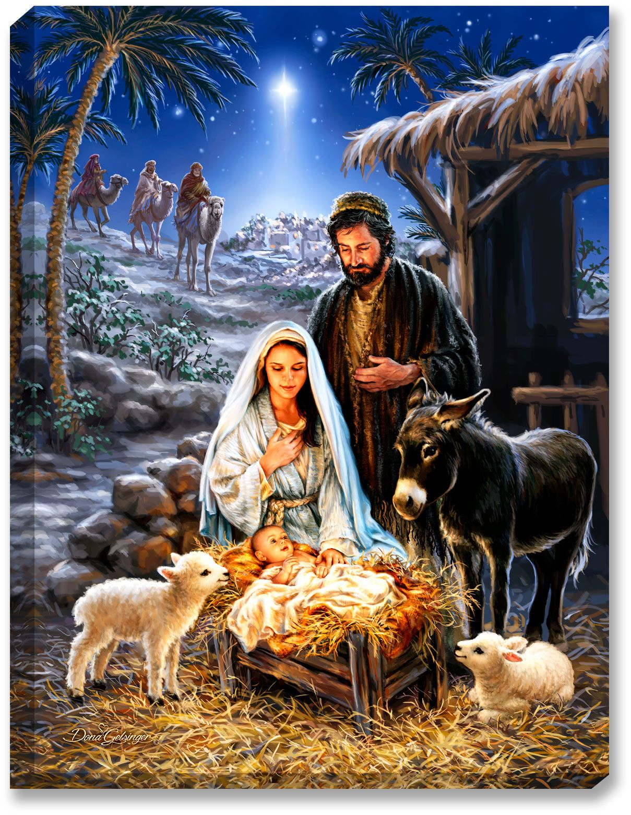
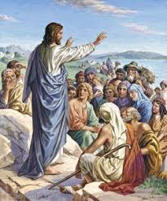
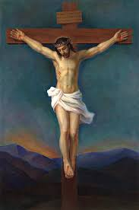

How Do We Know How God Acts?

Slide 14
Four Levels of Love
Love Level I – Love makes me feel good.
  Focuses on the physical. Love is a positive feeling. I love my dog because he is cute.
Love Level II – Love makes me feel good about myself.
  Love is equated with being admired. ”I love you because you think I’m pretty, talented, smart, strong.”
  I love it when I am recognized for an achievement.
Love Level III – I love you more than I love myself.
  I put others’ needs in front of my own.
  I did the dishes without being asked because I could see my mother was tired.
Love Level IV – Love sees the image of God in every person.

Slide 15
Four Levels of Love
Love Level IV – Love sees the image of God in every person.
  We recognize that every person was made in the image and likeness of God.
  God manifested Himself as a human person in Jesus Christ.
  Jesus Christ’s life can be reduced to one four-letter word: “LOVE!”
  We are called to imitate Jesus by…
  Loving every person as if they were Jesus.

Slide 16

What about the World Today?
Deductive Thinking based on that which is:
  Objective
  Principled
Inductive thinking based on that which is:
  Subjective
  Experiential

Slide 17
Casey v Planned Parenthood
Supreme Court decision in 1992 defending the woman’s right to have an abortion at any time during her pregnancy.
Justice Stevens wrote the majority opinion.
“At the heart of liberty is the right to define one’s own concept of existence, of meaning, of the universe, and of the mystery of human life.”
It now became a universal right to define one’s own concept of existence!
Took our Creator (God) out of the picture!

Slide 18

God | Pure Spirit
Angels | Pure Spirits
Human Persons | Spiritual and Material Beings / Rational Souls
Non-human Animals | Material Beings / Sensitive Souls
Plants | Material Beings / Vegetative Souls
Non-living Beings | Material Beings
Remove God from the picture
“The human soul is a kind of horizon, and a boundary, as it were,
between the corporeal world and the incorporeal world.”
- St. Thomas Aquinas

Slide 19
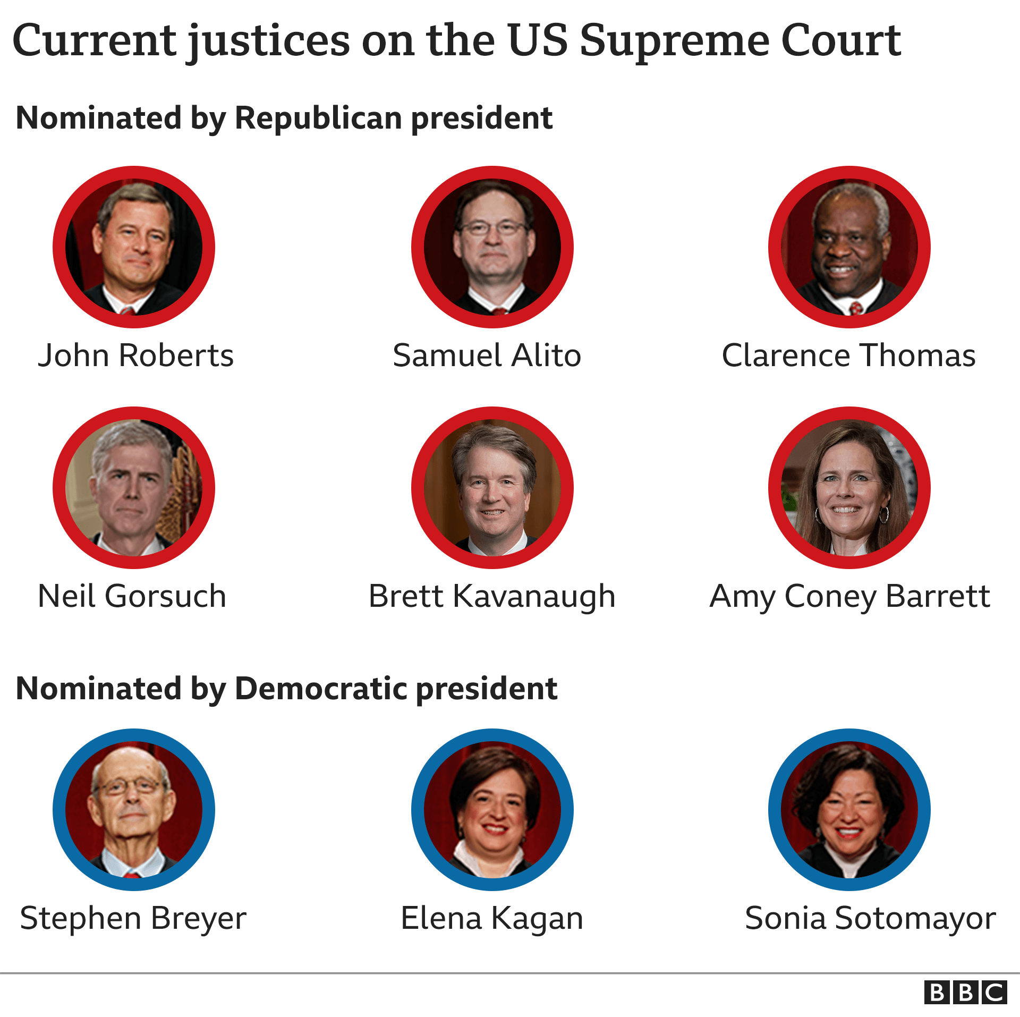
Composition of the U.S. Supreme Court
Notes:
Chief Justice

Slide 20
Two Supreme Court Cases for this term
The Mississippi Law – (Dobbs v. Jackson Women’s Health Organization) forbids abortions after the viability of the fetus (which can occur around 24 weeks of pregnancy); and prohibits most abortions after 15 weeks of pregnancy except for “medical emergencies or for severe fetal abnormality.” It has no exception for rape or incest. Physicians performing such abortions will have their medical licenses suspended or revoked and may be subject to added penalties and fines.
The Texas Law – (USA v. Texas) forbids abortions after the detection of a heart beat. The case also tests the government’s ability to sue a state to block a law that it deems to be unconstitutional.

