Slide 1
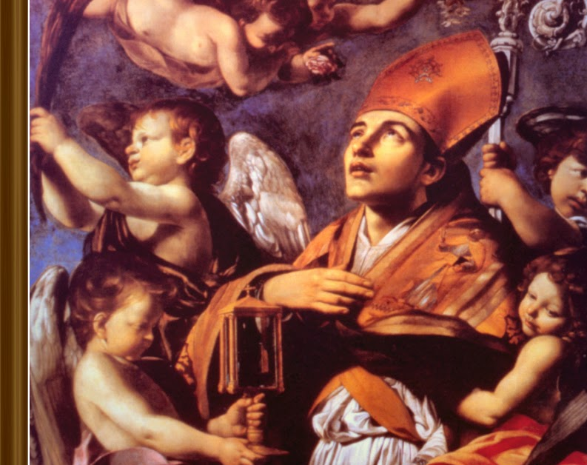
St. Raymond of Peñafort
Ninth Grade
Class 2
September 19, 2021

Slide 2
Anima Christi
Soul of Christ, sanctify me.
Body of Christ, save me.
Blood of Christ, inebriate me.
Water from the side of Christ, wash me.
Passion of Christ, strengthen me.
O Good Jesus, hear me.
Within your wounds hide me.
Permit me not to be separated from you.
From the wicked foe, defend me.
At the hour of my death, call me
and bid me come to you
That with your saints I may praise you
For ever and ever. Amen.

Slide 3
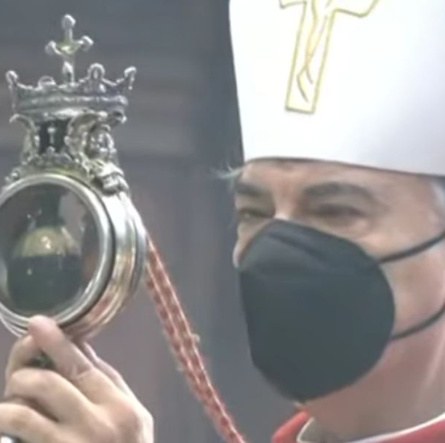
Story of St. Januarius, September 19th
Relatively obscure saint
5th century bishop of Naples, Italy
A woman preserved some of his blood which then dried.
Three times a year (including on September 19th) the dried blood liquifies.
It happened today!
Been studied for centuries without a natural cause for this to happen.
Clearly a miracle – showing the presence of God in the world even today.

Slide 4
Review: The Cosmological Argument
Whatever begins to exist has a cause. (TRUE)
The universe began to exist. (TRUE)
Therefore, the universe has a cause. That Cause had to exist outside of time and space and had to be Super Intelligent. (THEREFORE TRUE)
WHERE WAS GOD WHEN THE UNIVERSE CAME INTO EXISTENCE?

Slide 5

Faith and Reason?
Aquinas 101 – Thomastic Institute.org
St. Thomas on Faith and Reason

Slide 6
Where Does Our Faith Come From?
Sacred Scripture: The Bible: “Inspired word of God.”
Sacred Tradition: Teaching handed down to us. Written or oral, entrusted by Christ to the Apostles and their successors, which has been transmitted to us through Apostolic Succession
“Truth cannot contradict truth.” (from Pope St. JPII’s address to the Pontifical Academy of Science - pre-read for today)
What if there is a contradiction?

Slide 7
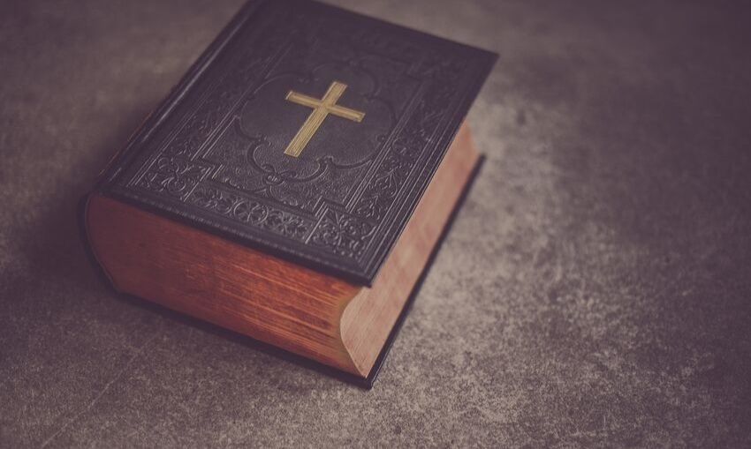
Review: What is “Sola Scripture?”
Faith without works (James 2:14-18)

Slide 8
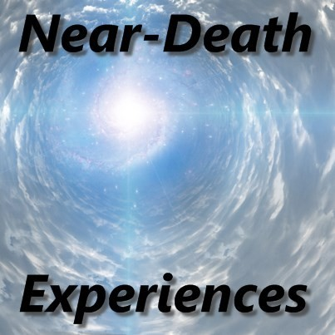
Near Death Experiences (NDE) Video
Medical Evidence
of a Human Soul
Near-Death Experiences (NDEs)
https://www.crediblecatholic.com/12ppt/7E-P1-A/

Slide 9
Parallels between NDE Reports and Scripture
1. Jesus appears to His disciples after the Resurrection
John 20:19; Luke 24:3_________________________________________________
2. The disciples meet Jesus on the road to Emmaus
Luke 24:28-32:______________________________________________________
3. The Resurrection of the body
1 Cor. 15:42-44:______________________________________________________
4. Unconditional Love of Jesus
1 John 4:16-19 :______________________________________________________

Slide 10
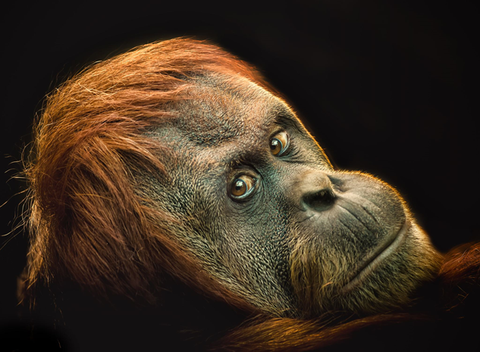
Evolution and the Bible
https://magiscenter.com/evolution-and-the-bible/

